Slide 1

BlockInsure
Streamlining the auto insurance claims process with blockchain technology
Team 7

Slide 2


Slide 3
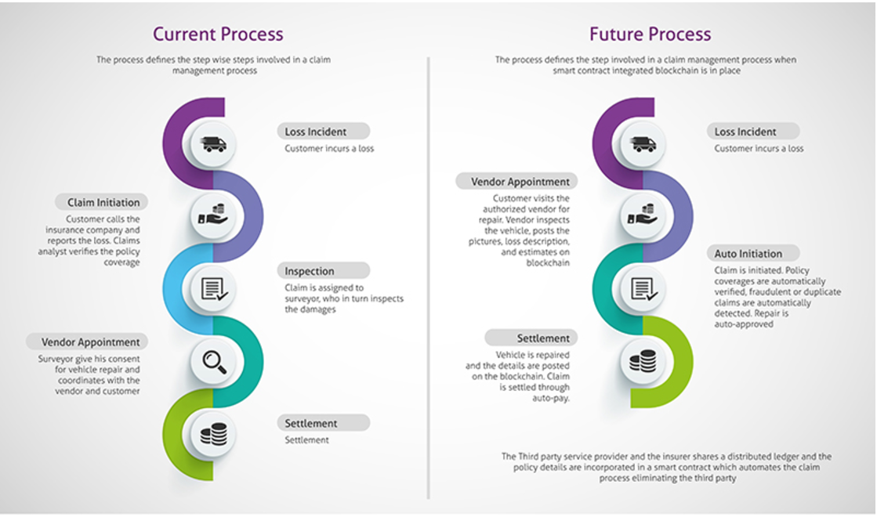
Source : https://blogs.mindtree.com/blockchain-four-most-compelling-use-cases-for-insurance

Slide 4
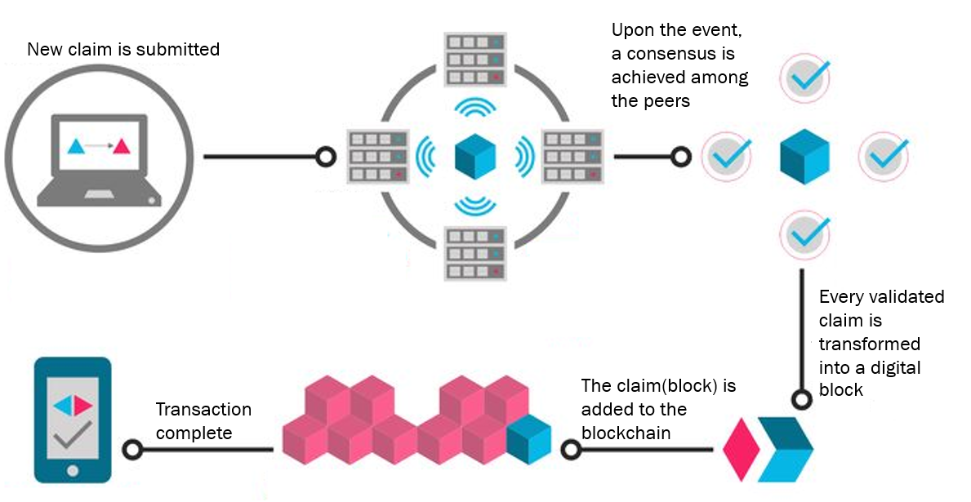
The entire process flow

Slide 5
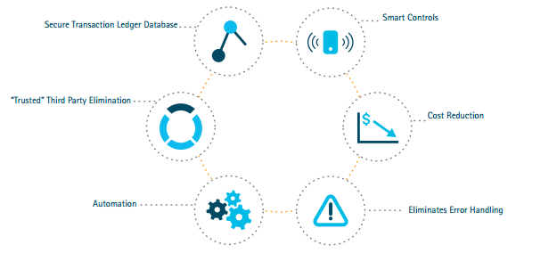
Advantages with blockchain

Slide 6

Lets see this in action

