Slide 1
PaaS Ops with Alexa System Architecture and Interaction
Project Team# 18
Date: 03/13/2018 Version: 1.0

Slide 2
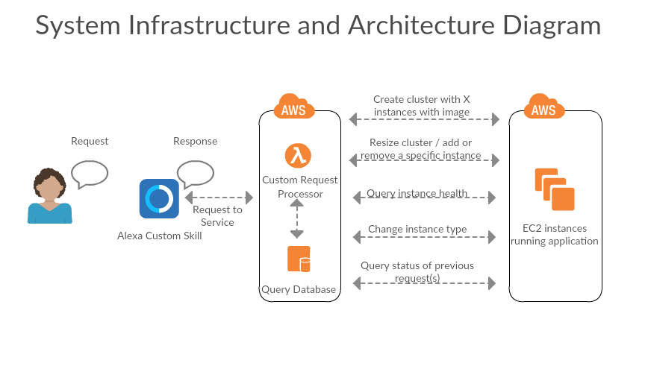

Slide 3
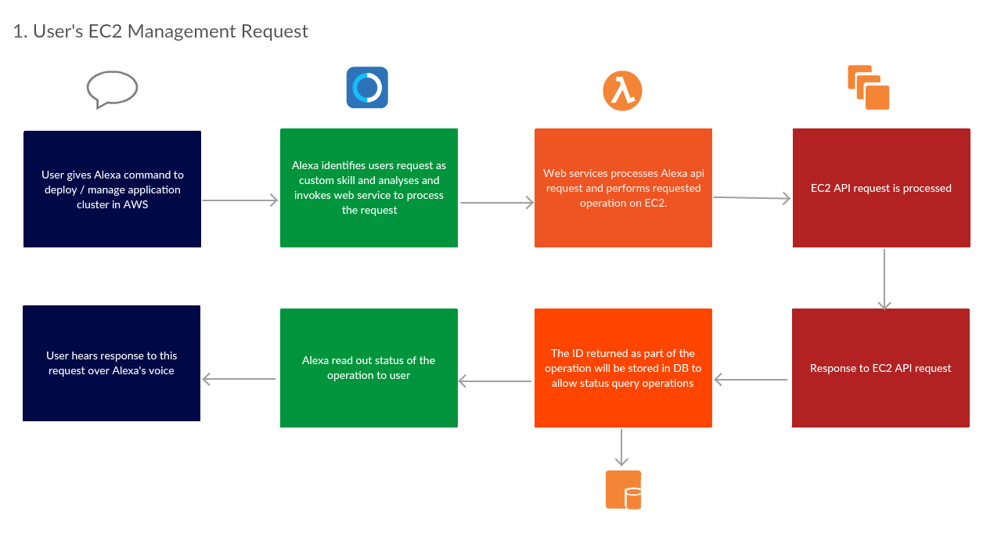
System Interaction

Slide 4
