Slide 1
PaaS Ops with Alexa
Project Team# 18

Slide 2
Overview
Developed custom skills for Alexa which will enable us to manage DevOps in cloud with the help of Alexa.
Alexa will execute the command, provided by the User and try to match it with the functional integrity of Lambda intents which will perform the operation by extracting the input provided by the user.
Deploying instances Amazon with simple command
create {number} instance with {image} image
Resizing, removing and getting information about instances can be done with developed Alexa custom skills.

Slide 3
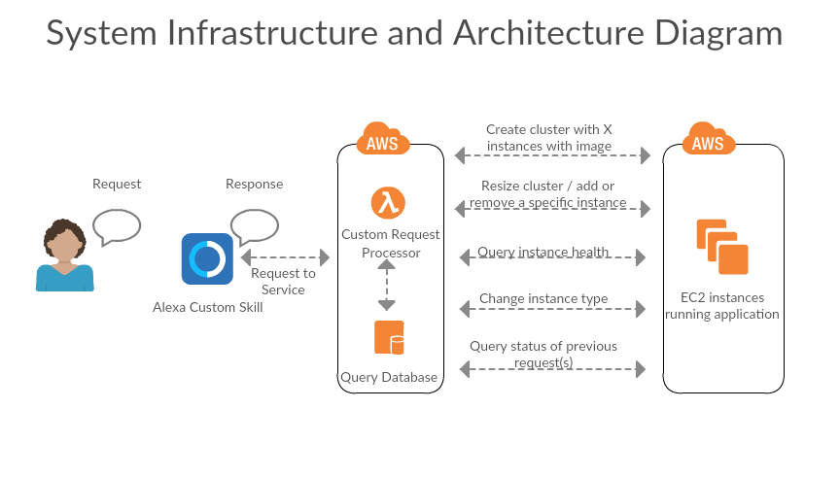

Slide 4
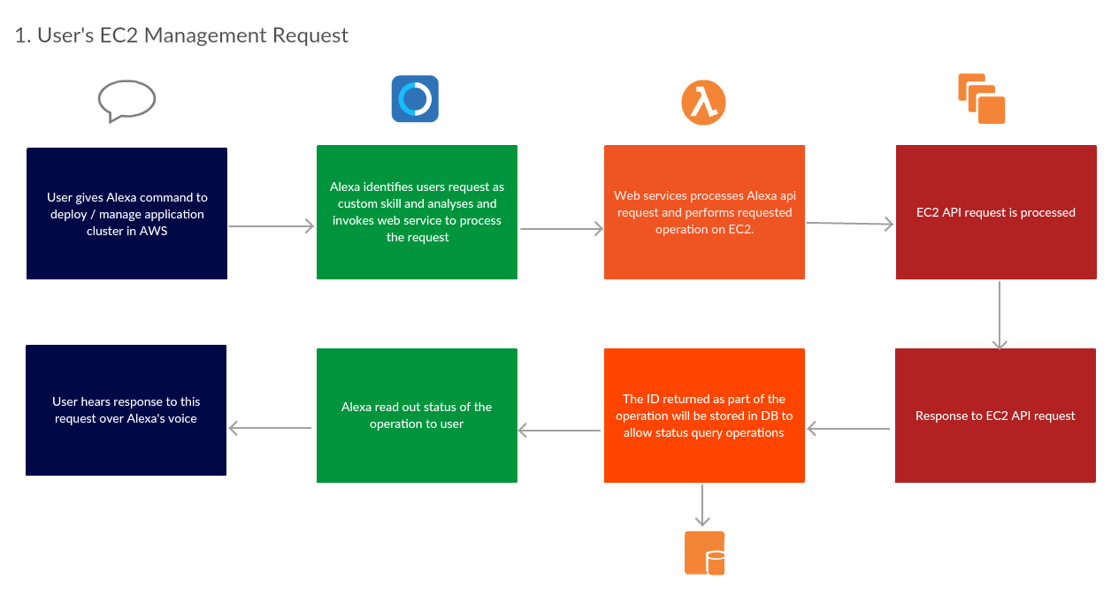
System Interaction

Slide 5
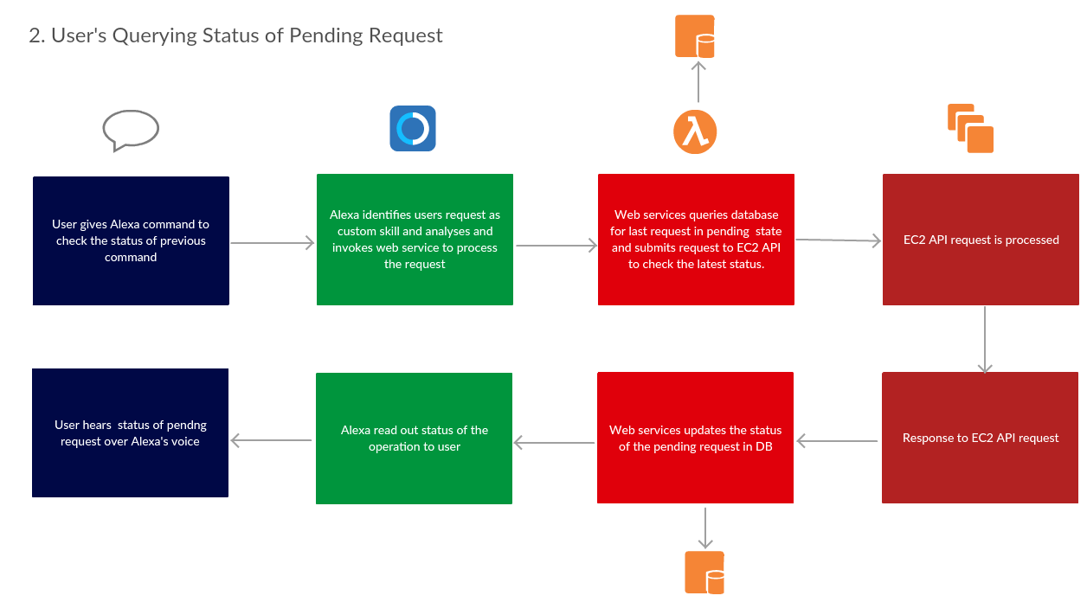

Slide 6
DEMO
If we are ready with the video, add here. Or We can just change the slide.

Slide 7
Questions?

Slide 8
THANK YOU

