Slide 1


Automated Pet Surveillance Tool

Slide 2

CMPE 272
PawPatrol
An Automated Pet Surveillance Tool
Enterprise Software Platform Fall – 2019
Submitted by:
Project Group 19
Atharva Munshi Kapil Mulchandani Namrata Deshmukh Vijay Ghanshani

Slide 3
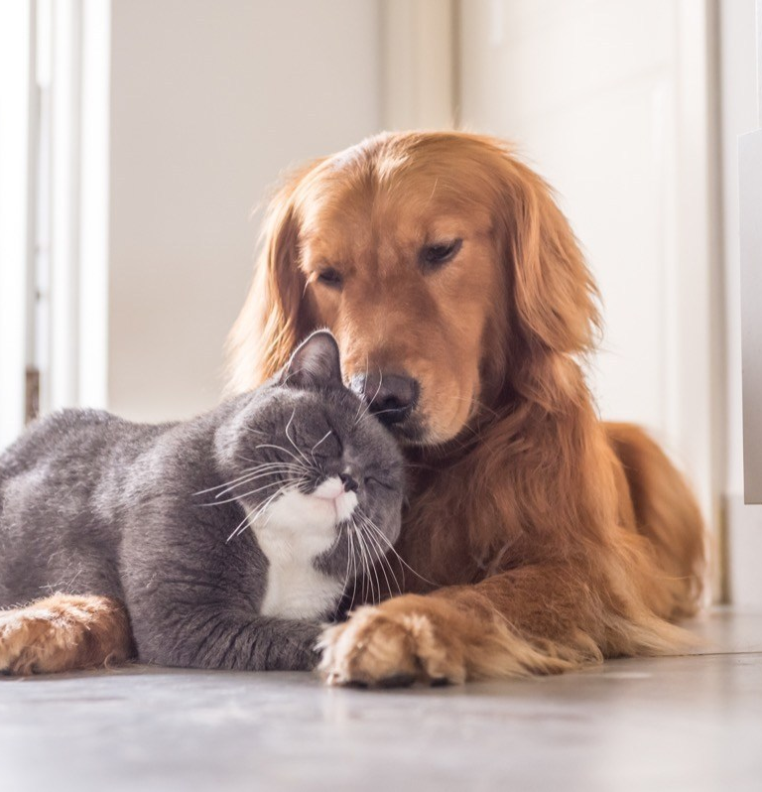
NEED
Current era’s ‘Time Poor’ lifestyle
Consequences of Solitude
Main cause of Separation anxiety
Change in behavior
Increased sensitivity to stressful events
Solution to unpredictable events

Slide 4
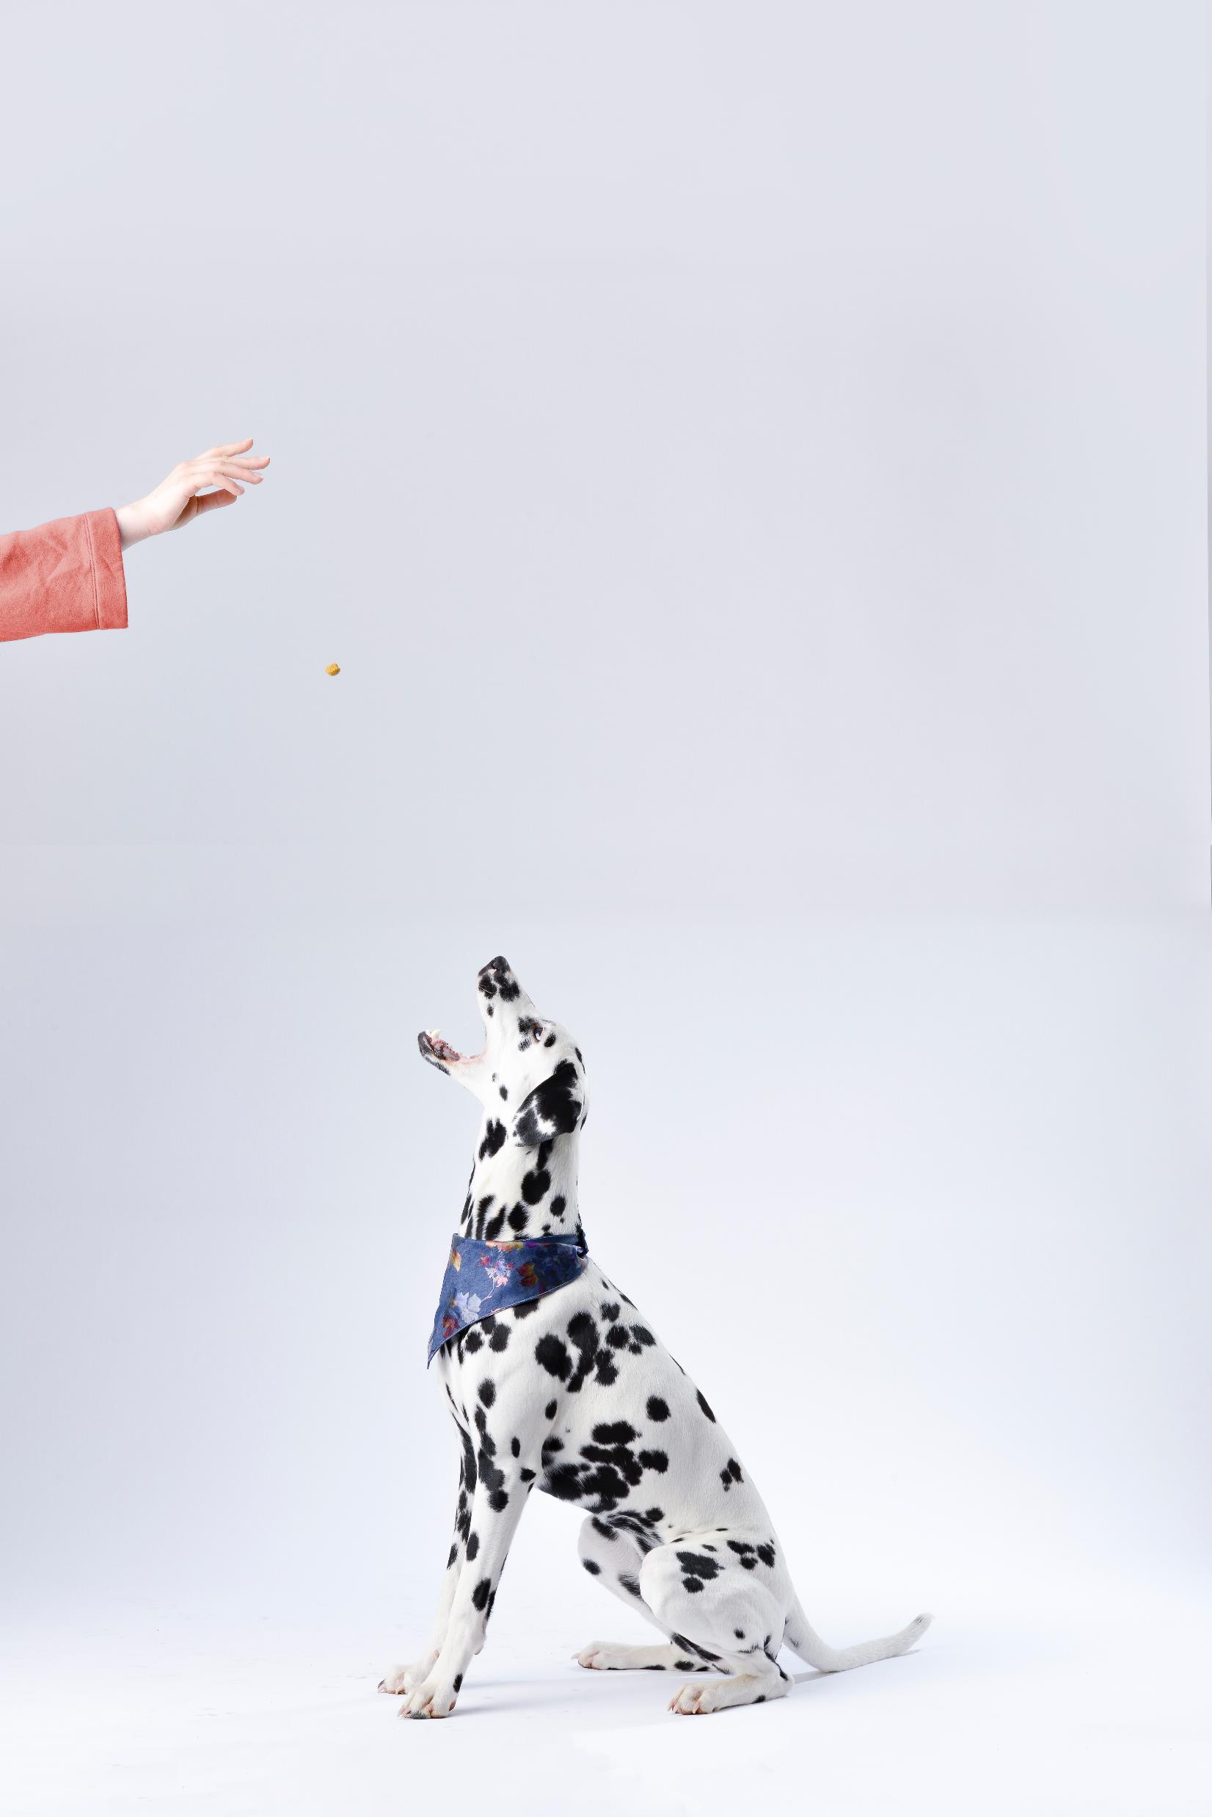
PawPatrol
24 / 7 Monitoring : Provision of direct live stream
Automated food dispenser
Provision to feed manually with just a button click
Notification in case of excessive barking
Dashboard to show notification frequency of the ongoing week

Slide 5
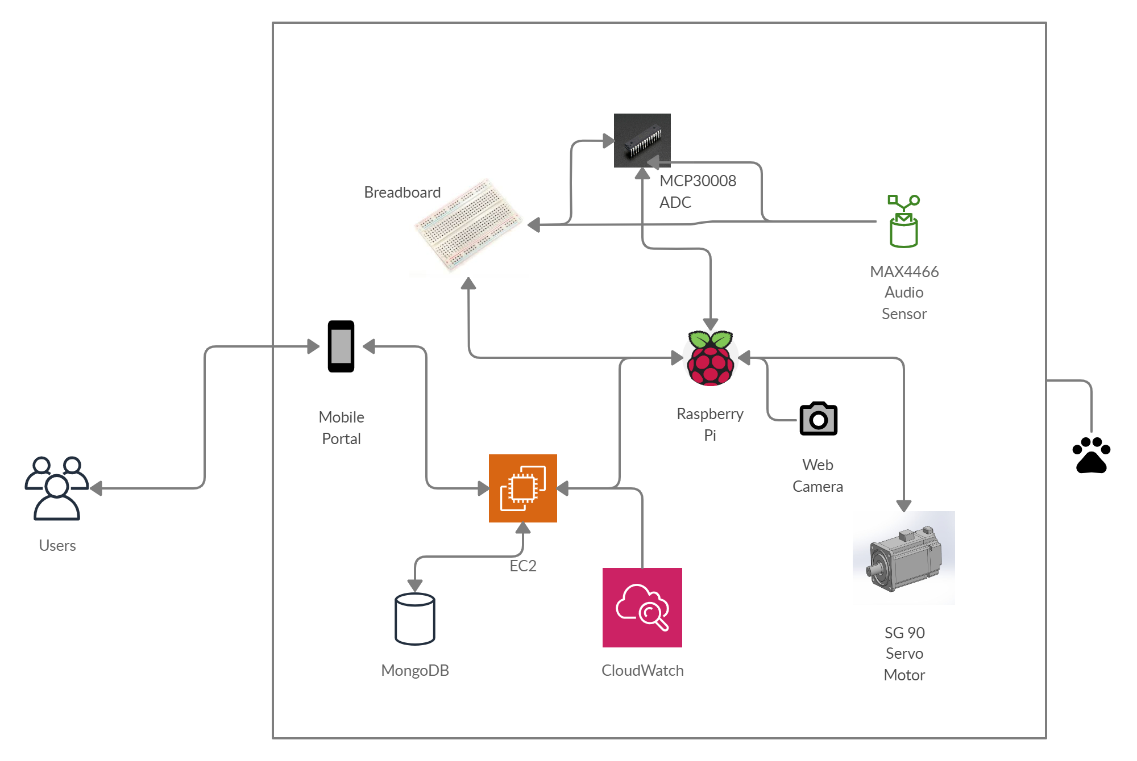
Architecture Diagram

Slide 6
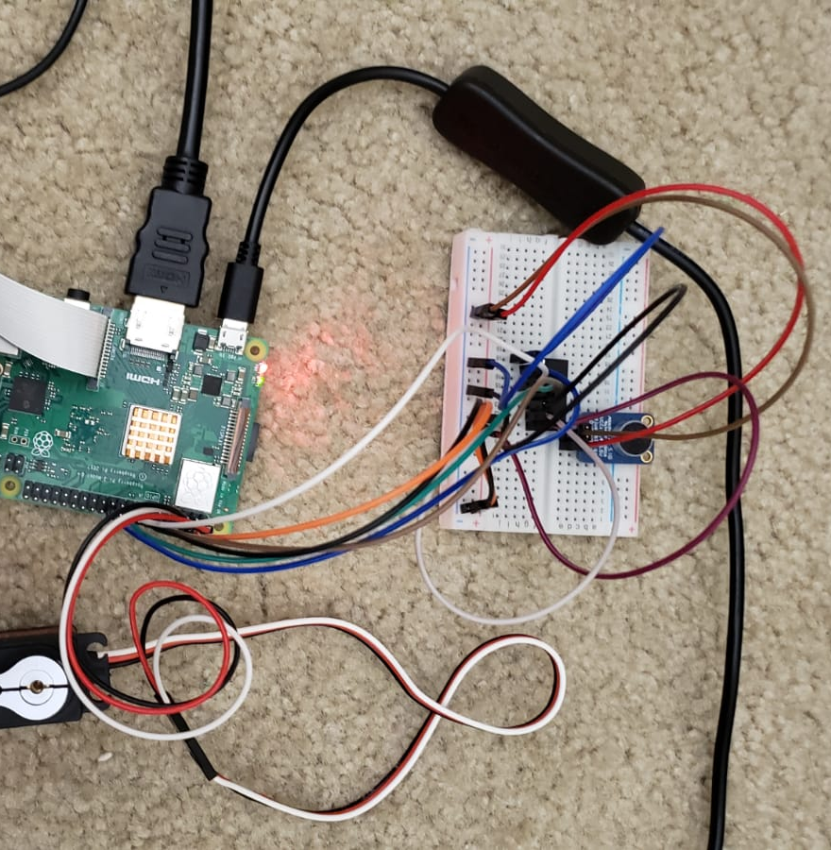
DEMO

Slide 7
Future Scope
Support for multiple rooms
Support for multiple types of pets
Integration with smart systems to provide functionalities like appointment scheduling

Slide 8
THANK YOU

