Slide 1

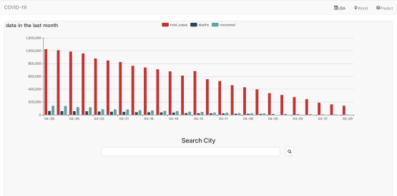



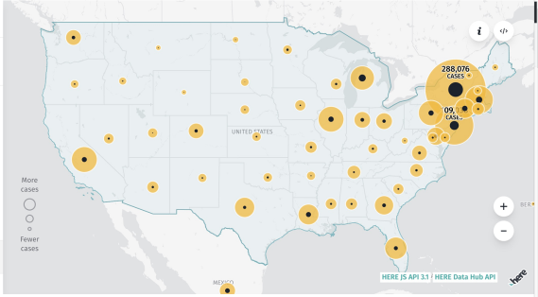
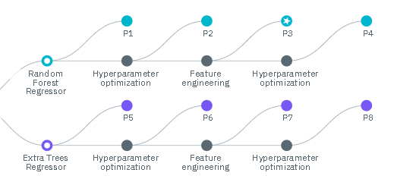
Dataset
IBM Cloud
Data Storage
IBM Cloud
ML Experiment
AWS Front-End

