Slide 1
Amazon Prototype
CMPE 273 – Group 10
Members:
Janette Lopez Urzua
Kena Mehta
Mahenaz Sayyed
Pranav Karmalkar
Sarthak Jain
Puneet Jyot Singh Khurana

Slide 2
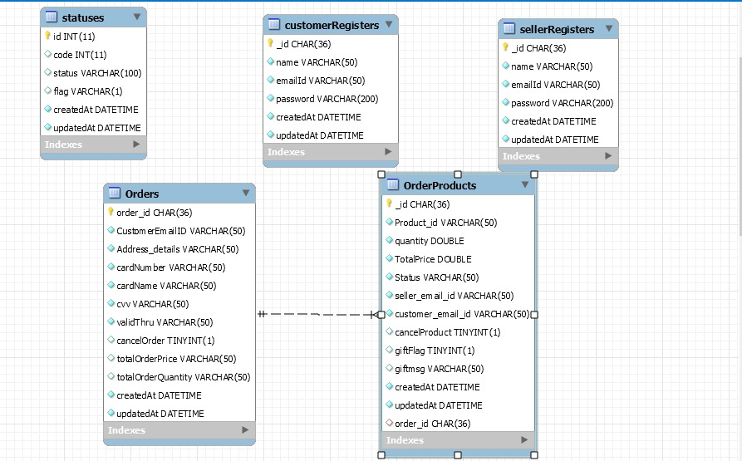
Database schema
MySQL ER Model:

Slide 3
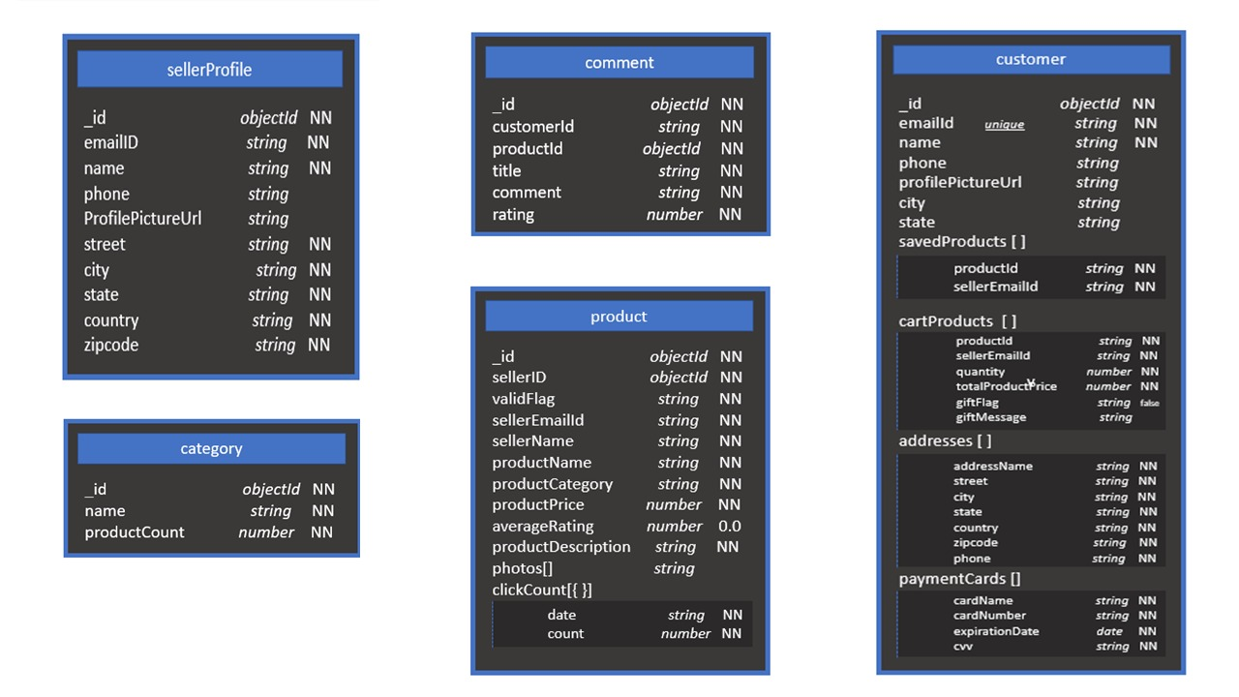
Database schema
MongoDB Model:

Slide 4
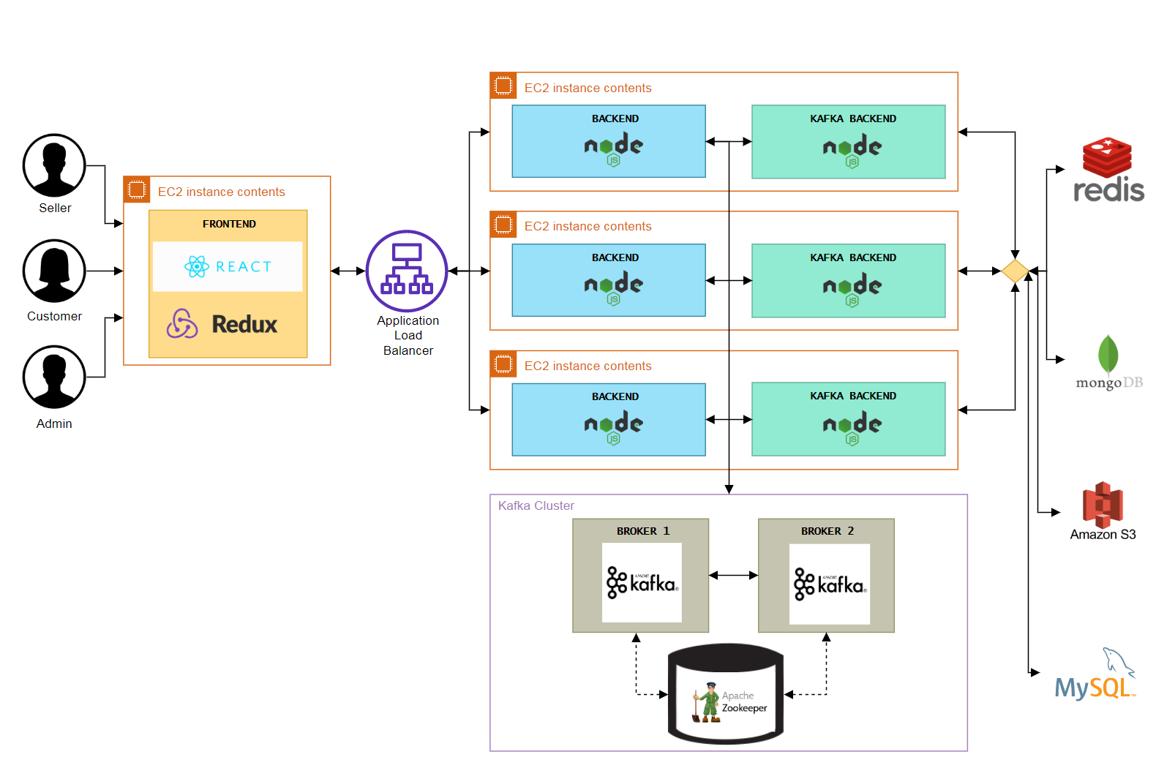
SYSTEM Architecture and design

Slide 5
Performance comparison – Distributed features
Throughput values in per minute:
 | 100 users (in /minute) | 200 users (in /minute) | 300 users (in /minute) | 400 users (in /minute) | 500 users (in /minute)
B | 932 | 872 | 847 | 1,280 | 1,344
B + D | 1,017 | 1,303 | 1,379 | 1,324 | 1,358
B + D + S | 2,127 | 2,482 | 2,782 | 3,049 | 3,199
B + D + S + K | 2,333 | 2,569 | 2,886 | 3,153 | 3,213
B + D + S + K + 2 Broker & 2 Partition | 2,862 | 3,277 | 3,856 | 4,227 | 4,672

Slide 6
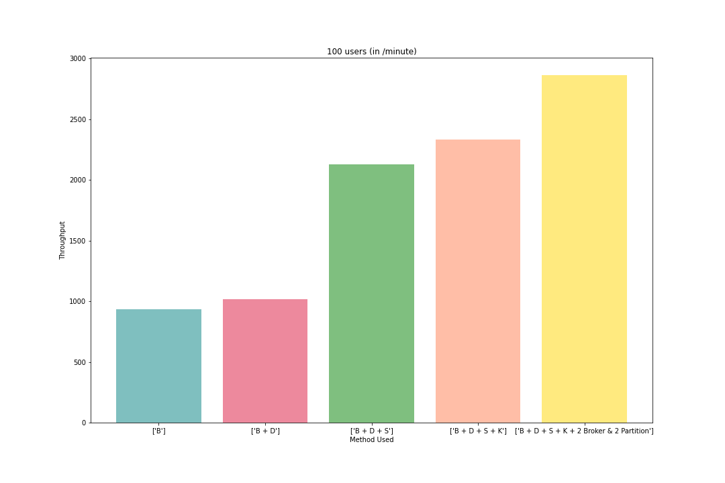
Performance comparison – Distributed features
For 100 users:

Slide 7
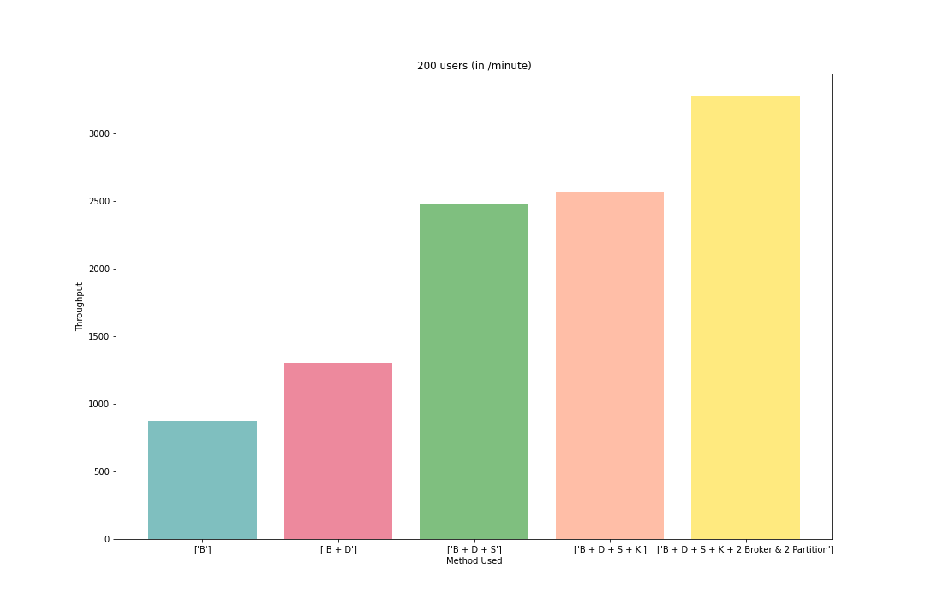
Performance comparison – Distributed features
For 200 users:

Slide 8
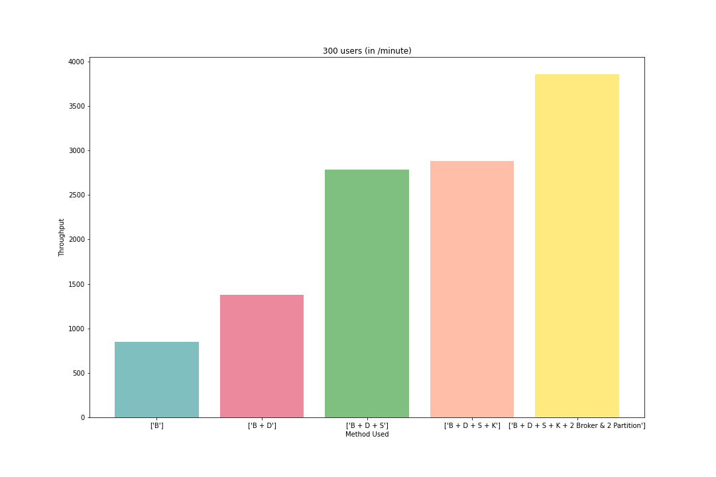
Performance comparison – Distributed features
For 300 users:

Slide 9
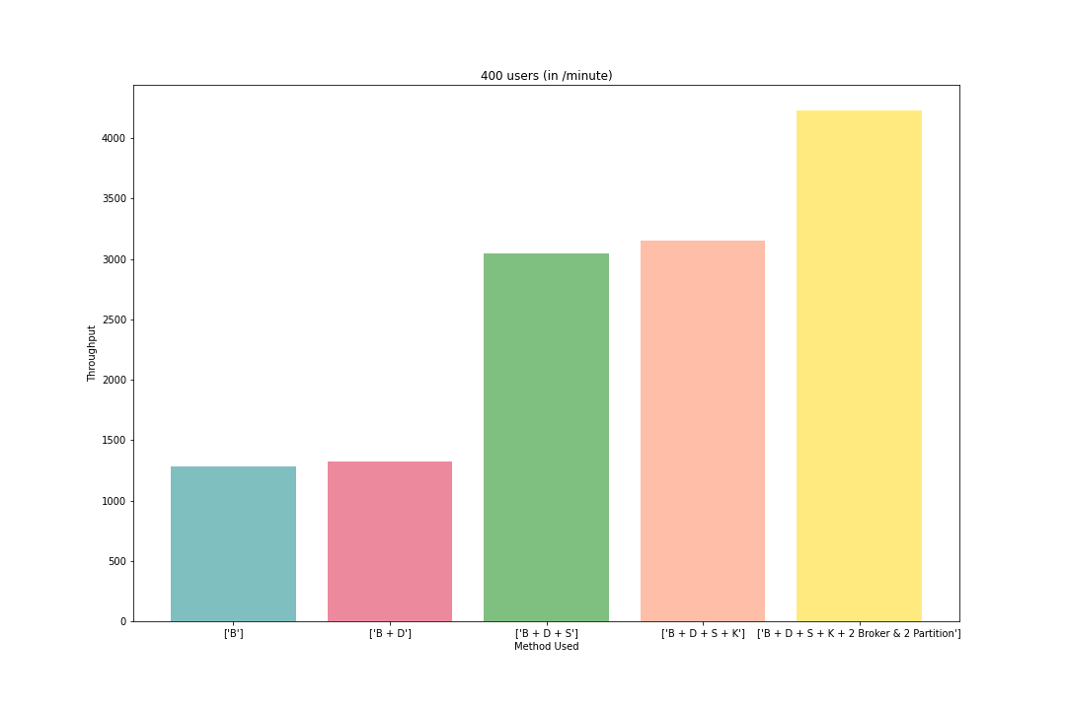
Performance comparison – Distributed features
For 400 users:

Slide 10
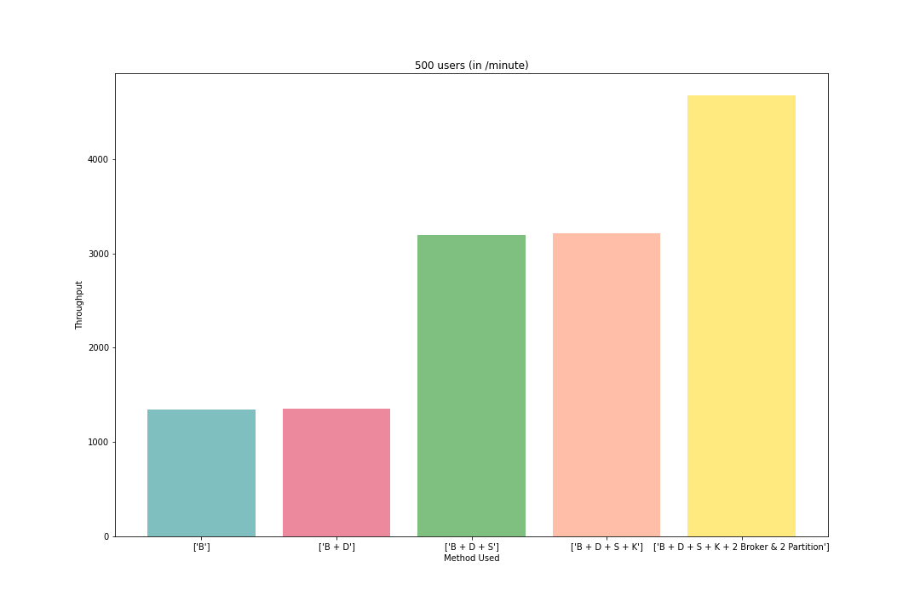
Performance comparison – Distributed features
For 500 users:

Slide 11
Performance comparison – Load balancer
Performance comparison after load balancer
 | 100 users (in /minute) | 200 users (in /minute) | 300 users (in /minute)
1 services server | 924 | 1,090 | 1,339
3 services server | 1,167 | 1,337 | 1,444
4 services server | 1,201 | 1,621 | 1,528

Slide 12
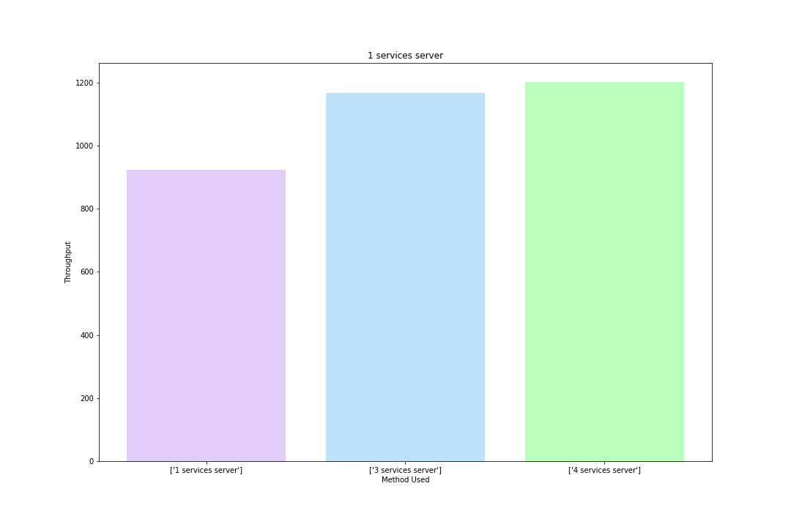
Performance comparison – Load balancer
1 Services Server:

Slide 13
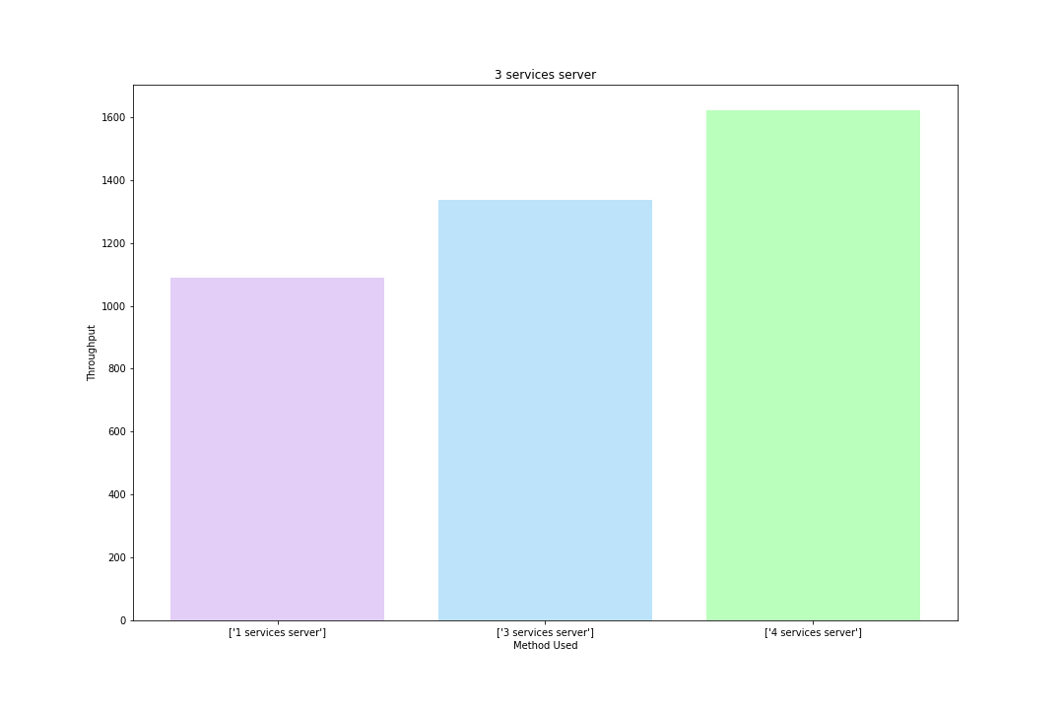
Performance comparison – Load balancer
2 Services Server:

Slide 14
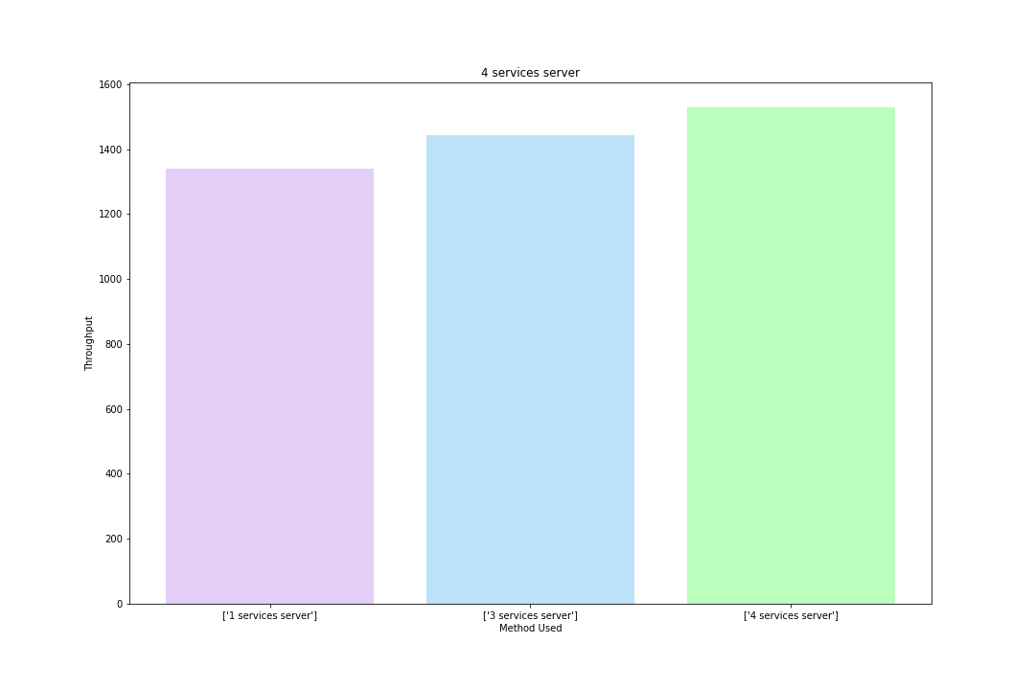
Performance comparison – Load balancer
3 Services Server:

Slide 15
THANK YOU

