Slide 1
Aqua365
Team #4
Ishan Kanungo
Priyansh Patel
Swaroop Patwari
Esha Sah

Slide 2
Problem Statement
California being a draught region, low water flows and extended heat had degraded the water quality.
The biodiversity of these water bodies have suffered over the years.
Due to the degrading water quality, the fishing industry has lost over 1 billion dollars in last 80 years.
A crucial first step to preserving and protecting freshwater habitats is by acknowledging the current quality of water and understanding its forecasted values.

Slide 3
Water Quality Index
WQI is calculated using a weighted geometric average. Weight factor used for different variables are defined by National Sanitation Foundation(NSF)
These parameters are:
Dissolved oxygen (DO)
Coliform
Nitrate
pH
Biochemical oxygen demand (BOD)
Temperature
Electric conductivity

Slide 4
Persona
Government agencies like California Department of Water Resources
Stakeholders of Pisciculture industries
Aquatic Life conservationists

Slide 5
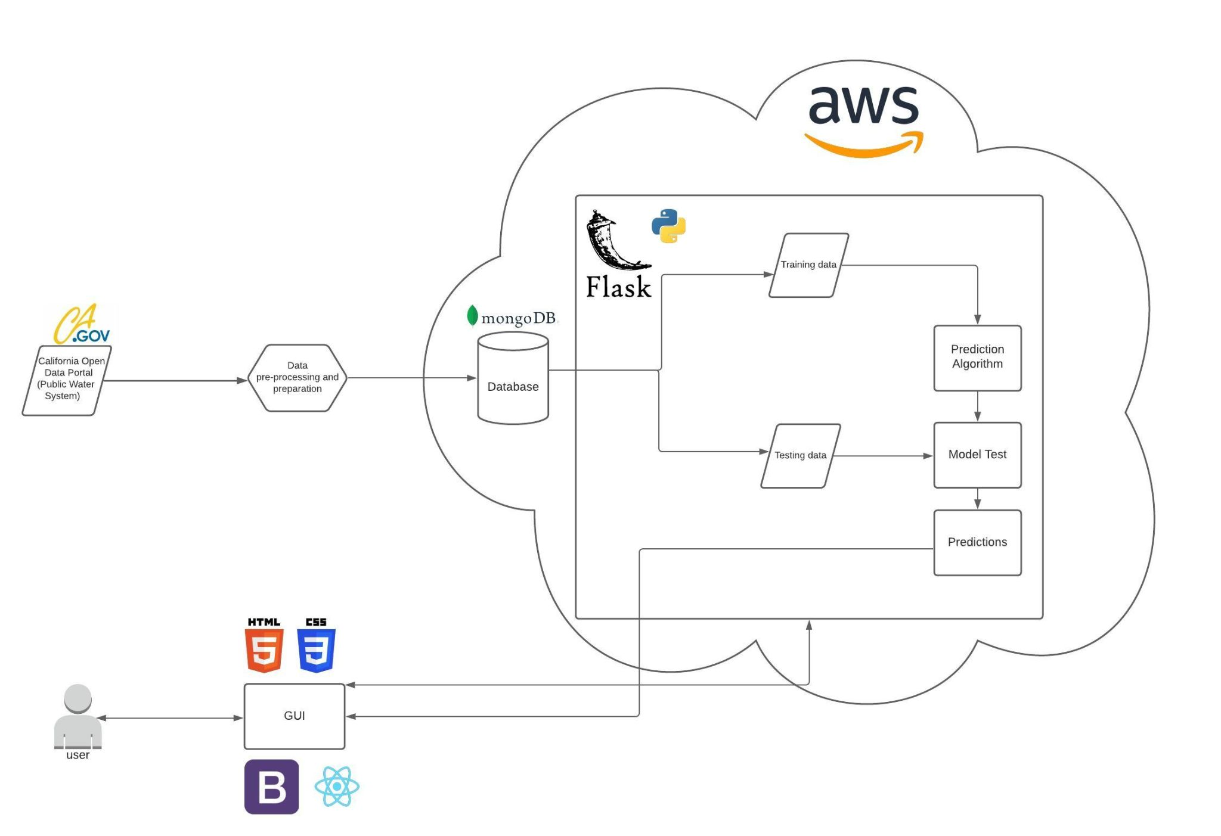
Technologies used
Machine Learning Model:
Linear Regression
XG boost
PMD Arima
Database:
MongoDB
Backend:
Flask
Frontend:
React

Slide 6
Demo

Slide 7
Future Scope
Implementing IoT to gather data through sensors and implementing machine learning to automatically detect anomalies and alert the stakeholders.
Our scope can be extended to industries that conduct controlled breeding of marine life as well as pisciculture sector.

