Slide 2
Content

Slide 3
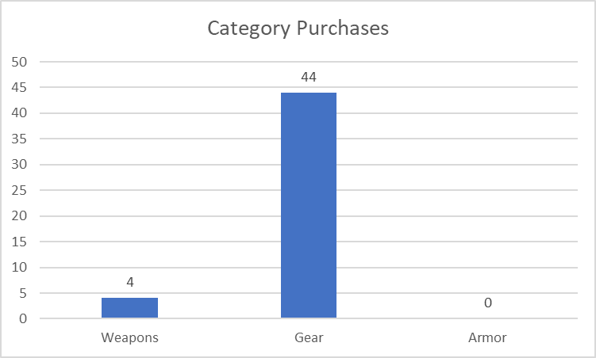
The frequency of purchasing ‘Gear’ is significantly higher than the rest (alpha = 0.01)
However, it’s a little different when it comes to the value of sales

Slide 4
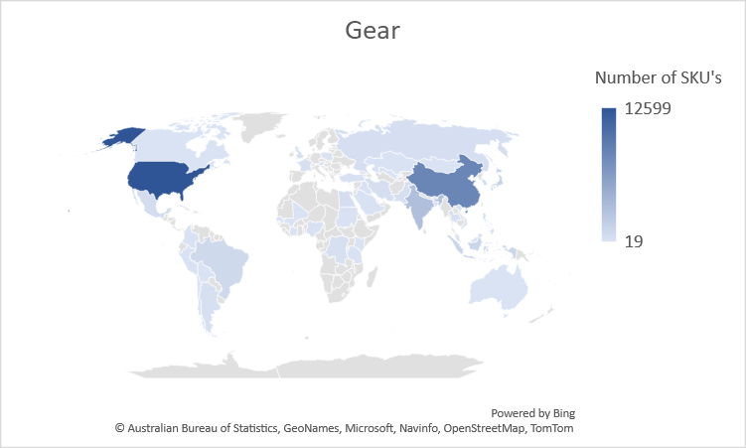
Gear as a product purchased online (SKU)
The US leads in this product type
China flows closely

Slide 5
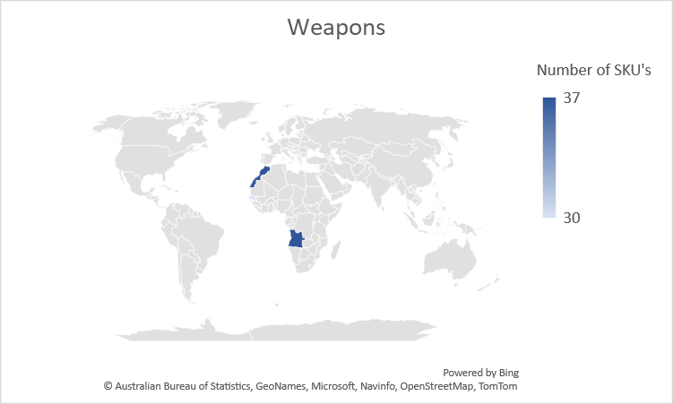
Weapons as a product purchased online (SKU)
Africa as a continent leads in this type of category
Morocco and Angola account to 37 SKUs purchased during 2021

Slide 6
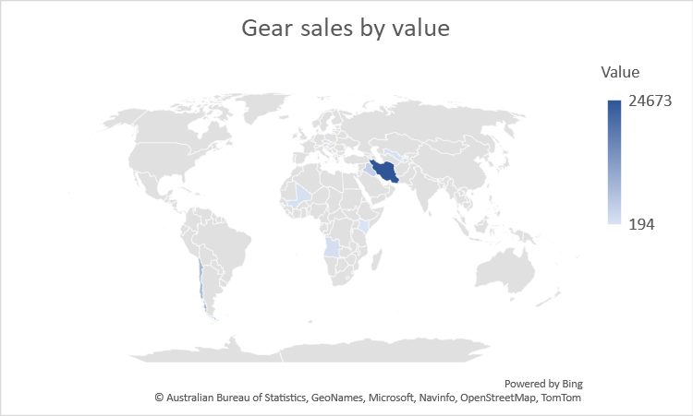
Gear as a product purchased online (SKU) in value
The Middle East (Iran) leads in this category in value
Scattered results observed in Africa
Results are more scarce in other parts of the world

Slide 7
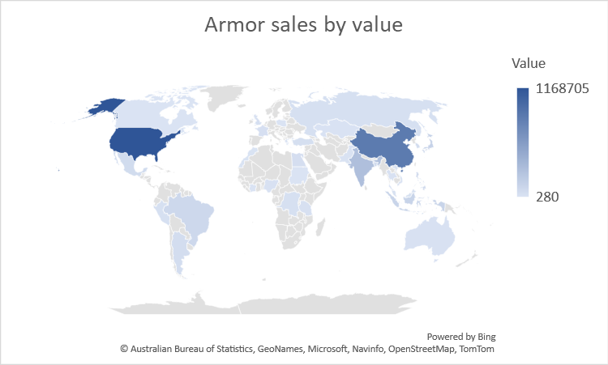
Armor as a product purchased online (SKU) in value
In terms of value, it has a global coverage
Predominantly from USA and China followed by India

Slide 8
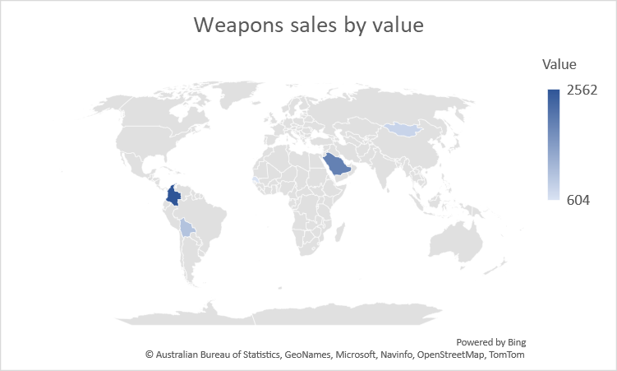
Weapons as a product purchased online (SKU) in value
Weapons are more profitable in Colombia
This is followed by Saudi Arabia

