Slide 1




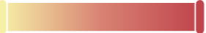
DQMS for ML
Training Data
Data
Selector
train / fine-tune
Data Source
Training
round
Data
Attributer
feedback
Data Quality*
ML model
Data Selection
Data Debugging
Data Augmentation
…
task requirements
❶
Data
Profiler
Data Valuation
Sample based Explanation
Data Quality Assessment
…
❷
Data Visualization
Data Summary
…
User
❸
*data quality: poor good

