Slide 1
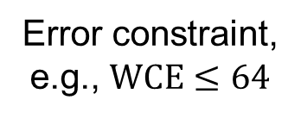
MECALS-Based Approximate Logic Synthesis
Exact circuit
Approximate circuit satisfying error constraint
Error constraint,
e.g., $WCE≤64$

