Slide 1
HON - Huawei Open Network
Huang Yongxi
2019.9

Slide 2

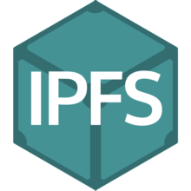

About Project
Our Goal:
Use IPFS as dIstribute file system
Running stable IPFS peers on mobile devices
Build SDK for App writing
Work in Progress
Using and optimizing Textile to meet our own requirement:
Sharing Videos, Searching Local Contacts,
Support for Huawei OpenID
FS

Slide 3
What is IPFS ?
A series of peer-to-peer hypermedia protocol
A content-address File System
InterPlanetary
File System

Slide 4
What is IPFS ?
A series of peer-to-peer hypermedia protocol
Generative identity
Network communication based on LibP2P
Routing algorithm for DHT
A constructing swap protocal BitSwap
A data structure Merkle DAG
It use several successful previous ideas
Kademlia Algorithm
Derive from Bittorrent
Derive from Git version tree

Slide 5
What is IPFS ?
A content-address File System. It can be used as:
A general filesystem
A personal sync folder
A data sharing system
A communication platform
A distributing database
A web system
...
Textile
orbit-db

Slide 6
What is IPFS ?
IPFS Stack
Identities – manages node identity generation
Network – manages connections to other peers
Routing – maintaining information to locate specific peers and objects
Exchange – a novel block exchange protocol (BitSwap)
Objects – a Merkle DAG of content-addressed immutable objects with links
Files – versioned file system hierarchy inspired by Git
Naming – a self-certifying mutable naming system

Slide 7
What is IPFS ?
IPFS Stack:
Identities
Nodes are identified by a NodeID, the cryptographic hash of a public key, created with S/Kademlia’s crypto puzzle.
S/Kademlia’s crypto puzzle can effectively prevent Eclipse Attack and Sybil Attack

Slide 8
What is IPFS ?
IPFS Stack:
Network
IPFS can use any transport protocol.
IPFS can provide reliability using uTP or SCTP
IPFS also uses the ICE NAT traversal techniques
Optionally check integrity of messages using a hash checksun
Optionally checkes authenticity of messages using HMAC with sender’s public key

Slide 9
What is IPFS ?
IPFS Stack:
Routing
Using a DSHT based on S/Kademlia and Coral.
S/Kademlia guarantees the safety.
Coral (DSHT) promotes the performances.

Slide 10
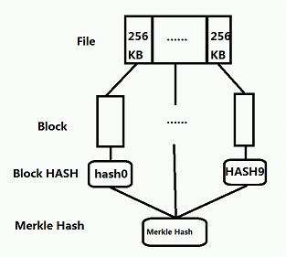
What is IPFS ?
IPFS Stack:
Objects (Merkle DAG)
Files in IPFS are partitioned into a set of blocks with maximum size 256 Kb
Merkle-DAG is a DAG where each node corresponds to a file block.
Merkle-DAG nodes are immutable. Any change in a node would alter its identifier and essentially creating a different DAG.

Slide 11
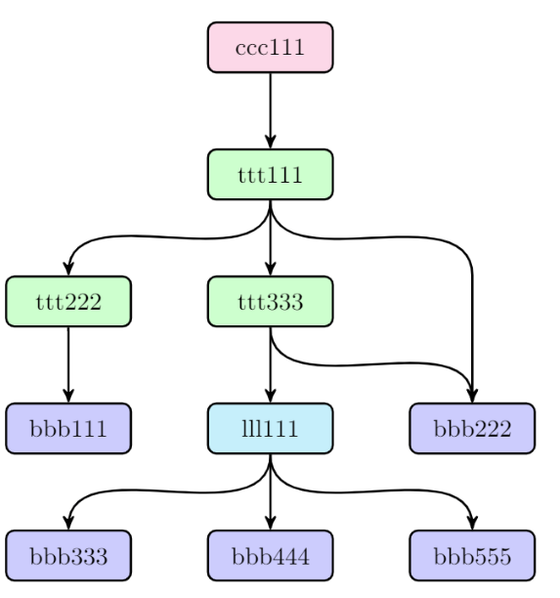
What is IPFS ?
IPFS Stack:
Files
A versioned filesystem on top of the Merkle DAG
The File Model is similar to Git’s:
block: a variable-size block of data
list: a collection of blocks or other lists
tree: a collection of blocks, lists, or other trees
commit: a snapshot in the version history of a tree

Slide 12
What is IPFS ?
IPFS Stack:
Naming (Inter-Planetary Name System)
A system for creating and updating mutable links to IPFS content.
A name in IPNS is the hash of a public key. It is associated with a record containing information about the hash it links to that is signed by the corresponding private key.

Slide 13

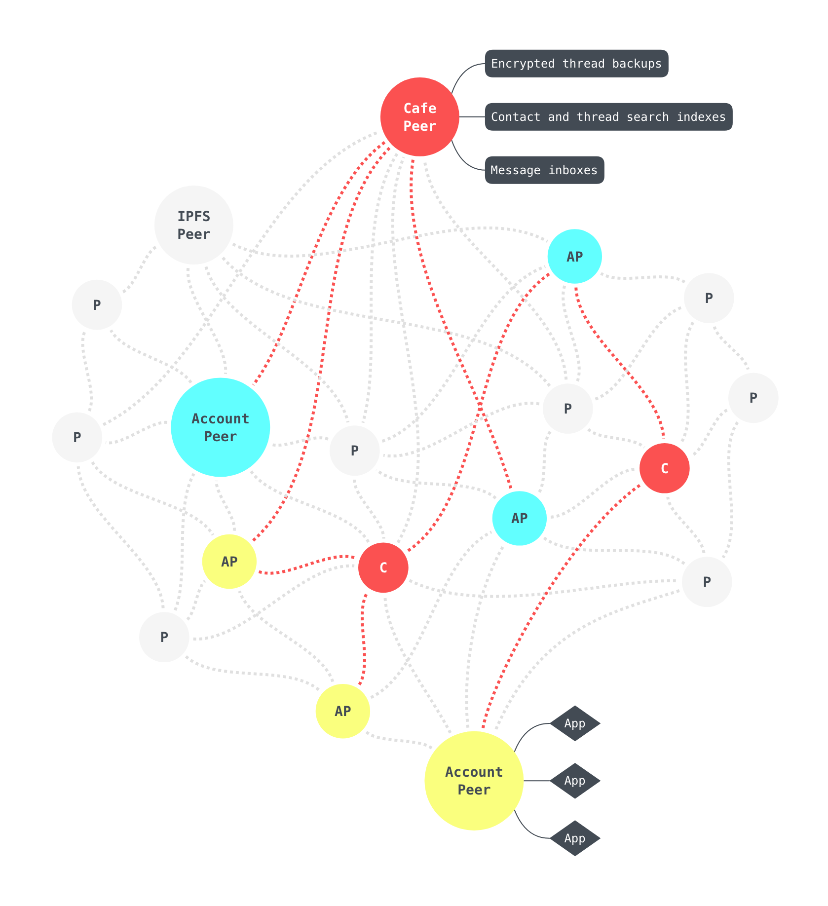
About Textile
A toolbox for building apps based on IPFS
Provide photo backup and storage over IPFS
Decentralized photo sharing
Extensibility for other applications

Slide 14
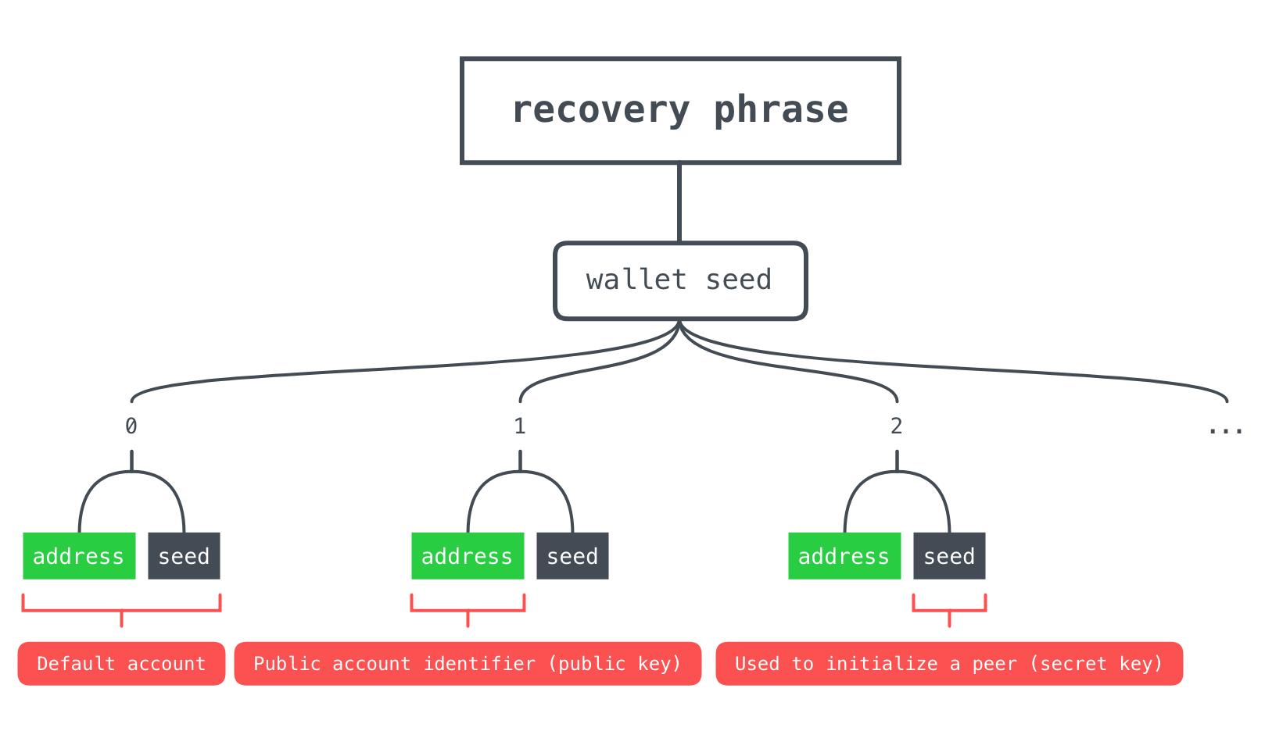
About Textile
Core Concepts
Wallet and Account
A hierarchical deterministic (HD) wallet to derive account keys from a set of unique words, mnemonic phrase.
Each account can own several account peers which are automatically stay in sync.

Slide 15
About Textile
Core Concepts
Thread and File
Thread is the fundation of Textile. Sharing is implemented by thread syncing.
A thread is a hash chain with blocks containing different kinds of data.
File block contains metadata including CID on IPFS.
Thread
Block
Block
File
Name
Type
Hash (CID)
Owner
Timestamp
…

Slide 16
About Textile
Core Concepts
Contact and Search
A contact can be seen as the peers belong to the same account. As each account may have several peers, textile use contact as the agent of account.
Each peer will maintain an account thread containing:
Account Thread
Self
Others
...
name
avatar
address
Derived from the last updated peer
Contact
Peer
Peer
name
avatar
address
Peer
self contact
a contact 'address book'

Slide 17
About Textile
Core Concepts
Cafe Peer
Cafe peers are consider to be always online. However, any peer can operate as a cafe. It provide several ‘extra’ services:
Thread A Old Ver.
Thread A
Peer
Peer
Unreachable
Update
Cafe
Thread A updated
Backup: thread snapshots and pinning data
Message inbox-ing: message like thread update
User account indexing: contact is query-able via cafe
Search query
contact info
Peer

Slide 18
About Textile
Textile provide:
An account management scheme based on wallet and account syncing
A sharing and contacting way based on thread
A network topology based on cafe peers and account peers
A contact searching and communicating method
A series of cross-platform API

Slide 19
Work in Progress
Using and optimizing Textile
Share Videos
Search Local Contacts
Support for Huawei OpenID

Slide 20
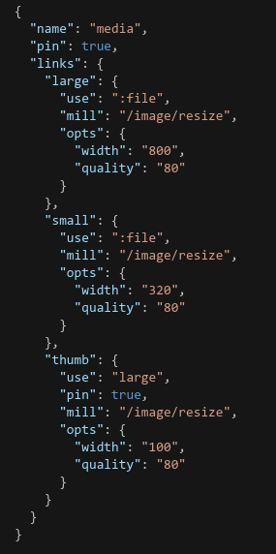
Share Videos
How does Textile share photos?
Design the specific thread for certain purpose.
The design is embodied in two aspects:
Schema: Define the structure of thread.
Mill: The operation apply on files
Note: Both schema and mill are concepts related to threads instread of files.
media schema definition

Slide 21
Share Videos
Schema:
Instruction for how to “mill” an input.
Define whether or not the DAG node should be pinned on peers.
Mill:
Validate the input against accepted media types.
Transform the input data (encode, resample, encrypt, etc)
Index a metadata object describing the transformed output.
Note: Mill is implemented as interface instead of struct.
File
Thread
Block
File
Schema
Mill
Transformed data and meta
File Node

Slide 22
Share Videos
How to make videos shareable?
Design the specific thread video sharing.
Basic Schema: Define the structure of thread.
Add more options:
name: video
pin: true
links:
use: file
mill: video
opts:
rate control
streaming
...

Slide 23
Share Videos
How to make videos shareable?
Design the specific thread video sharing.
Basic Mill: Transform the file just as blob
Add more functionality:
Support video streaming: Segment the video based on HLS protocol and build DAG structure for files.
Rate control.
Accelerate the transformation.

Slide 24
Search Local Contacts
Contacts Search Strategy of Textile
Textile search contacts in three ways:
Search the local contacts address book.
Search through cafe peer.
Search through pubsub if there is no cafe peer.

Slide 25
Search Local Contacts
Use mDNS to search the local network directly
Plan A: Use mDNS as an independent module to search contacts.
Plan B: Add mDNS as a additional search approach for all kinds of search query.

Slide 26
Support for Huawei OpenID
Textile’s Account generate method:
Genarate through hierarchical deterministic (HD) wallet.
Monemonic phrase serve as the recovery phrase when get the accounts back.
Textile’s Account generate method:
Derive wallet seed from OpenID.
Note: An wallet object only contains a monemonic phrase.
mnemonic phrase
OpenID
Wallet seed
Account 1
Account 2

Slide 27
Questions & Discuss
Is IPFS powerful enough as a File System?
Maybe feasible for sharing data but not frequently changing data.
Would mobile peers be harmful to the existing network?
About private IPFS network.
About IPFS-Cluster.

Slide 28
谢 谢！

