Slide 1
Open-Sora及其计算复用
SHANGHAI JIAO TONG UNIVERSITY
刘昊凇

Slide 2
Open-Sora整体网络架构
01

Slide 3
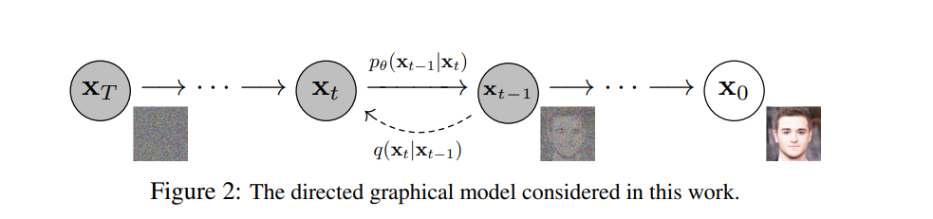
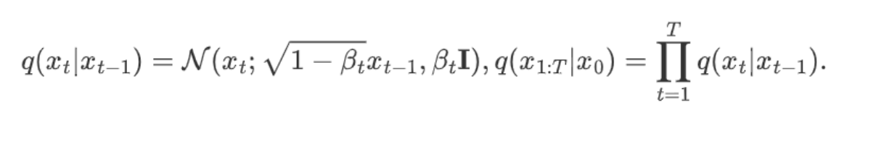
Denoising Diffusion Probabilistic Model

Slide 4
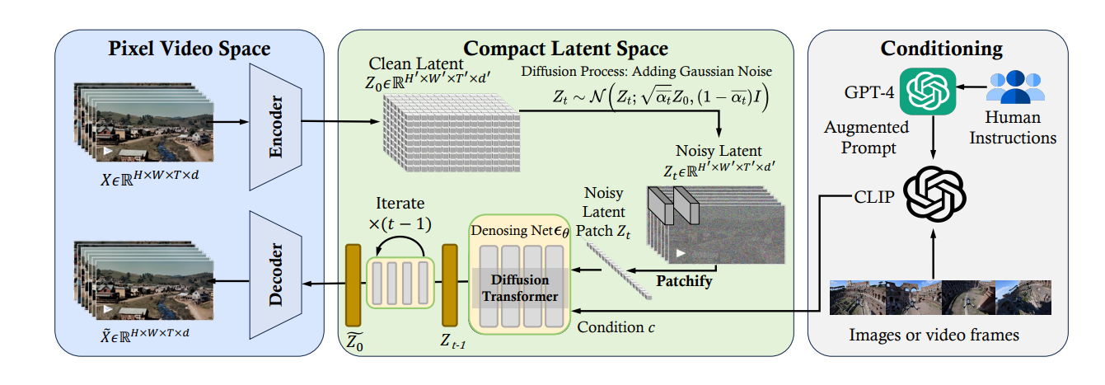
OpenSora

Slide 5
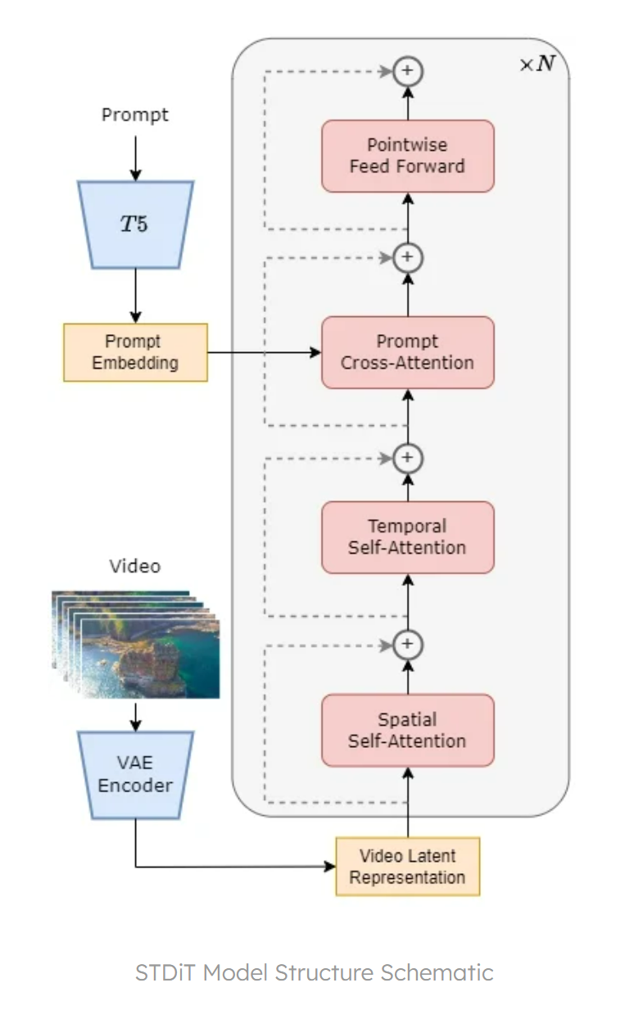
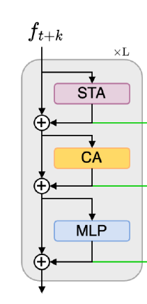
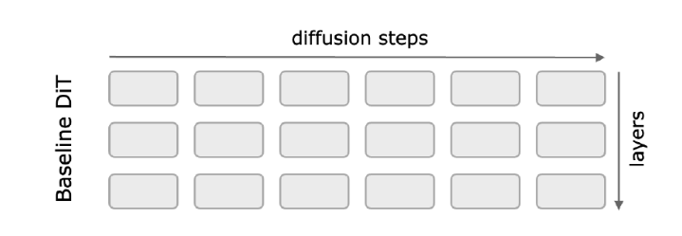
Diffusion Transformer

Slide 6
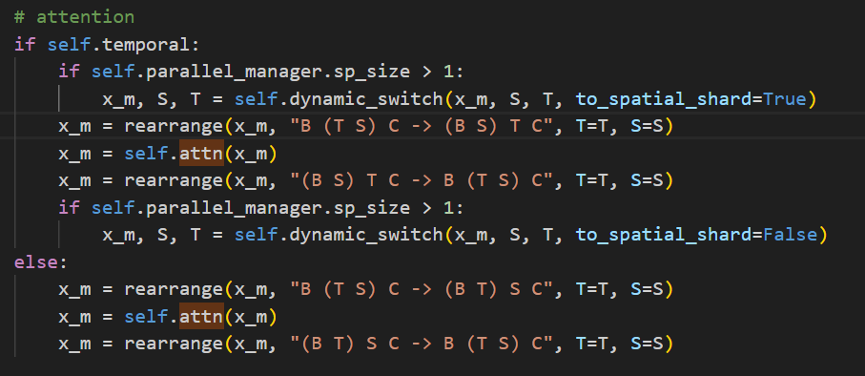
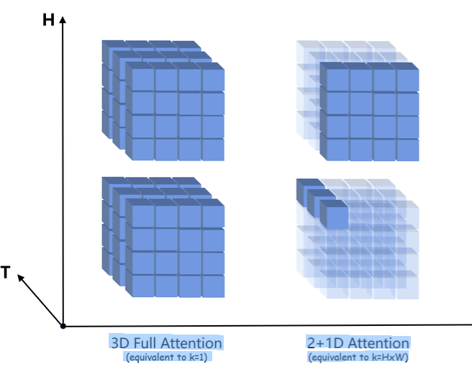
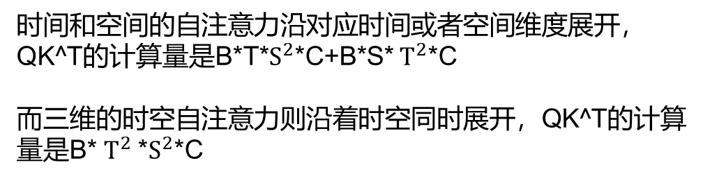
时间和空间的自注意力沿对应时间或者空间维度展开，QK^T的计算量是B*T*$S^{2}$*C+B*S* $T^{2}$*C
而三维的时空自注意力则沿着时空同时展开，QK^T的计算量是B* $T^{2}$*$S^{2}$*C

Slide 7
复用的可行性
02

Slide 8
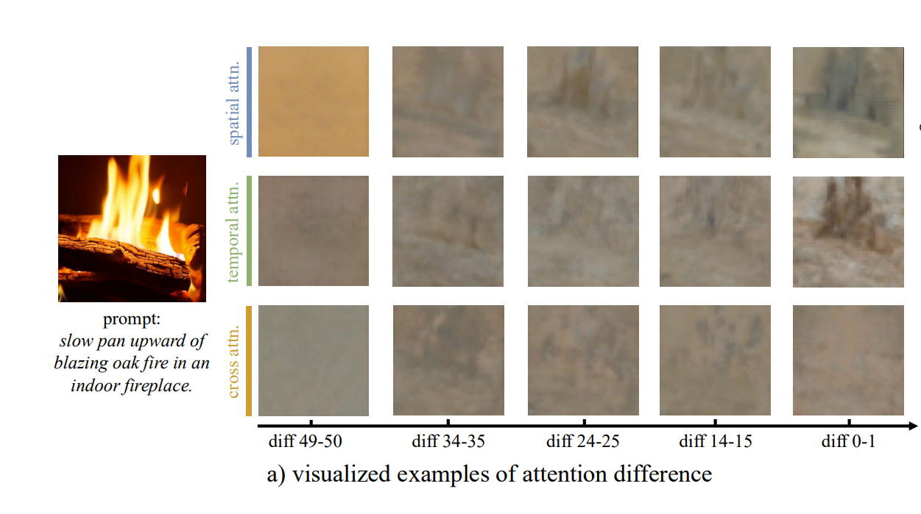

Slide 9
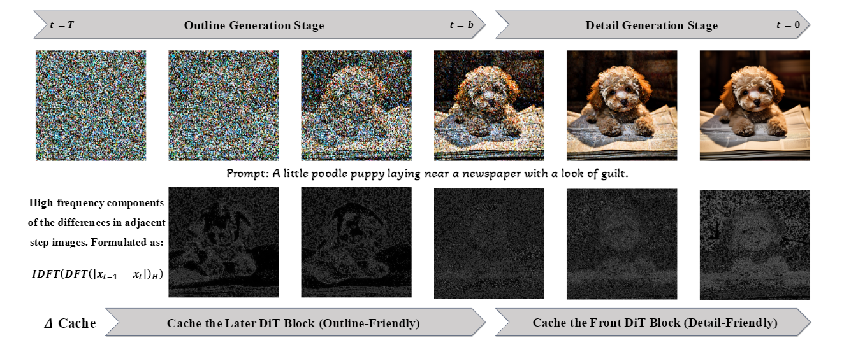

Slide 10
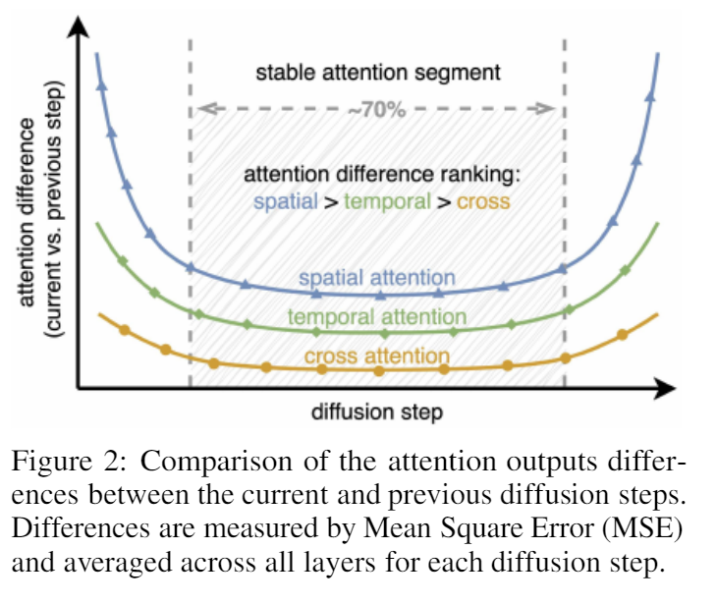

Slide 11
复用的维度
03

Slide 12
复用的对象
DiT base Layer base
Block base Token base
复用的内容
Attention Output Attention Score
The Changes of the Attention Map

Slide 13
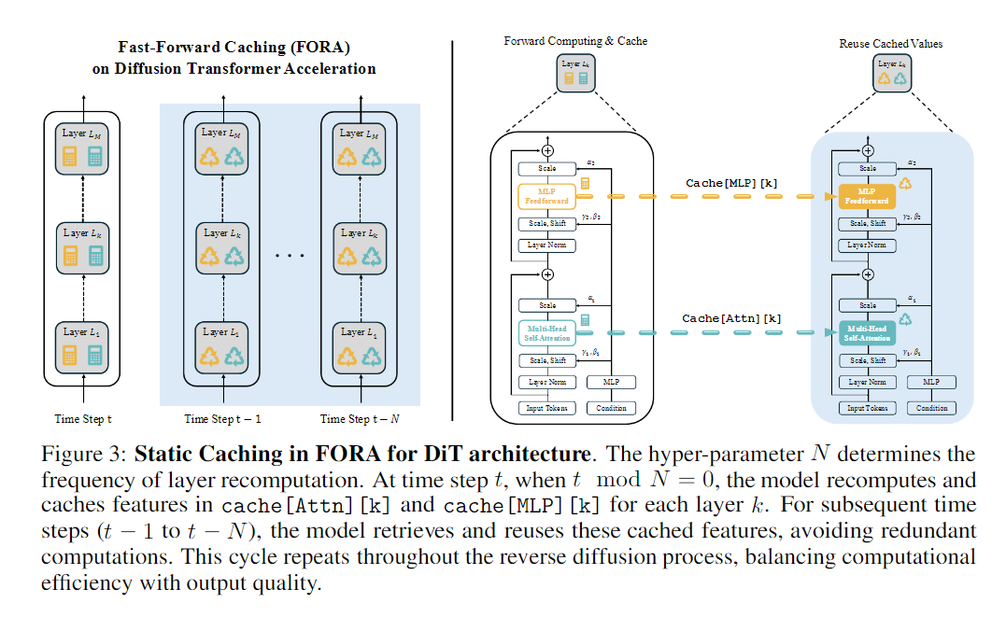
Layer Base

Slide 14
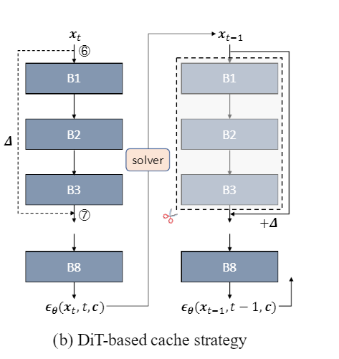
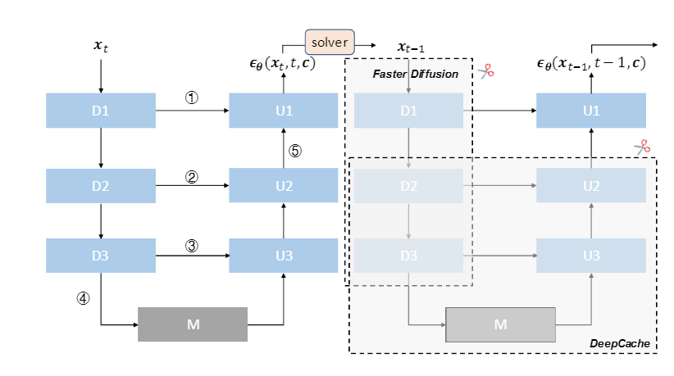
∆-DiT: A Training-Free Acceleration Method Tailored for Diffusion Transformers
Layer Base
∆-Cache caches the deviations between feature maps
Resolve the issue of degraded generation quality caused by losing previous sampling information when caching the output feature maps of DiT blocks.
Unlike Faster Diffusion in DiT, which can only skip the ﬁrst few blocks, ∆-Cache allows skipping of front, middle, or back blocks, offering greater ﬂexibility.

Slide 15
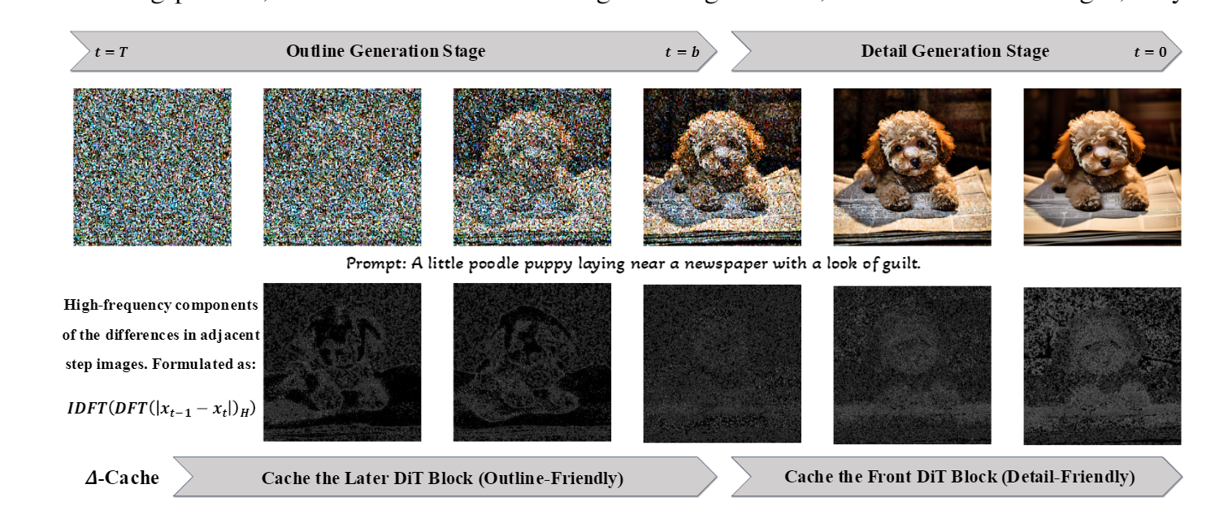

Slide 16
Block Base

Slide 17
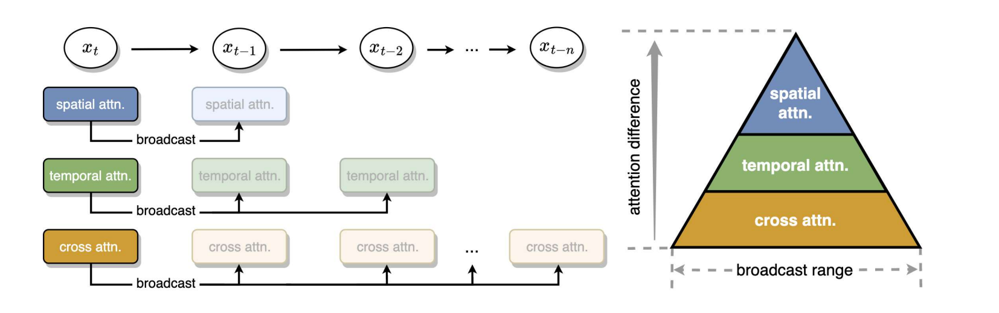
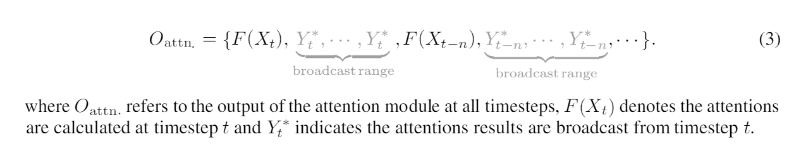
“REAL-TIME VIDEO GENERATION WITH PYRAMID ATTENTION BROADCAST”
Block Base

Slide 18
Token Base
“ACCELERATING DIFFUSION TRANSFORMERS WITH TOKEN-WISE FEATURE CACHING”
FRAMEWORK
Cache Initialization
Computing with the Cache
Cache Updating
Cache Initialization
Given a set of adjacent timesteps {t, t + 1, . . . , t + N − 1}, compute all the tokens at the first timestep t, and storing the computation result (intermediate features) of each self-attention, cross-attention, and MLP layer in a cache, denoted by C.

Slide 19
Computing with the Cache
In the following timesteps, skip the computation of some unimportant tokens by reusing their value in the cache C. Firstly pre-define the cache ratio R of tokens in each layer, which indicates that the computation of R% of the tokens in this layer should be skipped by using their value in the cache, and the other (1 − R%) tokens should still be computed. To achieve this, a caching score function S is introduced to decide whether a token should be cached.

Slide 20
Cache Updating
For the tokens xi ∈ I Compute which are computed, we update their corresponding value in the cache C, which can be formulated as C(xi) := F(xi) for i ∈ I Compute.

Slide 21
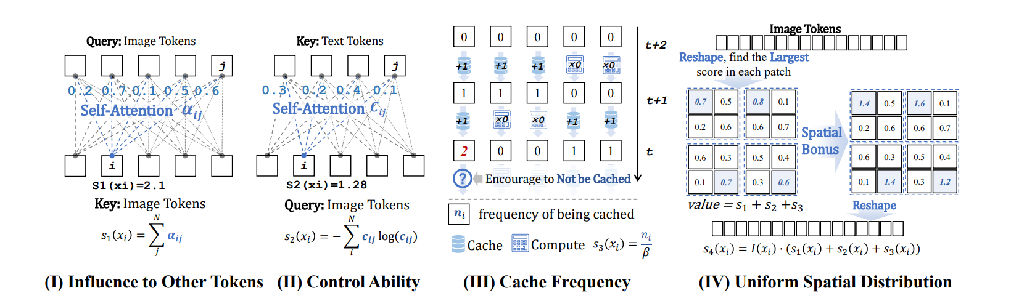
TOKEN SELECTION
The S(xi) is composed of four sub-scores {s1, s2, s3, s4}, corresponding to the following four principals.

Slide 22
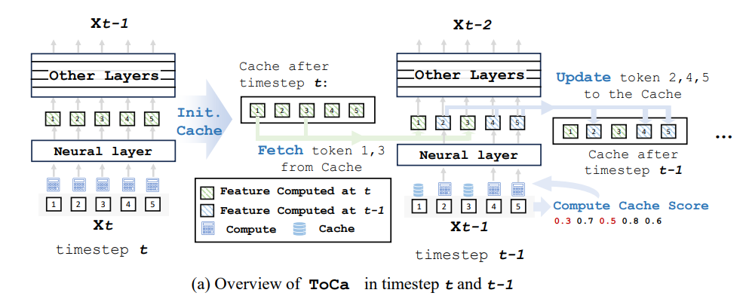
Token Base
“ACCELERATING DIFFUSION TRANSFORMERS WITH TOKEN-WISE FEATURE CACHING”

Slide 23
感谢您的观看与聆听！
SHANGHAI JIAO TONG UNIVERSITY

