Slide 1
LoRA LLM Serving
Haoyan Zhang
2024.10.11

Slide 2
Outline
Paper info
dLoRA: Dynamically Orchestrating Requests and Adapters for LoRA LLM Serving
OSDI’24
Related work -- Punica: PUNICA: MULTI-TENANT LORA SERVING (MLSys’23)
Related work -- S-LORA: SERVING THOUSANDS OF CONCURRENT LORA ADAPTERS (MLSys’24)
Background : LoRA and Serving on LoRA
Challenges : merge v.s. unmerge; multiple adapters with varying rank (size) and request loads
Solution : batching strategy; memory allocation strategy

Slide 3
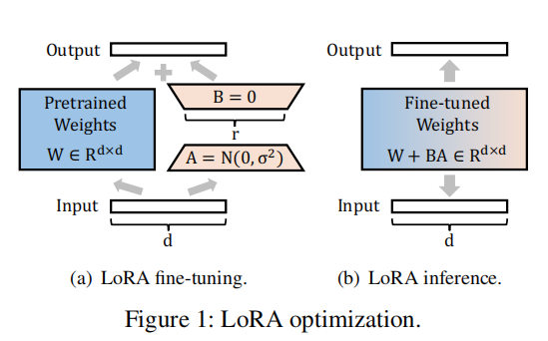
Background -- LoRA (Low Rank Adaptation)
LoRA
An efficient fine-tuning method
Training:
Freeze pretrained weight,
Fine-tune only a small number of parameters (adapter)
Inference:
Merge adpter with pretrained weight to avoid computation overhead

Slide 4
Background -- Serving on LoRA
Requests
LLM Serving
(Orca) : request level -> iteration level
Only batch for operations like MLP
(vllm) : Paged attention to reduce memory fragmentation
Feature : Only for one LLM (with a single adapter)
adapter 0
adapter 1
······
adapter n
Replica 0
Replica 1
New Feature with LoRA
A huge number of adapters on one base model
Different requests require different adapters
Different adapters have different request loads
Base Model

Slide 5
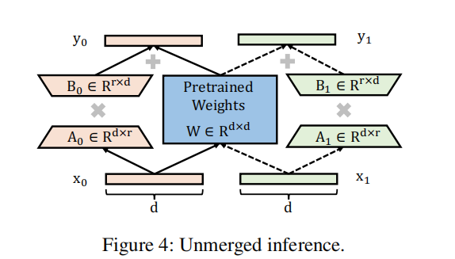
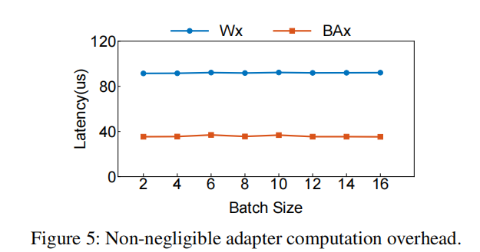
Challenge -- Merge v.s. Unmerge
Switching adapter introduces significant overhead to merged version
Unmerged version introduces computational overhead, about 2/5
Need trade-off

Slide 6
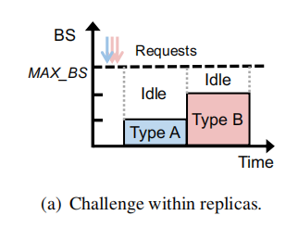
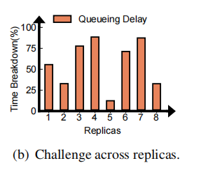
Challenge -- adapters with varying rank and loads
Within a model replica
Request on different adapters cannot be simply batched
Varying ranks of adapters
GPU underutilization and memory fragment
Across replicas
Varying number of adapters on replicas and requests on adapters
Variable input and output length of requests
Load imbalance

Slide 7
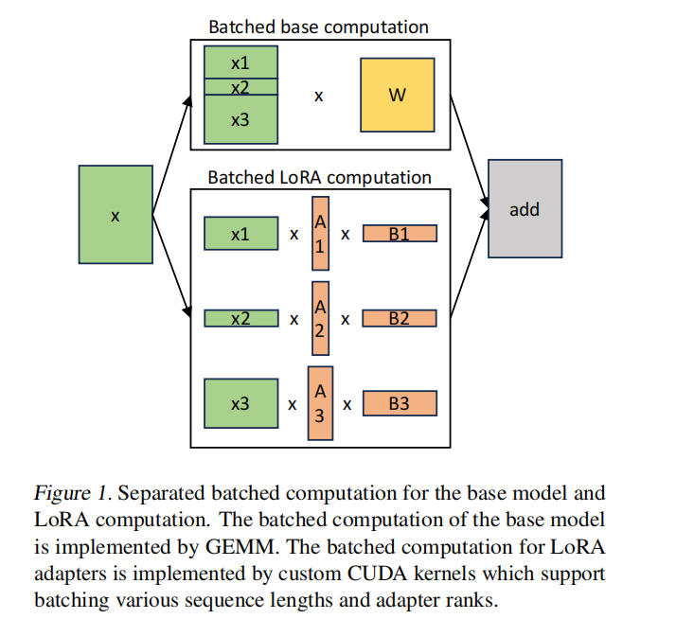
Solutions Proposed by S-LoRA
Batching Strategy
Separate computation of adapters from the base model
Customized CUDA kernel for varying request length and adapter ranks
Memory Strategy
Unify adpaters into page strategy
Parallelism
Introduce tensor parallelism to adapters
Remaining problems
Computation overhead introduced by adapters
Overlook the load imbalance across replicas

Slide 8
Solution of dLoRA
Dynamic batching
Switch between merged and unmerged inference
Tune the switching threshold
Dynamic load balancing
Proactive Mechanism -- greedy approach
Reactive Migration -- adapter-request co-migration

Slide 9
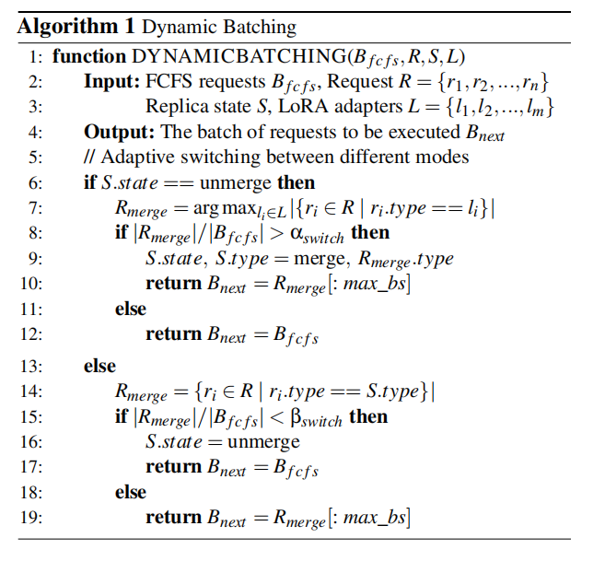
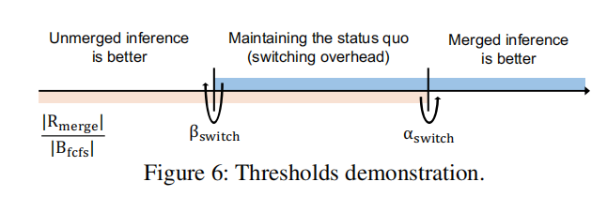
Dynamic Batching
Objective: Whether to change state (merge / unmerge)
Introduce the overhead of switching state
Unmerged : FCFS
Merged : Prioritize one adapter
Amortize the overhead of switch into future iterations

Slide 10
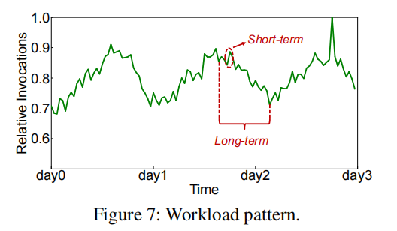
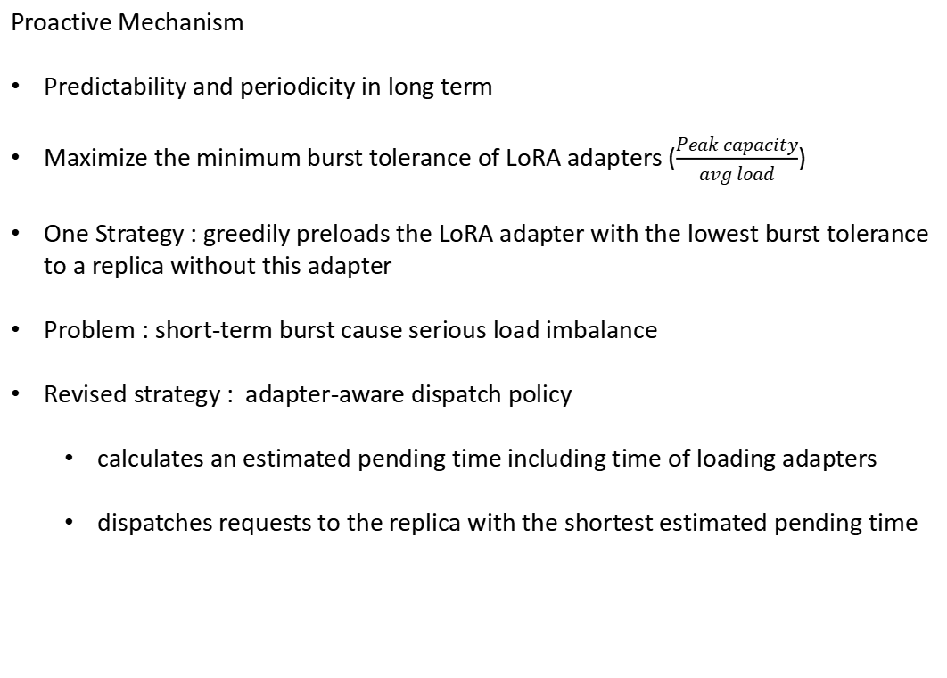
Dynamic Load Balancing
Proactive Mechanism
Predictability and periodicity in long term
Maximize the minimum burst tolerance of LoRA adapters ($\frac{Peak capacity}{avg load}$)
One Strategy : greedily preloads the LoRA adapter with the lowest burst tolerance to a replica without this adapter
Problem : short-term burst cause serious load imbalance
Revised strategy : adapter-aware dispatch policy
calculates an estimated pending time including time of loading adapters
dispatches requests to the replica with the shortest estimated pending time

Slide 11
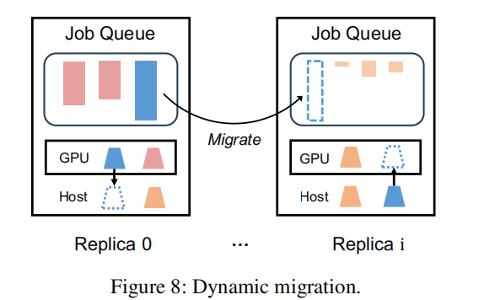
Dynamic Load Balancing
Reactive Migration
Varying input and iutput length of requests
Strategy: migrate LoRA adapters and requests

Slide 12
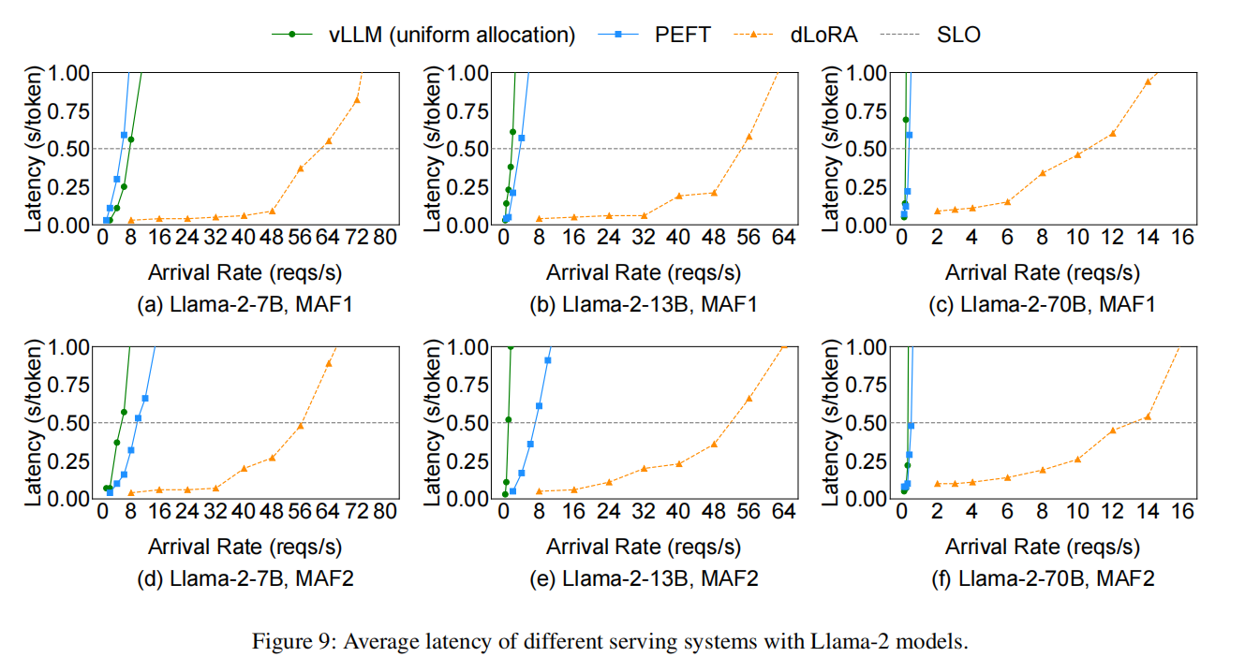
Evaluation Results
Build on vllm, 8 adapters. a four-node GPU cluster, 8 A800 for a node

Slide 13
Evaluation Results
Build on vllm. a four-node GPU cluster, 8 A800 for a node

