Slide 1
Stealing Part of a Production Language Model
Nicholas Carlini et al., Deep Mind+
https://arxiv.org/abs/2403.06634

Slide 2
Stealing part of a LLM overview
Background
Steal last embedding
Stealing in a playground
Moving to practical API
Experiments
Defense & Conclusion

Slide 3
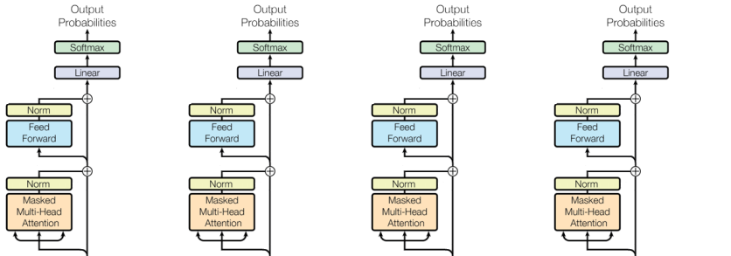
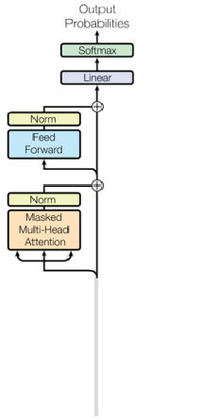
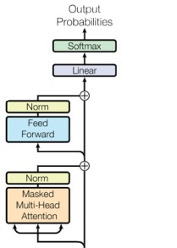
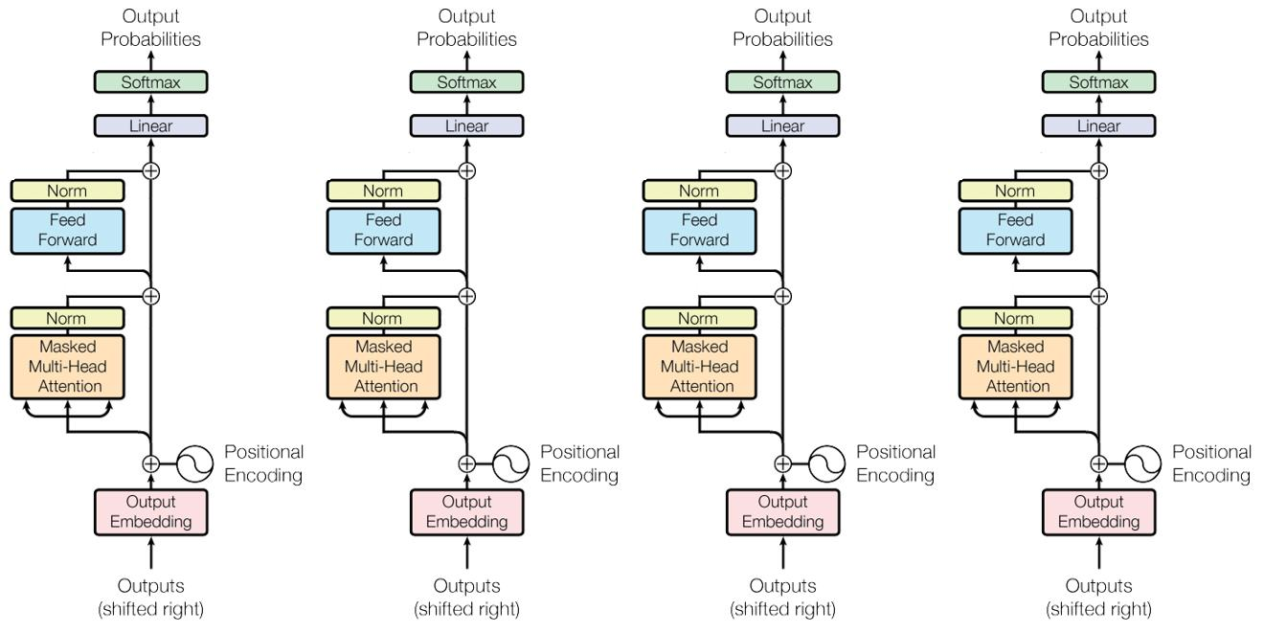
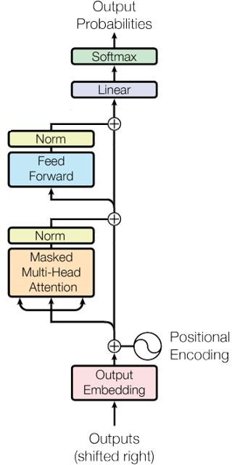
Decoder, Multiple Tokens and Multiple Layers

Slide 4
Decoder-only Transformer, Straight Through
This is where they extracted
the size and the weights

Slide 5
Decoder-only LLM
Softmax
Softmax
Softmax
Softmax
Softmax
Output projection matrix
shown with multiple tokens
Linear
Linear
Linear
Linear
Linear

Slide 6
Extracting hidden model dimensionality [1]
Assume attacker has access to all of the logits (prior to the softmax)
model dim D
vocabulary size V
H
Embedding weight
Q
Token num
N

Slide 7
Extracting hidden model dimensionality [1]
Output matrix is V x N where V > D and N > D, but can be at most rank D
Use SVD and plot the singular values to see the rank
model dim D
vocabulary size V
H
Embedding weight
Q
Token num
N

Slide 8
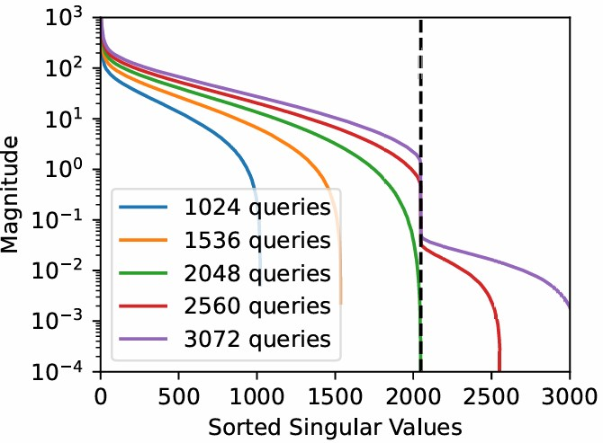
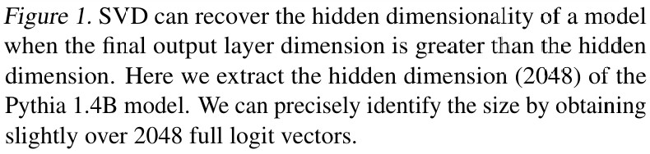
Extracting hidden model dimensionality [2]
Q = U ∙ Σ ∙ V^{T}
Notes:
奇异值分解是特征值分解的推广，从方阵->任意矩阵

Slide 9
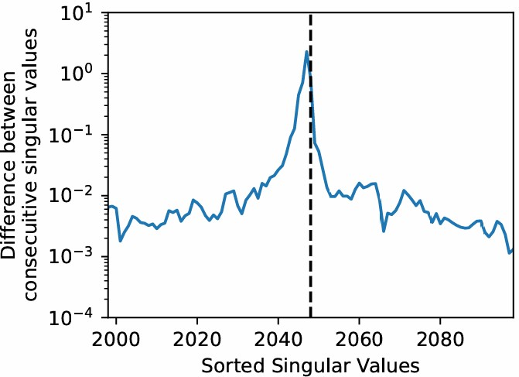
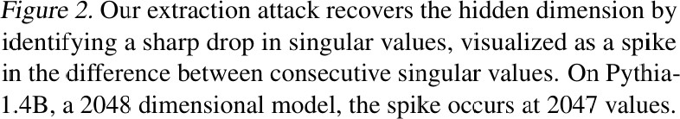
Extracting hidden model dimensionality [3]
Due to floating point limitations, there will be more than D singular values, but the fake ones will be much smaller

Slide 10
Full output layer extraction from logits
LLM is invariant to the affine transformation
$$W∗H=W∗W^{′}∗H^{′}$$
$$=(W∗G)∗(G^{−1}∗W^{′})∗H^{′}$$

Slide 11
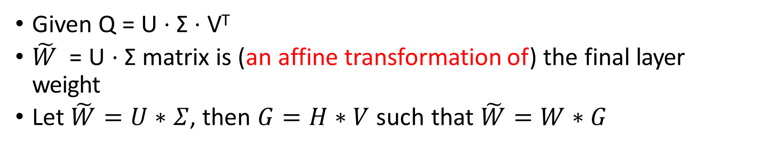
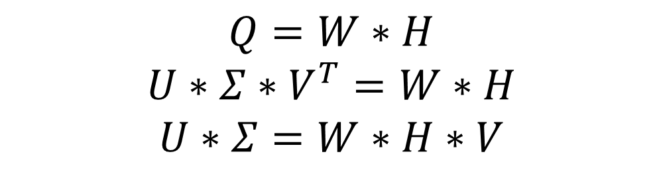
Full output layer extraction from logits
Given Q = U ∙ Σ ∙ V^{T}
$\tilde{W}$= U ∙ Σ matrix is (an affine transformation of) the final layer weight
Let $\tilde{W}=U∗Σ$, then $G=H∗V$ such that $\tilde{W}=W∗G$
$$Q=W∗H$$
$$U∗Σ∗V^{T}=W∗H$$
$$U∗Σ=W∗H∗V$$
Notes:
V是正交矩阵，是Q^T*Q的特征向量
H*V总是可以求逆的，因为V是满秩，H可以选维度

Slide 12
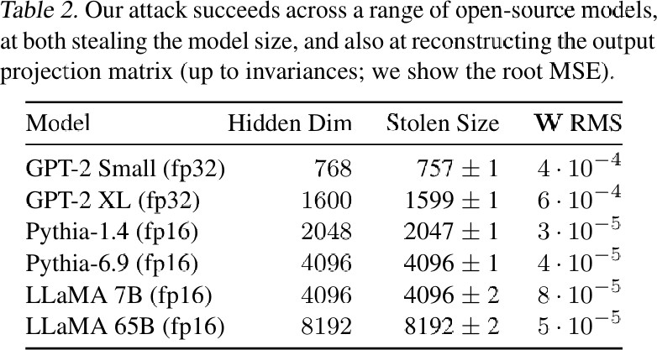
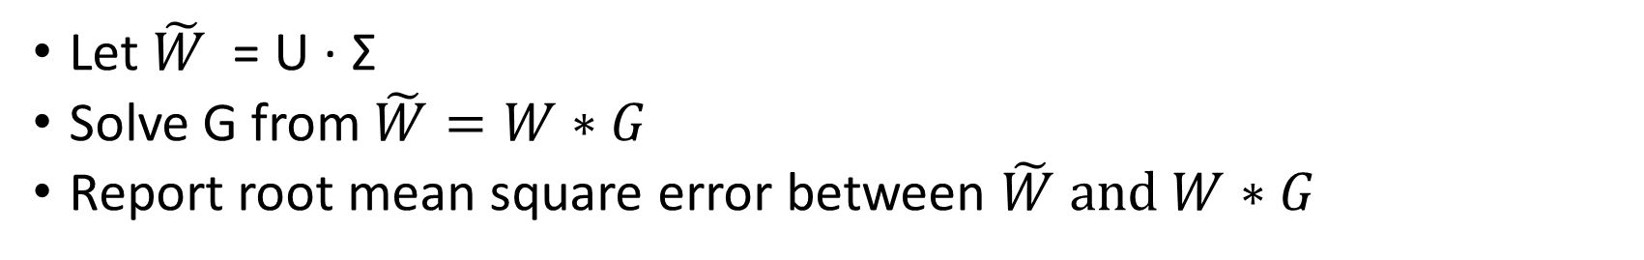
Full output layer extraction from logits
Let $\tilde{W}$= U ∙ Σ
Solve G from $\tilde{W}=W∗G$
Report root mean square error between $\tilde{W} and W∗G$

Slide 13

Realistic attacks using logit bias feature [1]
Real API
$$𝒪\left(p,b\right)←TopK\left(logsoftmax\left(Z\right)\right)$$

Slide 14
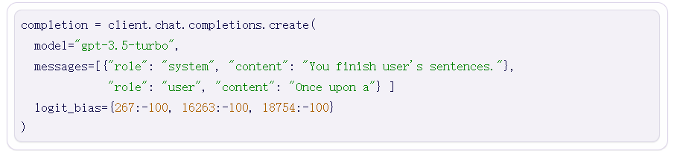
Realistic attacks using logit bias feature [1]
Real APIs offer only the top K probabilities, but also offer logit bias
Logit bias allows user to specify value to be added to logit for certain tokens
If had the top 5 logits, attacker could cycle through adding a huge logit bias to different tokens until you recovered all logits

Slide 15


Realistic attacks using logit bias feature [1]
Production APIs actually return the log probabilities.
With bias B, the logprob for the ith token is:
The extra term goes away for the logprob difference from a reference token:
Always keep a token and cycle the rest four tokens

Slide 16
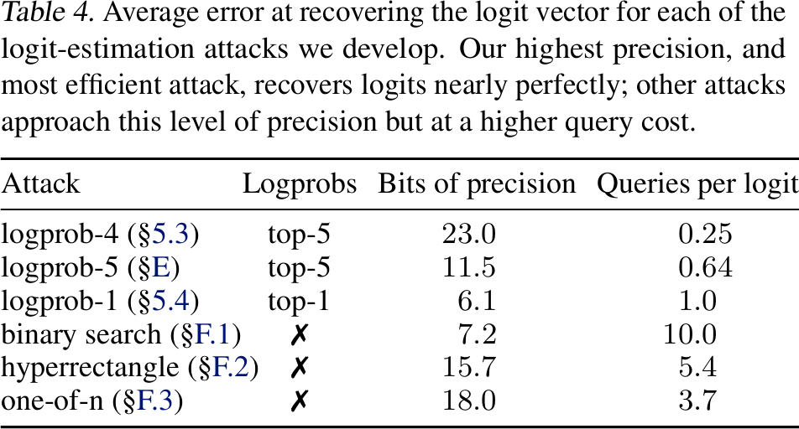
Efficiency
The attack algorithms described are reasonably efficient

Slide 17
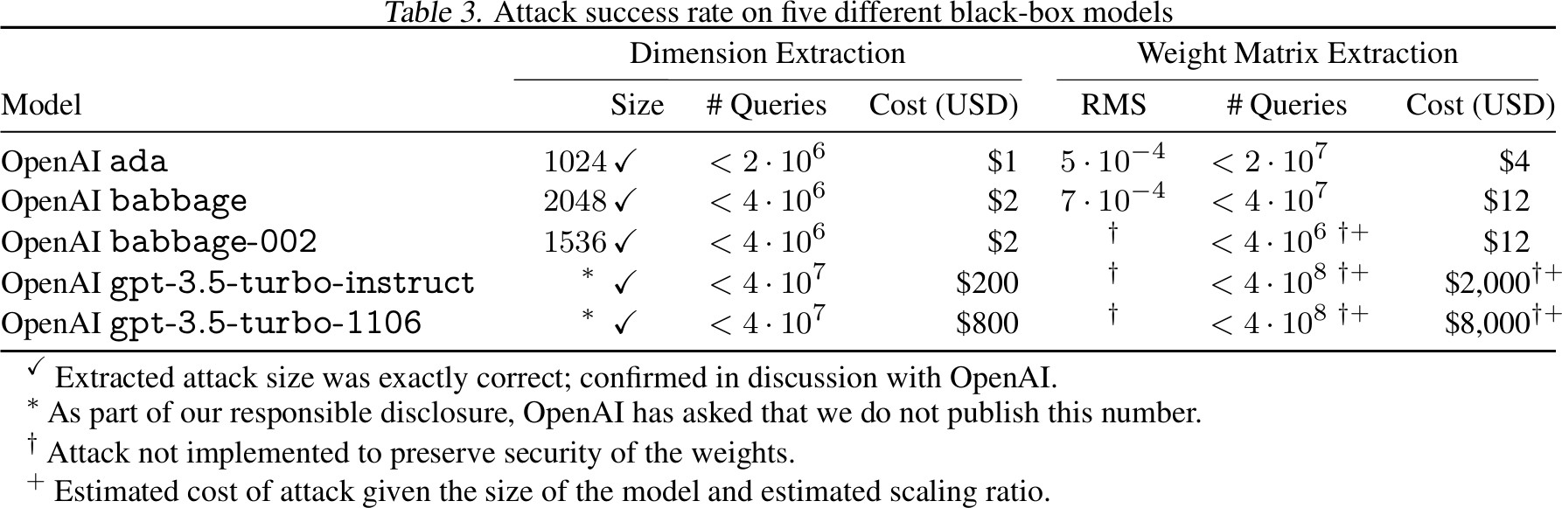
Results
The attacks were successful on production models

Slide 18
Prevention
The attacks described in this paper can be completely prevented using one of the following measures:
Remove the logit bias feature
Replace logit bias with a list of blocked tokens
Change the architecture of the model
E.g., split the final layer into two layers, which would be costly
Post-hoc alteration of the architecture
After training is complete, add orthogonal noise that looks realistic

Slide 19
Mitigation
The attacks described in this paper can be made more costly or less accurate using one of the following measures:
Add noise
Note that logit noise potentially makes the LLM less useful
Limit the number of logit bias queries for each prompt
Serious issues with cost of saving state and privacy risks
Find a way to detect malicious queries
Current defenses insufficient

Slide 20
Stealing part of a LLM conclusion
Similar idea appears in 2016:
Stealing Machine Learning Models via Prediction APIs (USENIX Security’16)
Innocuous designs do impact the security of the product
Architecture design
Logit bias and log probability
Attack is sophisticated and easy to defend

Slide 21
Stealing part of a LLM overview
Common decoder-only LLMs like ChatGPT work on numeric vectors
First, they embed text tokens into dense vectors of the hidden model dimension
These vectors are modified by the transformer layers
Finally, the vectors are projected back into the vocabulary dimension and passed through a softmax to generate output token probabilities
Developed a set of techniques which can extract the hidden model dimension and the full token projection matrix from black box models
Techniques use the token log probabilities and the logit bias feature
Also include a section on mitigation strategies

Slide 22
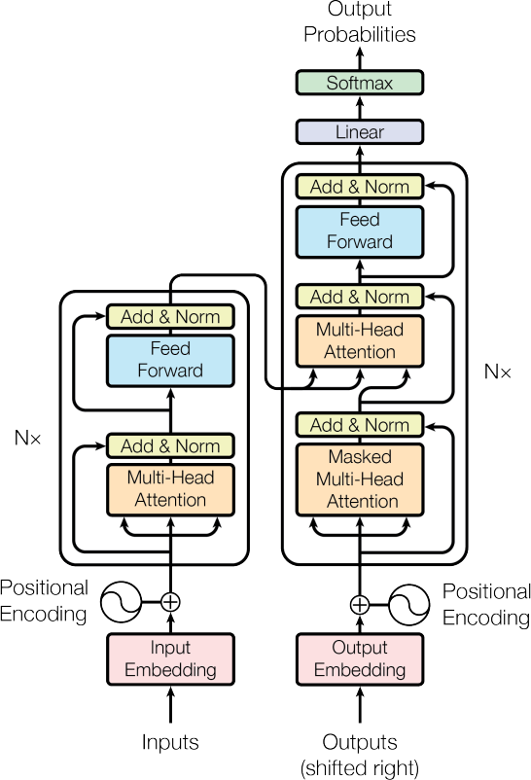
Original Transformer
“Attention Is All You Need,” Vaswani et al., https://arxiv.org/abs/1706.03762

Slide 23
Decoder-only Transformer

Slide 24
Extracting hidden model dimensionality [1]
This is an easy to understand attack to start with, though not realistic
Assume you have access to all of the logits (prior to the softmax)
For vocabulary size V and model dim D, with D < V:
The projection matrix is a V x D matrix, and it can be at most rank D
Collect N full logit predictions, where N > D, arranging them as columns of a new matrix Q of logits
This logit matrix is V x N where V > D and N > D, but can be at most rank D because its columns came from the rank D projection matrix
Use SVD and plot the singular values to see the rank

Slide 25
Realistic attacks using logit bias feature [3]
Finally it is possible to extract logits using logit bias without logprobs
This attack requires a binary search over logit bias values
If you want to know the logits within a small value ε
Then the cost per token is at most log₂( B / ε )
In the appendix, they detail more complex algorithms that track multiple tokens at a time and solve systems of equations, further reducing the number of queries needed

