Slide 1
A Survey of LLMs for CUDA Code
Xing Ma
2025-10-24

Slide 2
Outline
Background & motivation
Workflow-based solution
Training-based solution
Summary

Slide 3
Background
Motivation: why use LLM for code?
Aspect | Traditional Compiler | LLM for Code
Optimization Basis | Rule-based and heuristic-driven | Data-driven and semantic reasoning
Adaptability | Manual pass tuning for new architectures or operator | Easy generalization to new tasks
Complementary to compiler
LLMs discover implicit patterns beyond manual rules
Faster adaptation to new hardware and operators
Current state: LLM struggle with cuda codegen– complex programing and lack of knowledge

Slide 4
Background
Two Paradigms in LLM for Code Systems
(1) Workflow-based: design agent workflows and specify each agent’s role and system interactions
Astra: A Multi-Agent System for GPU Kernel Performance Optimization(arxiv’25)
Don’t Transform the Code, Code the Transforms (NIPS’24 workshop)
KNighter: Transforming Static Analysis with LLM-Synthesized Checkers(SOSP’25)
(2) Training-based: enhance model capability via SFT / RL
CuAsmRL: Optimizing GPU SASS Schedules via Deep Reinforcement Learning (CGO'25)
Kevin: Multi-Turn RL for Generating CUDA Kernels(ICML’25 workshop)
Three types of task:
Code generation
Code optimization
Bug detection

Slide 5
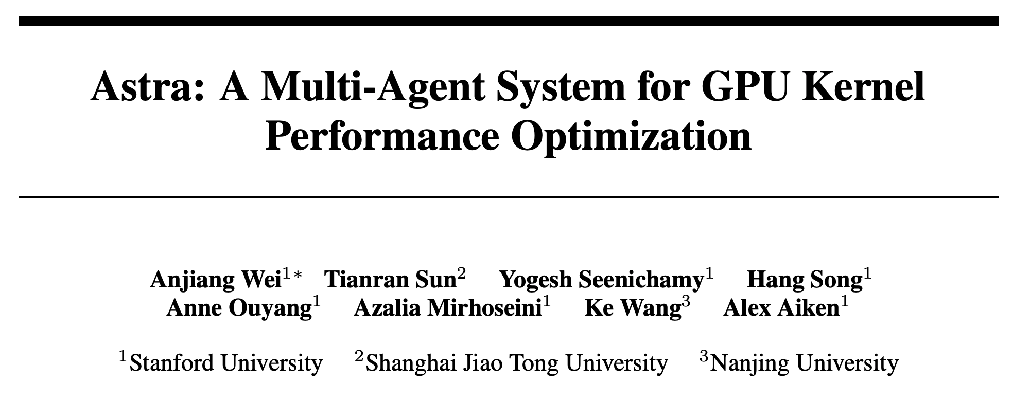
TL;DR:
Design Multi-Agent System for GPU Kernel Performance Optimization,
Achieve avg 1.32x speedup in sglang kernel

Slide 6
Astra: Overview
Agent concept: LLM as reasoning core + external modules
Memory Module: short-term (context text), long-term (RAG retrieval, graph-based memory)
Tool Module: external utilities
Reflection Module: self-analysis / feedback loop
Multi-Agent System: Agents handle subtasks
Task decomposition → simpler tasks, better correctness
Separate memory per agent → prevents error contamination

Slide 7
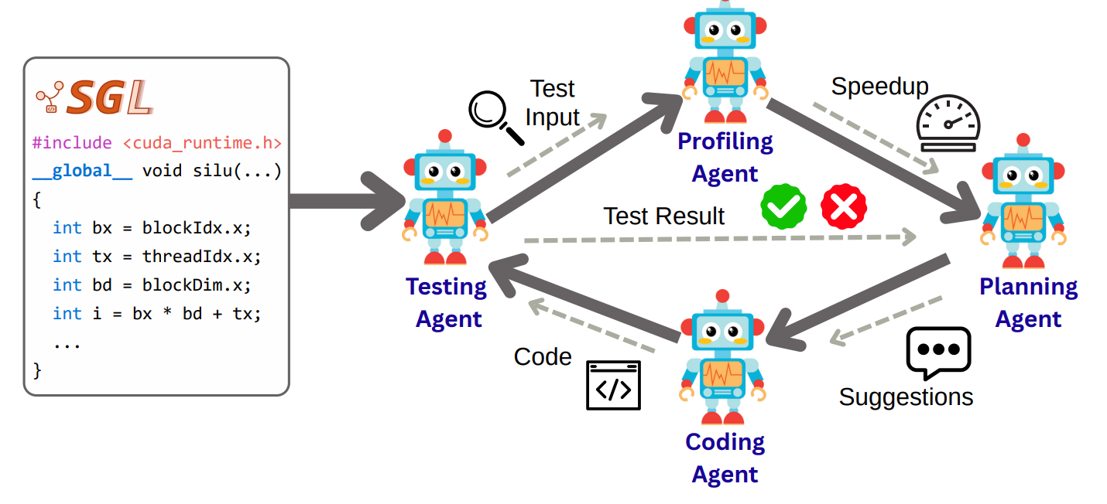
Astra: Overview
Agent role:
Planning Agent: decide optimization locations & methods
Coding Agent: generate optimized code from suggestions
Testing Agent: create test units
Profiling Agent：analyze code & provide error diagnostics

Slide 8
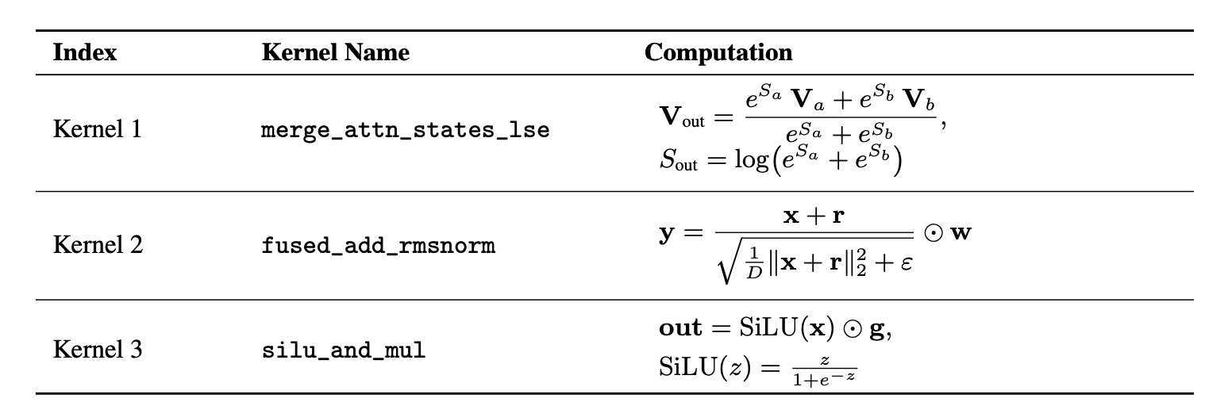
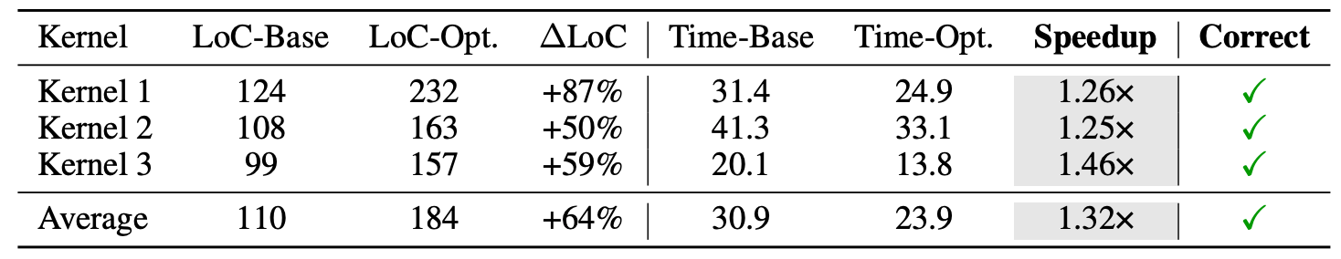
Astra: Evaluation
Experiment Setup
Workload: kernel extracted from SGLang
Model: OpenAI’s o4-mini
Hardware: NVIDIA H100 GPU
Result
All correct, avg 1.32x speedup compared to human expert
Case study: Which cases optimized? How were they optimized?
Loop-Invariant Code Motion
Improved memory access
Shared memory block-level → warp-level reduce (__shfl_down_sync)
Vectorized memory access
Use fast math intrinsics, e.g. __frcp_rn, __fmul_rn

Slide 9
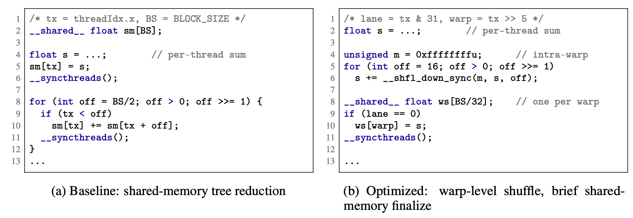
Astra: case study(cont.)
Shared mem block-level reduce → warp-level reduce:

Slide 10
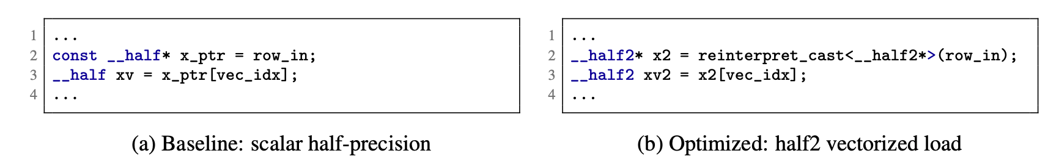
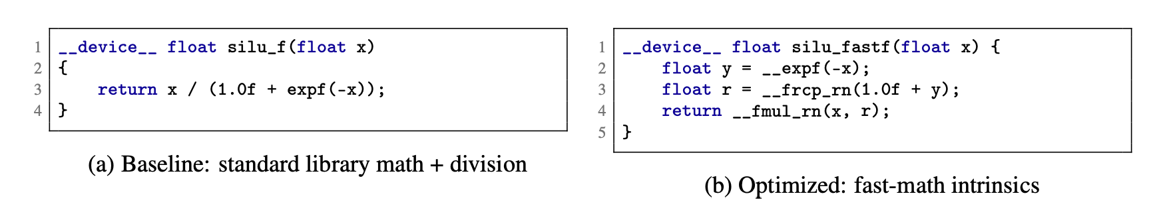
Astra: case study(cont.)
Vector memory access:
Fast math intrinsics:

Slide 11
Astra: case study(cont.)
Shared mem block-level reduce → warp-level reduce:
Vector memory access:
Fast math intrinsics:

Slide 12
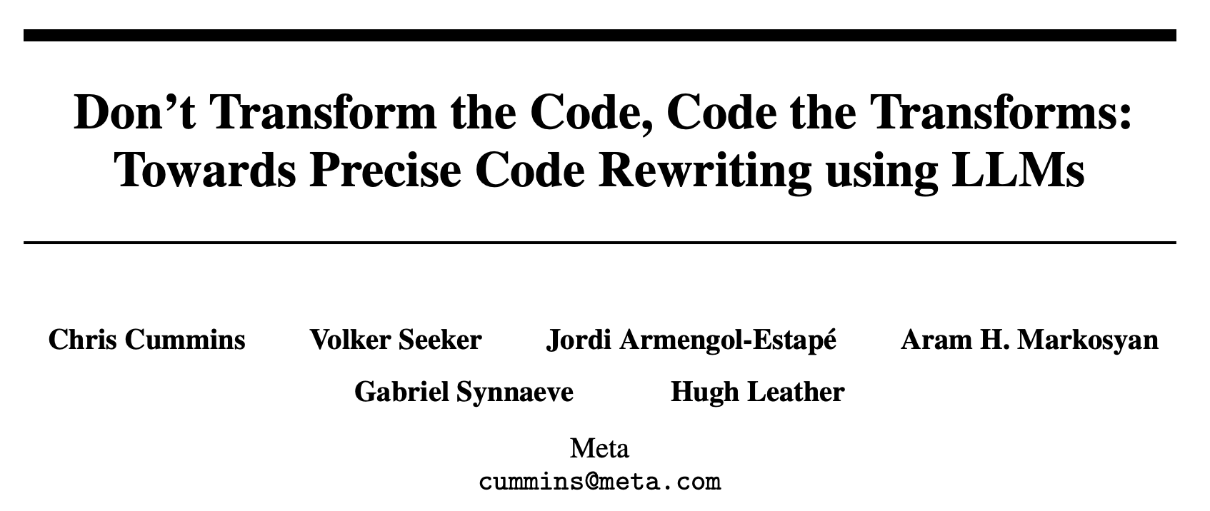
TL;DR:
Target: Python code transformation
Design: Use LLM to generate transform functions instead of directly transforming code
Achieves higher accuracy

Slide 13
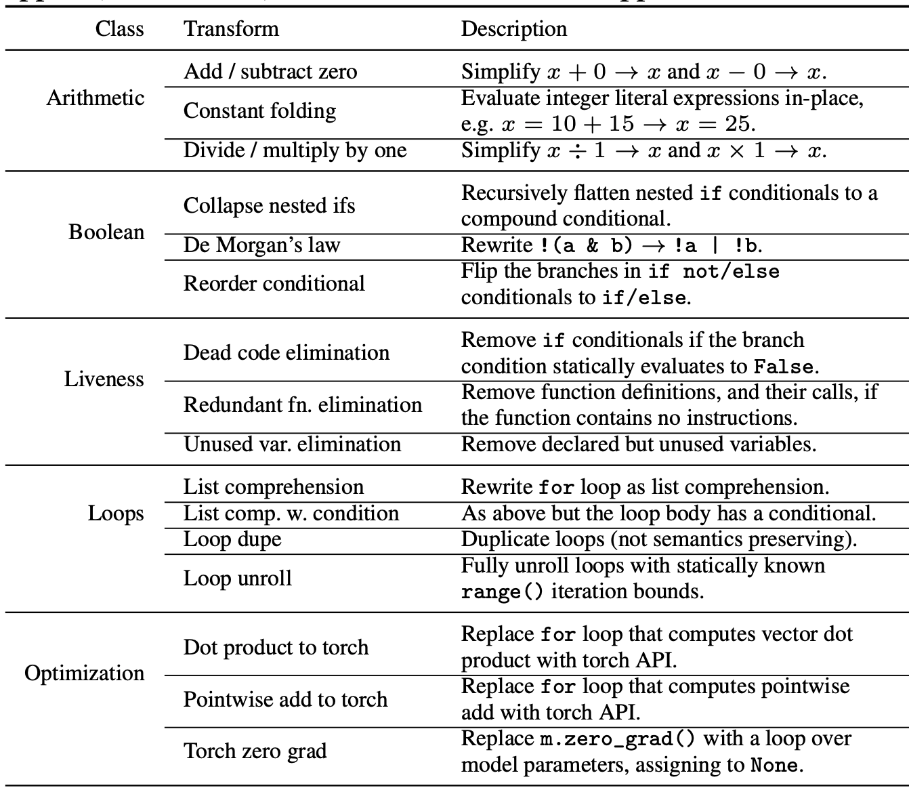
Introduction
Task description:
Python code transformations: f(c) → c ′
Many software tasks can be framed as code transformations (e.g., compiler optimization, refactoring)
Key insight:
Use LLMs to generate transformation functions (llm(C, C′) → f), instead of directly rewriting code.
reduce LLM uncertainty, enhance interpretability

Slide 14
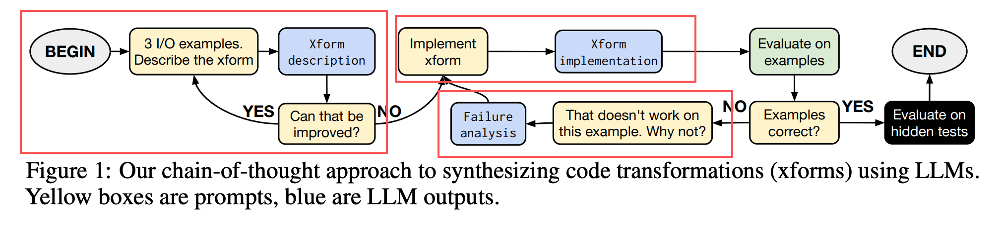
Overview
Formulate solution: def Xform(AST)-> AST.
Three agent:
Planer: generate Xform description
Coder: implement Xform according description
Analyzer: Failure analysis
Planer
Coder
Analyzer

Slide 15
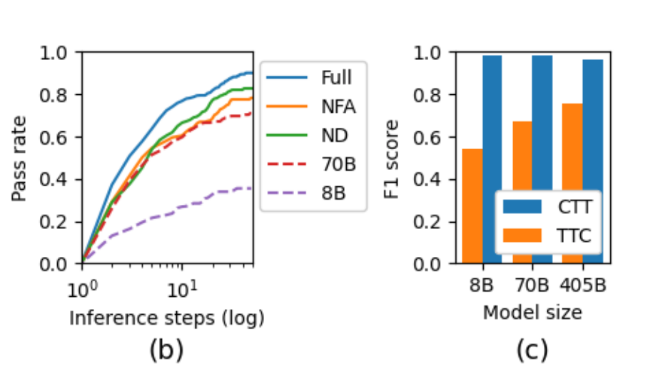
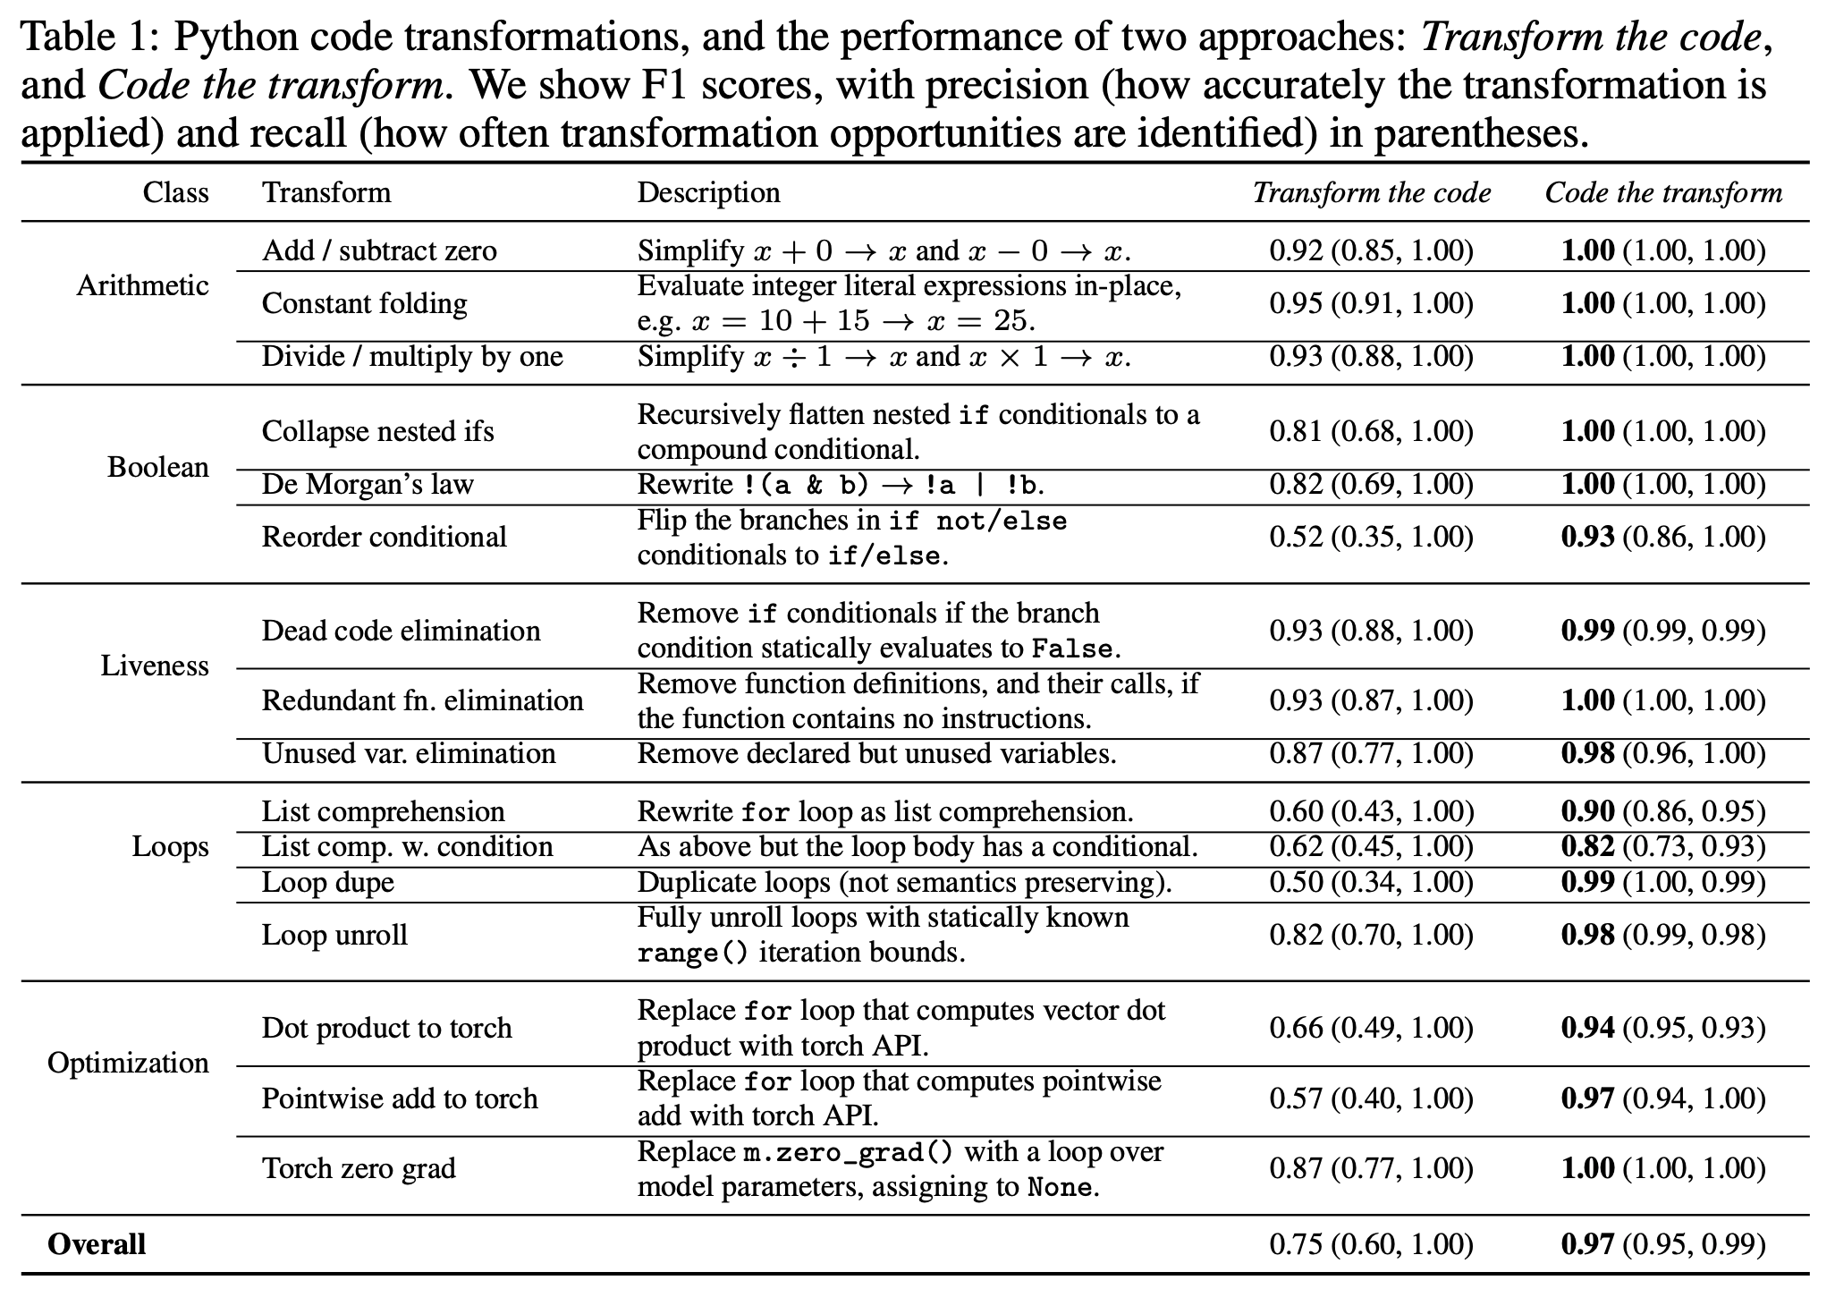
Evaluation
Experiment setup
Dataset: 480 Python I/O programs, 16 transformation types
Compare: Code-the-Transforms (CTT) vs Transform-the-Code (TTC)
Metric: precision and recall
Result
CTT achieves near-perfect accuracy (~1.0)
Ablation shows effectiveness of multi-agent design
CTT maintains high accuracy across different model sizes

Slide 16
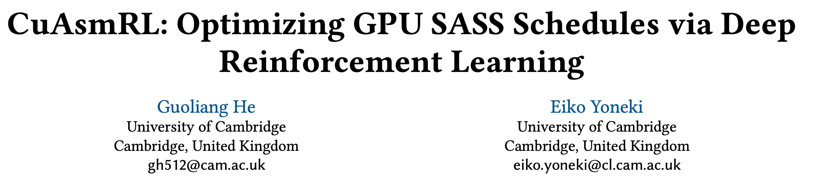
TL;DR:
Target: optimize SASS instruction schedule
Design: define the problem as RL problem and training a model as SASS scheduler

Slide 17
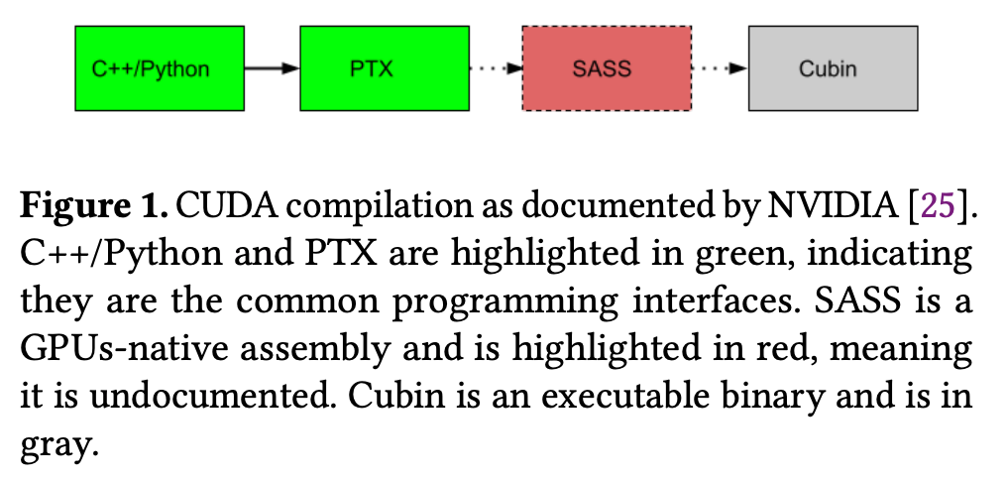
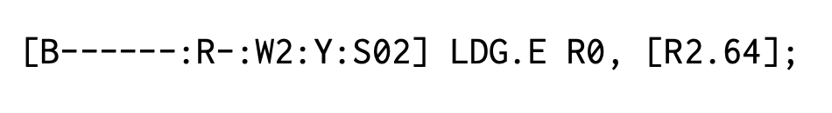
Background
SASS instruction
Closed-source
Components: control code, opcode, operands
Since Kepler: GPU uses static scheduling → compiler manages control codes to avoid data hazards
instruction format:
Optimization Space:
Compute instruction latency known
Load instruction latency unpredictable (due to multi-level memory & caches) → compiler cannot fully optimize order
Previous Methods:
MaxAs (assembler, trial-and-error), TuringAs (assembler, profiling-guided)

Slide 18
Motivation:
Manual SASS tuning/debugging is time-consuming
Instruction reordering can be formalized as an RL problem
Key Idea:
Define state space, action space, reward function of RL
Integrate the sass optimizer into triton

Slide 19
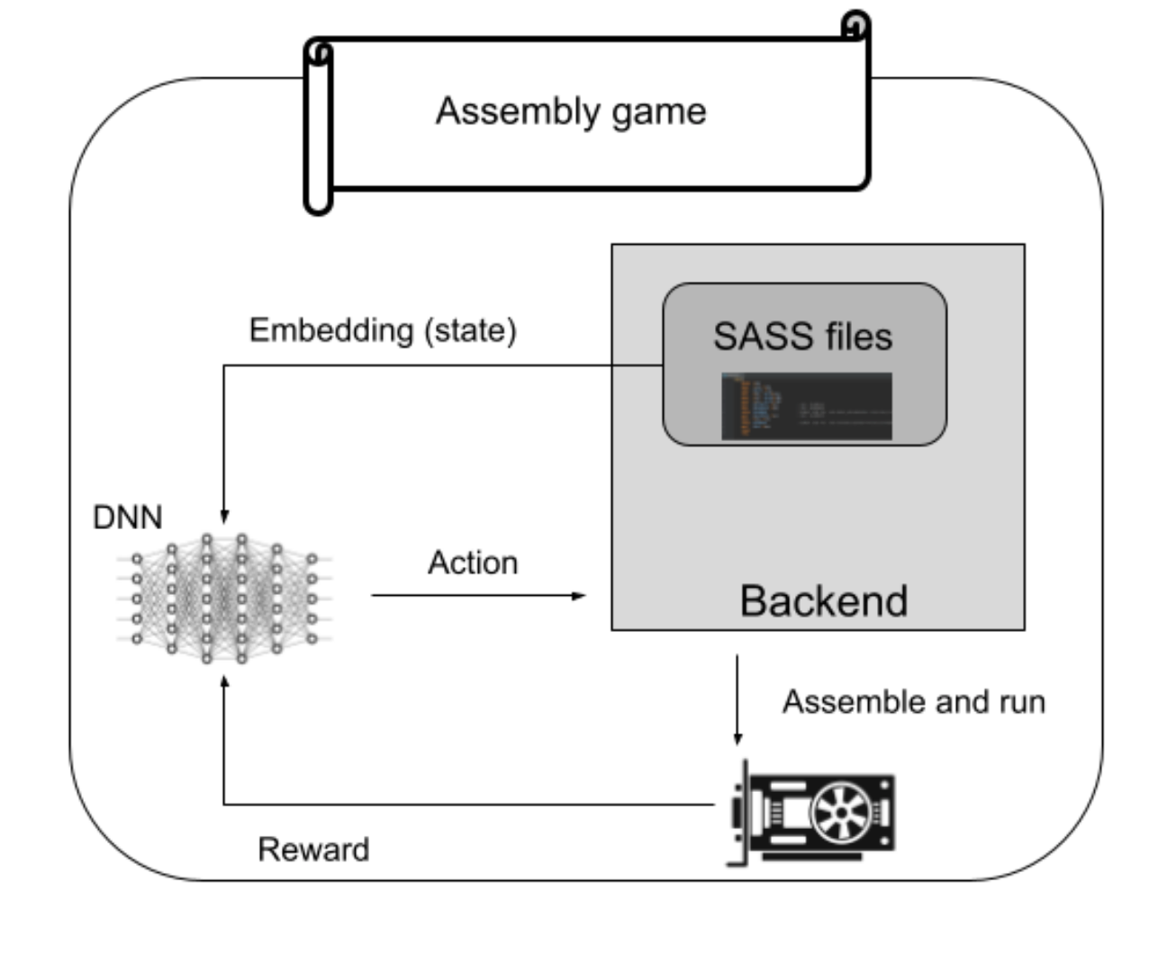
Overview
Reinforcement Learning
Interaction Phase:
agent interact with environment, store (S, a, S’, R)
Learning Phase
Updating model parameters use dataset(S, a, S’, R)
RL workflow

Slide 20
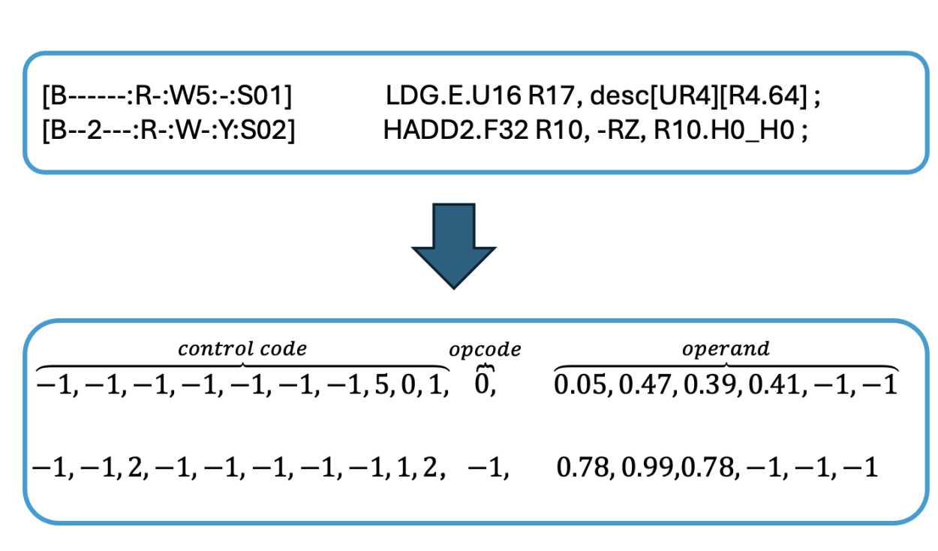
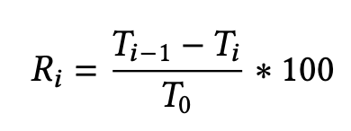
Overview
State space
Embed sass file
Action space
Action： select an instruction & swap with previous/next
Action Masking: filter illegal moves
Register Dependency: instruction using a register cannot precede its write
Stall Check: detect accumulation stalls between define–use pairs
reward function
Embedding(stage)

Slide 21
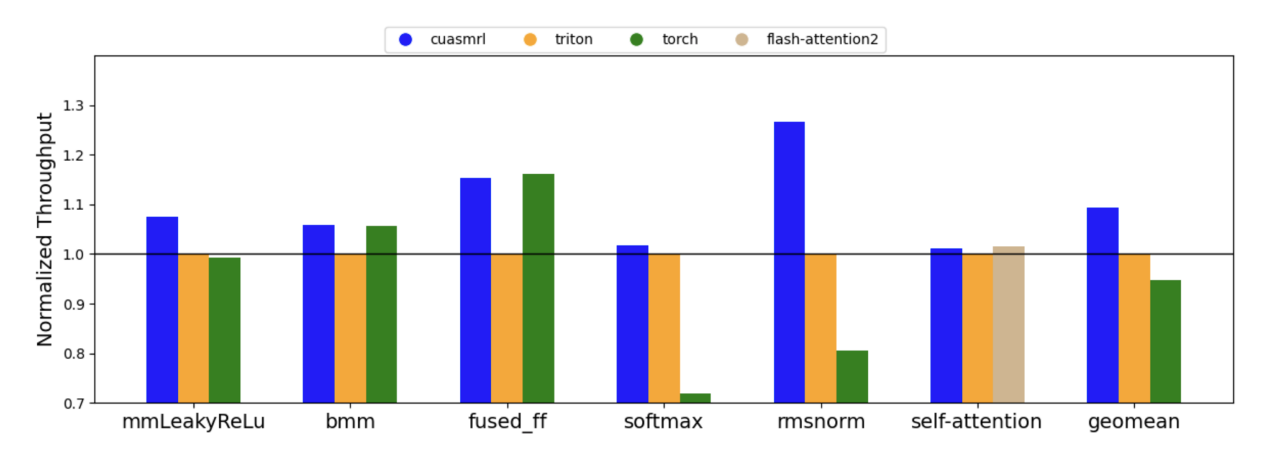
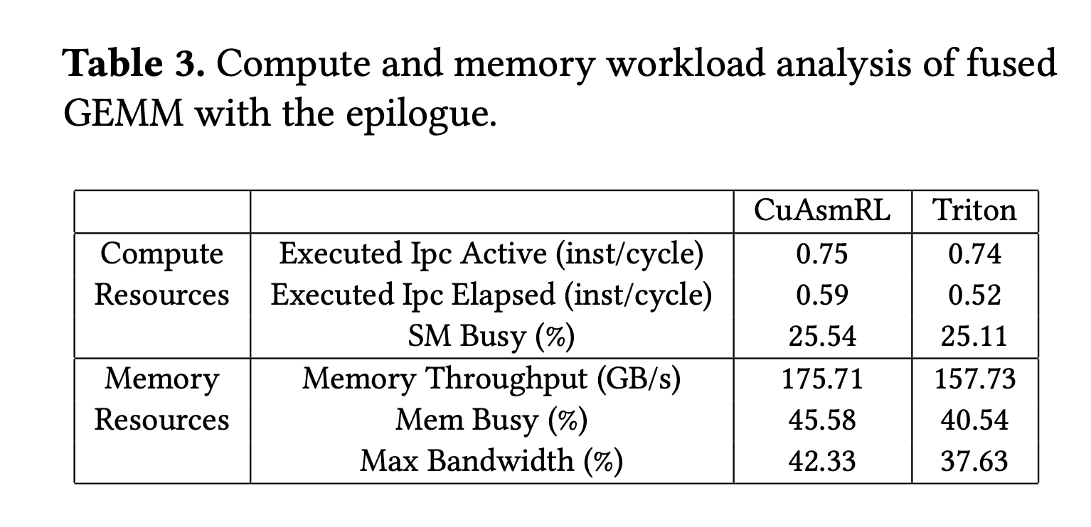
Evaluation
Throughput in different operator
CuAsmRL outperforms Triton on all kernels
show capability of improving by SASS scheduling
Speedups breakdown analysis
Optimization focuses on memory rather than computation

Slide 22
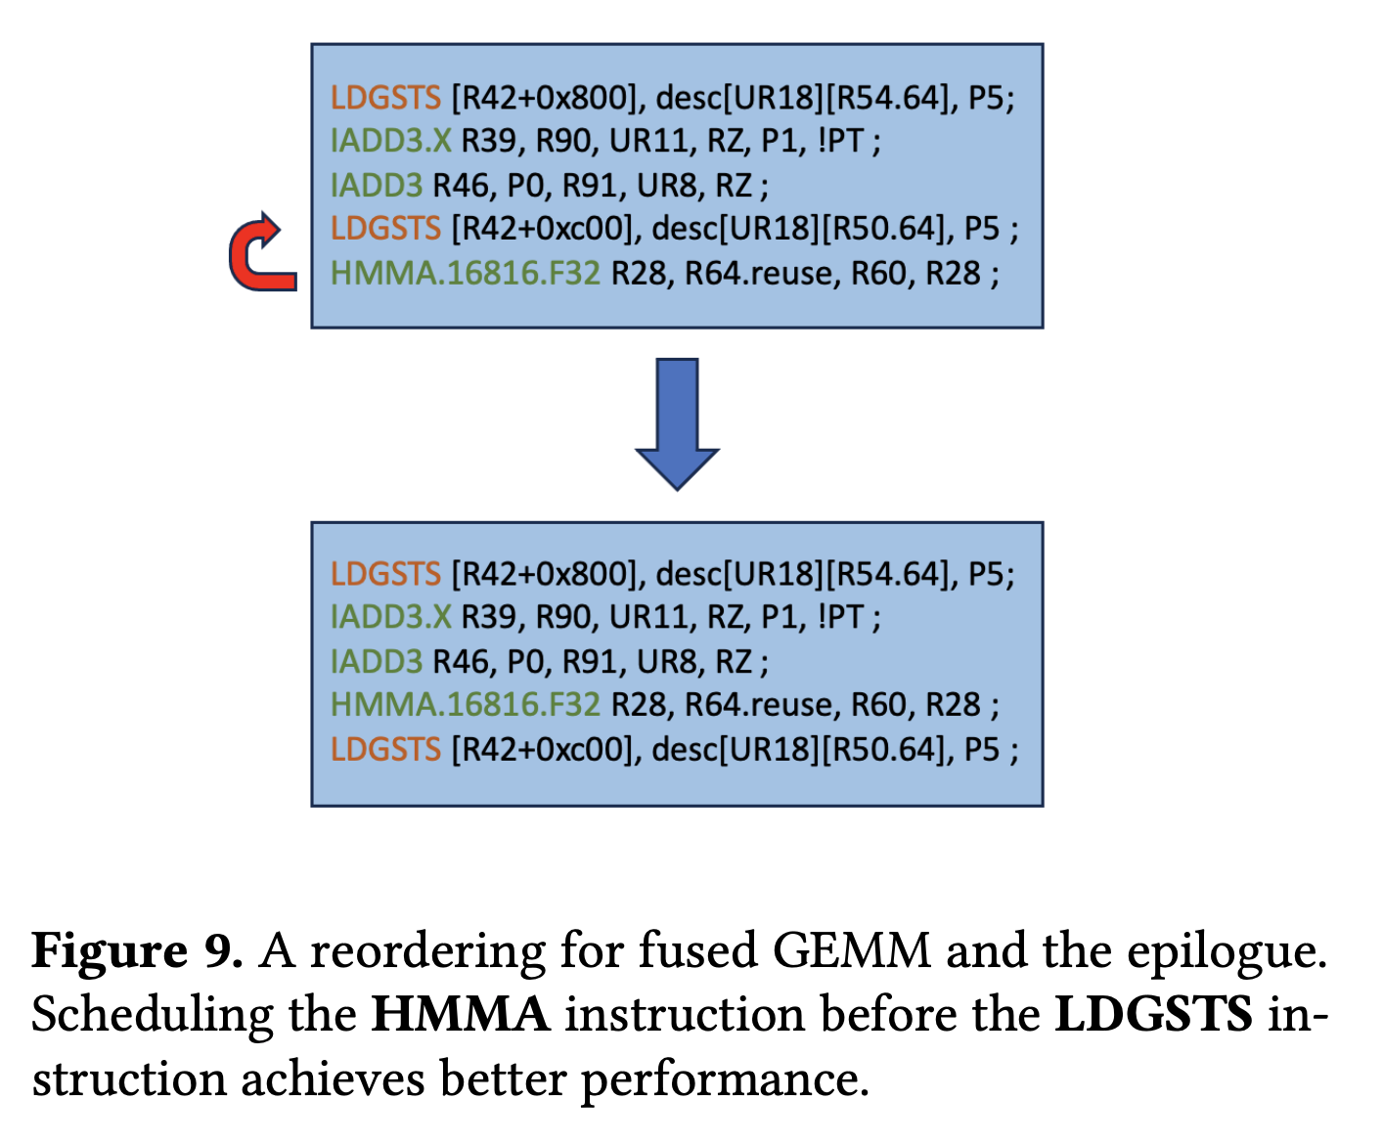
Case study
Case study— Fused GEMM with LeakyReLU
Instruction Reordering: HMMA & LDGSTS reordering → +7% throughput
.reuse Flag: hints to reuse operand cache → reduces register bank conflicts
Observation:
Original schedule: removing .reuse has no effect → cache reuse invalidated by warp scheduler (TLP)
Optimized schedule: removing .reuse loses performance gain → effective operand cache reuse

Slide 23
Summary
Method Type | Core Idea | Advantages | Limitations
Training-based | Fine-tune or RL to let LLM learn code patterns | Learns new optimization patterns | High training cost & Convergence or not
Workflow-based (multi-agent) | Decompose tasks into collaborating agents | Modular, flexible | Heavily depends on planning & prompts
Workflow-based (transform-func) | Generate code transformation functions, not direct code | Interpretable, reusable | Limited to pattern-specific tasks
Naive prompting limits LLM power → Workflow + prompt with task decomposition & In-context learning unlock potential ability. Beyond that → need Training (e.g., Fine-tuning, RL).
Transform-func inspires us deliberate LLM role & interface design.
Notes:
普通的调用难以激发llm的全部能力，我们通过设计workflow和prompt，引入任务分解和in-context learning的方法，使llm能力接近理论峰值,
超出能力之外需引入fine tune等训练,
transform-func这类范式也启发我们，如何定位llm在系统中角色，设计llm与其他组件的接口也很重要

Slide 24
Thank you
Q&A

