Slide 1
How does Deepspeed ZeRO perform distributed training to train LLMs

Slide 2
Contents
Background
Opportunities and Challenges in distributed training
w.r.t. communication, network, parallelism search
Distributed training works
w.r.t. communication, throughput, ease of use, scalability and resilience
Deepspeed ZeRO trilogy
ZeRO, ZeRO-Offload, ZeRO-Infinity

Slide 3
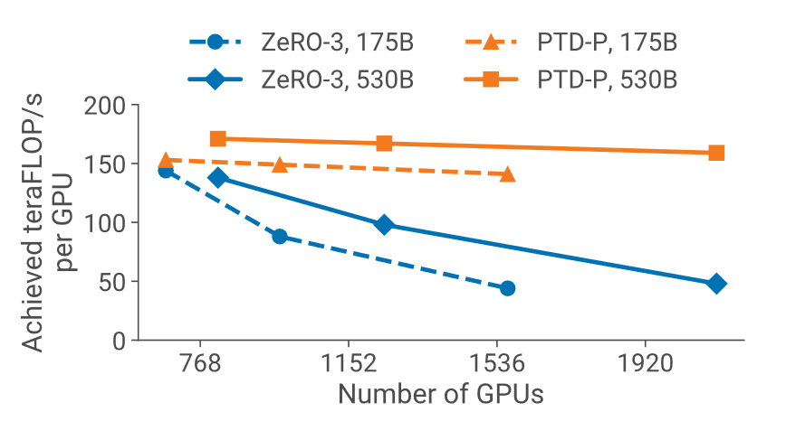
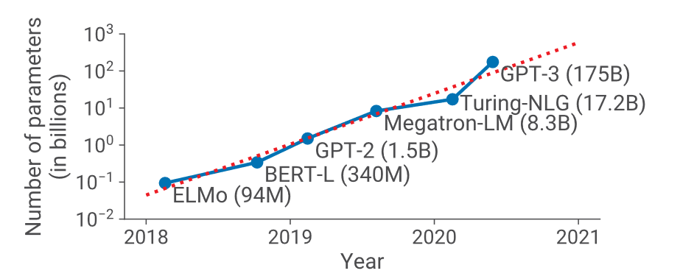
Why we need distributed training ?
Achieve higher utilization of GPU
Price scissorsbetween Parameters Size and Memory Capacity

Slide 4
Opportunities and Challenges in distributed training
Parallelism Strategy
Network and Communication Optimization
Other Optimizations

Slide 5
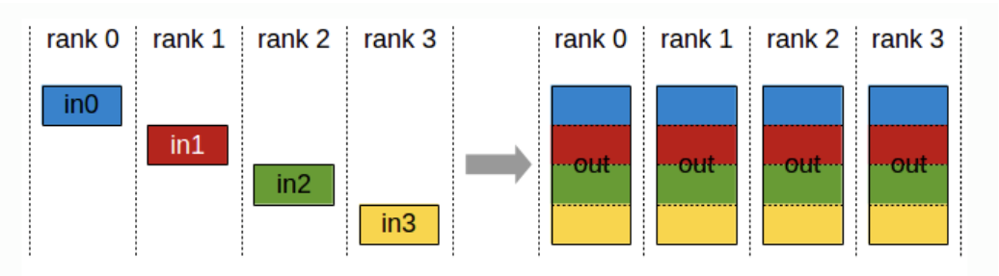
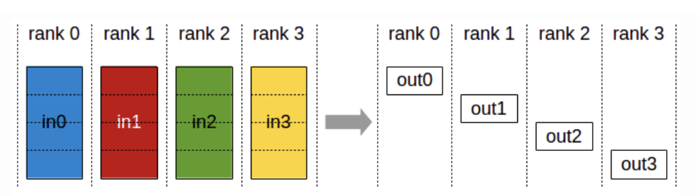
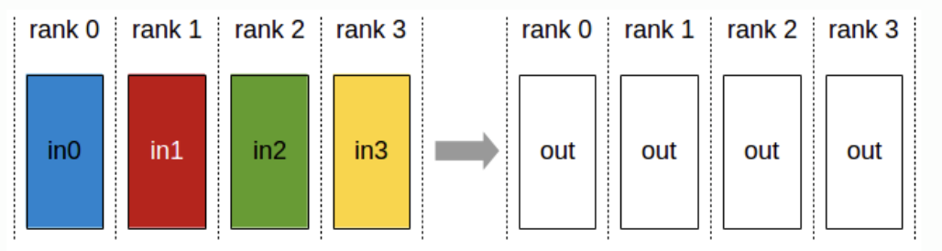
Background - Collective Communication
all-gather
reduce-scatter
all-reduce

Slide 6
Background - Communication Bandwidth
Inter-node (100 ~ 800 Gbps)
Ethernet
InfiniBand
Intra-node
CPU – GPU : 10
GPU – GPU : 100
PCIe (a100:64GB/s h100:128GB/s)
NVLink (600 ~ 900 GB/s)
CPU – NVMe SSD : 1

Slide 7


Background - Memory Footprint
Model States: FP32 weights, FP32 momentum, FP32 variance, FP16 weights
$$14ϕ bytes$$
Mixed Precision Training
FP16 gradients, (FP32 gradients)
$\left(2\right)6ϕ bytes$
Memory Footprint
Adam Optimizer
Residual States: FP16 Activations and others

Slide 8
Distributed training methodology
Data Parallelism
Pipeline Model Parallelism
Tensor Model Parallelism
ZeRO Data Parallelism

Slide 9
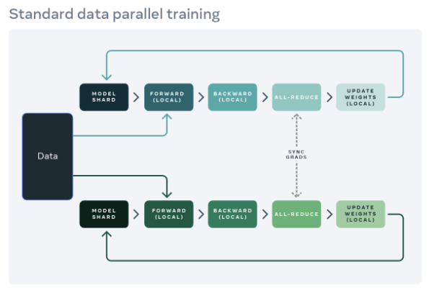
Data Parallelism
Procedure
Forward locally
Backward locally
Gradient All-reduce globally
Update weights locally
Cons
Every rank holds a whole Model Shard thus has worst memory efficiency.
In large scale GPU cluster, little batch size lead to low utilization & high communication cost.
Pros
Each model takes a different micro-batch.
Relatively low communication cost than model parallelism.
Ease of use.

Slide 10
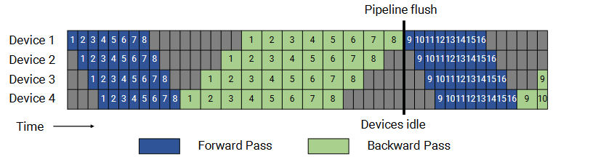

Pipeline Model Parallelism
Procedure
Forward locally, send output to the next rank.
If there are enough micro-batches, keep perform step 1.
Else go into Bubble until backward start.
Backward locally, send output to previous rank.
Keep doing until the iteration ends(pipeline flush)
Bubble fraction = $\frac{p−1}{m}$
Cons
Need large micro batch size to hide pipeline bubble and flush.
Large micro batch thus causing high activation memory footprint & convergence issue.
It’s of difficulty to divide balanced pipeline workload.
Pros
Each model takes a different micro-batch, which a part of the input batch.
Communication cost is relatively low. (one point-to-point communication).

Slide 11
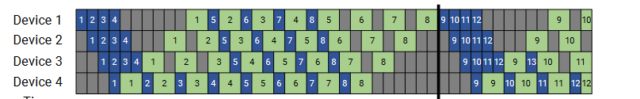
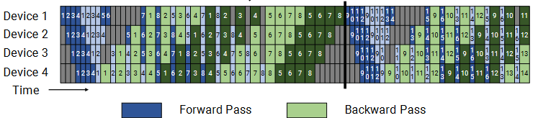

Pipeline Model Parallelism
Decrease In-flight memory footprint
Decrease bubble fraction
Bubble fraction = $\frac{1}{v}\frac{p−1}{m}$

Slide 12
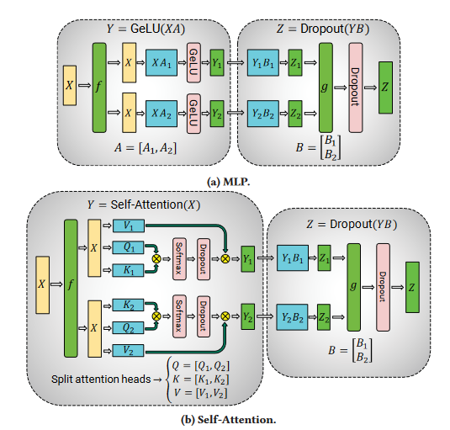
Tensor Model Parallelism
Procedure
Divide weight vertically into A_1 & A_2
Multiply input X with A_1, A_2 in rank_0, rank_1 respectively
Perform GeLU respectively
All reduce
Peform Dropout respectively
Pros
Effective in Transformer-based models in small scale of GPU cluster.
Cons
Higher communication cost. Per MLP/attention a all-reduce operation.
Need to store multiple copy of input
Need to modify source code. (But they claim that it’s easy).
High degree of TP decrease GPU utilization

Slide 13
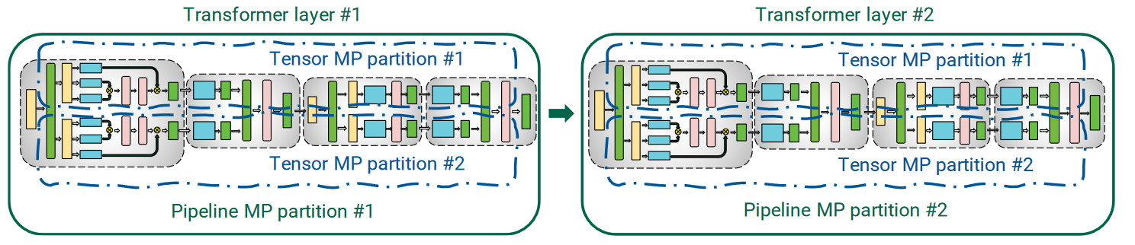
PTD(3D) Parallelism
for pipe in pipeline_parallelism
for tensor in tensor_parallelism
for mb in data_parallelism
perform dp(pipe, tensor, mb)
end
perform tp(pipe, tensor)
end
perform pp(pipe)
end

Slide 14
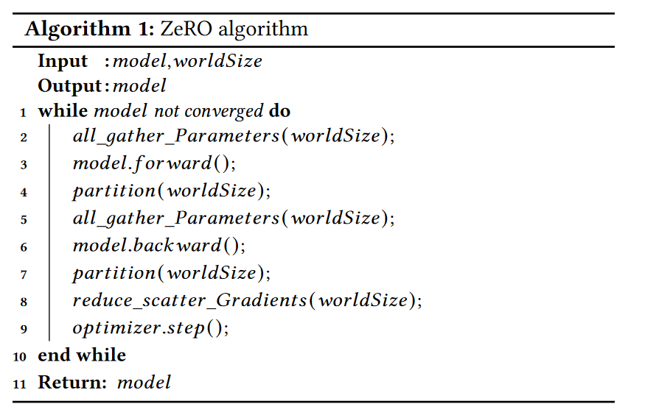
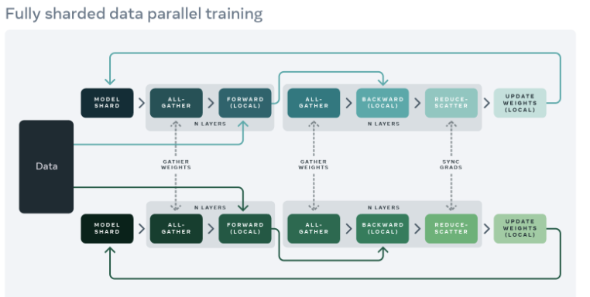
Deepspeed-ZeRO / FSDP
Pros
Have same or better effectiveness than PP / TP.
Be able to scale out to 1000B using only ZeRO data parallelism.
Less communication cost than TP.
Cons
Like Data parallelism. Low GPU utilization.

Slide 15
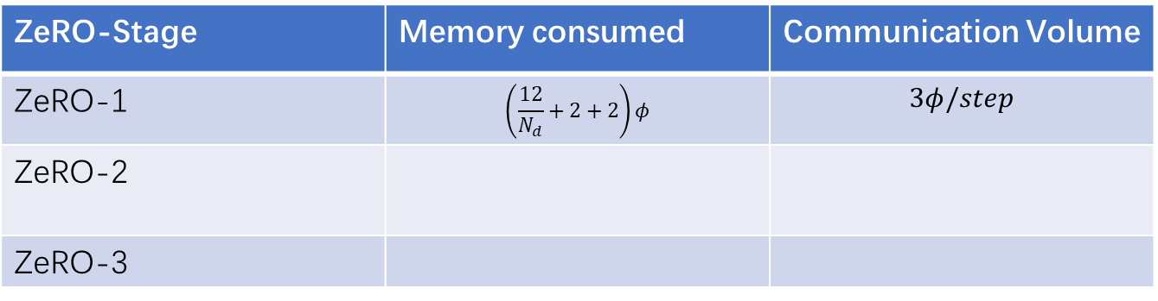
Deepspeed-ZeRO-1
Fp32 optimizer state
Fp16 weight
All Gather
Fp16 gradient
All Reduce
ZeRO-Stage | Memory consumed | Communication Volume
ZeRO-1 | $$\left(\frac{12}{N_{d}}+2+2\right)φ$$ | $$3φ/step$$
ZeRO-2
ZeRO-3

Slide 16
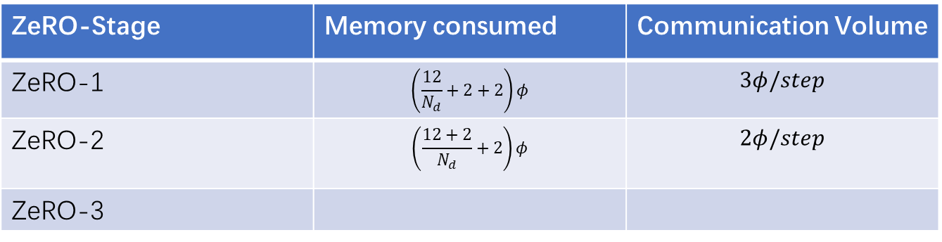
Deepspeed-ZeRO-2
Fp32 optimizer state
Fp16 weight
All Gather
Fp16 gradient
Reduce-Scatter
ZeRO-Stage | Memory consumed | Communication Volume
ZeRO-1 | $$\left(\frac{12}{N_{d}}+2+2\right)φ$$ | $$3φ/step$$
ZeRO-2 | $$\left(\frac{12+2}{N_{d}}+2\right)φ$$ | $$2φ/step$$
ZeRO-3

Slide 17

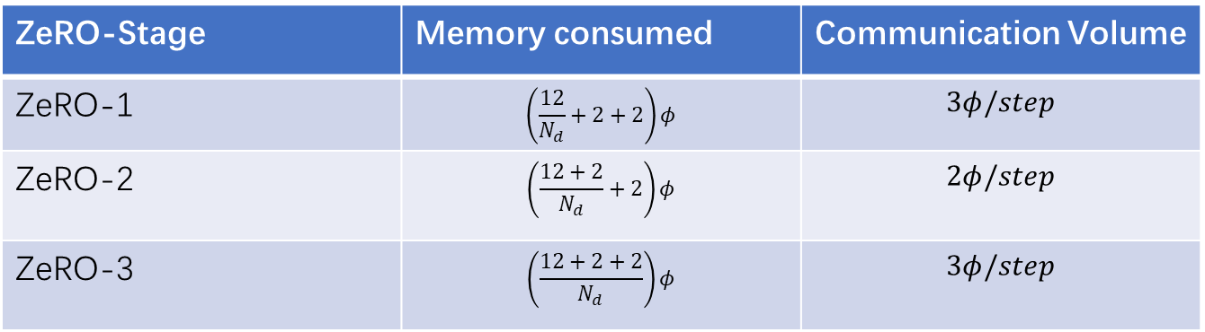
Deepspeed-ZeRO-3
Fp32 optimizer state
Fp16 weight
All Gather
Fp16 gradient
Reduce-Scatter
ZeRO-Stage | Memory consumed | Communication Volume
ZeRO-1 | $$\left(\frac{12}{N_{d}}+2+2\right)φ$$ | $$3φ/step$$
ZeRO-2 | $$\left(\frac{12+2}{N_{d}}+2\right)φ$$ | $$2φ/step$$
ZeRO-3 | $$\left(\frac{12+2+2}{N_{d}}\right)φ$$ | $$3φ/step$$

Slide 18
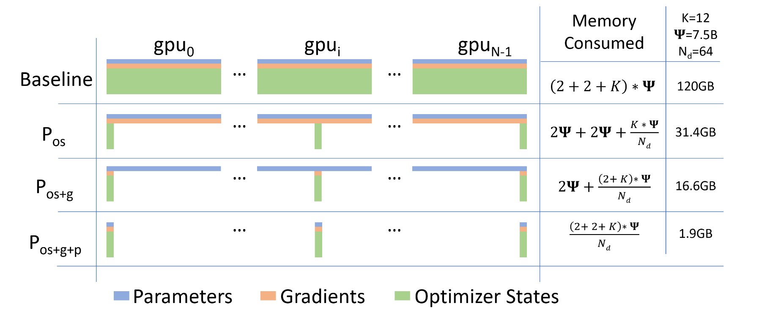
Deepspeed-ZeRO-3

Slide 19
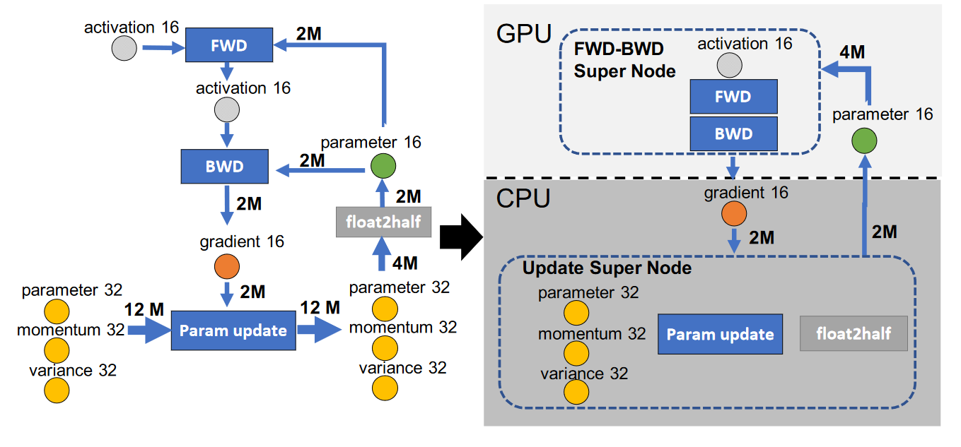
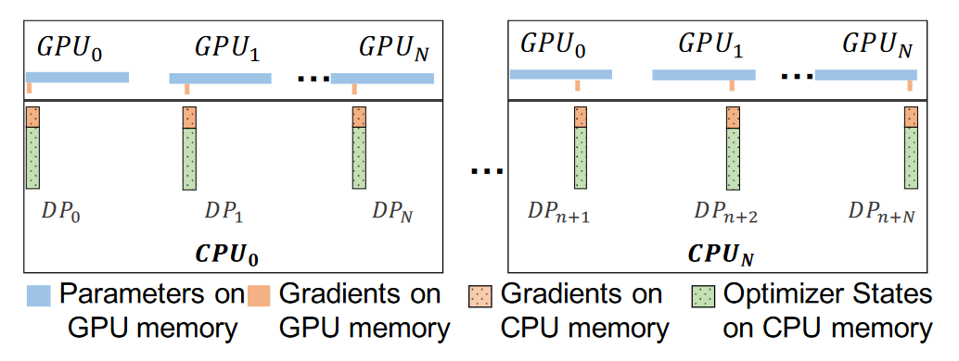
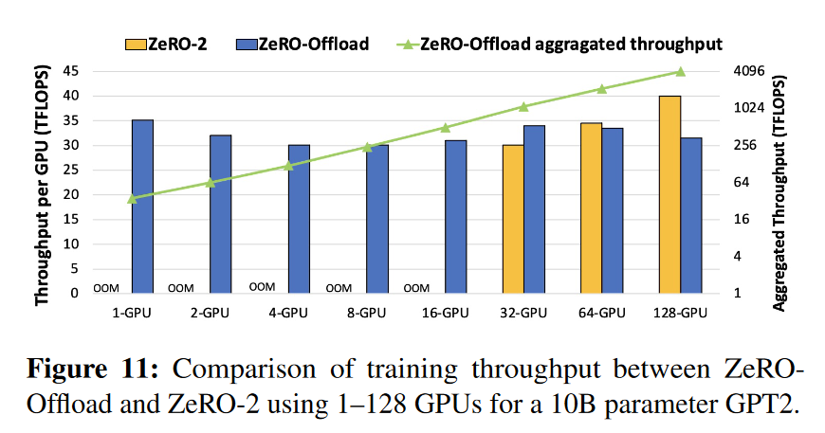
Deepspeed-ZeRO-Offload
$$O\left(Bφ\right)≫O(ϕ)$$

Slide 20
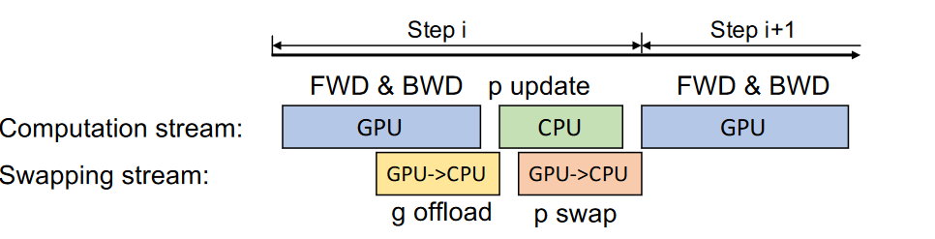
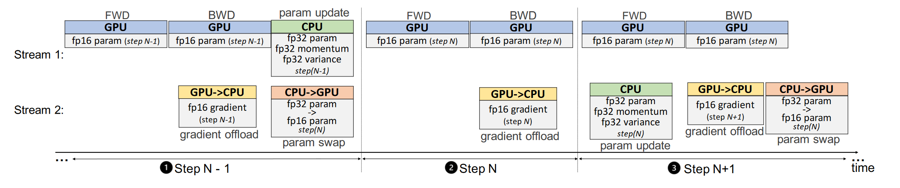
Deepspeed-ZeRO-Offload

Slide 21
Deepspeed-ZeRO-Offload

Slide 22
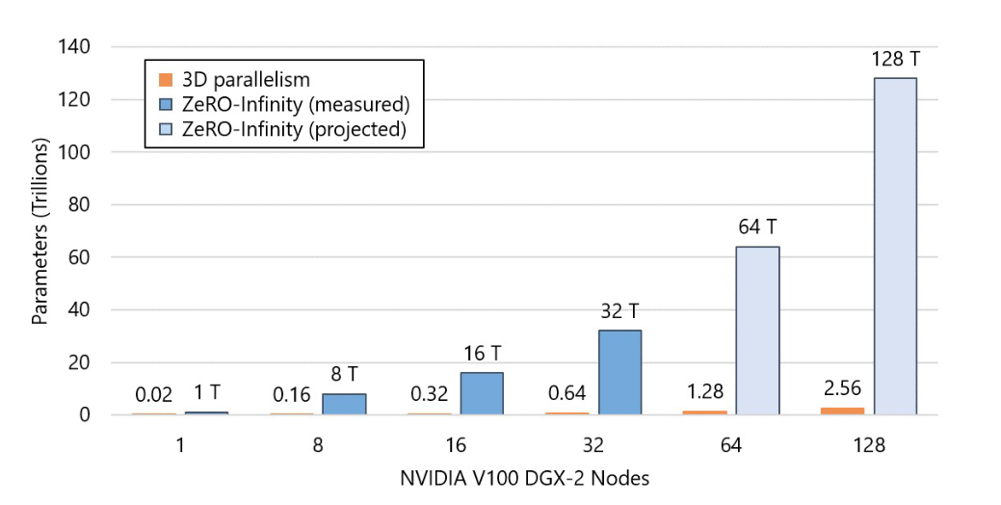
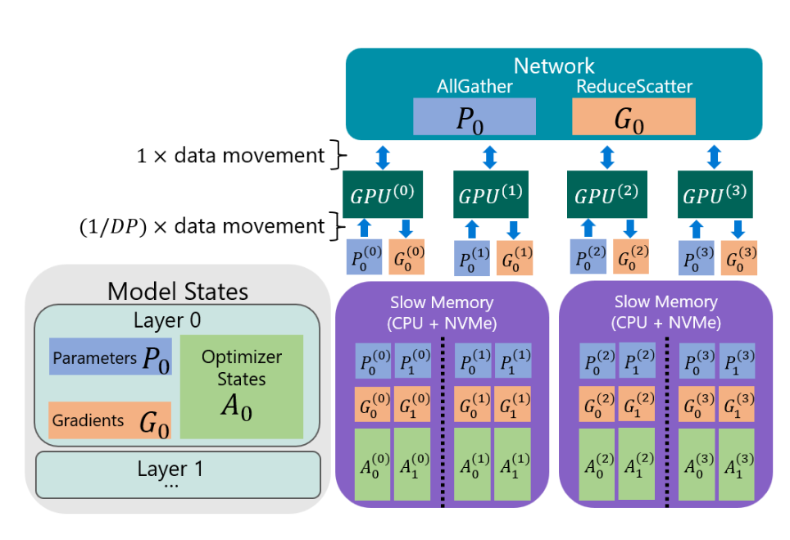
Deepspeed-ZeRO-Infinity
Memory Defragmentation
Overlap Centric Design
Operator Break down

Slide 23
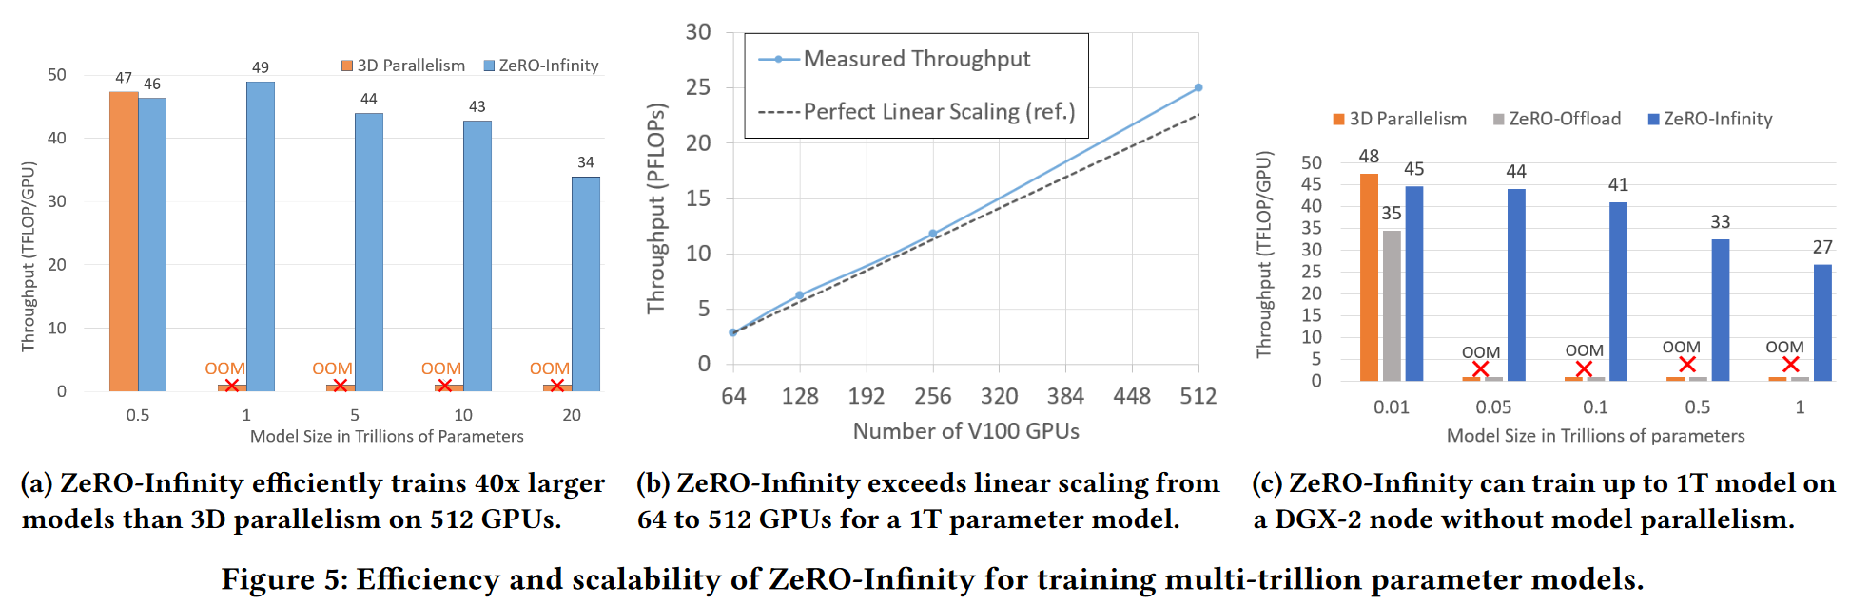
Deepspeed-ZeRO-Infinity

Slide 24
Thanks For Listening ! ! !

