Slide 2
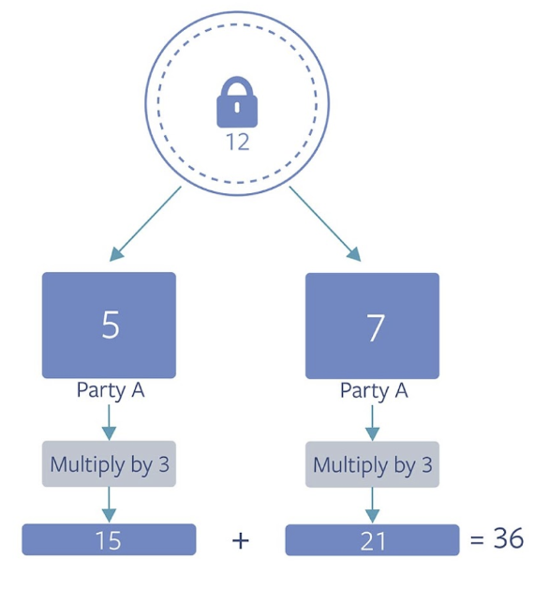
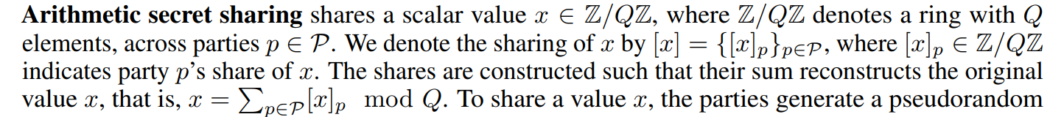
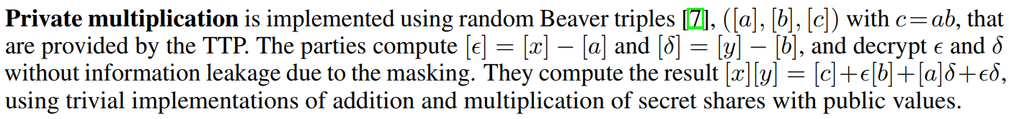

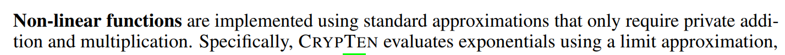
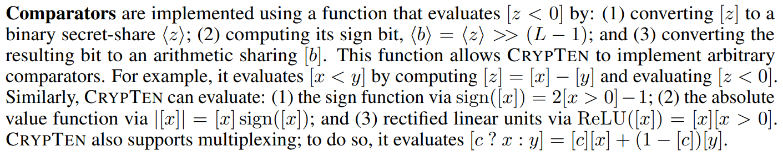




Secret sharing
$$x={\left[x\right]}_{1}+{\left[x\right]}_{2}$$
$$y={\left[y\right]}_{1}+{\left[y\right]}_{2}$$
$${\left[ax+by\right]}_{P}=a{\left[x\right]}_{P}+b{\left[y\right]}_{P}$$
Multi-party computation
Linear:
Homomorphic encryption
Secret sharing
Non-linear:
Secret sharing
Garbled circuit
Oblivious transfer
$xy=({\left[x\right]}_{1}+{\left[x\right]}_{2})$(${\left[y\right]}_{1}+{\left[y\right]}_{2}$)

Slide 3
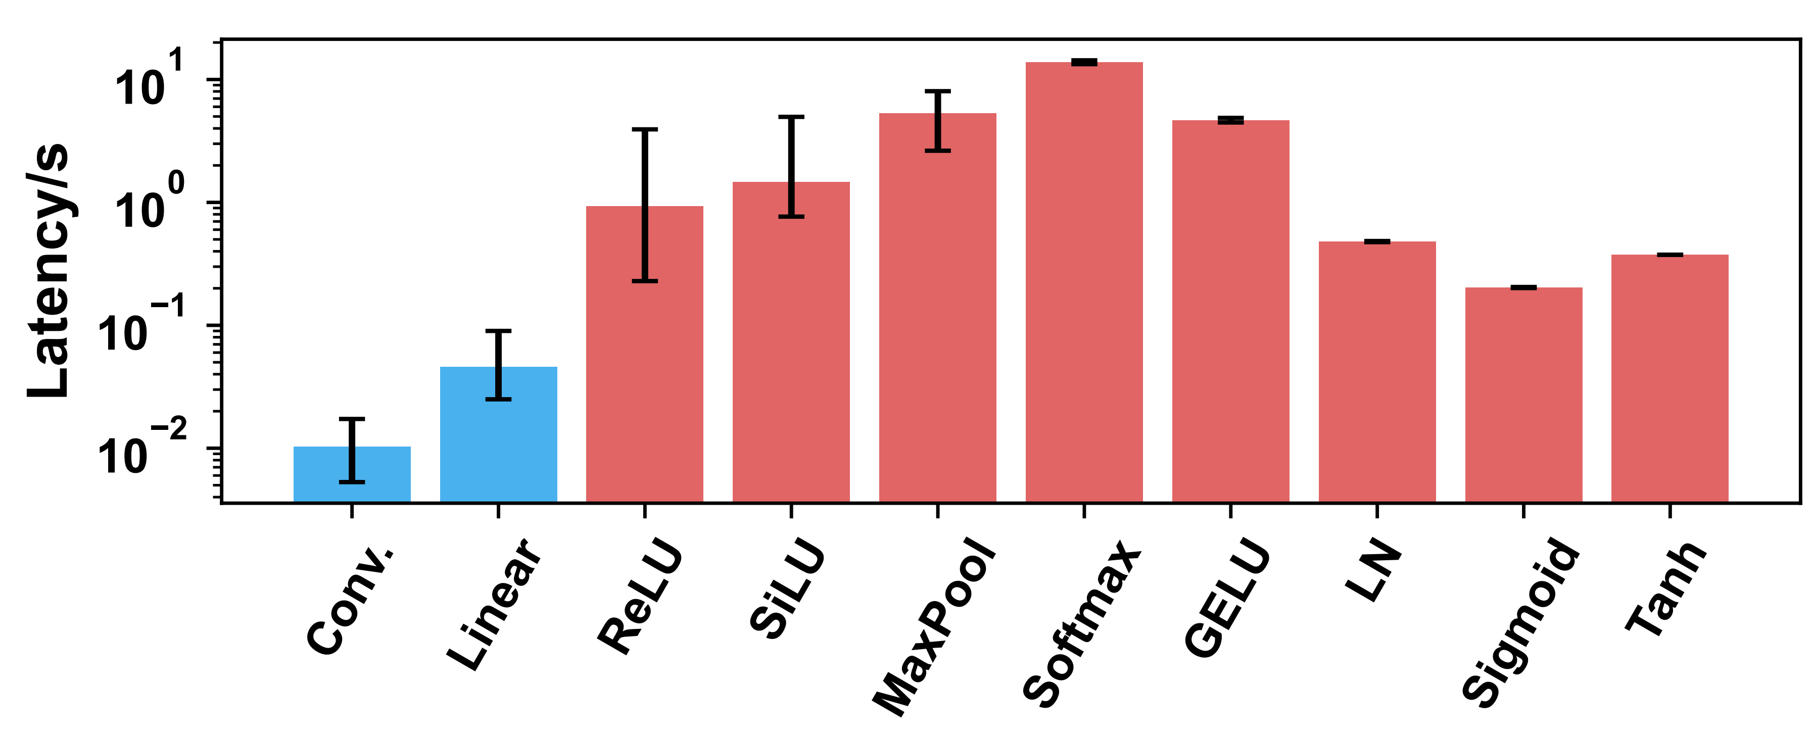














Evaluate Linear and Non-linear layers
$${\left[\text{x}\right]}_{S}$$
$${\left[\text{y}\right]}_{S}$$
$${\left[\text{x}\right]}_{S}$$
Server
$${\left[\text{W}\right]}_{S}$$
$${\left\langle \text{y}\right\rangle }_{S}$$
$${\left\langle {\text{y}}_{MSB}\right\rangle }_{S}$$
$${\left[y_{MSB}\right]}_{S}$$
$${\left[\text{x}\right]}_{C}$$
$${\left[\text{y}\right]}_{C}$$
$${\left[\text{x}\right]}_{C}$$
Client
$${\left[\text{W}\right]}_{C}$$
$${\left\langle \text{y}\right\rangle }_{C}$$
$${\left\langle {\text{y}}_{MSB}\right\rangle }_{C}$$
$${\left[y_{MSB}\right]}_{C}$$
Linear
ReLU
Machine Learning as a Service (MLaaS)
Client: input data; Server: model and datasets
Computation process: Perfect protection on the both sides.
Computation result: black-box attack on model weights or datasets
Model extraction attack
Adversarial attack
Member inference attack
Property inference attack
Model inversion attack

Slide 4




Three types of private inference
Linear op.
Non-linear op.
Aggr. op.
Outsourced Op.
SMG outsourced Op.
Server
Client
Server
Client
Server
Client
(a) Fully encrypted private inference(FEPI).
(b) Partially encrypted private inference(PEPI).
(c) Adequately encrypted private inference(AEPI).

Slide 5





Fully encrypted PI
Non-linear operators are at least one magnititude slower.
Partially encrypted PI
Revealed information are strong connected with the private information.—weaken the connection
Revealed information are easy to perform attack.—disturb the revealed information
$$\left[\begin{matrix}\text{1}\text{.3} \\ \text{0.6}\end{matrix} \begin{matrix}\text{−}\text{0.4} \\ \text{0.9}\end{matrix}\right]$$
Surrogate Model
$$\left[\begin{matrix}\text{1} \\ \text{0}\end{matrix} \begin{matrix}\text{0} \\ \text{1}\end{matrix}\right]$$
$$\left[\begin{matrix}\text{1}\text{.3} \\ \text{0.6}\end{matrix} \begin{matrix}\text{−}\text{0.4} \\ \text{0.9}\end{matrix}\right]$$
$$\left[\begin{matrix}\text{0}\text{.2} \\ \text{−0.5}\end{matrix} \begin{matrix}\text{0}\text{.8} \\ \text{0.6}\end{matrix}\right]$$
Linear
ReLU
Linear
ReLU
Linear
ReLU
Linear
ReLU
$$\left[\begin{matrix}\text{0}\text{.5} \\ \text{0.2} \\ \text{0.3}\end{matrix}\right]$$
New attack that leaks the exact model
Enhance existing attacks

Slide 6
Adequate privacy goal
Adequate Privacy Goal: The information allowed revealing during the inference include:
Model architecture
Inference results
Intermediate activations that satisfy the following conditions
(Weaken the connection) The input and the output of any operator with private weights must not be both revealed to the client.
(Disturb the revealed information) Before revealing to the client, the activation is subject to row-wise and column-wise shuffling.

Slide 7
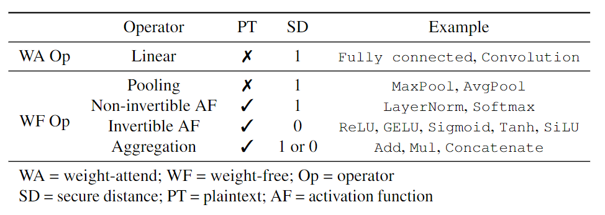




Secure micro-graph (SMG)
X
$$[Y]$$
$$X^{′}$$
Linear
WF-op
Linear
WF-op
Secure distance regularization—condition1
Position encryption—condition2
X
$$[Y]$$
$$X^{′}$$
Linear
Aggr.
WF-op
Secure distance regularization
Only non-invertible computation contributes to the isolation of the dataflow.
Define the secure distance as the isolation property
Condition1==secure distance > 1
Notes:
残差可能来自别的micrograph输出，也可能是某个micrograph内部的密文

Slide 8








Secure micro-graph (SMG)
X
$$[Y]$$
$$X^{′}$$
Linear
WF-op
Linear
WF-op
Secure distance regularization—condition1
Position encryption—condition2
X
$$[Y]$$
$$X^{′}$$
Linear
Aggr.
WF-op
Position encryption
Other cryptographic primitive (HE) encrypts the activation vector-wise.
Reorder the ciphertext requires the rotation, very expensive!
Implemented across the SMGs.
The order recovery applies to the weight tensor.
[X]
$${\text{π}}_{l}\text{X}{\text{π}}_{r}$$
$$\text{h}\text{(}{\text{π}}_{l}\text{X}{\text{π}}_{r}\text{)}$$
$$\text{h}\text{(}{\text{π}}_{l}\text{X}\text{)}$$
Linear
$$\text{Wh}\text{(}\text{X}\text{)}$$
WF-op
$$\text{S}\text{→}\text{C}$$
$$\text{C}\text{→}\text{S}$$
$${\text{SecGraph}}_{i}$$
$${\text{SecGraph}}_{i+1}$$

Slide 9
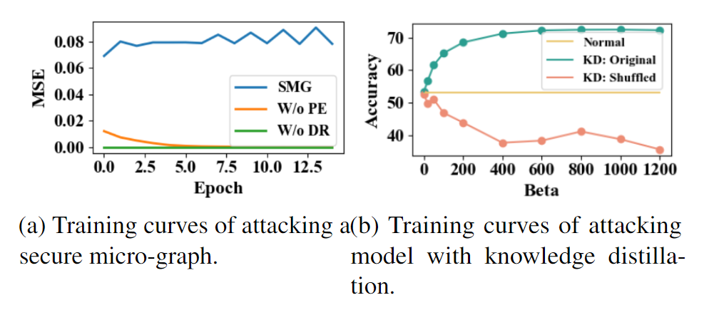
Adequate privacy goal
Adequate Privacy Goal: The information allowed revealing during the inference include:
Model architecture
Inference results
Intermediate activations that satisfy the following conditions
The input and the output of any operator with private weights must not be both revealed to the client.
Before revealing to the client, the activation is subject to row-wise and column-wise shuffling.

Slide 10
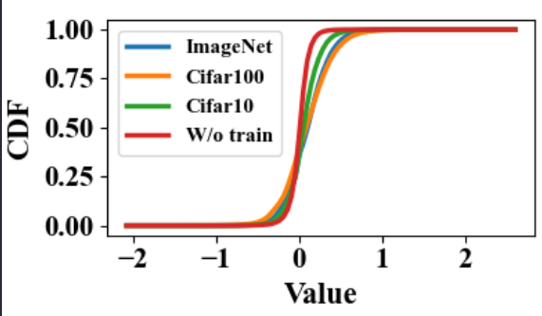
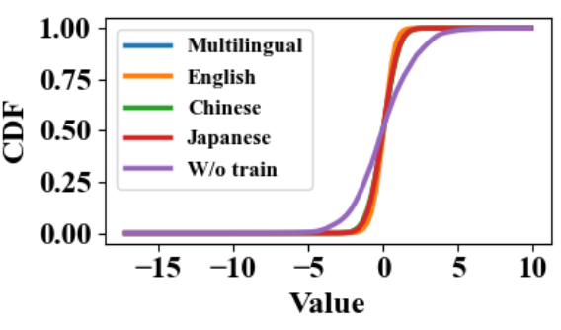
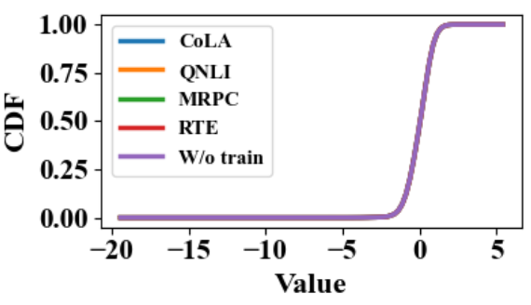
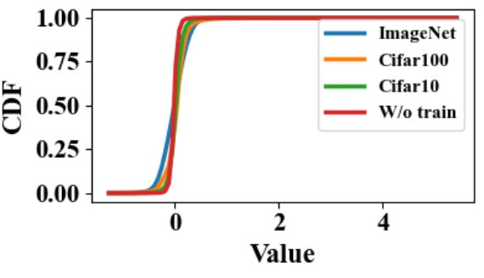
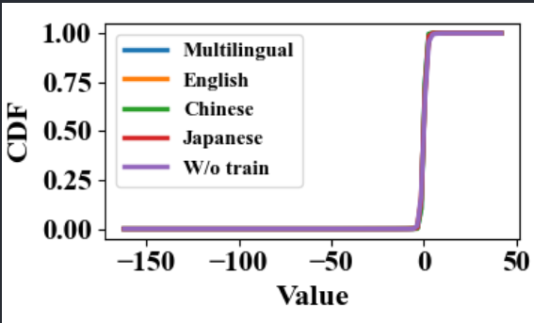
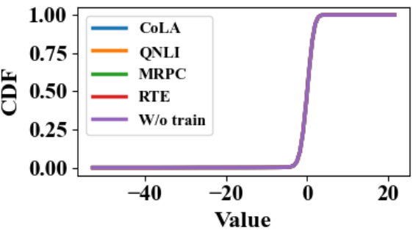
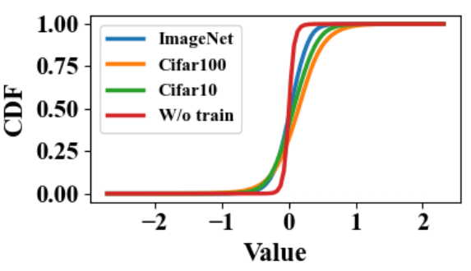
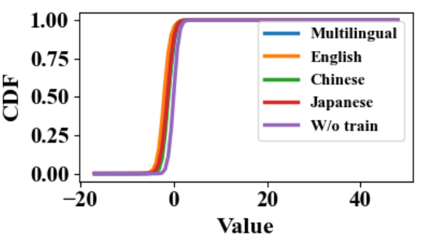
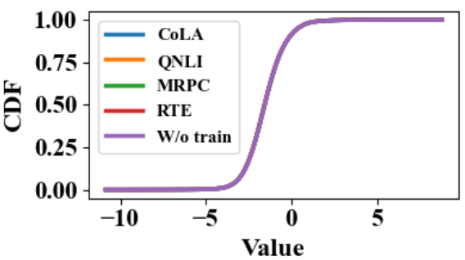
Adequate privacy goal
Prevent known attacks, but for future potential risks…
Consider the what information the client can obatin.
ResNet-50
Pretrained BERT
Finetuned BERT

Slide 11




Generate a SMG partition plan
Maximize the latency reduction while satisfy the distance regularization
ReLU
256*56*56
Addition
Conv.
ReLU
384*28*28
Conv.
ReLU
256*28*28
$$\text{[}\text{X}\text{]}$$
$\text{Conv}$.
ReLU
128*56*56
$\text{Conv}$.
ReLU
256*56*56
Conv.
ReLU
256*28*28
DAG structure
Global view
Notes:
下边是更好的例子，greedy：256*56*56+512*28*28=1,204,224。 Optimal：384*56*56+512*28*28=1,605,632
256,128

Slide 12
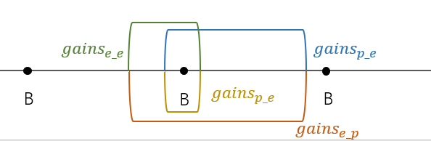



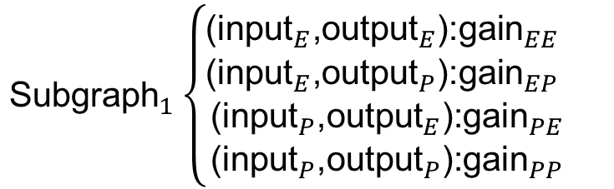


Subgraph partition and candidates
$${\text{Subgraph}}_{1}$$
$${\text{Subgraph}}_{2}$$
$${\text{Subgraph}}_{3}$$
$$\text{P}\text{/}\text{E}$$
$$\text{P}\text{/}\text{E}$$
${\text{Subgraph}}_{1}\left\{\begin{aligned}{\text{(}\text{input}}_{E}\text{,}{\text{output}}_{E}\text{):}{\text{gain}}_{EE} \\ {\text{(}\text{input}}_{E}\text{,}{\text{output}}_{P}\text{):}{\text{gain}}_{EP} \\ {\text{(}\text{input}}_{P}\text{,}{\text{output}}_{E}\text{):}{\text{gain}}_{PE} \\ {\text{(}\text{input}}_{P}\text{,}{\text{output}}_{P}\text{):}{\text{gain}}_{PP}\end{aligned}\right.$
Notes:
weak model
乘法

Slide 13






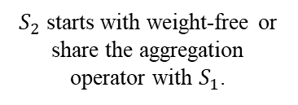



Global optimal choice of candidates
Transform to the non-overlapping interval problem.
The non-overlapped intervals guarantee the security requirements.
The maximal gain found corresponds to the maximal latency reduction
 | $B_N$ | $B_L$ | $B_A$
$B_A$ | 1 | 2 | 1
P
2
P
1
E
E
$${\text{S}}_{2}$$
$${\text{S}}_{2}$$
$${\text{S}}_{1}$$
P
$${\text{S}}_{1}$$
E
E
P
$S_{2}$ starts with weight-free or share the aggregation operator with $S_{1}$.
$S_{2}$ starts with weight-attend operator.
$${gains}_{e_e}$$
$${gains}_{p_e}$$
B
B
B
$${gains}_{p_e}$$
B
B
$${gains}_{e_p}$$
Notes:
这个表除了any+pool+linear+block(any)这种特殊的没有，其他都包括了

Slide 14
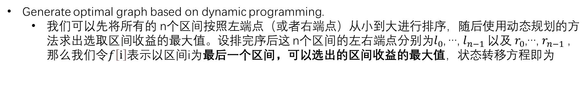


Subgraph partition and candidates
Generate optimal graph based on dynamic programming.
我们可以先将所有的 n个区间按照左端点（或者右端点）从小到大进行排序，随后使用动态规划的方法求出选取区间收益的最大值。设排完序后这 n个区间的左右端点分别为$l_{0}$, …, $l_{n−1}$以及 $r_{0}$,…, $r_{n−1}$，那么我们令$f\left[ⅈ\right]$表示以区间i为最后一个区间，可以选出的区间收益的最大值，状态转移方程即为
$$f\left[ⅈ\right]=gains\left[i\right]+\max_{j<i ∧ r_{j}<l_{i}}{f[j]}$$
$${gains}_{i}$$
block
$${gains}_{e_e}$$
$${gains}_{p_e}$$
B
B
B
$${gains}_{p_e}$$
B
B
$${gains}_{e_p}$$

Slide 15
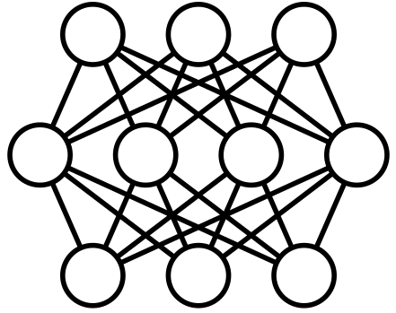









System overview
Offline Stage
Inference Stage
Encrypted
model
Input
Extractor
Subgraph partitioner
$${\text{S}\text{MG}}_{1}$$
$${\text{WF} \text{Op}}_{1}$$
$${\text{WF} \text{Op}}_{1}$$
subgraphs
+
gains
MPC encryptor
Model
$${\text{S}\text{MG}}_{2}$$
E/P Time
Optimal
graph
$${\text{WF} \text{Op}}_{2}$$
$${\text{WF} \text{Op}}_{2}$$
Profiler
Global scheduler
Position encryptor
$${\text{S}\text{MG}}_{n}$$
SD-aware
plan generator
Encryptor
Output
$${\text{WF} \text{Op}}_{n}$$
Server
Server
Client
Processing flow
Inference dataflow

Slide 16
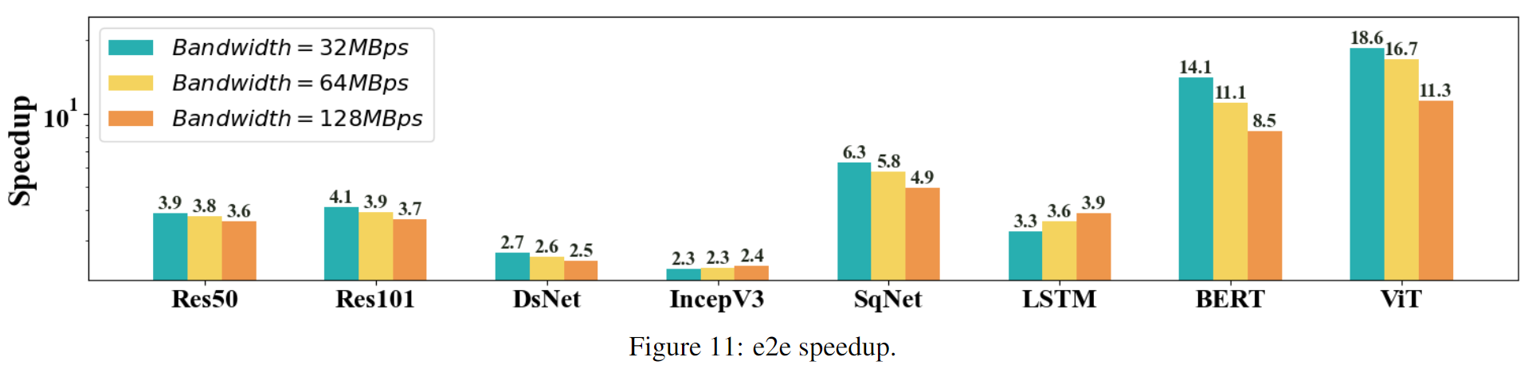
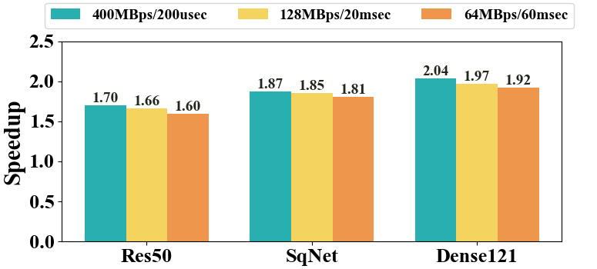
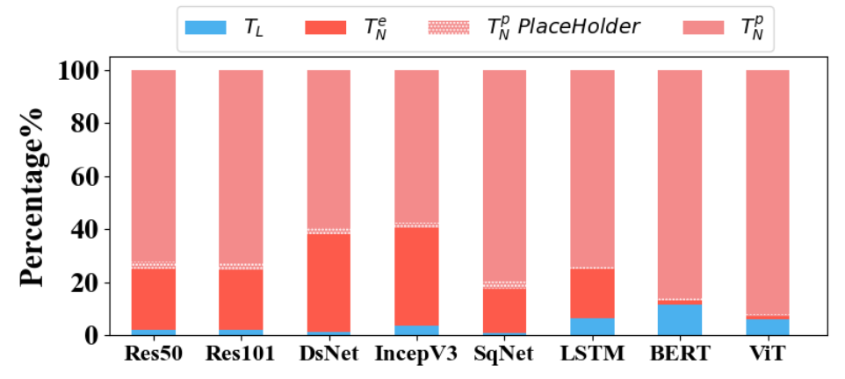
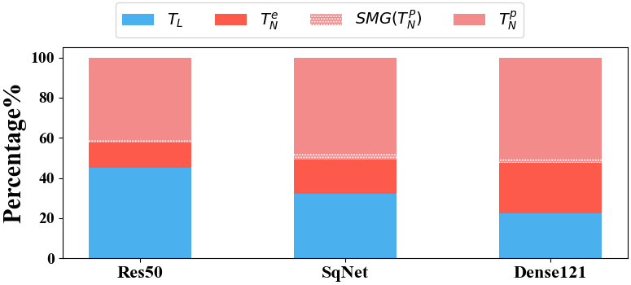


Speedup compared with Crypten/Cheetah
$$Crypten$$
$$Cheetah$$

Slide 17
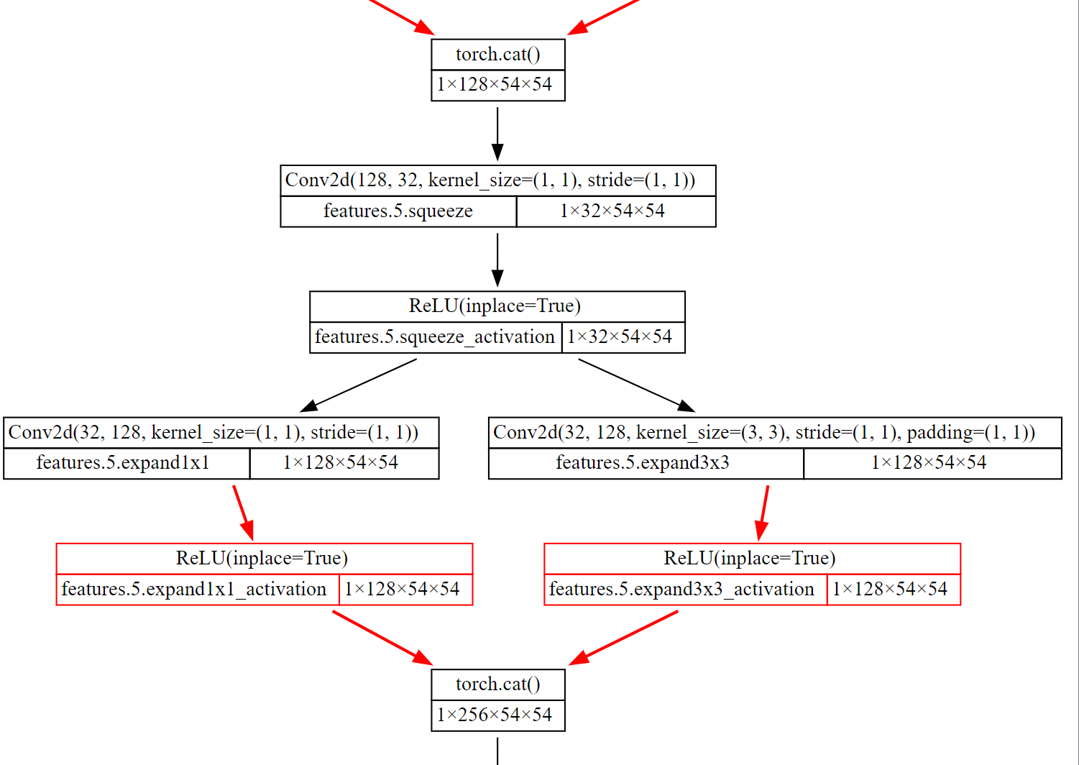
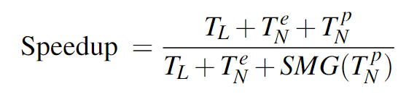
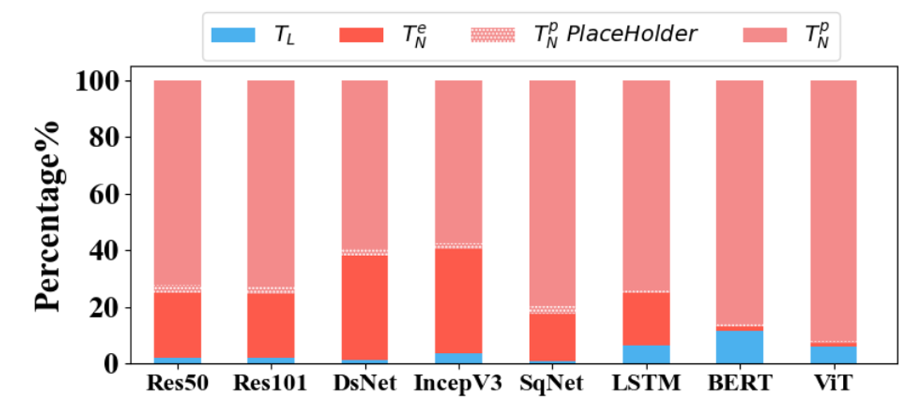
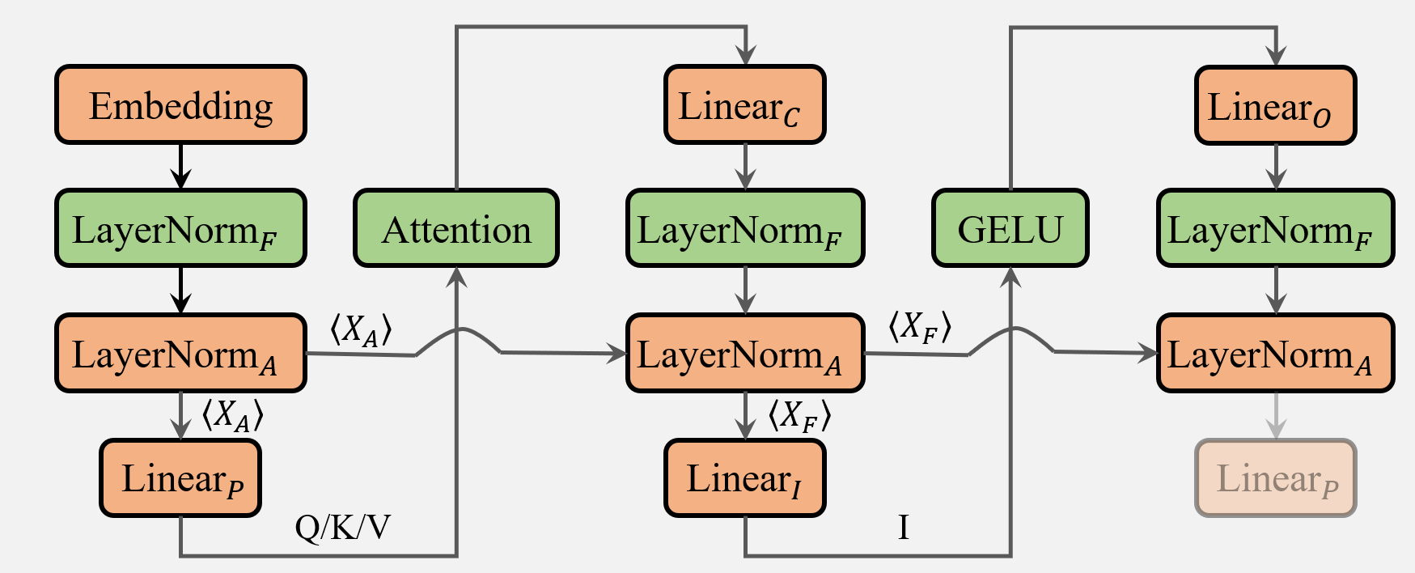


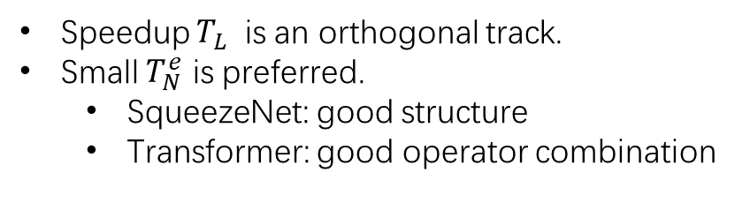
Speedup compared with Crypten
$$SqueezeNet$$
Speedup $T_{L}$ is an orthogonal track.
Small $T_{N}^{e}$ is preferred.
SqueezeNet: good structure
Transformer: good operator combination
$$BERT/ViT$$

Slide 18




Cat
Conv
Conv
Conv
AvgPool
ReLU
ReLU
Conv
$$\text{Conv}$$
$$\text{Conv}$$
Conv
ReLU
ReLU
ReLU
Cat
$$\text{Conv}$$
$$\text{Conv}$$
ReLU
ReLU
ReLU
Cat
ReLU
Cat
Notes:
weak model
乘法

Slide 19

















$${\text{Linear}}_{O}$$
$${\text{Linear}}_{C}$$
$${\text{Linear}}_{O}$$
Embedding
$${\text{LayerNorm}}_{F}$$
Attention
$${\text{LayerNorm}}_{F}$$
GELU
$${\text{LayerNorm}}_{F}$$
$$\text{N}×$$
Encoder
$${\text{LayerNorm}}_{A}$$
$$\left\langle X_{A}\right\rangle$$
$${\text{LayerNorm}}_{A}$$
$$\left\langle X_{F}\right\rangle$$
$${\text{LayerNorm}}_{A}$$
Classifier
$$\left\langle X_{A}\right\rangle$$
$$\left\langle X_{F}\right\rangle$$
$${\text{Linear}}_{P}$$
$${\text{Linear}}_{I}$$
$${\text{Linear}}_{P}$$
Q/K/V
I
Notes:
weak model
乘法

Slide 20















Embedding
$${\text{Linear}}_{C}$$
$${\text{Linear}}_{O}$$
$${\text{LayerNorm}}_{F}$$
Attention
$${\text{LayerNorm}}_{F}$$
GELU
$${\text{LayerNorm}}_{F}$$
$${\text{LayerNorm}}_{A}$$
$$\left\langle X_{A}\right\rangle$$
$${\text{LayerNorm}}_{A}$$
$$\left\langle X_{F}\right\rangle$$
$${\text{LayerNorm}}_{A}$$
$$\left\langle X_{A}\right\rangle$$
$$\left\langle X_{F}\right\rangle$$
$${\text{Linear}}_{P}$$
$${\text{Linear}}_{I}$$
$${\text{Linear}}_{P}$$
Q/K/V
I
Notes:
weak model
乘法

Slide 21




















$$Q$$
$$w_{Q}$$
WF-op
$$P$$
$$Softmax\left(\frac{QK^{T}}{\sqrt{d_{K}}}\right)$$
$$X$$
$$K$$
$$A$$
$$w_{K}$$
$$PV$$
$$w_{o}$$
$$⊕$$
$$Layer$$
$$Norm.$$
$$V$$
$$w_{V}$$
Attention Module
$$X$$
WF-op
$$w_{hs}$$
$$GELU$$
$$w_{hc}$$
$$⊕$$
$$Layer$$
$$Norm.$$
FFN Module

