Slide 1
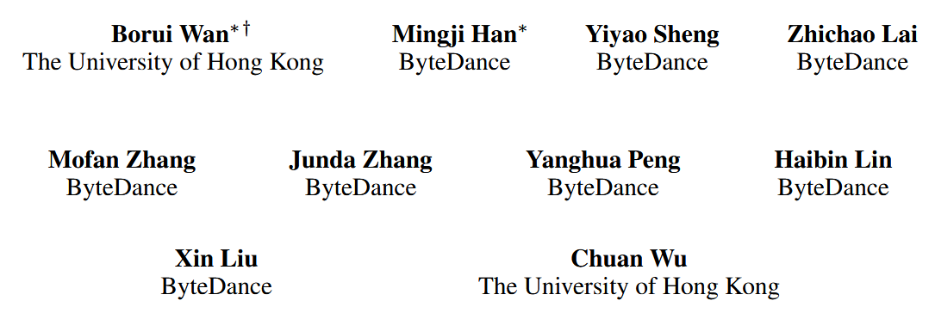
ByteCheckpoint: A Unified Checkpointing System for LLM Development

Slide 2
Outline
Introduction
Challenges of Checkpointing
Related Work
System Design
Performance Optimization Techniques
Evaluation

Slide 3
Introduction
Parallelism in training
pipeline parallel
tensor parallel
data parallel

Slide 4
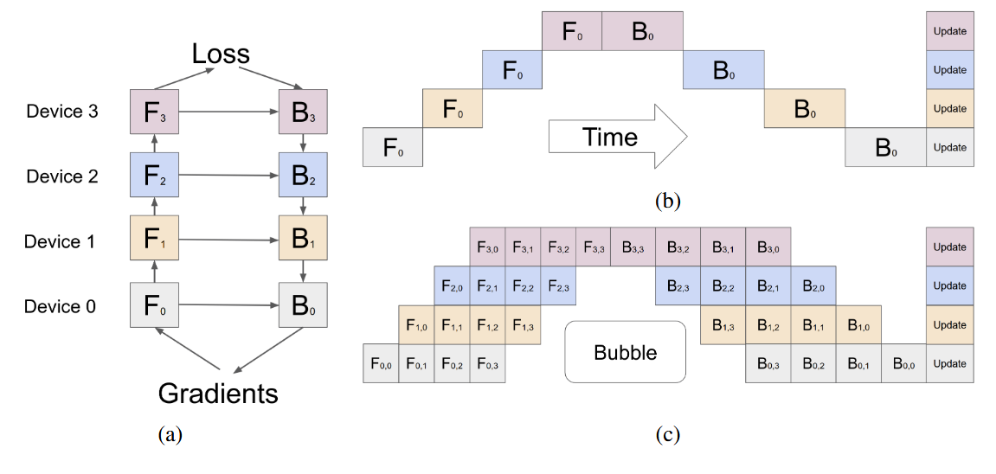
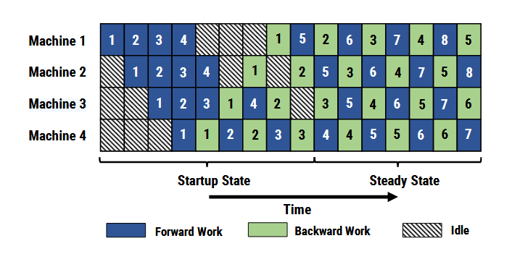
Pipeline parallel
Gpipe
model para + data para
microbatch
sync gradient
re-materialization
segmentation problem
PipeDream
async gradient
dynamic segmentation
weight stashing

Slide 5
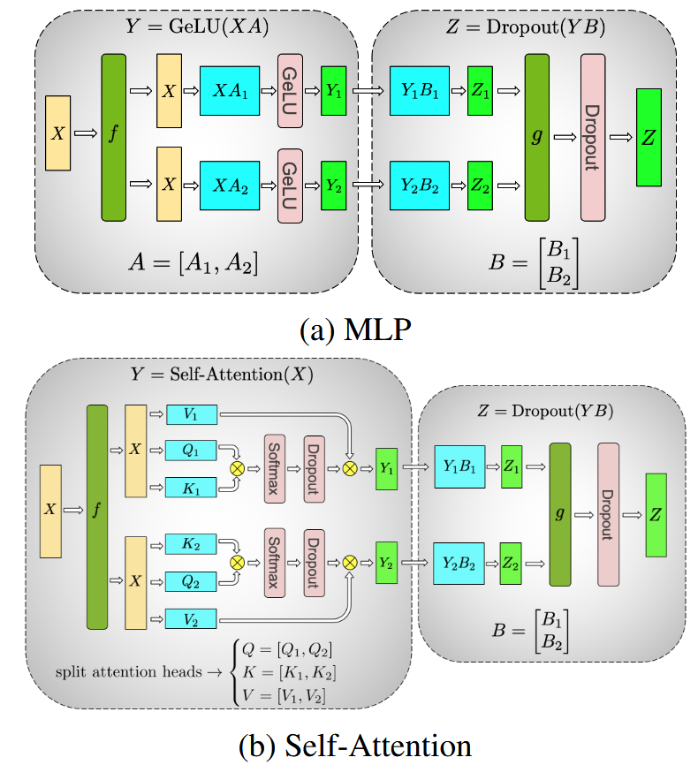
Tensor parallel
Megatron-LM
different matrix segmentation in different layers
MLP column, Attn row (hidden dimension)
only need 2 all-reduce in Z
need to communicate the output in every layer
can not parallel the compution and communication

Slide 6
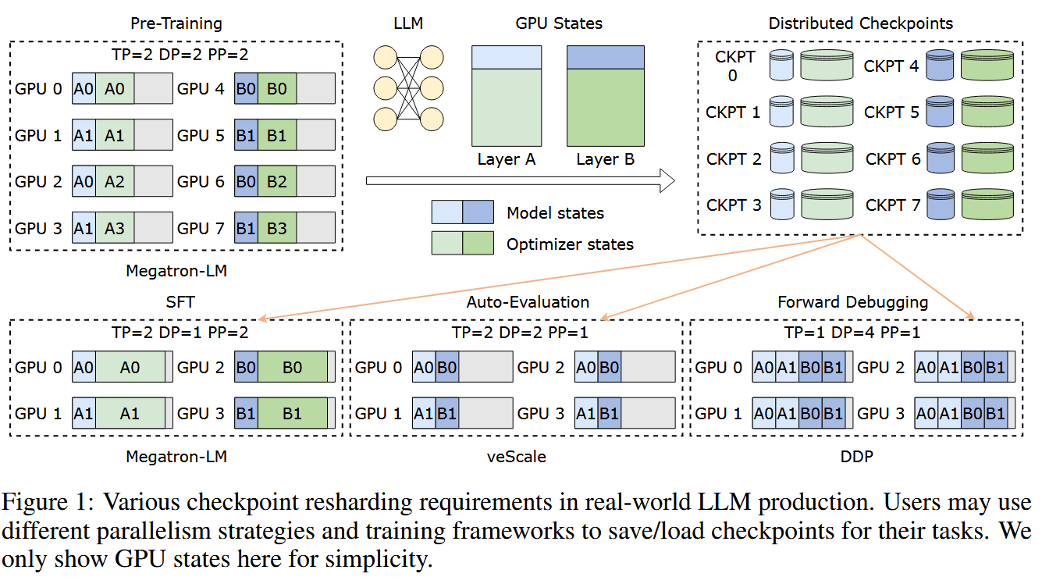
Instruction
There is a consistent need for checkpoint resharding
In the industry platforms, engineers often choose different training frameworks (e.g., Megatron-LM for efficient large-scale distributed training, PyTorch DDP for simple single-node model debugging) and save checkpoints in the storage systems.
Notes:
, defined as saving distributed checkpoints with certain parallelism strategies and configurations but loading them into different ones

Slide 7
Challenge of checkpointing
High I/O cost of checkpoint saving and loading
Poor performance, flexibility, and scalability of offline scripts
High development cost for multi-framework support

Slide 8
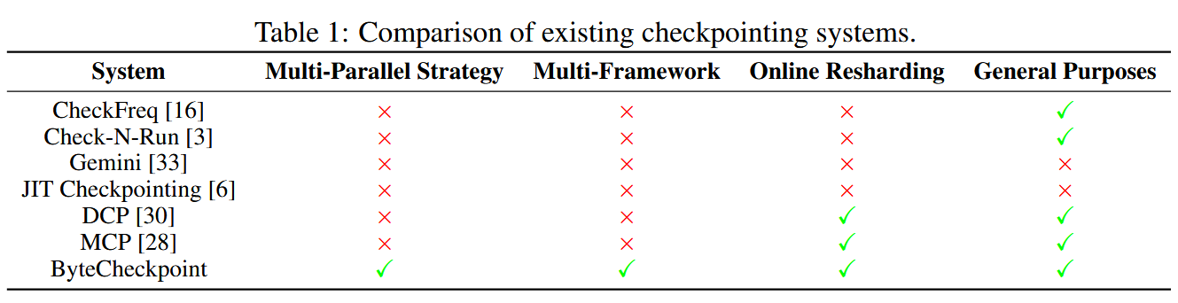
Related work
Checkpointing without online resharding
Check-N-Run, CheckFreq,Gemini, JIT Checkpointing
Checkpointing with online resharding
DCP,MCP

Slide 9
ByteCheckpoint
Save the entire training state in the selected storage backend
Efficient automatic online checkpoint resharding
Compatible with multiple training frameworks
Provide 2 simple APIs to simplify integration
Optimized IO perfomance with 529.22 times in saving and 3.51 times in loading
Ensure the stability and efficiency of large-scale training

Slide 10
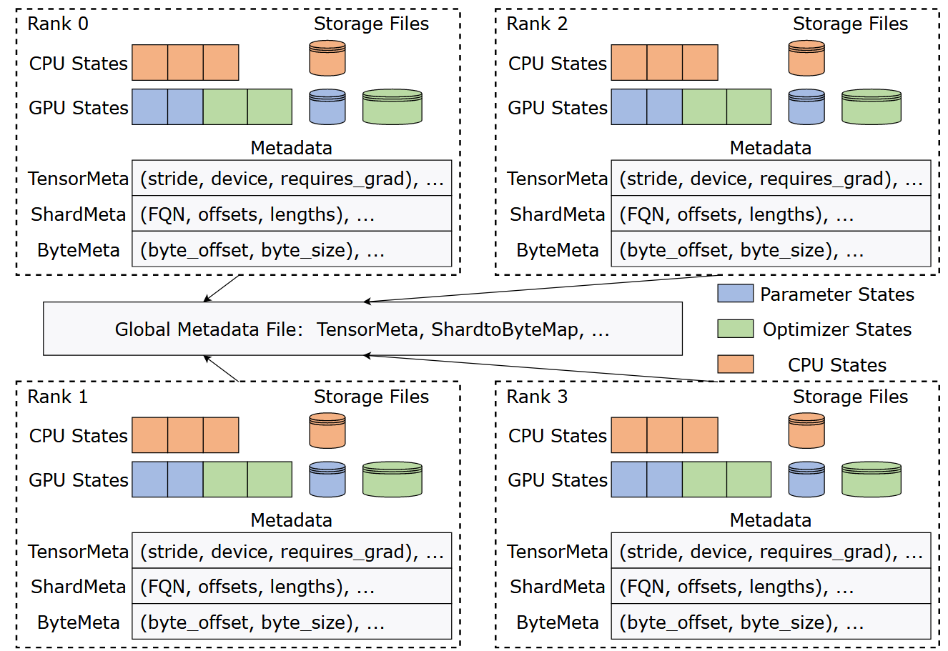
System Design - auto online resharding
Auto online checkpoint resharding
separate the storage of checkpoint data and the metadata files
disaggregate checkpoints from parallelism settings and training frameworks
TensorMeta: basic information of individual tensor shards
ShardMeta: records the relative position information of tensor shards from a global view
ByteMeta:records the byte start offset and length of each tensor shard within the storage files
Use ShardMeta and ByteMeta to establish a mapping between saved tensor shards and storage files.(ShardtoByteMap)

Slide 11
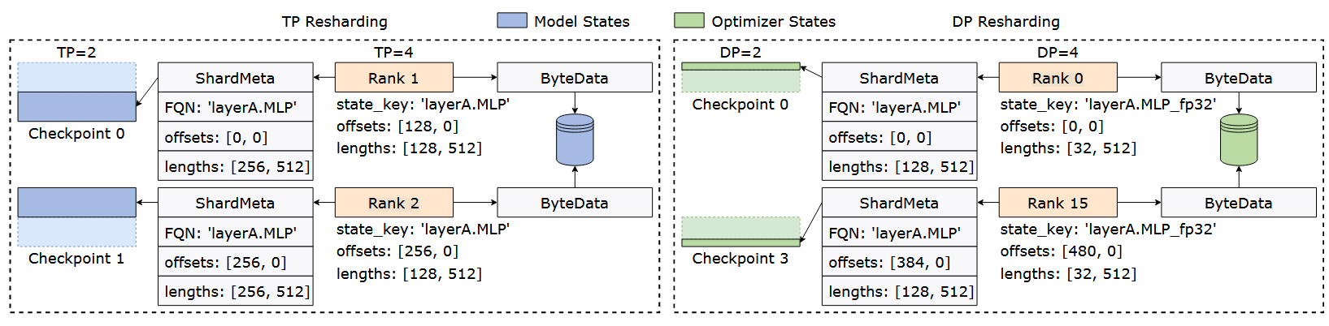
System Design - auto online resharding
Each process will run a resharding algorithm to identify the matching parts between the saved tensor shard and the currently instantiated tensor shard
Retrieve the corresponding values in the storage file, restoring the final runtime state of the tensor shard.

Slide 12
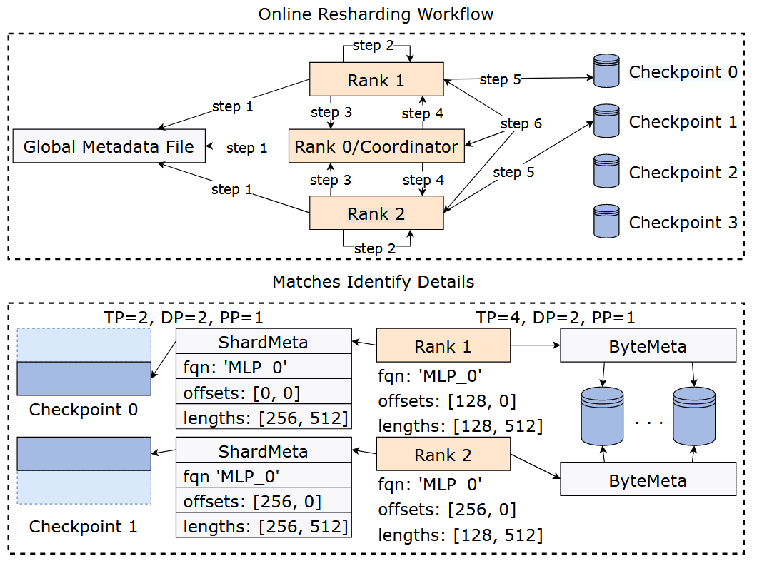
System Design - resharding workflow

Slide 13
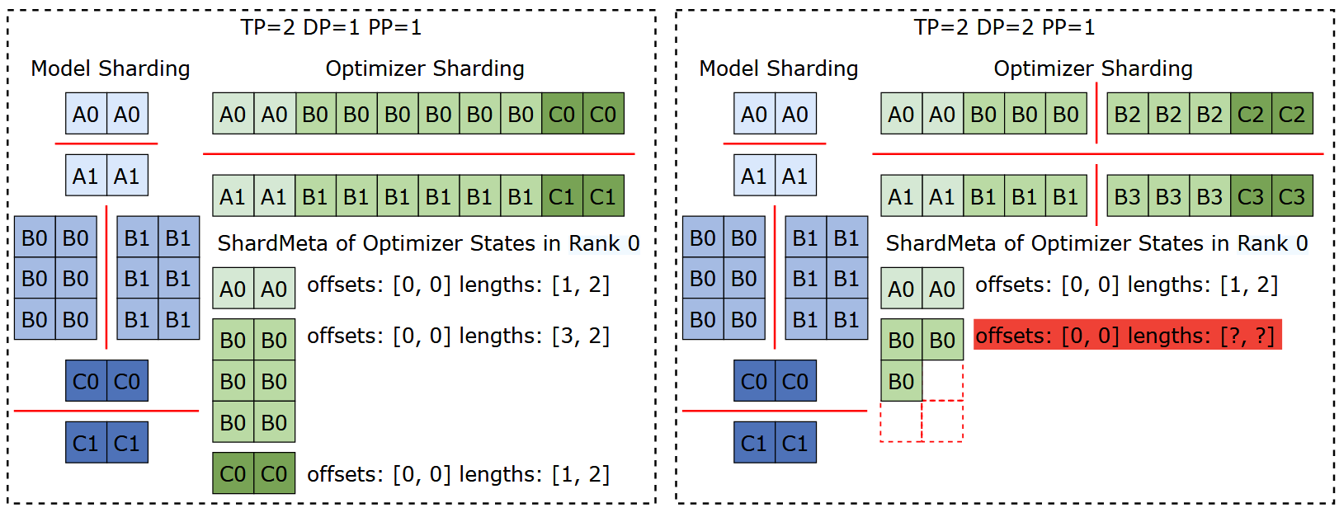
System Design - settle irregular tensor sharding
Training Frameworks modify the original shape of tensors
Irregular tensor cannot be represented as (FQN, offset, length)
ByteCheckpoint proposes asynchronous tensor merging
Identify all irregular tensor slices
Asynchronous P2P communication to collect slices and integrate them into regular slices without blocking the default workflow
Use the Worst Fit algorithm to allocate irregular tensor slices between processes.

Slide 14
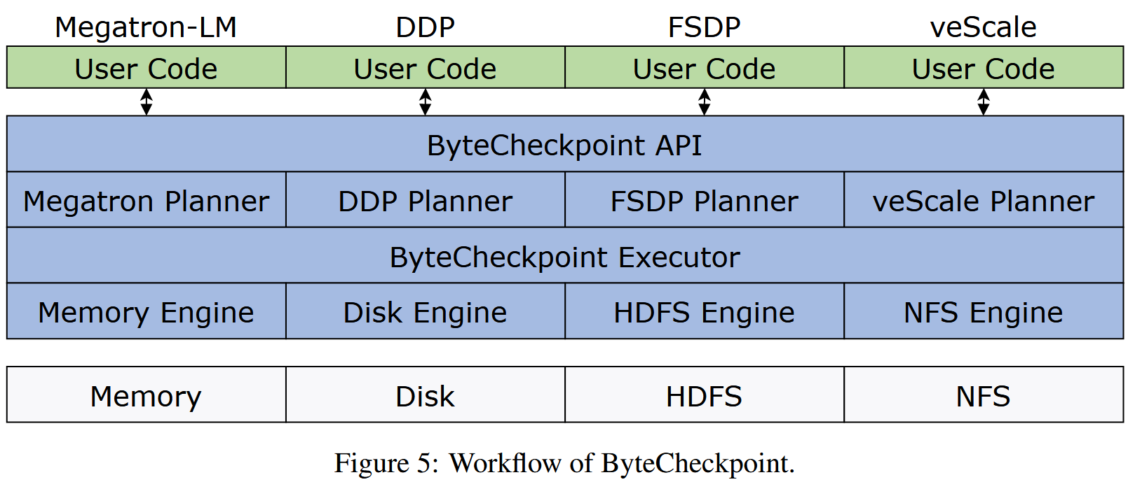
System Design - checkpoint workflow

Slide 15
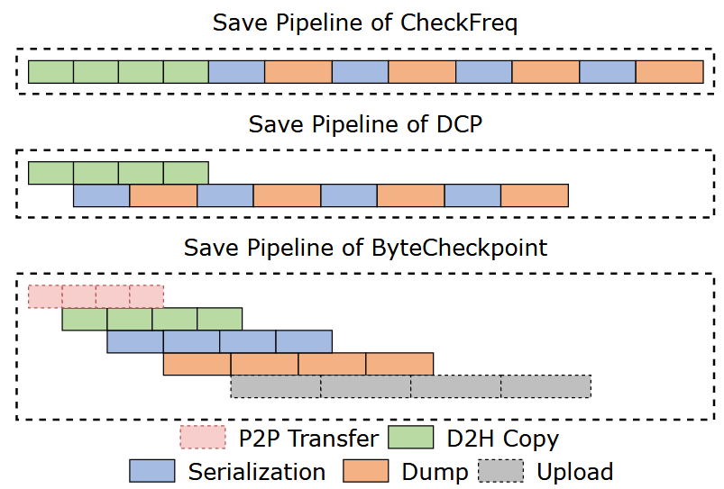
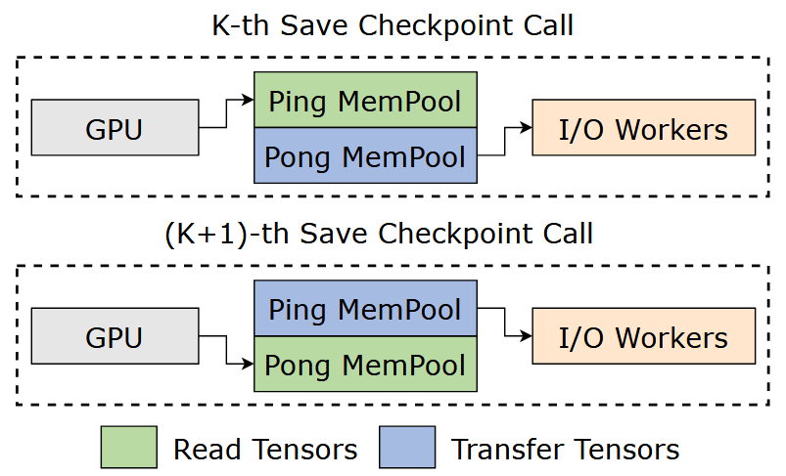
System Design - Saving Optimizations
Fully asynchronous pipeline
Ping-Pong pinned memory pool
Workload balancing
Plan and metadata cache

Slide 16
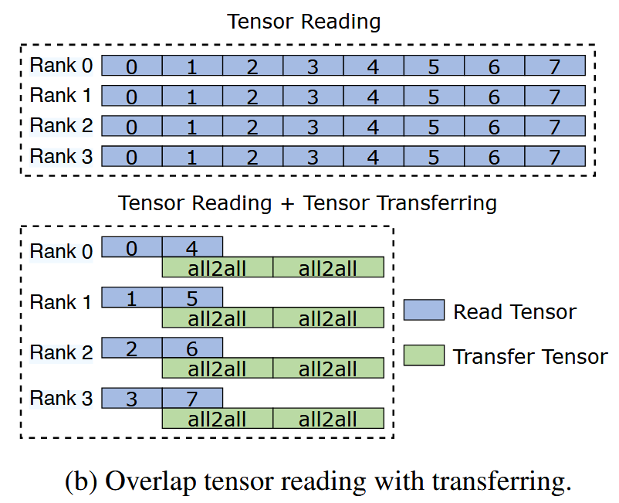
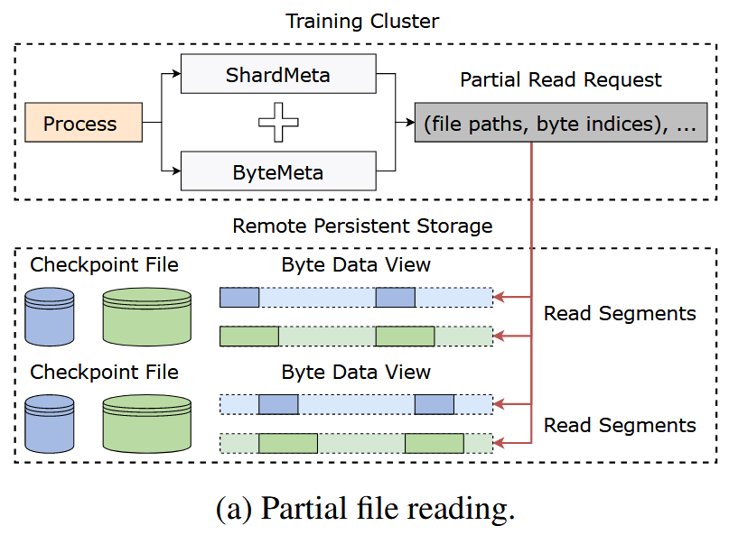
System Design - Loading Optimizations
Fully asynchronous pipeline
Zero redundant loading
partial file reading
overlap tensor reading with transferring

Slide 17
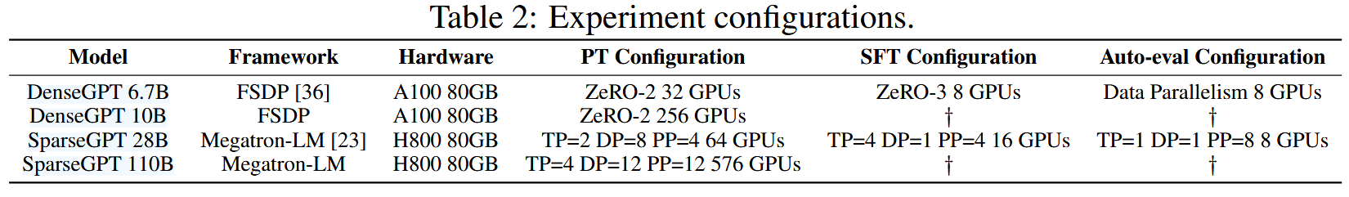
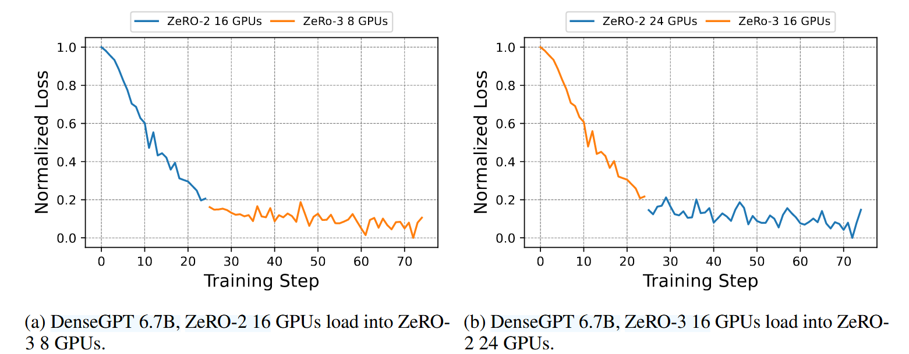
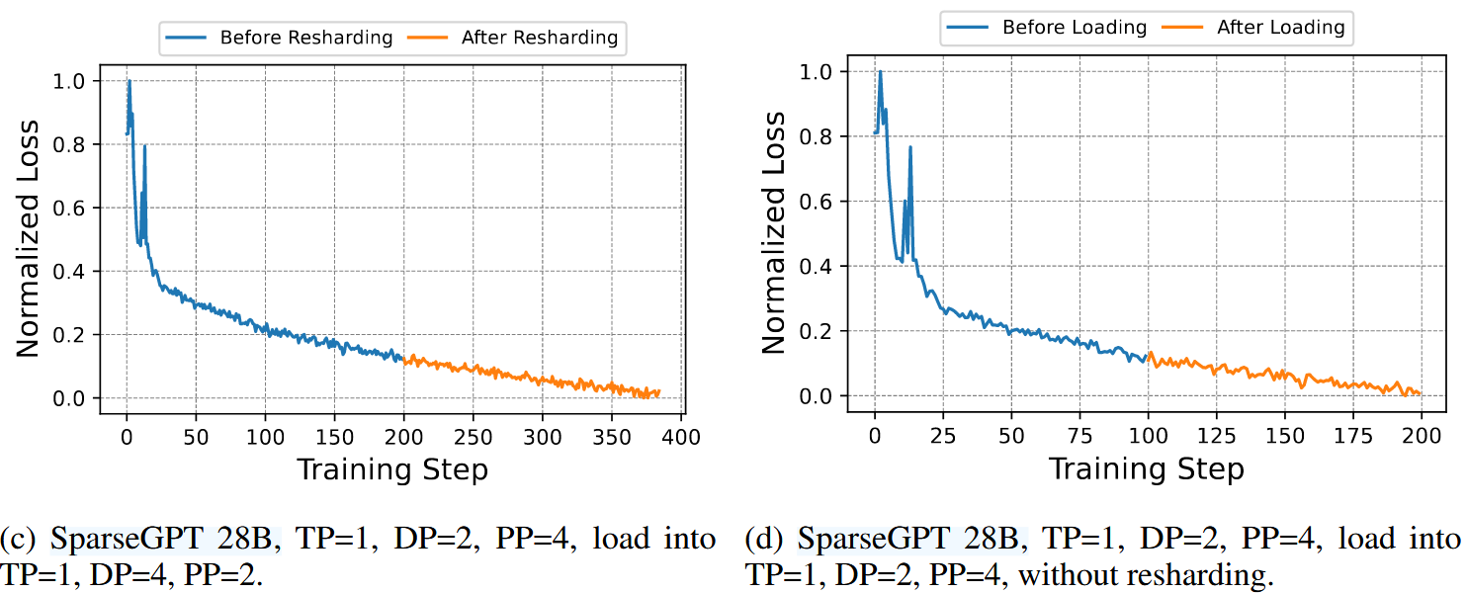
Evaluation - Checkpoint Correctness

Slide 18
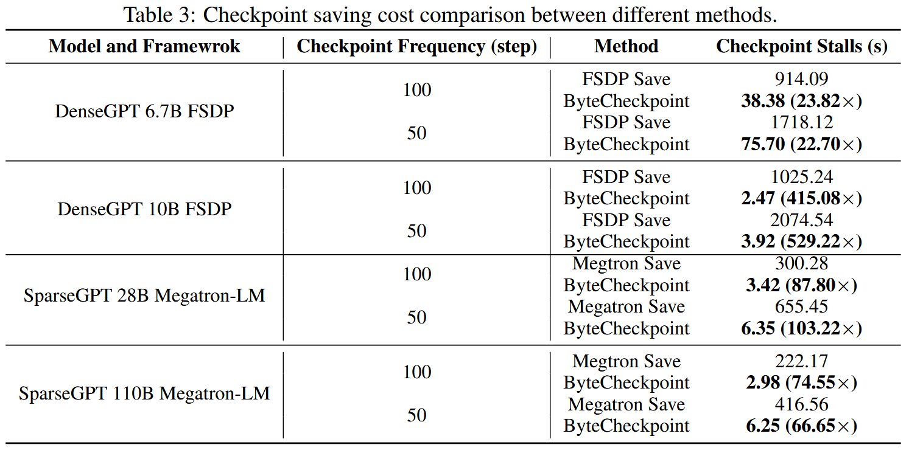
Evaluation - Saving Efficiency

Slide 19
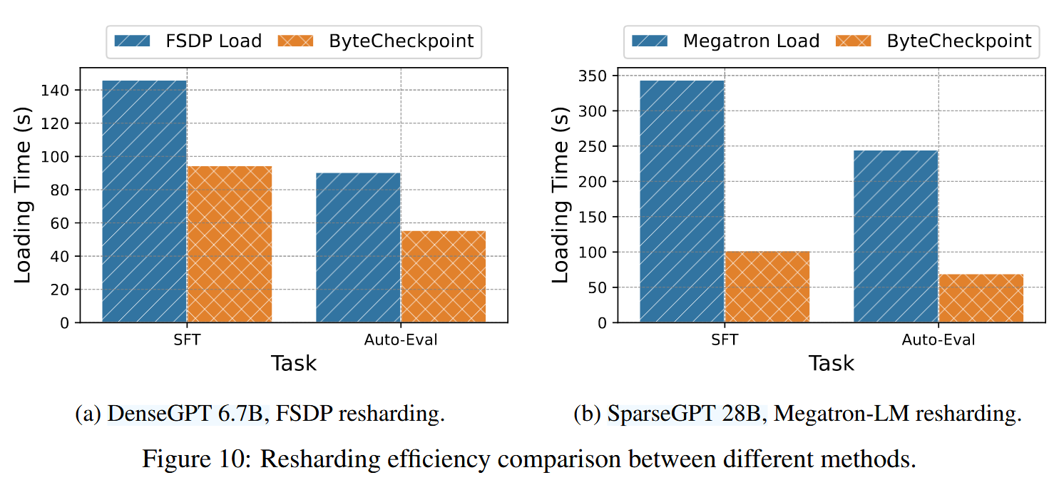
Evaluation - Loading Efficiency

