Slide 1
Private Preserving Machine Learning
Private inference

Slide 2
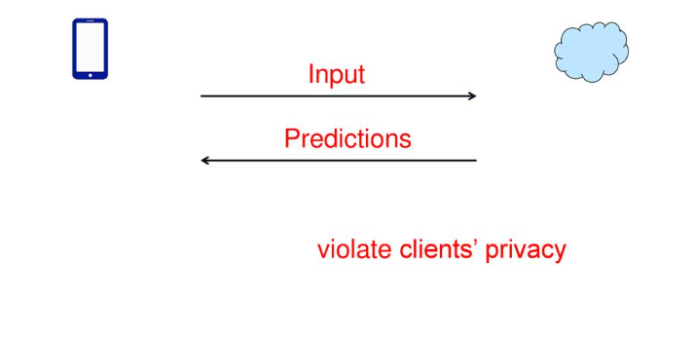
Machine learning as a service (MLaaS)

Slide 3



Private Inference
Given a neural network, is it possible to make it oblivious?
server learns nothing about clients’ input;
clients learn nothing about the model except the prediction.
Many efforts
CryptoNets, SecureML, MinoONN, Gazelle, Delphi, SIRNN, SecFloat, Cheetah.
SEAL-Microsft
EzPC-MSRI
Crypten-Meta
SecretFlow-Alibaba
Rosetta-LatticeX

Slide 4
Private Inference
CryptoNet (2016, ICML)
Gazelle (2018, USENIX Security)
Cheetah (2022, USENIX Security 2022)

Slide 5
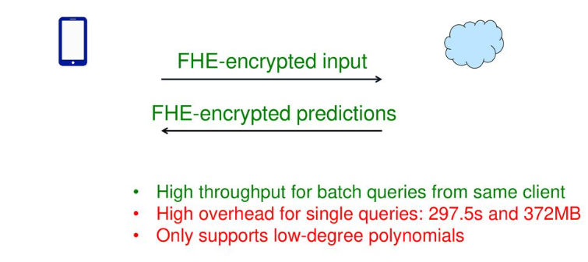
Example: CryptoNets
[GDLLNW16] CryptoNets,ICML 2016

Slide 6
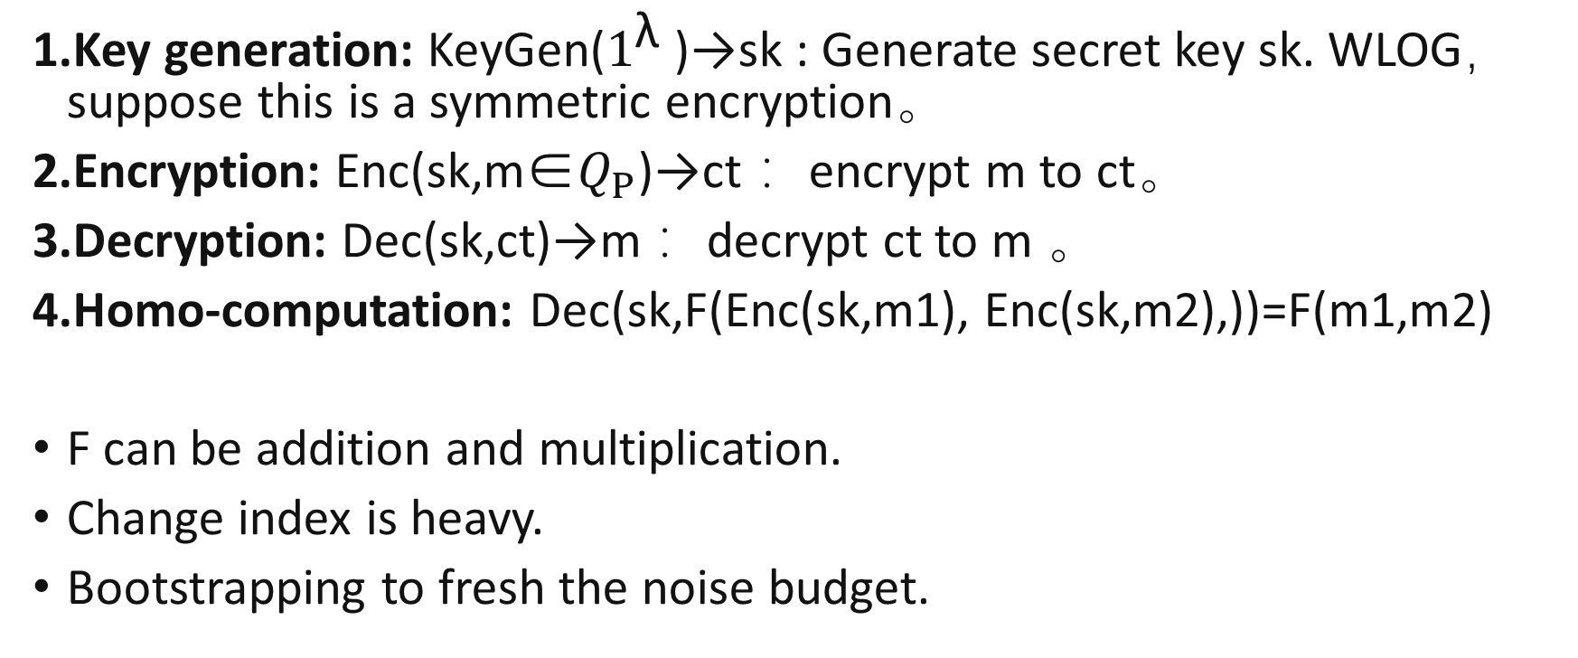
Fully homomorphic encryption
Key generation: KeyGen($1^{\text{λ}}$)→sk : Generate secret key sk. WLOG， suppose this is a symmetric encryption。
Encryption: Enc(sk,m∈$Q_{P}$)→ct ：encrypt m to ct。
Decryption: Dec(sk,ct)→m ：decrypt ct to m 。
Homo-computation: Dec(sk,F(Enc(sk,m1), Enc(sk,m2),))=F(m1,m2)
F can be addition and multiplication.
Change index is heavy.
Bootstrapping to fresh the noise budget.

Slide 7
Example: CryptoNets
Fig
Conv1
Square
Pool
Square
FC
Cls
30s
81s
127s
10s
1.6s
Using MNIST (28*28)
Encoding+Encryption: 44.5 seconds
Network application: 250 seconds
Decryption+Decoding: 3 seconds
Communication: 372MB

Slide 8
Example: Gazelle
Import Multi-Party Computation (MPC)
Support non-linear function
Avoid overhead of the bootstrapping
MPC starts from Yao’s Millionaire problem (1982):
Secret sharing
Oblivious transfer
Garbled circuit
Gazelle, USENIX Security 2018

Slide 9
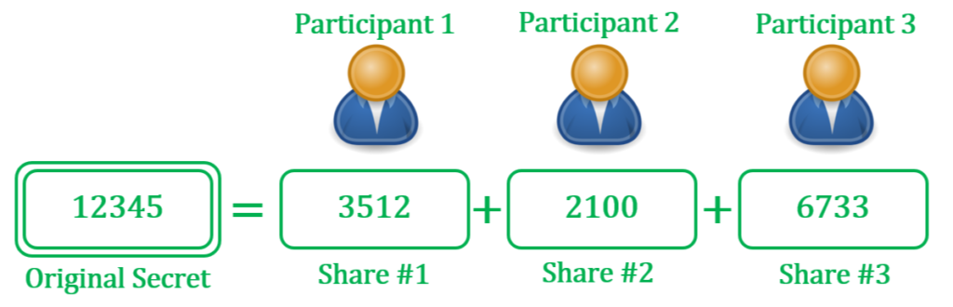
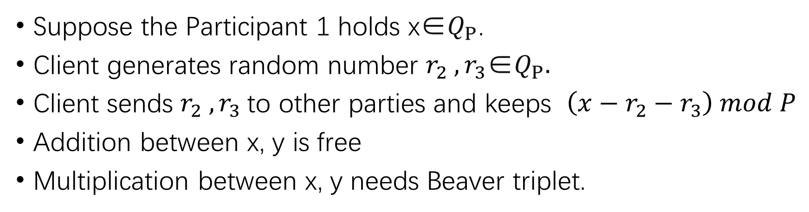
Secret sharing
Suppose the Participant 1 holds x∈$Q_{P}$.
Client generates random number $r_{2} ,r_{3}$∈$Q_{P}.$
Client sends $r_{2} ,r_{3}$to other parties and keeps $\left(x−r_{2}−r_{3}\right) mod P$
Addition between x, y is free
Multiplication between x, y needs Beaver triplet.

Slide 10
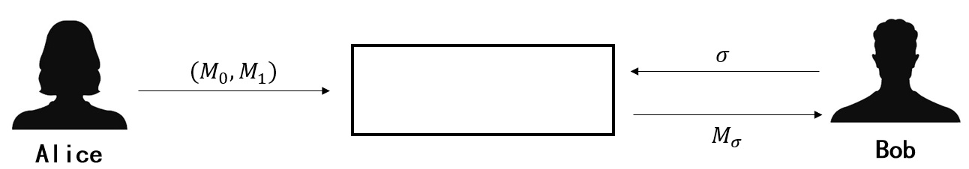

Oblivious Transfer
Alice has two messages $M_{0}$ and $M_{1}$.
Bob has his choice $σ$.
Bob gets $M_{σ}$ and Alice gets nothing.

Slide 11
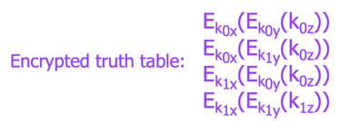
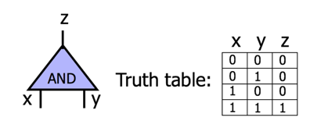
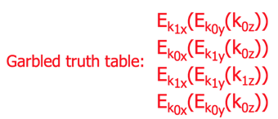
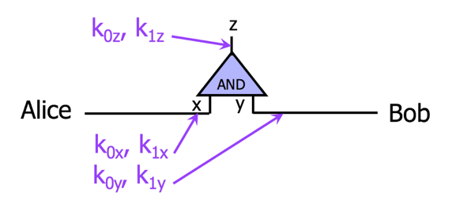
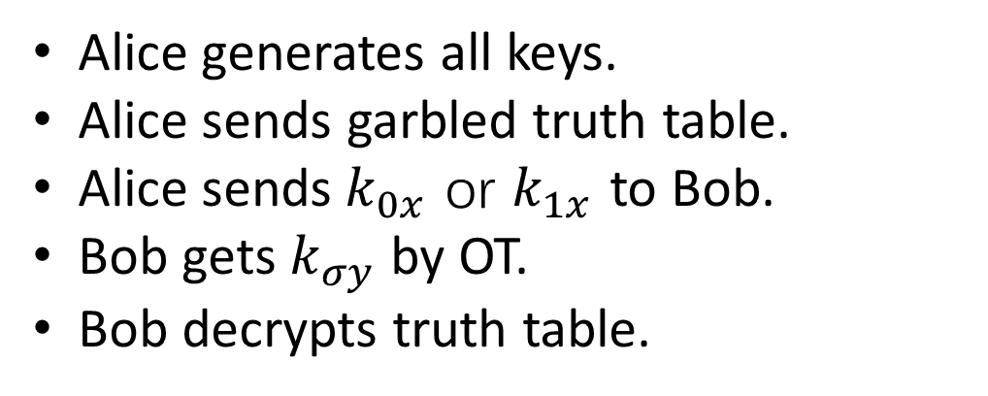
Garbled circuit
Alice generates all keys.
Alice sends garbled truth table.
Alice sends${ k}_{0x}$ or $k_{1x}$ to Bob.
Bob gets $k_{σy}$ by OT.
Bob decrypts truth table.

Slide 12
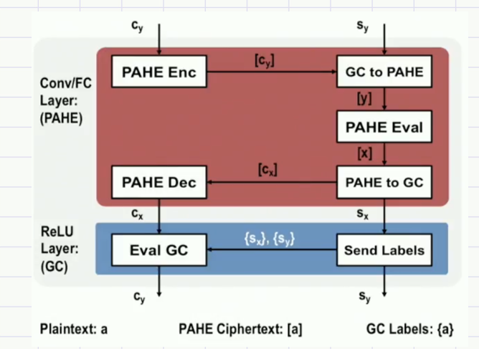
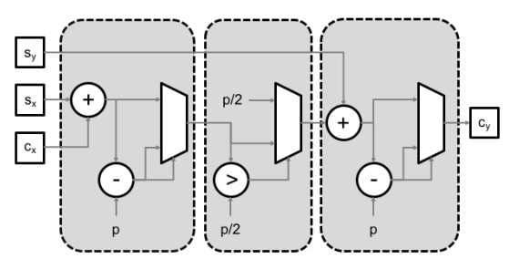
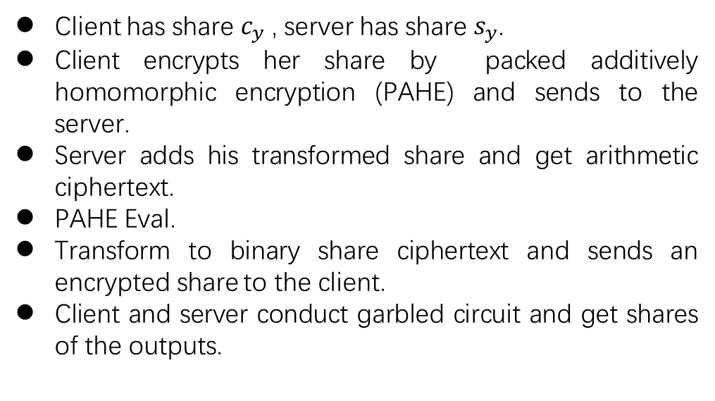
Example: Gazelle
Client has share $c_{y}$, server has share $s_{y}$.
Client encrypts her share by packed additively homomorphic encryption (PAHE) and sends to the server.
Server adds his transformed share and get arithmetic ciphertext.
PAHE Eval.
Transform to binary share ciphertext and sends an encrypted share to the client.
Client and server conduct garbled circuit and get shares of the outputs.
Gazelle, USENIX Security 2018

Slide 13
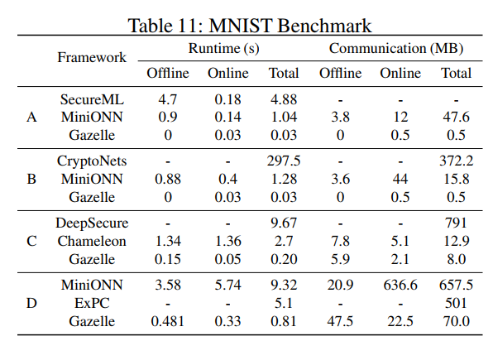
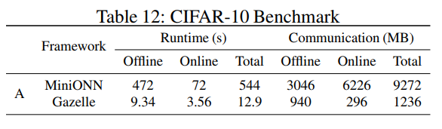
Example: Gazelle

Slide 14
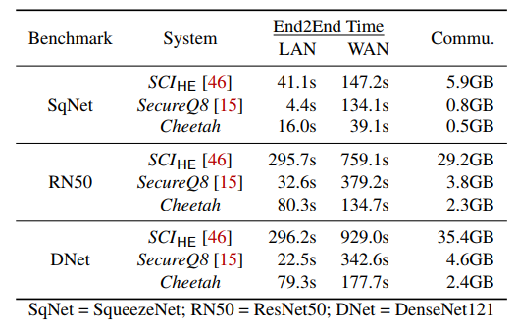
Example: Cheetah
Improved linear protocol
Improved OT
384 MBps (LAN)
44 MBps (WAN)
Using Imagenet
Cheetah, USENIX Security 2022

