Slide 1
Quantization on Transformers: Batched Inference
Haoyan Zhang
2023.11.16

Slide 2
Outline
Background
Quantization
Transformer
Quantization on Transformers Inference
Discussion on Batched Inference
Summary

Slide 3






Background—Quantization
min
quantization error
0
max
min
0
max
Origin Value
Origin Value
0
Quantized Value
0
Quantized Value
-8
-4.3
7
-8
7
-4
rounding
$$s.f.=\frac{max−min}{max_int−min_int} ;$$
$$z.p.=min$$
$$s.f.=\frac{max}{max_int} ;$$
$$z.p.=0$$
$$Q’=\left\lfloor \left.\frac{Q−z.p.}{s.f.}\right\rceil \right.+min_int$$
$$Q’=\left\lfloor \left.\frac{Q}{s.f.}\right\rceil \right.$$
$$\hat{Q}=\left(Q’−min_int\right)×s.f.+z.p.$$
$$\hat{Q}=Q’×s.f.$$
Asymmetric
Symmetric

Slide 4


Background—Quantization
K
N
N
X
s_{x}
z_{x}
W
Y
s_{x}
z_{x}
M
=
M
K
s_{w}
s_{w}
z_{w}
z_{w}
Origin:
$$Y=\hat{X}\hat{W}$$
Int op
fp16 op
dot product
element-wise product
Symmetric:
$$Y=\left(X·sx\right)\left(W·sw\right)=XW · sx · sw$$
MNK + 2MN
sum
Asymmetric:
$$Y=\left(X·sx\right)\left(W·sw+zw\right)=XW · sx · sw+X · sx · zw$$
MNK + 2MN + (MK + 2MN)
$$Y=\left(X·sx+zx\right)\left(W·sw+zw\right)=XW · sx · sw+X · sx · zw+zx · W · sw +zx · zw$$
MNK + 2MN + (MK + 2MN) + (NK + 2MN) + MN
Notes:
蓝色框框是低比特低精度计算，红色框框是高精度计算
X 是先在K dimension累加，再和sx点乘，和zw外积
W也是在K dimension上累加，和zx做外积，和sw点乘

Slide 5
Background—Quantization
Pros
Reduce memory footprint
Speed up inference
Load faster with less memory footprint
Compute faster with low precision datatype computation
Cons
Accuracy loss

Slide 6
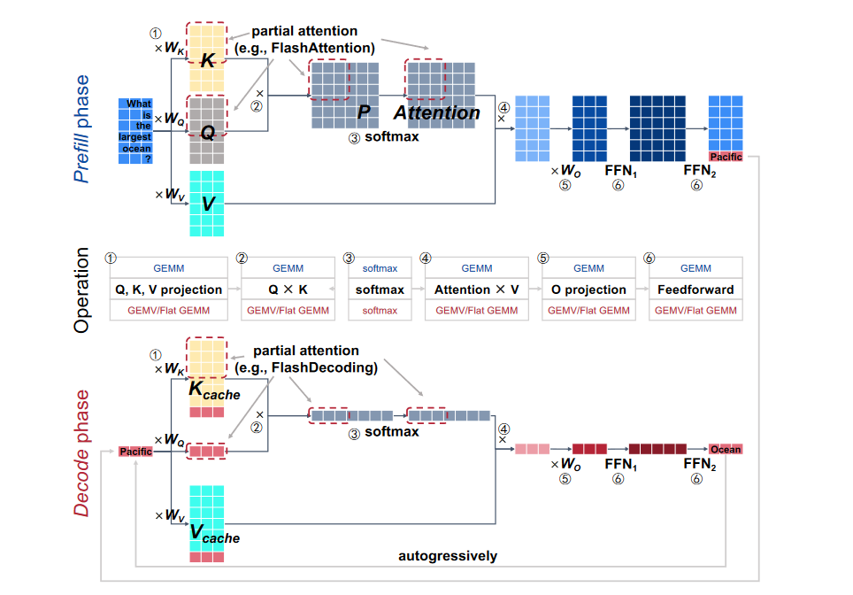


Background—Transformer
Linear projection layer
(Dense layer)
$$Y = XW$$
Attention
FLASHDECODING++: FASTER LARGE LANGUAGE MODEL INFERENCE ON GPUS

Slide 7
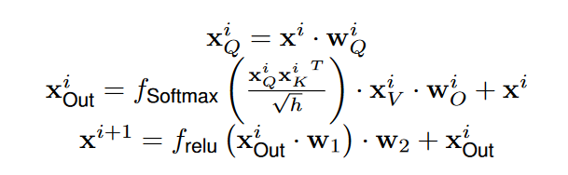

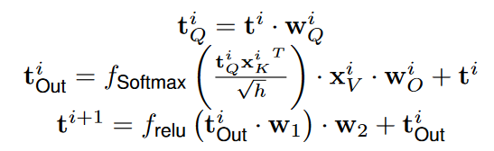
Background—Transformer
Prefill phase (GEMM)
Cache K and V
Get first output token
Decode phase (GEMV)
Per token output
Extend K and V
FLASHDECODING++: FASTER LARGE LANGUAGE MODEL INFERENCE ON GPUS; FlexGen
Notes:
KV cache 是为了避免重复计算 K 和 V

Slide 8
Background—Transformer
Memory footprint
Weight
KV-cache (batch)
Inference latency
Memory access
Computation
Double buffer
FLASHDECODING++: FASTER LARGE LANGUAGE MODEL INFERENCE ON GPUS
Notes:
由于double buffer的存在，如果是memory-bounded，就压缩，并且可以增加一些计算overhead，e.g. encoding/decoding；如果是compute-bounded，那就要优化计算，e.g. low-bit computation

Slide 9
Quantization on Transformers Inference
Linear projection
Weight
Pre-encoded
Only to decode during inference
Activation
Pre-compute min/max
Run-time encode + decode
Attention
KV-cache

Slide 10
KV-cache Compression
Prefill phase
Decode phase
K
K
Compress
K
K
K₀
Compress
K
K₁
...
K₁₀₂₃

Slide 11
Quantization on Transformers Inference
Weight-only quantization
Motivation : Transformer inference is memory-bounded. Thus, we can quantize W only and recover it to fp16 during inference.
Hidden condition : Batch size = 1
Cons : Only applied to linear projection layer. Do nothing to attention layer (bottleneck). Limited speed-up.
Question : What will happen when batch size increase?

Slide 12
Batched Transformer Inference
Attention
Sequential
Memory-bounded --> Memory-bounded
Memory : MK + NK --> 8MK + 8NK
Computation : MNK --> 8MNK
Linear-projection
Batched
Memory-bounded --> Compute-bounded
Memory : MK + NK --> 8MK + NK
Computation : MNK --> 8MNK

Slide 13
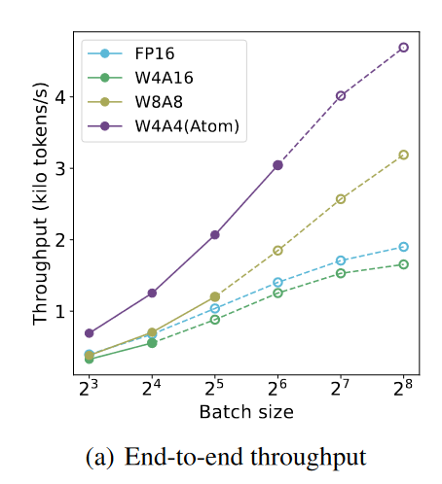
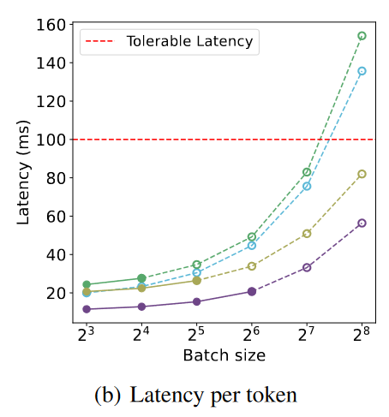
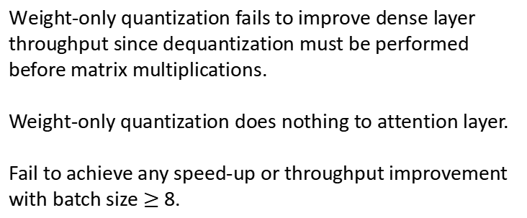
Batched transformer inference
Weight-only quantization fails to improve dense layer throughput since dequantization must be performed before matrix multiplications.
Weight-only quantization does nothing to attention layer.
Fail to achieve any speed-up or throughput improvement with batch size $≥$ 8.
ATOM: LOW-BIT QUANTIZATION FOR EFFICIENT AND ACCURATE LLM SERVING

Slide 14
Discussion
Attention layer (memory-bounded)
KV-cache compression
Tolerant encoding and decoding overhead
Linear projection layer (compute-bounded)
weight-activation quantization, compute with low-precision datatype
weight-only quantization?
accelerate computation, maybe bit-serial computation
ATOM: LOW-BIT QUANTIZATION FOR EFFICIENT AND ACCURATE LLM SERVING

