Slide 1
Global routing in the stack
You estimated congestion on GCells
learn_global_routing — 00 intro
Notes:
You estimated congestion on GCells. Global routing commits coarse paths on the GCell graph, depositing usage on edges before detailed routing or CTS. This course teaches that graph, pattern routers, overflow, and rip-up on a tiny chip.

Slide 2
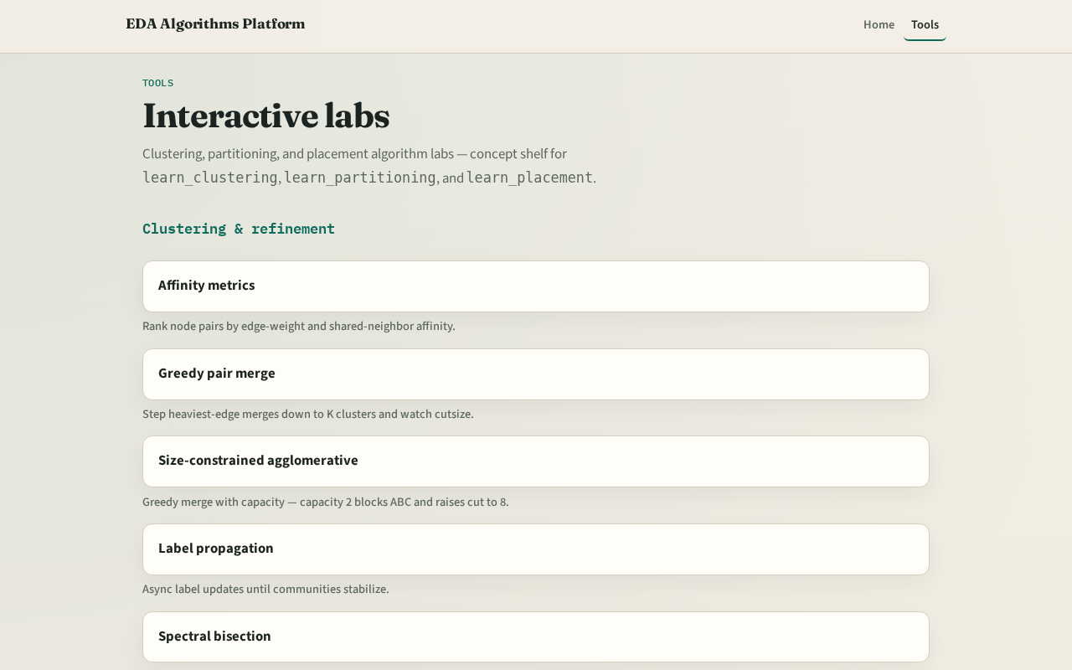
Two tracks
Track B is the browser lab: route nets, watch edge heat, clear challenges
Track A is implement: Python solvers on tiny_gr.json
Use either or both
Browser first for intuition is fine
learn_global_routing — 00 intro
Notes:
Track B is the browser lab: route nets, watch edge heat, clear challenges. Track A is implement: Python solvers on tiny_gr.json. Use either or both. Browser first for intuition is fine.

Slide 3
Course map
Foundations cover the routing graph and terminals
Patterns cover L, Z, maze, and multipin star
Congestion response covers edge overflow and rip-up
Sequential global ties the flow together
Offline compare and wrap close the path
learn_global_routing — 00 intro
Notes:
Foundations cover the routing graph and terminals. Patterns cover L, Z, maze, and multipin star. Congestion response covers edge overflow and rip-up. Sequential global ties the flow together. Offline compare and wrap close the path.

Slide 4
Prerequisites
Finish learn_congestion or learn_legalization so GCell indexing and placed netlists
Congestion demand maps are cousins, not the same as edge usage deposits
learn_global_routing — 00 intro
Notes:
Finish learn_congestion or learn_legalization so GCell indexing and placed netlists already make sense. Congestion demand maps are cousins—not the same as edge usage deposits.

Slide 5
How to move
Read each module README
Odd module slots leave room to insert algorithms later without renumbering
learn_global_routing — 00 intro
Notes:
Read each module README, pick a track, check the checklist, then skim the clip when media is available. Odd module slots leave room to insert algorithms later without renumbering.

Slide 6
Next
Complete the quiz for this part
Open the GCell routing graph and enumerate eleven edges on the four-by-two grid
learn_global_routing — 00 intro
Notes:
Open the GCell routing graph and enumerate eleven edges on the four-by-two grid.

