Slide 1
Why a routing graph
Global routers do not hop pixel by pixel
learn_global_routing — 01 routing graph
Notes:
Global routers do not hop pixel by pixel. They walk a coarse graph whose nodes are GCells and whose edges are the channels between neighbors. Before any pattern route, you must enumerate those edges on our four-by-two toy grid.

Slide 2
The idea
To the upper neighbor when j plus one is less than ny
On four by two you get eleven edges
Store each edge as a sorted pair of GCell indices so direction does not matter
learn_global_routing — 01 routing graph
Notes:
For each GCell at column i and row j, add an undirected edge to the right neighbor when i plus one is less than nx, and to the upper neighbor when j plus one is less than ny. On four by two you get eleven edges. Store each edge as a sorted pair of GCell indices so direction does not matter.

Slide 3
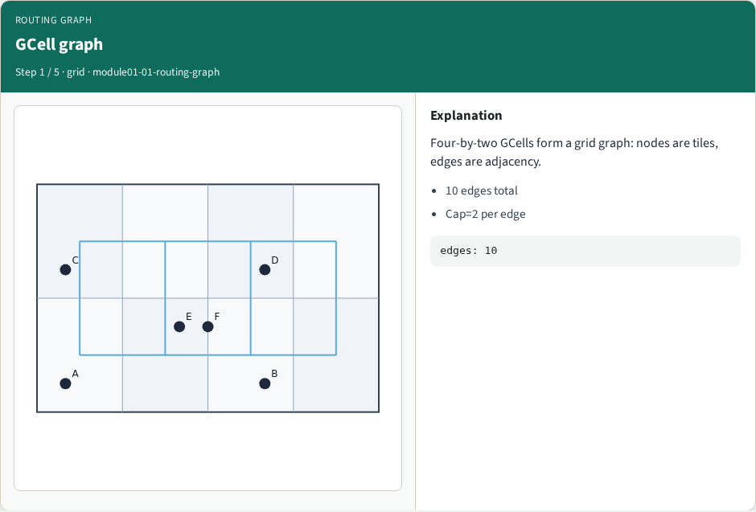
GCell graph
GCell graph
learn_global_routing — 01 routing graph
Notes:
Four-by-two GCells form a grid graph: nodes are tiles, edges are adjacency.

Slide 4
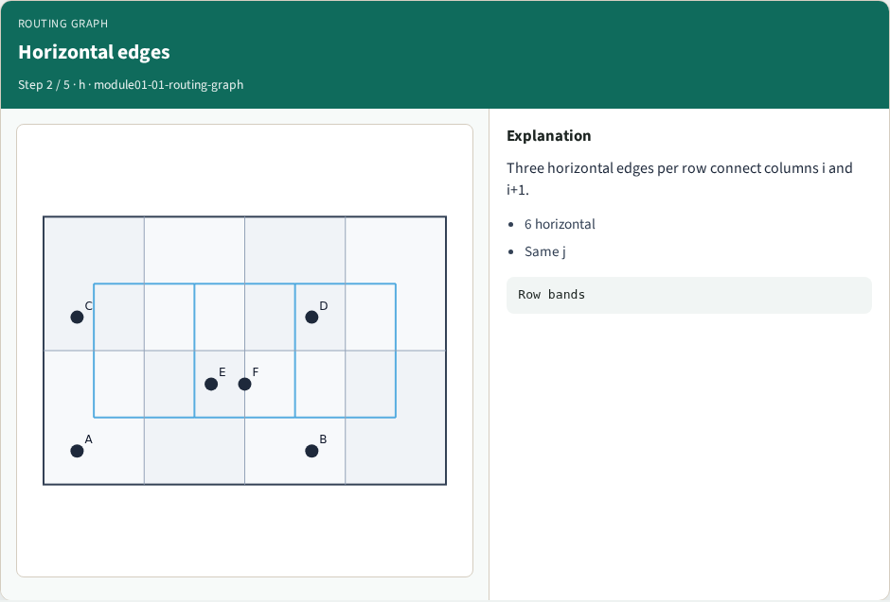
Horizontal edges
Horizontal edges
learn_global_routing — 01 routing graph
Notes:
Three horizontal edges per row connect columns i and i+1.

Slide 5
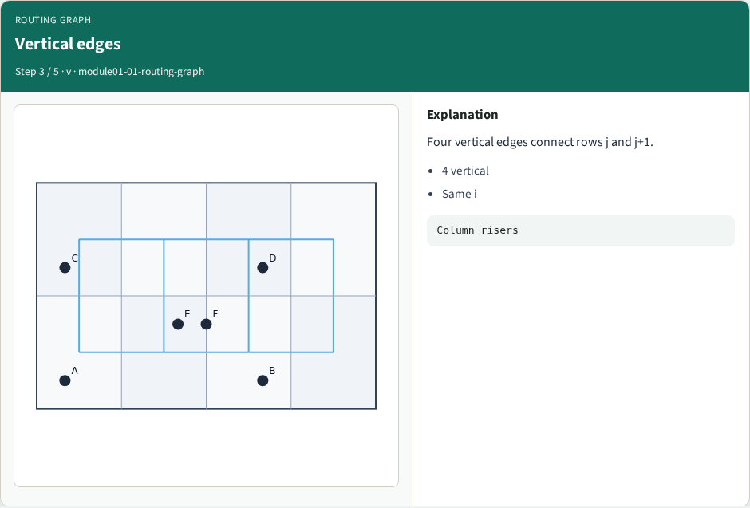
Vertical edges
Vertical edges
learn_global_routing — 01 routing graph
Notes:
Four vertical edges connect rows j and j+1.

Slide 6
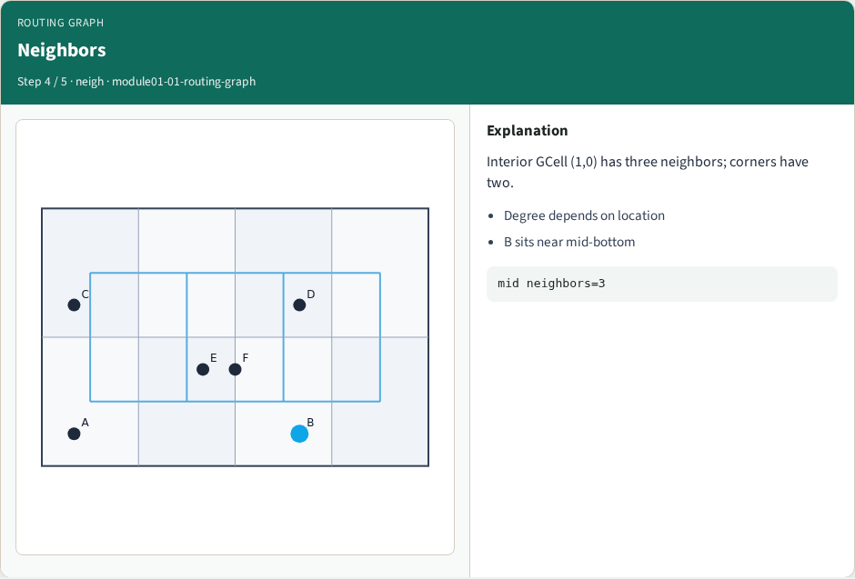
Neighbors
Neighbors
learn_global_routing — 01 routing graph
Notes:
Interior GCell (1,0) has three neighbors; corners have two.

Slide 7
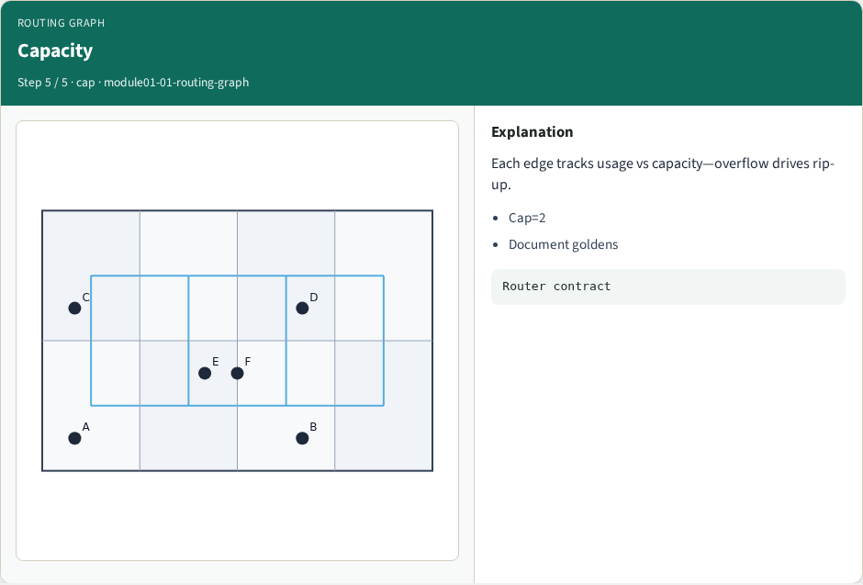
Capacity
Capacity
learn_global_routing — 01 routing graph
Notes:
Each edge tracks usage vs capacity—overflow drives rip-up.

Slide 8
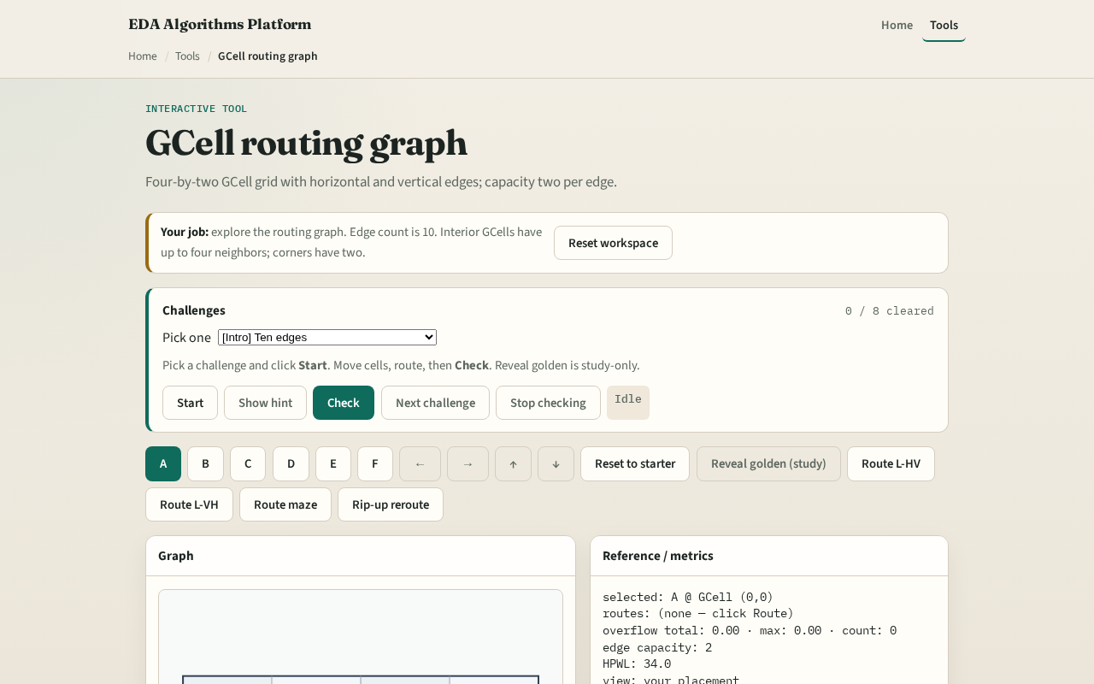
Browser lab track
Browser lab starter
learn_global_routing — 01 routing graph
Notes:
Open the **routing-graph** lab. Toggle grid lines and highlight one horizontal edge between columns zero and one. Read the edge list in the metrics panel. Match the count to eleven.

Slide 9
Implement track
Implement `edge_list(nx, ny)` in `common/grutil.py`
Print all edges for the tiny instance
Verify ((0,0),(1,0)) is present and diagonals are absent
learn_global_routing — 01 routing graph
Notes:
Implement `edge_list(nx, ny)` in `common/grutil.py`. Print all edges for the tiny instance. Verify ((0,0),(1,0)) is present and diagonals are absent.

Slide 10
Pitfalls
Counting tile interiors instead of adjacency channels
Double-counting undirected edges as two directed arcs without collapsing
Forgetting top and right boundary checks
learn_global_routing — 01 routing graph
Notes:
Counting tile interiors instead of adjacency channels. Double-counting undirected edges as two directed arcs without collapsing. Forgetting top and right boundary checks.

Slide 11
Your turn
Finish the checklist
Sketch the eleven edges from memory
Next: map pin placements to terminal GCells
learn_global_routing — 01 routing graph
Notes:
Finish the checklist. Sketch the eleven edges from memory. Next: map pin placements to terminal GCells.

