Slide 1
Pins become terminals
A global route starts and ends at GCell terminals, one tile per pin
learn_global_routing — 03 terminal gcells
Notes:
A global route starts and ends at GCell terminals—one tile per pin. Legal placement gives you x y coordinates; this module converts them to grid indices using the same floor-and-clamp rule as congestion GCells.

Slide 2
The idea
Cell_gcell of x y returns column i equals floor of x over cell width clamped
Cell A at one comma one maps to zero comma zero
Cell D at eight comma five maps to two comma one
Build a dictionary from cell id to GCell for every pin in the netlist
learn_global_routing — 03 terminal gcells
Notes:
cell_gcell of x y returns column i equals floor of x over cell width clamped, and row j likewise. Cell A at one comma one maps to zero comma zero. Cell D at eight comma five maps to two comma one. Build a dictionary from cell id to GCell for every pin in the netlist.

Slide 3
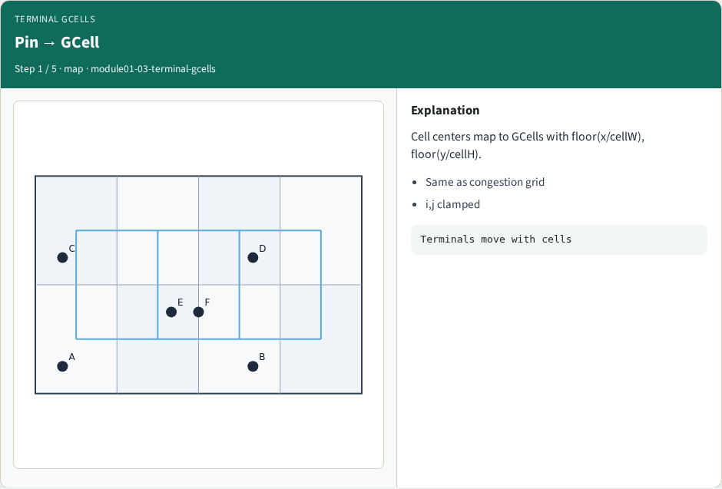
Pin → GCell
Pin → GCell
learn_global_routing — 03 terminal gcells
Notes:
Cell centers map to GCells with floor(x/cellW), floor(y/cellH).

Slide 4
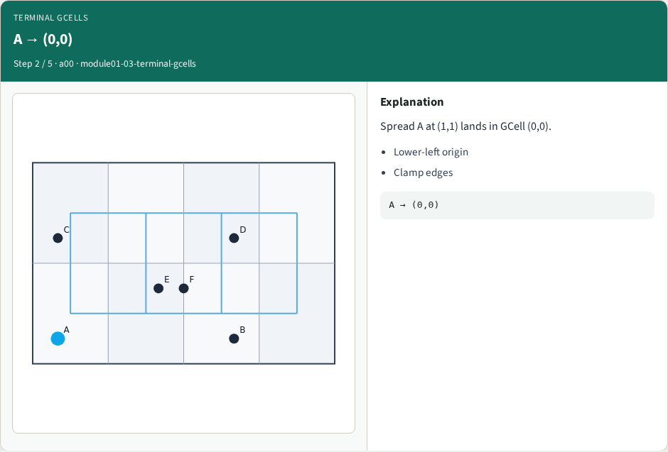
A → (0,0)
A → (0,0)
learn_global_routing — 03 terminal gcells
Notes:
Spread A at (1,1) lands in GCell (0,0).

Slide 5
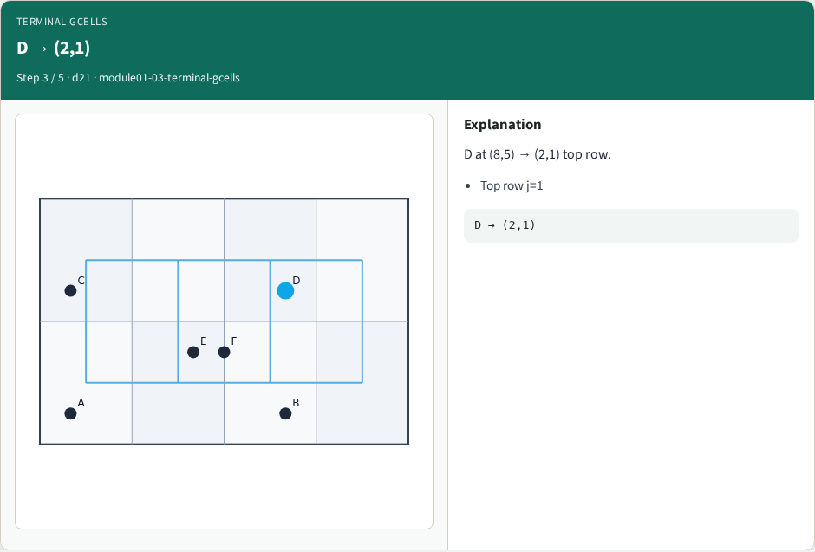
D → (2,1)
D → (2,1)
learn_global_routing — 03 terminal gcells
Notes:
D at (8,5) → (2,1) top row.

Slide 6
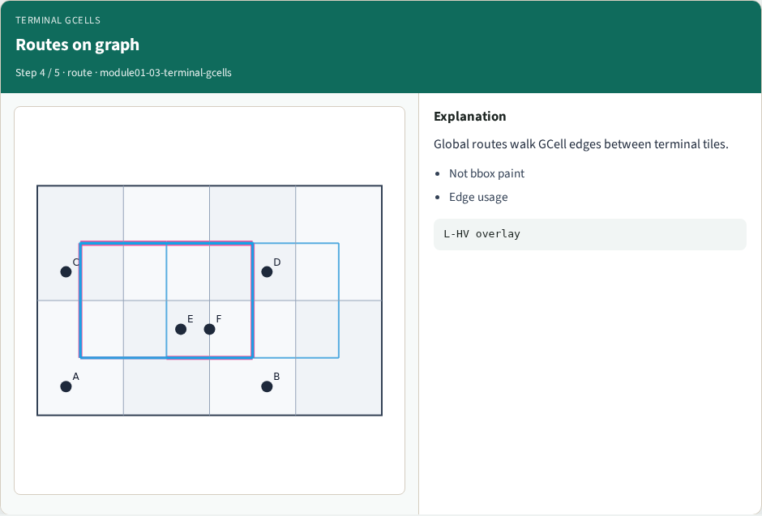
Routes on graph
Routes on graph
learn_global_routing — 03 terminal gcells
Notes:
Global routes walk GCell edges between terminal tiles.

Slide 7
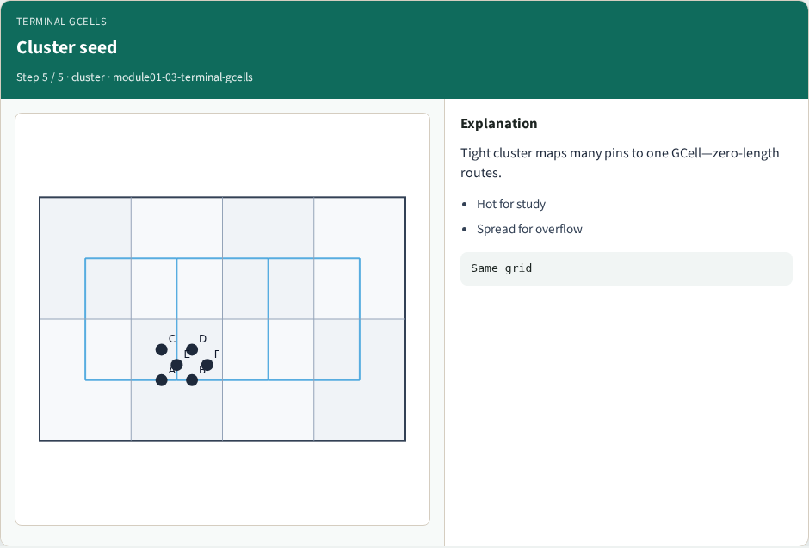
Cluster seed
Cluster seed
learn_global_routing — 03 terminal gcells
Notes:
Tight cluster maps many pins to one GCell—zero-length routes.

Slide 8
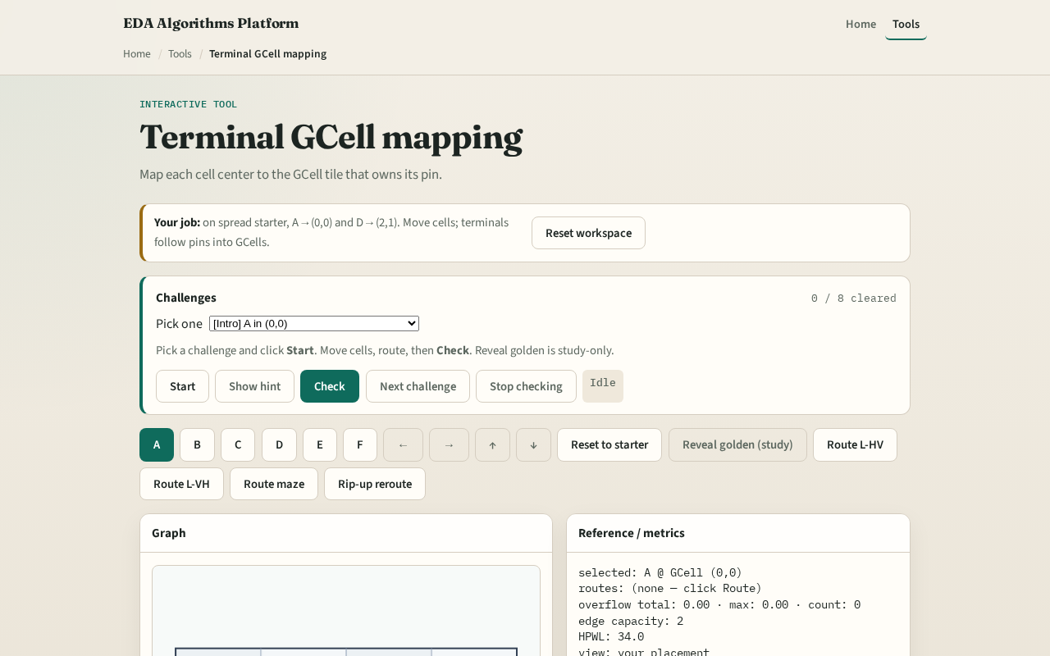
Browser lab track
Browser lab starter
learn_global_routing — 03 terminal gcells
Notes:
Open **terminal-gcells**. Hover each cell and read its terminal GCell. Move a pin across a boundary and watch the terminal index flip. Confirm the six cells on tiny_gr match your Track A printout.

Slide 9
Implement track
Implement `terminals(positions, data)` returning the map
Assert A through F on spread placement
Print terminals before any routing lab
learn_global_routing — 03 terminal gcells
Notes:
Implement `terminals(positions, data)` returning the map. Assert A through F on spread placement. Print terminals before any routing lab.

Slide 10
Pitfalls
Using cell origin instead of pin center
Off-by-one at the right or top chip edge without clamp
Mixing site columns from legalization with GCell columns
learn_global_routing — 03 terminal gcells
Notes:
Using cell origin instead of pin center. Off-by-one at the right or top chip edge without clamp. Mixing site columns from legalization with GCell columns.

Slide 11
Your turn
Complete terminals for all six cells
Next: L-shape pattern routes between two terminals
learn_global_routing — 03 terminal gcells
Notes:
Complete terminals for all six cells. Next: L-shape pattern routes between two terminals.

