Slide 1
The simplest global path
Two-pin global routing often starts with an L: travel along one axis, then the other
learn_global_routing — 01 pattern l route
Notes:
Two-pin global routing often starts with an L: travel along one axis, then the other. It is fast, deterministic, and good enough to teach edge usage before maze search or rip-up.

Slide 2
The idea
Prefer VH swaps the order
Emit the list of GCells visited and convert consecutive pairs to edges with path_to_edges
A path from zero comma zero to two comma one in HV uses three edges
learn_global_routing — 01 pattern l route
Notes:
Given terminals a and b, prefer HV walks horizontal to align columns then vertical to the row; prefer VH swaps the order. Emit the list of GCells visited and convert consecutive pairs to edges with path_to_edges. A path from zero comma zero to two comma one in HV uses three edges.

Slide 3
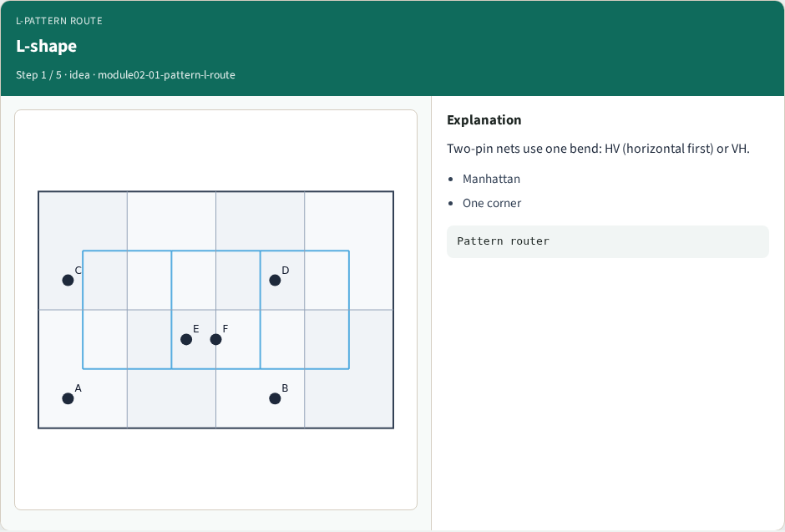
L-shape
L-shape
learn_global_routing — 01 pattern l route
Notes:
Two-pin nets use one bend: HV (horizontal first) or VH.

Slide 4
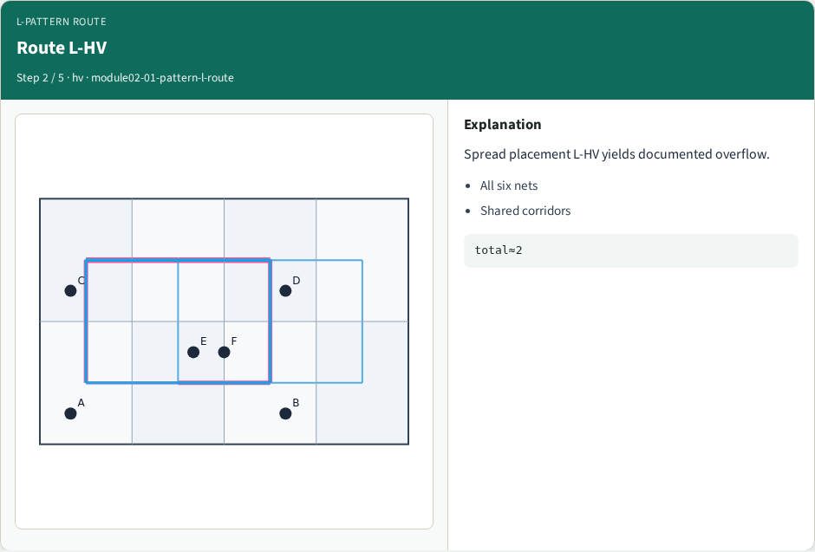
Route L-HV
Route L-HV
learn_global_routing — 01 pattern l route
Notes:
Spread placement L-HV yields documented overflow.

Slide 5
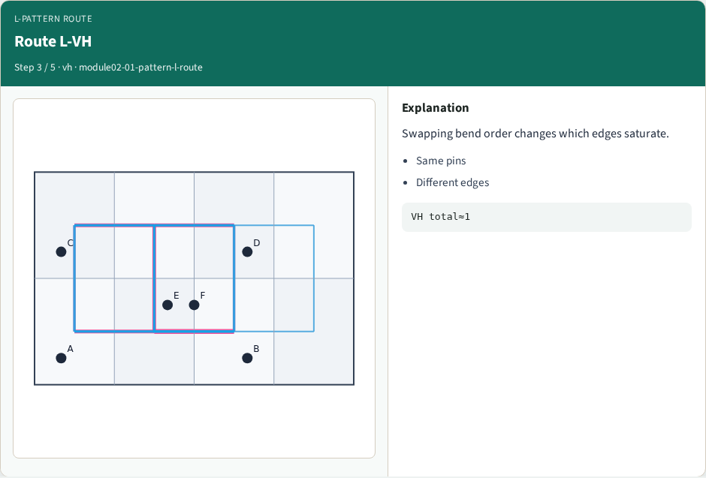
Route L-VH
Route L-VH
learn_global_routing — 01 pattern l route
Notes:
Swapping bend order changes which edges saturate.

Slide 6
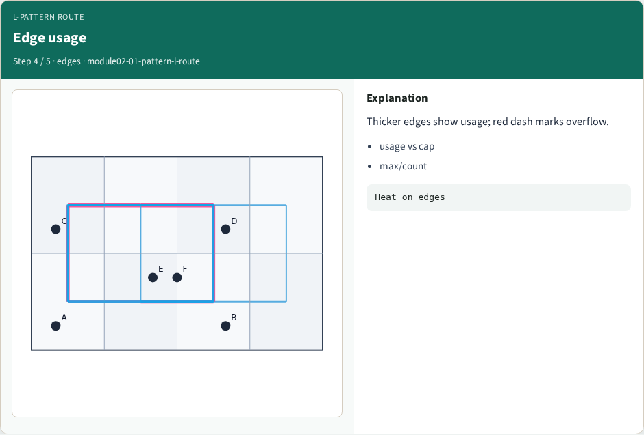
Edge usage
Edge usage
learn_global_routing — 01 pattern l route
Notes:
Thicker edges show usage; red dash marks overflow.

Slide 7
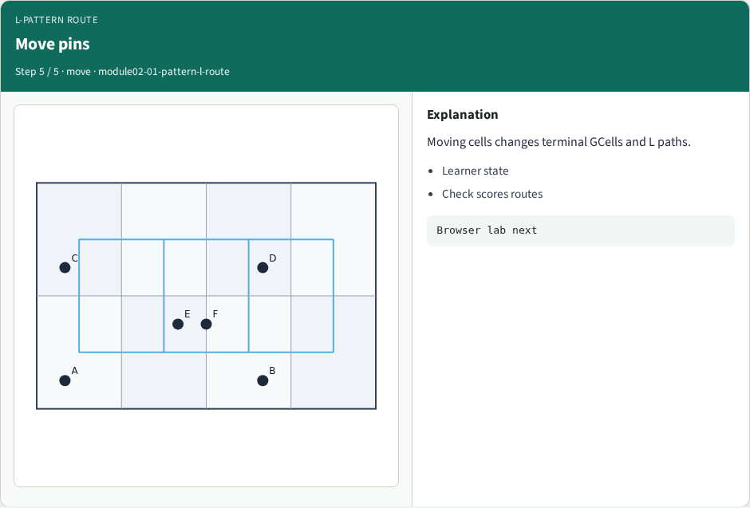
Move pins
Move pins
learn_global_routing — 01 pattern l route
Notes:
Moving cells changes terminal GCells and L paths.

Slide 8
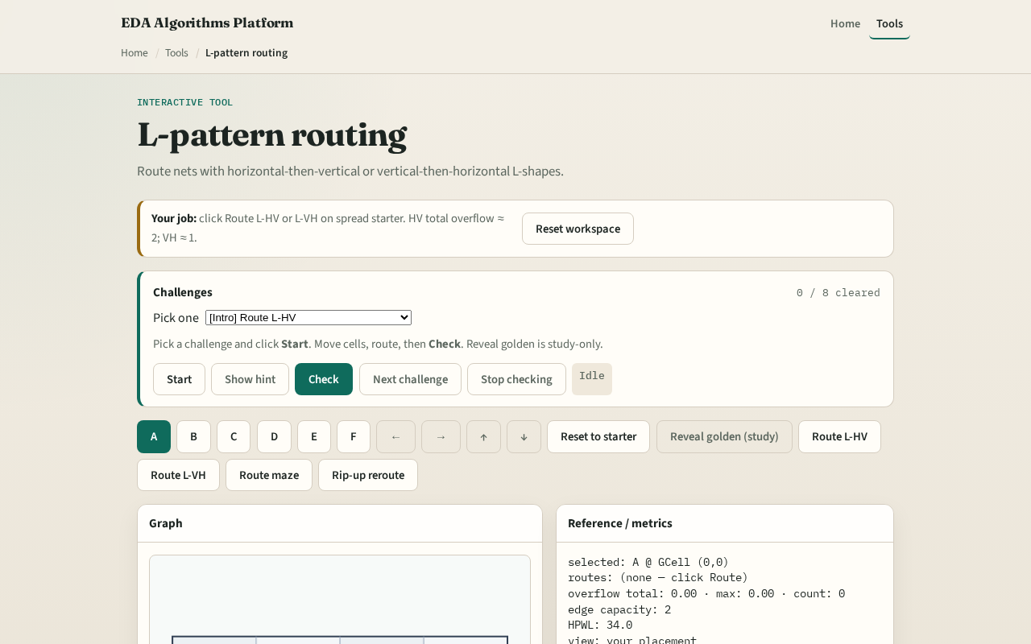
Browser lab track
Browser lab starter
learn_global_routing — 01 pattern l route
Notes:
Open **pattern-l-route**. Route A to B with HV and read the highlighted edges. Toggle VH on the same pair and compare the bend GCell.

Slide 9
Implement track
Implement `l_route(a, b, prefer)` and `path_to_edges`
Route net A–B on tiny_gr and print the edge list
Match the browser overlay
learn_global_routing — 01 pattern l route
Notes:
Implement `l_route(a, b, prefer)` and `path_to_edges`. Route net A–B on tiny_gr and print the edge list. Match the browser overlay.

Slide 10
Pitfalls
Skipping duplicate GCells at the bend
Returning directed edges inconsistently, always normalize undirected keys
Forgetting that L routes ignore existing congestion until sequential routing
learn_global_routing — 01 pattern l route
Notes:
Skipping duplicate GCells at the bend. Returning directed edges inconsistently—always normalize undirected keys. Forgetting that L routes ignore existing congestion until sequential routing.

Slide 11
Your turn
Ship Track A L-routes and clear browser challenges
Next: Z-shape patterns when you want a third segment
learn_global_routing — 01 pattern l route
Notes:
Ship Track A L-routes and clear browser challenges. Next: Z-shape patterns when you want a third segment.

