Slide 1
Three segments
When pins are not on the same row or column, an L is not your only pattern
learn_global_routing — 03 pattern z route
Notes:
When pins are not on the same row or column, an L is not your only pattern. A Z bends twice: horizontal to a midpoint column, vertical, then horizontal to the destination—or the vertical-first variant.

Slide 2
The idea
If a and b share a row or column, fall back to L-route
Otherwise with prefer HZ pick mid column as the average of the two columns, walk H–V–H
Path_to_edges should show at least three edges for off-axis pairs like zero comma zero to
learn_global_routing — 03 pattern z route
Notes:
If a and b share a row or column, fall back to L-route. Otherwise with prefer HZ pick mid column as the average of the two columns, walk H–V–H. path_to_edges should show at least three edges for off-axis pairs like zero comma zero to three comma one.

Slide 3
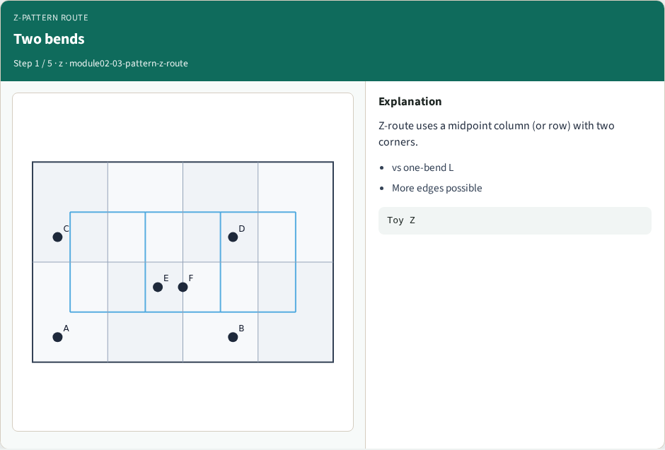
Two bends
Two bends
learn_global_routing — 03 pattern z route
Notes:
Z-route uses a midpoint column (or row) with two corners.

Slide 4
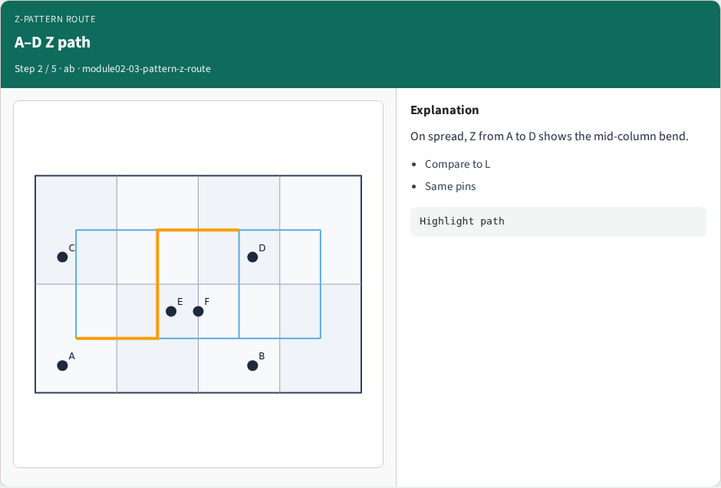
A–D Z path
A–D Z path
learn_global_routing — 03 pattern z route
Notes:
On spread, Z from A to D shows the mid-column bend.

Slide 5
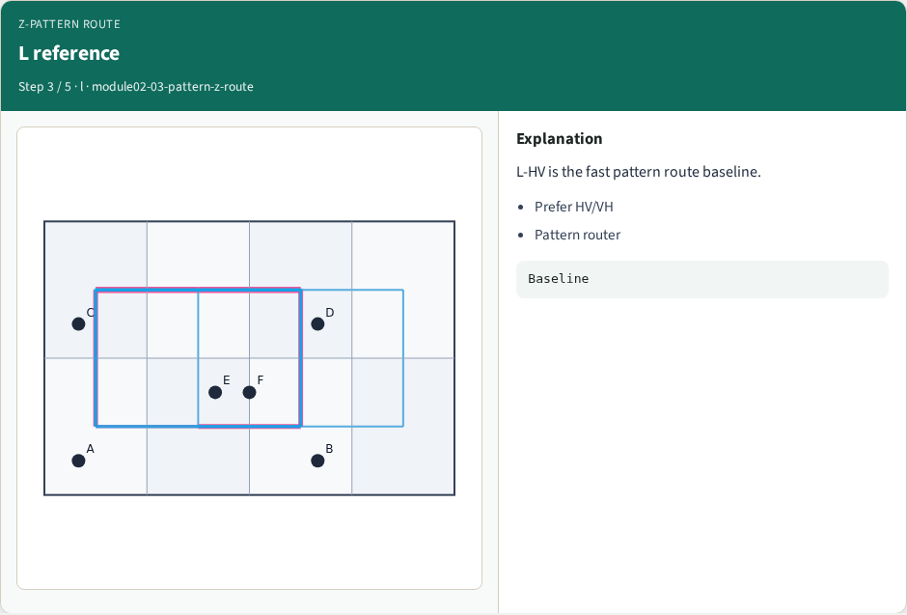
L reference
L reference
learn_global_routing — 03 pattern z route
Notes:
L-HV is the fast pattern route baseline.

Slide 6
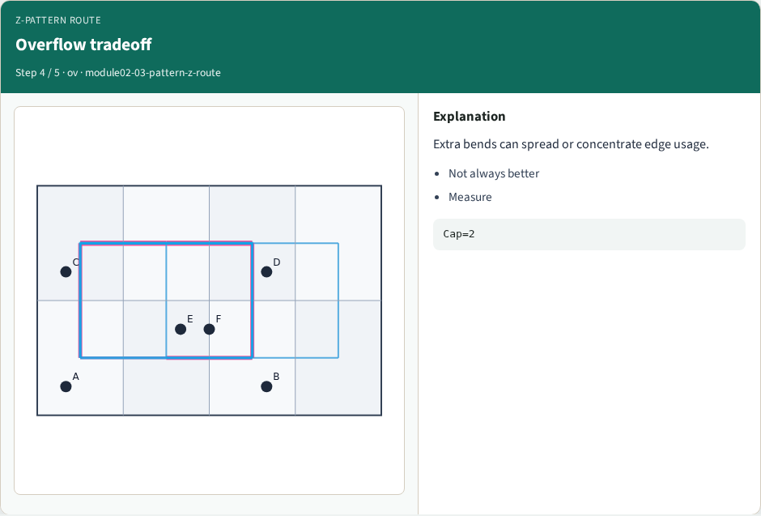
Overflow tradeoff
Overflow tradeoff
learn_global_routing — 03 pattern z route
Notes:
Extra bends can spread or concentrate edge usage.

Slide 7
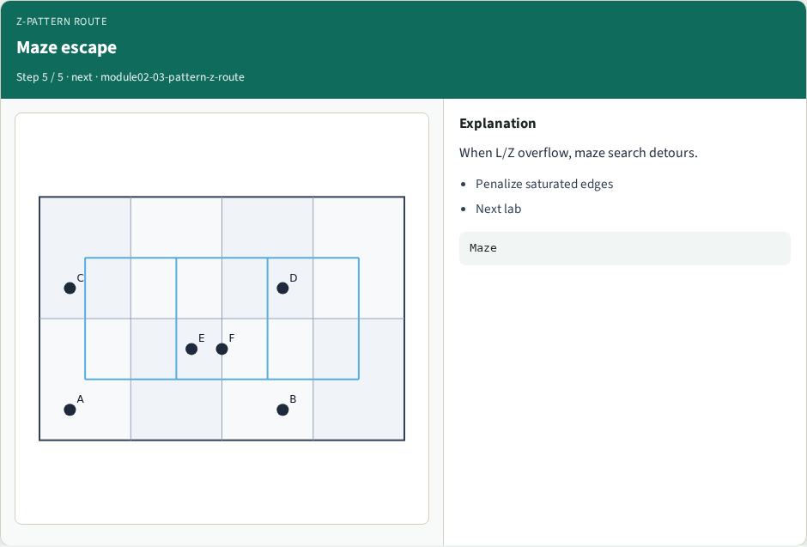
Maze escape
Maze escape
learn_global_routing — 03 pattern z route
Notes:
When L/Z overflow, maze search detours.

Slide 8
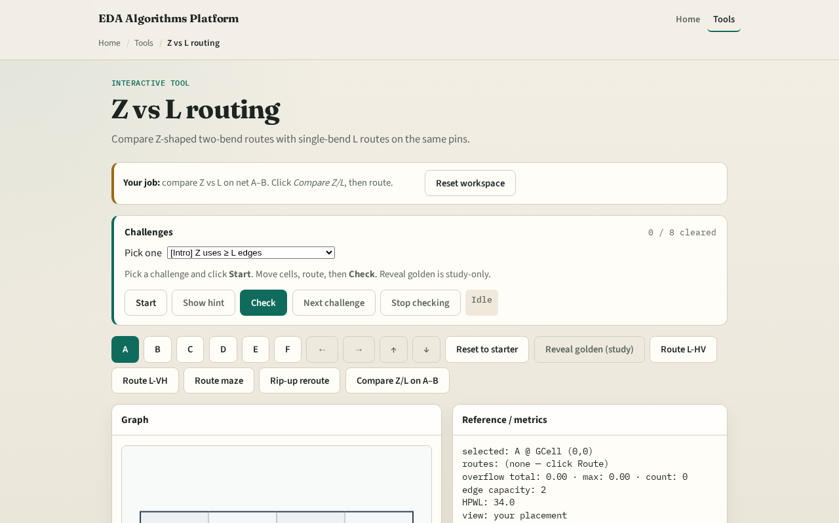
Browser lab track
Browser lab starter
learn_global_routing — 03 pattern z route
Notes:
Open **pattern-z-route**. Compare Z versus L on B to D. Note the extra bend GCell and how edge usage shifts.

Slide 9
Implement track
Implement `z_route(a, b, prefer)`
Print Z and L paths for the same terminal pair; explain one edge difference
learn_global_routing — 03 pattern z route
Notes:
Implement `z_route(a, b, prefer)`. Print Z and L paths for the same terminal pair; explain one edge difference.

Slide 10
Pitfalls
Using a midpoint that leaves zero-length segments
Not falling back to L on aligned pins
Confusing Z prefer HZ with L prefer HV naming
learn_global_routing — 03 pattern z route
Notes:
Using a midpoint that leaves zero-length segments. Not falling back to L on aligned pins. Confusing Z prefer HZ with L prefer HV naming.

Slide 11
Your turn
Finish Z routing on two-pin nets
Next: maze routing that respects congested edges
learn_global_routing — 03 pattern z route
Notes:
Finish Z routing on two-pin nets. Next: maze routing that respects congested edges.

