Slide 1
Routes that detour
Pattern routers ignore blocked channels
learn_global_routing — 05 maze gcell route
Notes:
Pattern routers ignore blocked channels. Maze routing runs BFS on the GCell graph, skipping any edge whose usage is already at capacity. That is how global routers find alternate corridors.

Slide 2
The idea
Seed a queue with start and path list
Pop, expand neighbors, skip edges with usage greater than or equal to capacity
First time you dequeue the goal, return the path
If the queue empties, return None
Shortest feasible path wins
learn_global_routing — 05 maze gcell route
Notes:
Seed a queue with start and path list. Pop, expand neighbors, skip edges with usage greater than or equal to capacity. First time you dequeue the goal, return the path. If the queue empties, return None. Shortest feasible path wins.

Slide 3
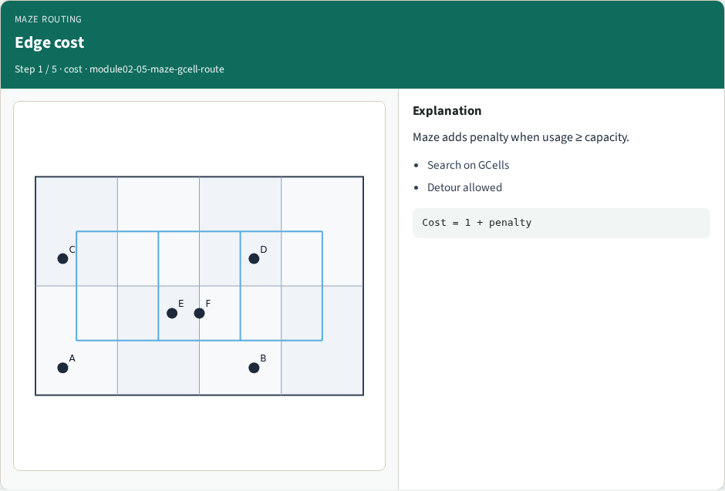
Edge cost
Edge cost
learn_global_routing — 05 maze gcell route
Notes:
Maze adds penalty when usage ≥ capacity.

Slide 4
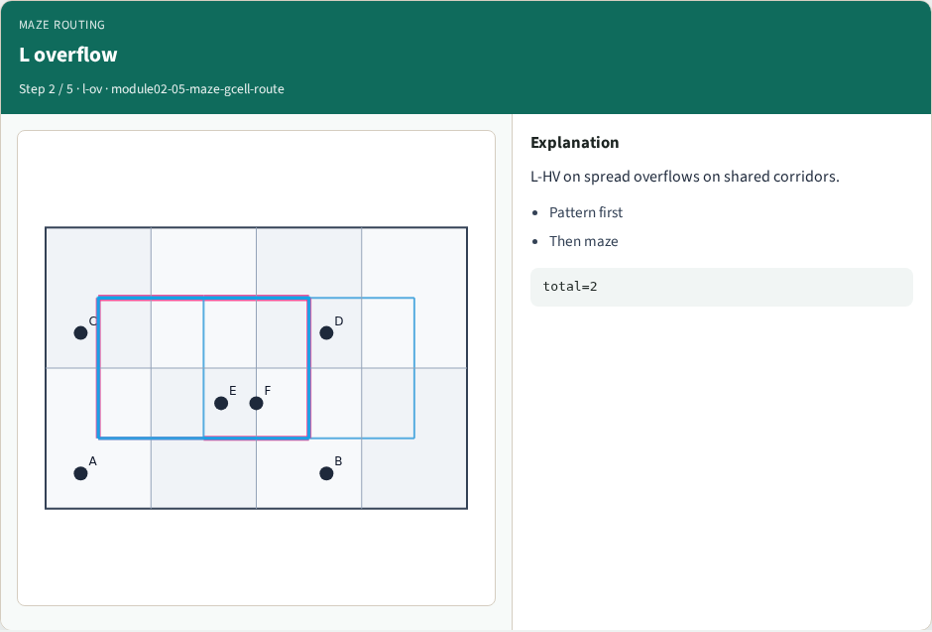
L overflow
L overflow
learn_global_routing — 05 maze gcell route
Notes:
L-HV on spread overflows on shared corridors.

Slide 5
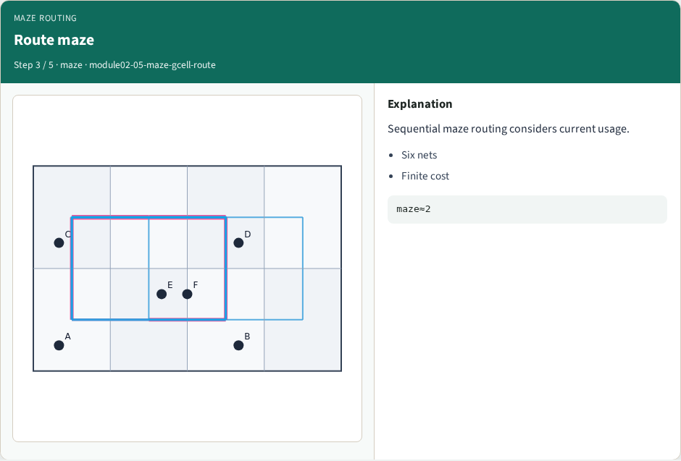
Route maze
Route maze
learn_global_routing — 05 maze gcell route
Notes:
Sequential maze routing considers current usage.

Slide 6
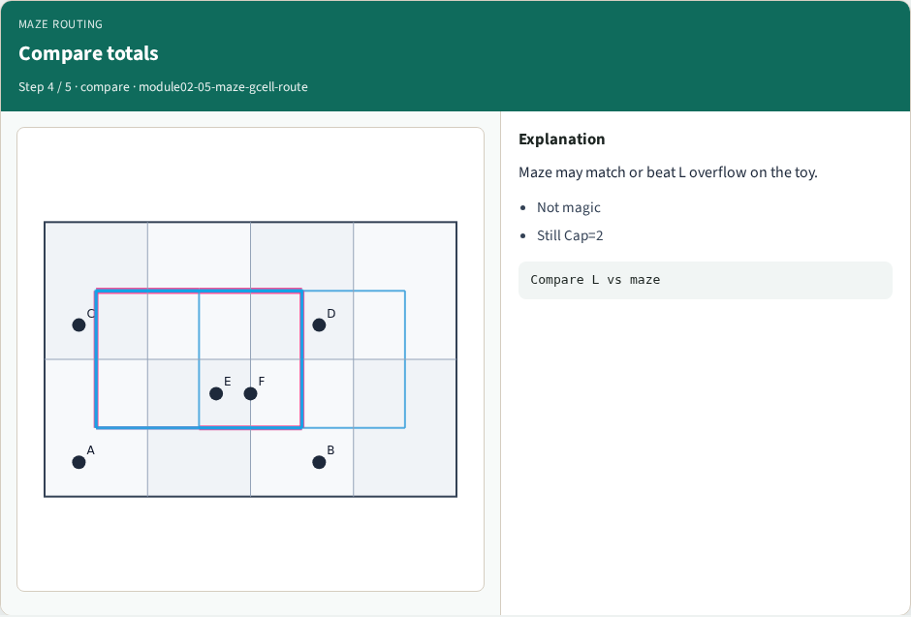
Compare totals
Compare totals
learn_global_routing — 05 maze gcell route
Notes:
Maze may match or beat L overflow on the toy.

Slide 7
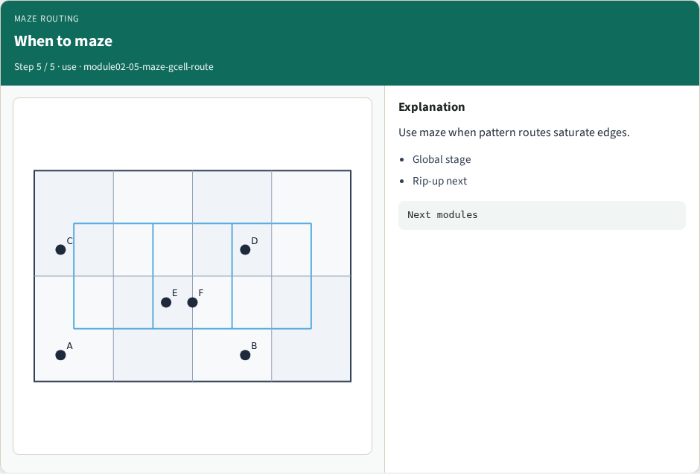
When to maze
When to maze
learn_global_routing — 05 maze gcell route
Notes:
Use maze when pattern routes saturate edges.

Slide 8
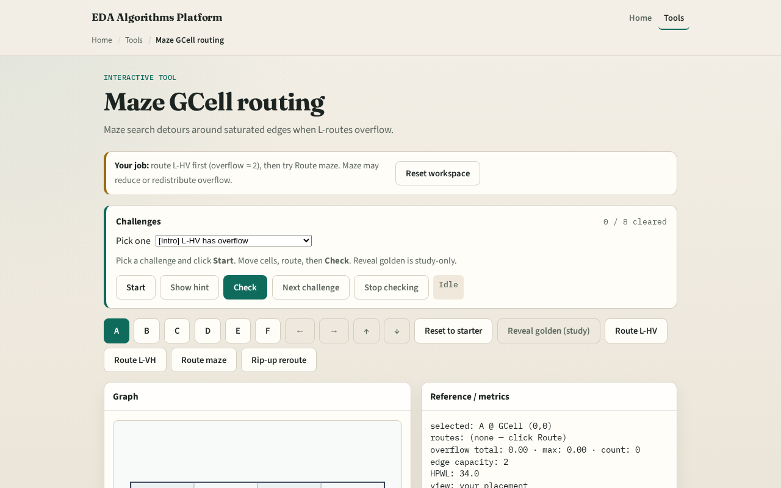
Browser lab track
Browser lab starter
learn_global_routing — 05 maze gcell route
Notes:
Open **maze-gcell-route**. Pre-fill an edge to capacity two and watch maze pick a longer detour. Clear the block and confirm the shortest path returns.

Slide 9
Implement track
Implement `maze_route(a, b, usage, capacity, nx, ny)`
Block edge ((0,0),(1,0)) at cap two and show maze cannot go direct
learn_global_routing — 05 maze gcell route
Notes:
Implement `maze_route(a, b, usage, capacity, nx, ny)`. Block edge ((0,0),(1,0)) at cap two and show maze cannot go direct; unblock a vertical detour path exists.

Slide 10
Pitfalls
Treating usage as per-tile instead of per-edge
Forgetting BFS needs visited set on GCells not edges
Returning a path through a full edge because you checked the wrong direction key
learn_global_routing — 05 maze gcell route
Notes:
Treating usage as per-tile instead of per-edge. Forgetting BFS needs visited set on GCells not edges. Returning a path through a full edge because you checked the wrong direction key.

Slide 11
Your turn
Pass maze goldens
Next: connect more than two pins with a star tree
learn_global_routing — 05 maze gcell route
Notes:
Pass maze goldens. Next: connect more than two pins with a star tree.

