Slide 1
More than two pins
Real nets have many pins
learn_global_routing — 07 multipin tree
Notes:
Real nets have many pins. A full Steiner tree is heavy; our Steiner-lite star picks the bbox-center GCell as a hub and L-routes each pin to that hub. Good enough to teach shared edge usage on the four-pin net A B C D.

Slide 2
The idea
Collect terminal GCells for the net
Center is the integer average of min and max column and row
For each pin, add the edges along l_route center to pin with HV unless you choose VH
Union all legs, edges shared by two legs count once in usage when you deposit
learn_global_routing — 07 multipin tree
Notes:
Collect terminal GCells for the net. Center is the integer average of min and max column and row. For each pin, add the edges along l_route center to pin with HV unless you choose VH. Union all legs—edges shared by two legs count once in usage when you deposit.

Slide 3
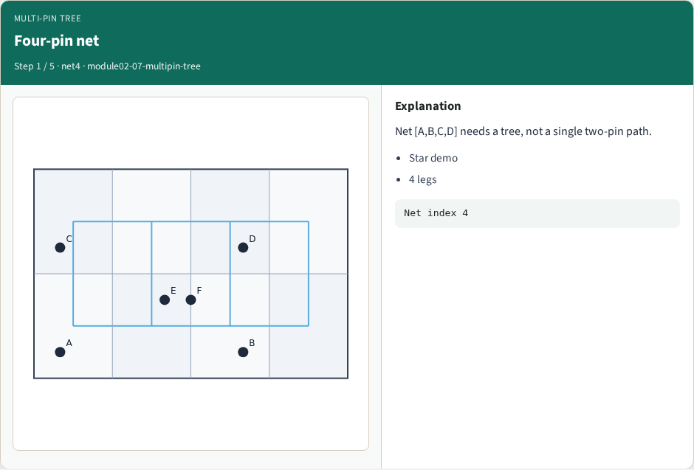
Four-pin net
Four-pin net
learn_global_routing — 07 multipin tree
Notes:
Net [A,B,C,D] needs a tree, not a single two-pin path.

Slide 4
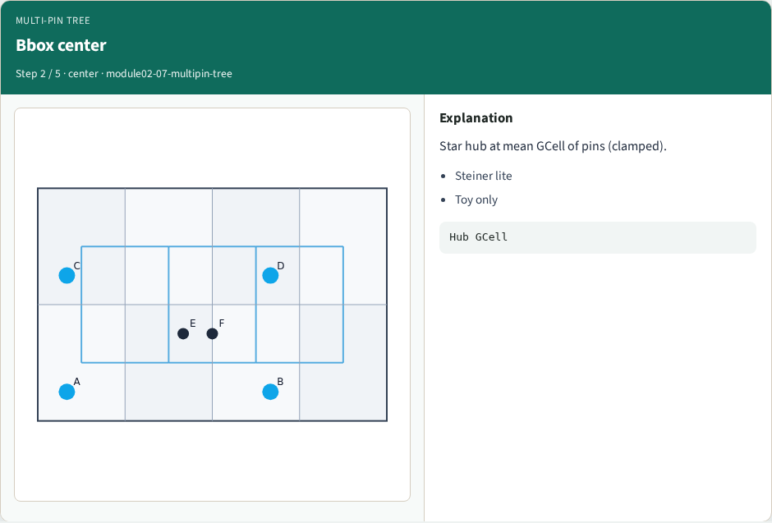
Bbox center
Bbox center
learn_global_routing — 07 multipin tree
Notes:
Star hub at mean GCell of pins (clamped).

Slide 5
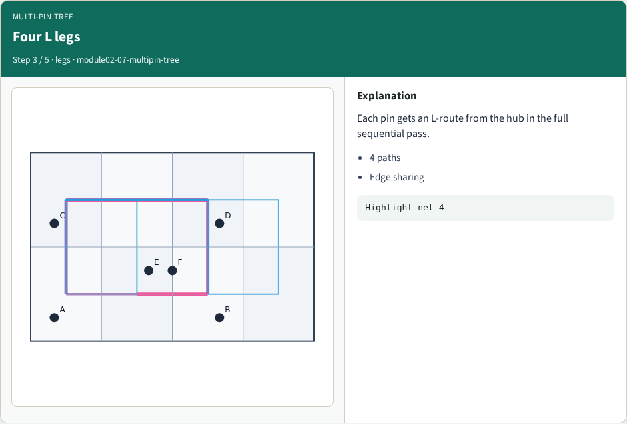
Four L legs
Four L legs
learn_global_routing — 07 multipin tree
Notes:
Each pin gets an L-route from the hub in the full sequential pass.

Slide 6
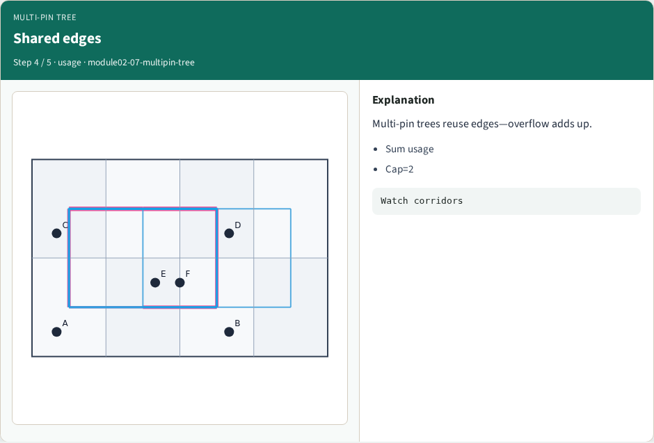
Shared edges
Shared edges
learn_global_routing — 07 multipin tree
Notes:
Multi-pin trees reuse edges—overflow adds up.

Slide 7
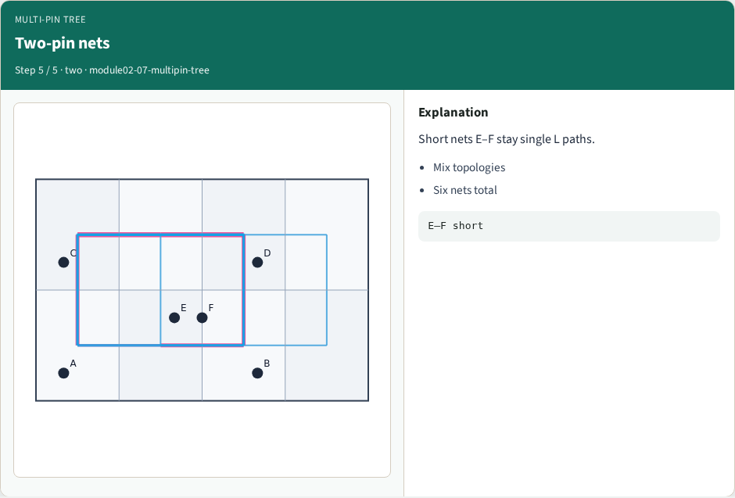
Two-pin nets
Two-pin nets
learn_global_routing — 07 multipin tree
Notes:
Short nets E–F stay single L paths.

Slide 8
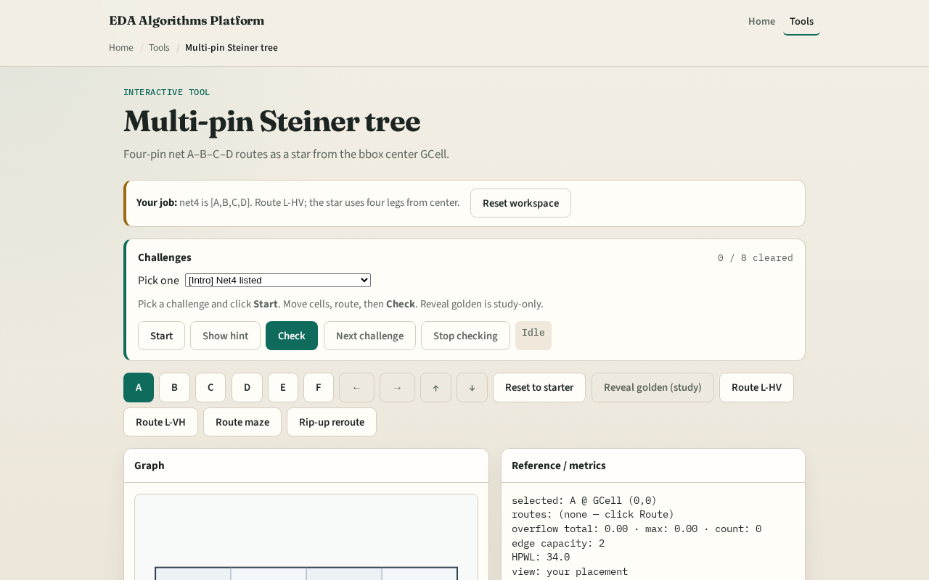
Browser lab track
Browser lab starter
learn_global_routing — 07 multipin tree
Notes:
Open **multipin-tree**. Route the four-pin net and highlight the hub near column one row zero. Compare total edges to four separate two-pin L routes.

Slide 9
Implement track
Implement `multipin_star` and `multipin_star_edges`
Route net index four on tiny_gr and print hub GCell plus edge count
learn_global_routing — 07 multipin tree
Notes:
Implement `multipin_star` and `multipin_star_edges`. Route net index four on tiny_gr and print hub GCell plus edge count.

Slide 10
Pitfalls
Routing pairwise between every pin pair, that explodes edges
Picking chip center instead of bbox center GCell
Double-depositing the same edge when summing legs
learn_global_routing — 07 multipin tree
Notes:
Routing pairwise between every pin pair— that explodes edges. Picking chip center instead of bbox center GCell. Double-depositing the same edge when summing legs—usage should increment per net once per edge traversed.

Slide 11
Your turn
Complete multipin routing
Next: quantify overflow on those shared edges
learn_global_routing — 07 multipin tree
Notes:
Complete multipin routing. Next: quantify overflow on those shared edges.

