Slide 1
When usage exceeds capacity
Each GCell edge has capacity two on tiny_gr
learn_global_routing — 01 edge overflow
Notes:
Each GCell edge has capacity two on tiny_gr. Every routed net deposits plus one on each edge it uses. Overflow is how far usage exceeds capacity—summed, maxed, and counted per edge.

Slide 2
The idea
For each edge e, overflow e equals max of zero and usage e minus capacity
Total is the sum across edges
Max is the worst edge
Count is how many edges have positive overflow
Sequential L-HV on all six nets should yield positive total overflow at cap two
learn_global_routing — 01 edge overflow
Notes:
For each edge e, overflow e equals max of zero and usage e minus capacity. Total is the sum across edges. Max is the worst edge. Count is how many edges have positive overflow. Sequential L-HV on all six nets should yield positive total overflow at cap two.

Slide 3
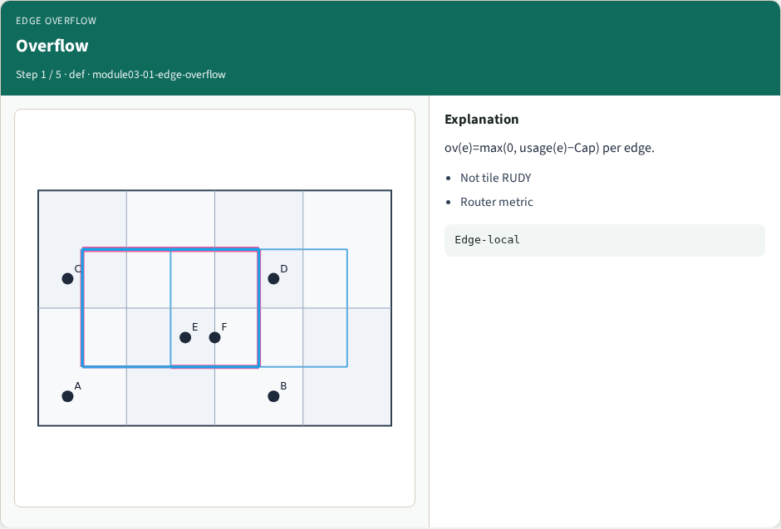
Overflow
Overflow
learn_global_routing — 01 edge overflow
Notes:
ov(e)=max(0, usage(e)−Cap) per edge.

Slide 4
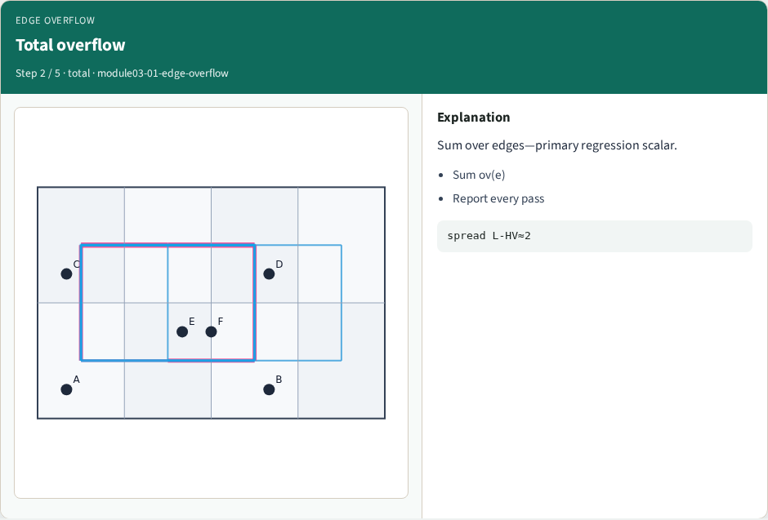
Total overflow
Total overflow
learn_global_routing — 01 edge overflow
Notes:
Sum over edges—primary regression scalar.

Slide 5
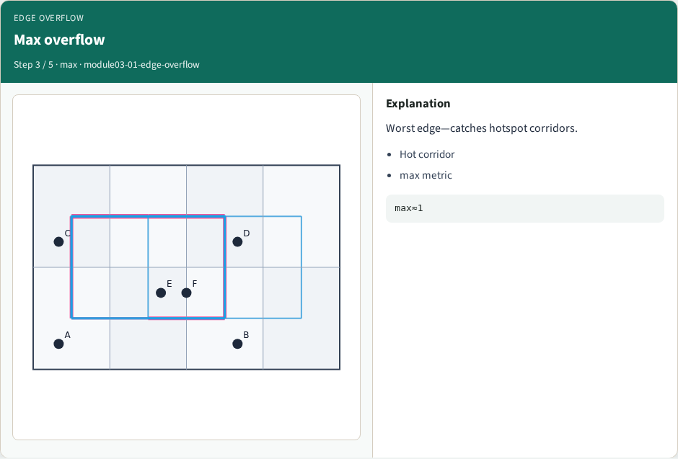
Max overflow
Max overflow
learn_global_routing — 01 edge overflow
Notes:
Worst edge—catches hotspot corridors.

Slide 6
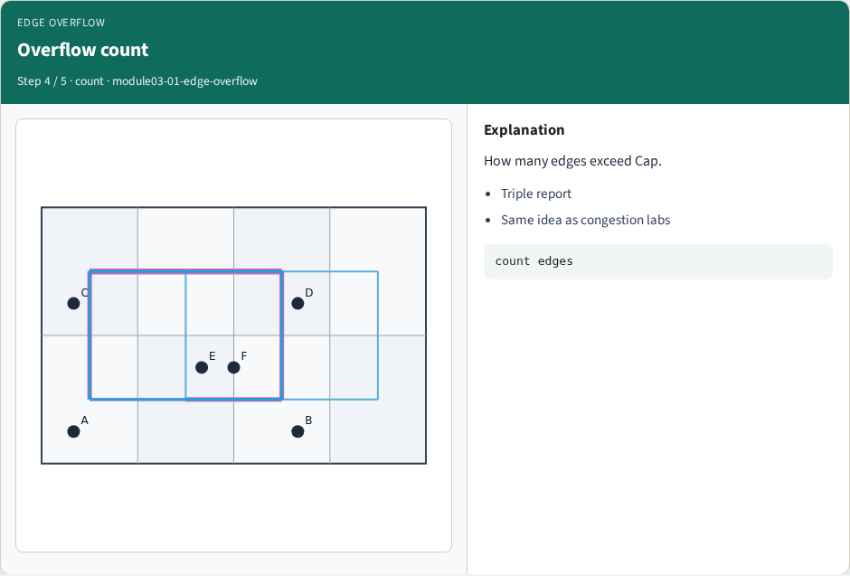
Overflow count
Overflow count
learn_global_routing — 01 edge overflow
Notes:
How many edges exceed Cap.

Slide 7
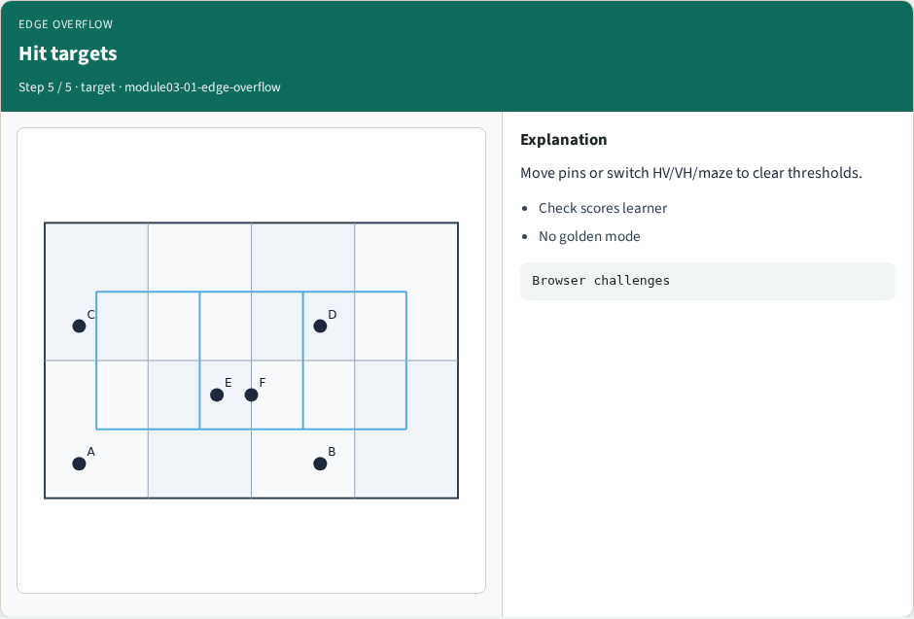
Hit targets
Hit targets
learn_global_routing — 01 edge overflow
Notes:
Move pins or switch HV/VH/maze to clear thresholds.

Slide 8
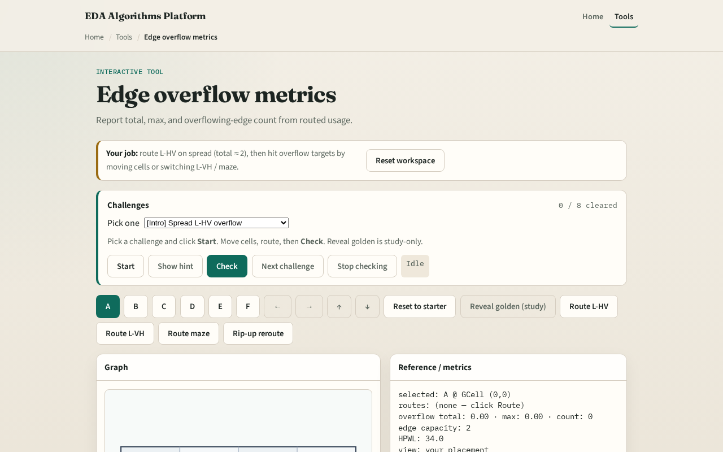
Browser lab track
Browser lab starter
learn_global_routing — 01 edge overflow
Notes:
Open **edge-overflow**. Run sequential L routes and read the triple total max count. Heat-map the worst edge.

Slide 9
Implement track
Implement `edge_overflow(usage, capacity)`
Call route_nets with mode l_hv on tiny_gr and assert total overflow is greater than zero
learn_global_routing — 01 edge overflow
Notes:
Implement `edge_overflow(usage, capacity)`. Call route_nets with mode l_hv on tiny_gr and assert total overflow is greater than zero.

Slide 10
Pitfalls
Computing overflow before summing all nets
Using tile demand from congestion instead of edge usage
Reporting negative overflow values
learn_global_routing — 01 edge overflow
Notes:
Computing overflow before summing all nets. Using tile demand from congestion instead of edge usage. Reporting negative overflow values.

Slide 11
Your turn
Hit overflow targets
Next: rip-up the hottest net and maze reroute
learn_global_routing — 01 edge overflow
Notes:
Hit overflow targets. Next: rip-up the hottest net and maze reroute.

