Slide 1
Relieve hotspots
When overflow appears, global routers rip up contributing nets and reroute around congested edges
learn_global_routing — 03 ripup reroute
Notes:
When overflow appears, global routers rip up contributing nets and reroute around congested edges. Our toy pass picks the net whose edges contribute the most overflow, removes its usage, then maze-reroutes.

Slide 2
The idea
Score each net by overflow on its edges
Subtract its route from usage
Run maze_route between its pins with the remaining usage map
Add the new edges back
Total overflow should not rise; ideally it drops versus the pre-rip state
learn_global_routing — 03 ripup reroute
Notes:
Score each net by overflow on its edges. Subtract its route from usage. Run maze_route between its pins with the remaining usage map. Add the new edges back. Total overflow should not rise; ideally it drops versus the pre-rip state.

Slide 3
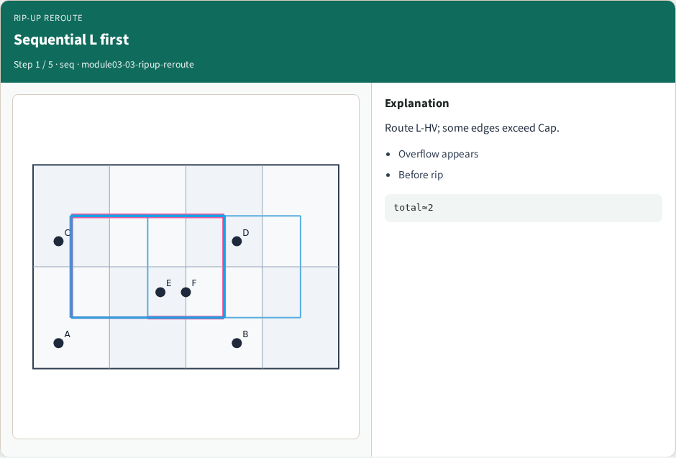
Sequential L first
Sequential L first
learn_global_routing — 03 ripup reroute
Notes:
Route L-HV; some edges exceed Cap.

Slide 4
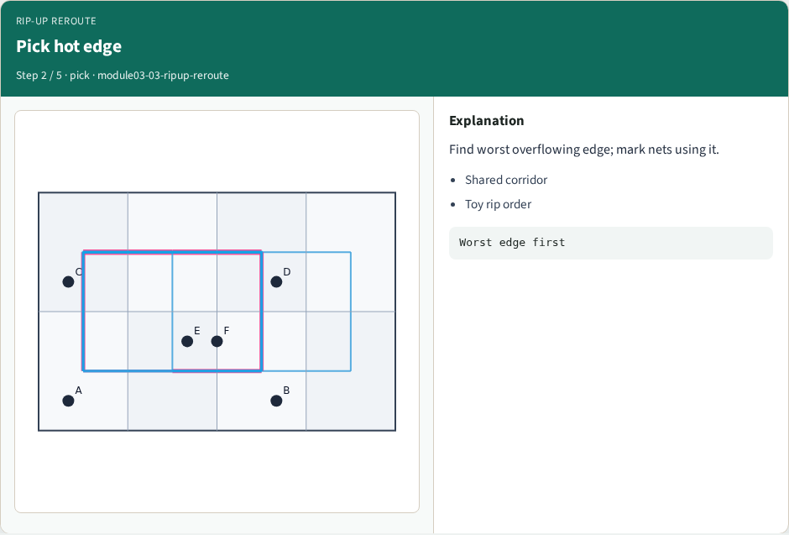
Pick hot edge
Pick hot edge
learn_global_routing — 03 ripup reroute
Notes:
Find worst overflowing edge; mark nets using it.

Slide 5
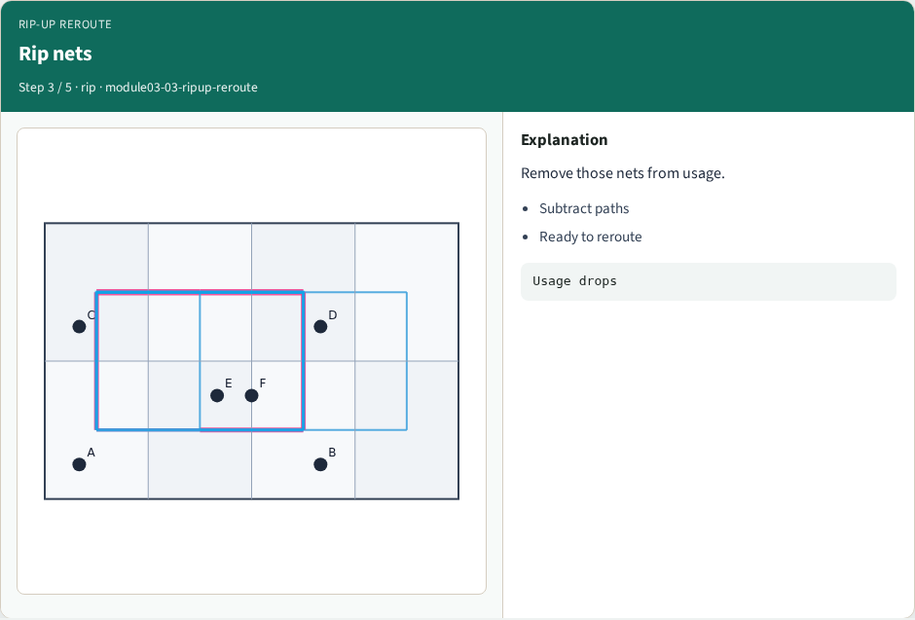
Rip nets
Rip nets
learn_global_routing — 03 ripup reroute
Notes:
Remove those nets from usage.

Slide 6
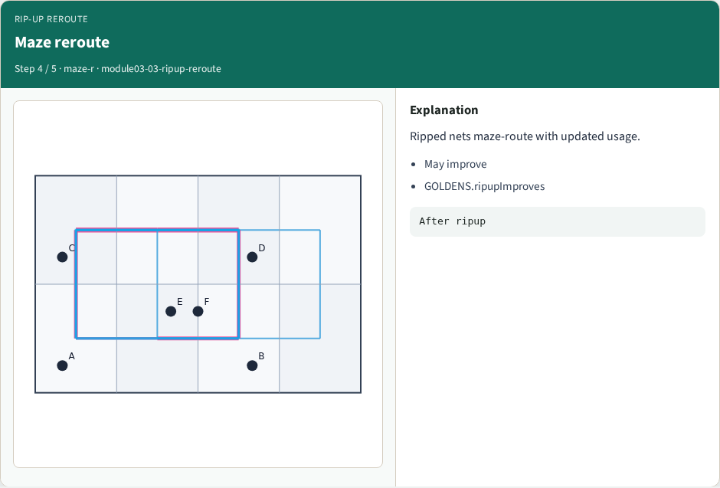
Maze reroute
Maze reroute
learn_global_routing — 03 ripup reroute
Notes:
Ripped nets maze-route with updated usage.

Slide 7
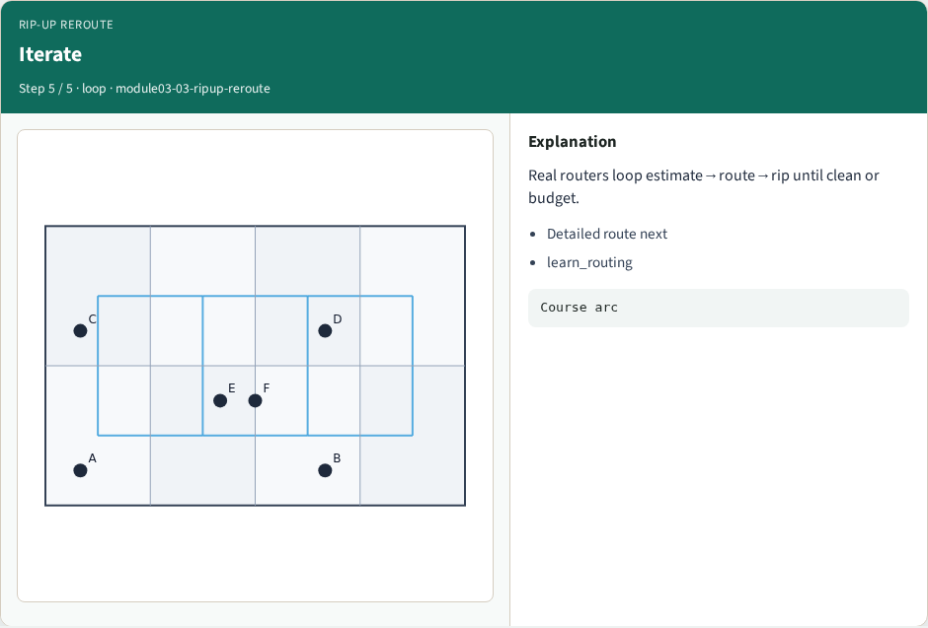
Iterate
Iterate
learn_global_routing — 03 ripup reroute
Notes:
Real routers loop estimate→route→rip until clean or budget.

Slide 8
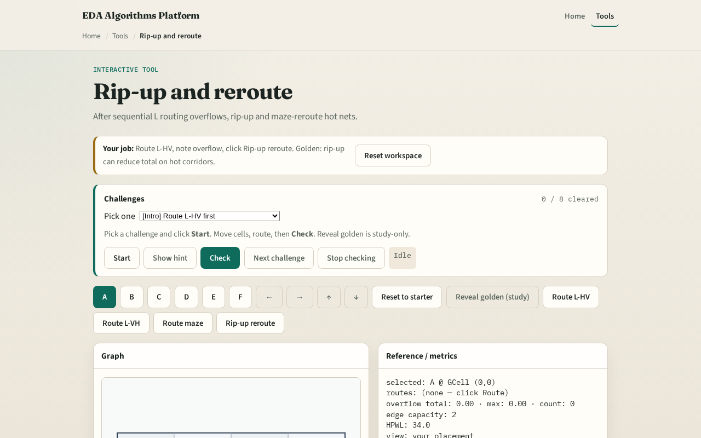
Browser lab track
Browser lab starter
learn_global_routing — 03 ripup reroute
Notes:
Open **ripup-reroute**. Run sequential L to create overflow, then one rip-up pass. Watch total overflow fall on the metrics panel.

Slide 9
Implement track
Implement `ripup_reroute(routes, usage, capacity, nets, term, nx, ny)`
Assert total overflow after is less than or equal to before on tiny_gr sequential L seed
learn_global_routing — 03 ripup reroute
Notes:
Implement `ripup_reroute(routes, usage, capacity, nets, term, nx, ny)`. Assert total overflow after is less than or equal to before on tiny_gr sequential L seed.

Slide 10
Pitfalls
Ripping a net but leaving ghost usage on its old edges
Rerouting with pattern L through the same hot edge
Picking the wrong net to rip, use overflow contribution not HPWL
learn_global_routing — 03 ripup reroute
Notes:
Ripping a net but leaving ghost usage on its old edges. Rerouting with pattern L through the same hot edge. Picking the wrong net to rip—use overflow contribution not HPWL.

Slide 11
Your turn
Clear rip-up challenges
Next: tie it together with full sequential global routing
learn_global_routing — 03 ripup reroute
Notes:
Clear rip-up challenges. Next: tie it together with full sequential global routing.

