Slide 1
Order matters
Production global routers process nets in an order
learn_global_routing — 01 sequential global
Notes:
Production global routers process nets in an order. Each net deposits usage on edges; later nets see a more congested graph. Sequential L-HV on tiny_gr is our baseline stress test.

Slide 2
The idea
Initialize empty usage
Increment usage on every edge in the route
Report final usage and edge_overflow summary
learn_global_routing — 01 sequential global
Notes:
Initialize empty usage. For each net in list order, compute terminals, route with the chosen mode—l_hv for two-pin L, star for multi-pin—and increment usage on every edge in the route. Report final usage and edge_overflow summary.

Slide 3
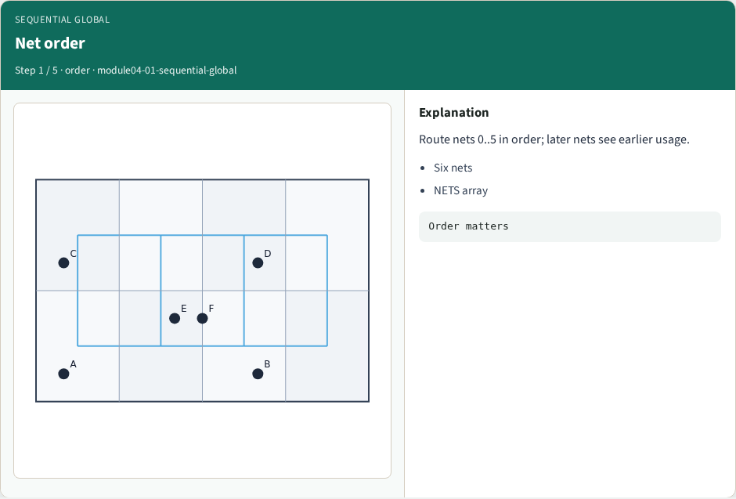
Net order
Net order
learn_global_routing — 01 sequential global
Notes:
Route nets 0..5 in order; later nets see earlier usage.

Slide 4
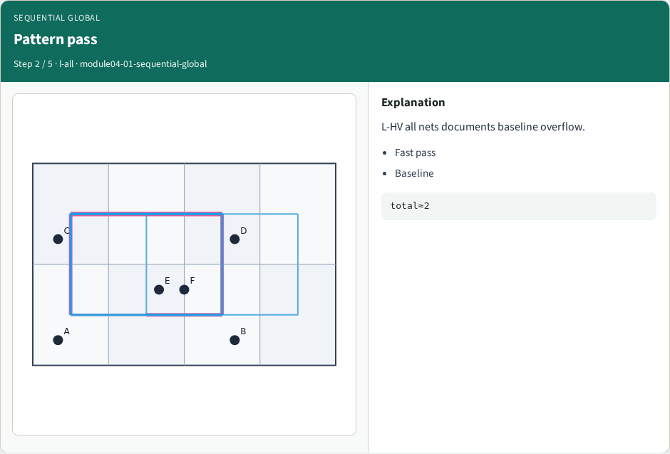
Pattern pass
Pattern pass
learn_global_routing — 01 sequential global
Notes:
L-HV all nets documents baseline overflow.

Slide 5
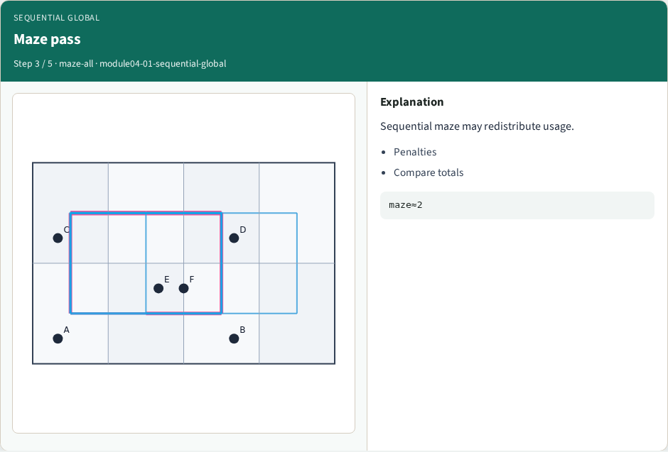
Maze pass
Maze pass
learn_global_routing — 01 sequential global
Notes:
Sequential maze may redistribute usage.

Slide 6
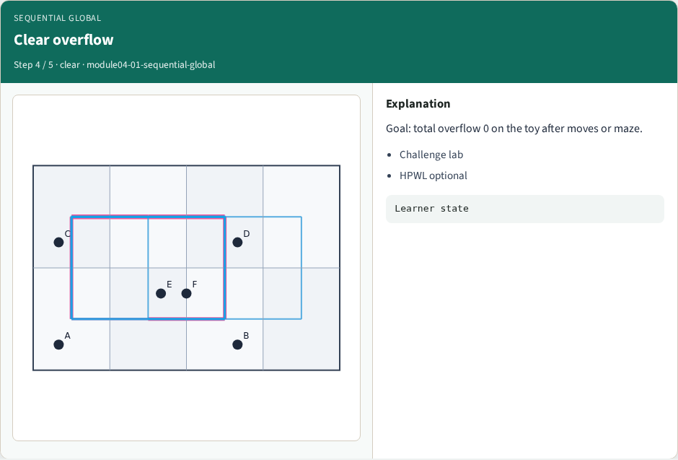
Clear overflow
Clear overflow
learn_global_routing — 01 sequential global
Notes:
Goal: total overflow 0 on the toy after moves or maze.

Slide 7
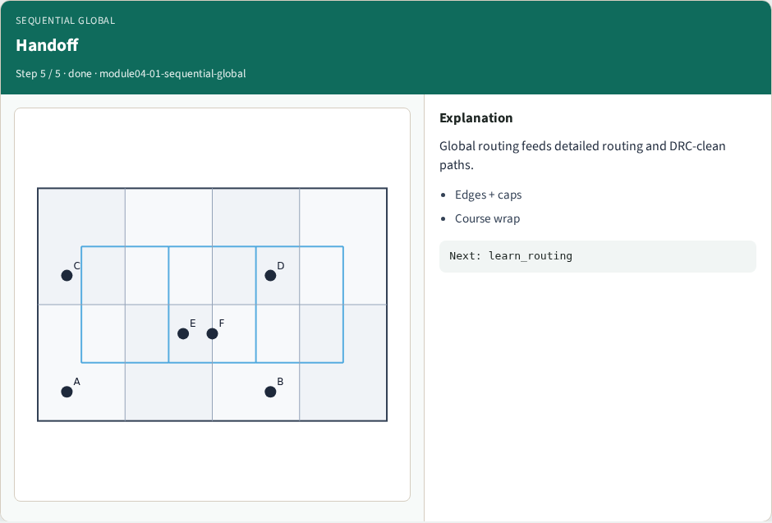
Handoff
Handoff
learn_global_routing — 01 sequential global
Notes:
Global routing feeds detailed routing and DRC-clean paths.

Slide 8
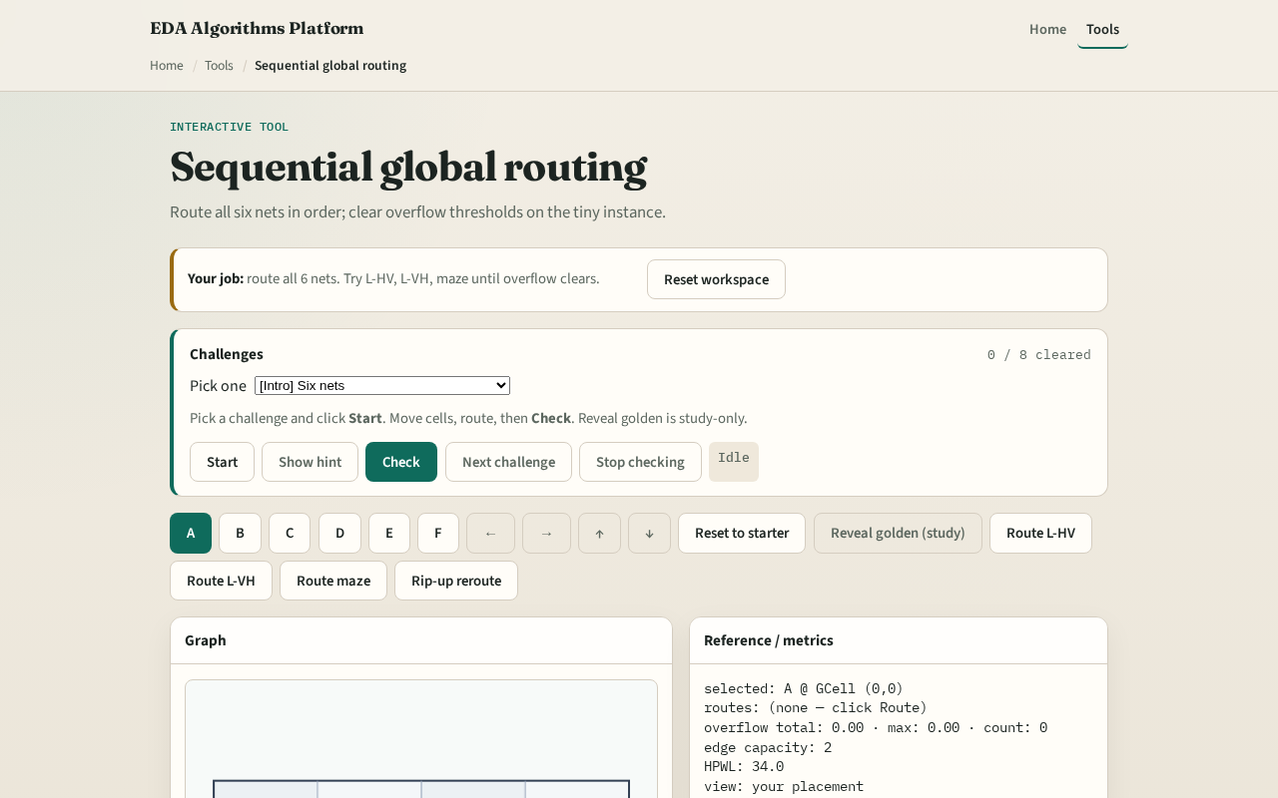
Browser lab track
Browser lab starter
learn_global_routing — 01 sequential global
Notes:
Open **sequential-global**. Route all nets in default order. Reorder mentally: would routing the four-pin net last change the hottest edge?

Slide 9
Implement track
Implement `route_nets` and `route_nets_with_routes`
Print usage and overflow after routing all six nets
Compare with maze mode on total overflow
learn_global_routing — 01 sequential global
Notes:
Implement `route_nets` and `route_nets_with_routes`. Print usage and overflow after routing all six nets. Compare with maze mode on total overflow.

Slide 10
Pitfalls
Parallel deposit without order, hides rip-up motivation
Ignoring multi-pin net in order list
Resetting usage between nets accidentally
learn_global_routing — 01 sequential global
Notes:
Parallel deposit without order— hides rip-up motivation. Ignoring multi-pin net in order list. Resetting usage between nets accidentally.

Slide 11
Your turn
Complete sequential global routing
Offline compare and wrap come next
learn_global_routing — 01 sequential global
Notes:
Complete sequential global routing. Offline compare and wrap come next.

