Slide 1
Boundary pin / I/O assignment
Pins sit on outline edges
learn_floorplanning — 03 pin assignment
Notes:
Pins sit on outline edges. Golden assignment places P0 left, P1 bottom, P2 right, P3 top—four sides covered so pinsValid is true. An empty list is invalid.

Slide 2
Pseudocode
Pin assignment validates boundary I/O
Pseudocode checks side and offset ranges and requires all four outline sides to appear
Open this module's examples file and find the Pseudocode section
That written sketch is what you implement on the implement track and what the browser
learn_floorplanning — 03 pin assignment
Notes:
Pin assignment validates boundary I/O. Pseudocode checks side and offset ranges and requires all four outline sides to appear.
Open this module's examples file and find the Pseudocode section. That written sketch is what you implement on the implement track and what the browser challenges measure.

Slide 3
Algorithm sketch
Golden pins cover left, bottom, right, and top and return valid true
An empty list fails validity
learn_floorplanning — 03 pin assignment
Notes:
Golden pins cover left, bottom, right, and top and return valid true. An empty list fails validity.

Slide 4
Algorithm sketch — try these
INPUT: outline, pin list {side, offset}
OUTPUT: pinsValid?
each pin on left|right|top|bottom edge
offset in range for that side
require all four sides represented
GOLDEN 4 pins (one/side) → valid true
empty list → valid false
learn_floorplanning — 03 pin assignment

Slide 5
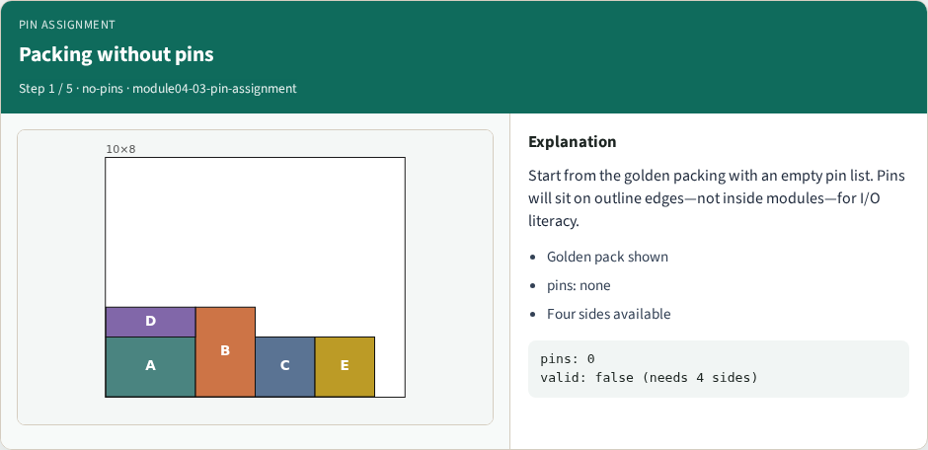
Packing without pins
Packing without pins
learn_floorplanning — 03 pin assignment
Notes:
Start from the golden packing with an empty pin list. Pins will sit on outline edges—not inside modules—for I/O literacy.

Slide 6
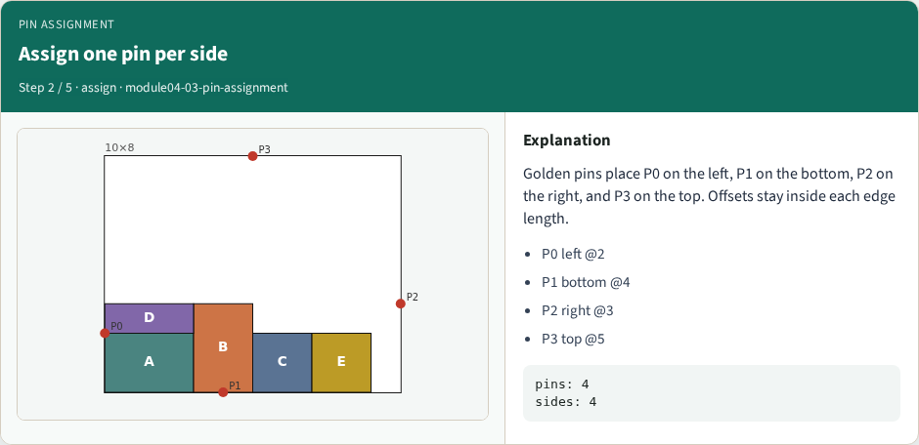
Assign one pin per side
Assign one pin per side
learn_floorplanning — 03 pin assignment
Notes:
Golden pins place P0 on the left, P1 on the bottom, P2 on the right, and P3 on the top. Offsets stay inside each edge length.

Slide 7
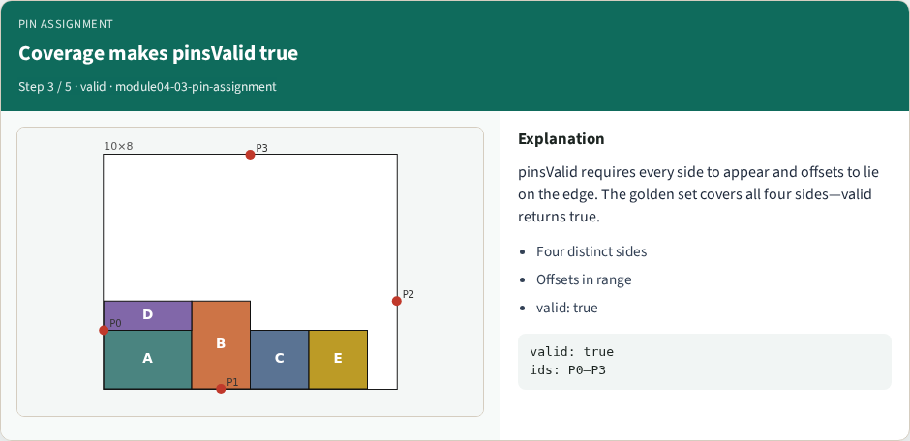
Coverage makes pinsValid true
Coverage makes pinsValid true
learn_floorplanning — 03 pin assignment
Notes:
pinsValid requires every side to appear and offsets to lie on the edge. The golden set covers all four sides—valid returns true.

Slide 8
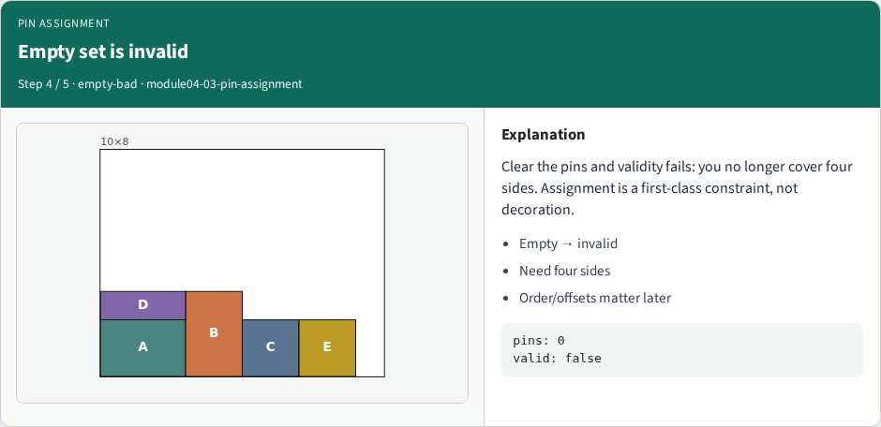
Empty set is invalid
Empty set is invalid
learn_floorplanning — 03 pin assignment
Notes:
Clear the pins and validity fails: you no longer cover four sides. Assignment is a first-class constraint, not decoration.

Slide 9

Pins feed place and route
Pins feed place and route
learn_floorplanning — 03 pin assignment
Notes:
Boundary pins shape terminal propagation and routing demand. After floorplan shapes settle, pin assignment is the bridge to placement.

Slide 10
Browser lab track
Open pin-assignment
Assign golden pins, confirm four sides and valid true
Clear pins and watch validity fail
learn_floorplanning — 03 pin assignment
Notes:
Open pin-assignment. Assign golden pins, confirm four sides and valid true. Clear pins and watch validity fail.

Slide 11
Implement track
Implement pinsValid requiring all four sides and in-range offsets
Assert golden pins pass and the empty list fails
learn_floorplanning — 03 pin assignment
Notes:
Implement pinsValid requiring all four sides and in-range offsets. Assert golden pins pass and the empty list fails.

Slide 12
Pitfalls
Putting pins inside modules
learn_floorplanning — 03 pin assignment
Notes:
Putting pins inside modules; offsets past edge length; claiming validity with only two sides covered.

Slide 13
Your turn
Ship a valid four-side assignment
Offline compare is next; then the wrap points to learn_placement
learn_floorplanning — 03 pin assignment
Notes:
Ship a valid four-side assignment. Offline compare is next; then the wrap points to learn_placement.

