Slide 1
Congestion in the stack
You placed and legalized cells
learn_congestion — 00 intro
Notes:
You placed and legalized cells. Routers still need room in each GCell. This course teaches how to estimate demand, read overflow, and feed congestion back into placement—before you open a full global router.

Slide 2
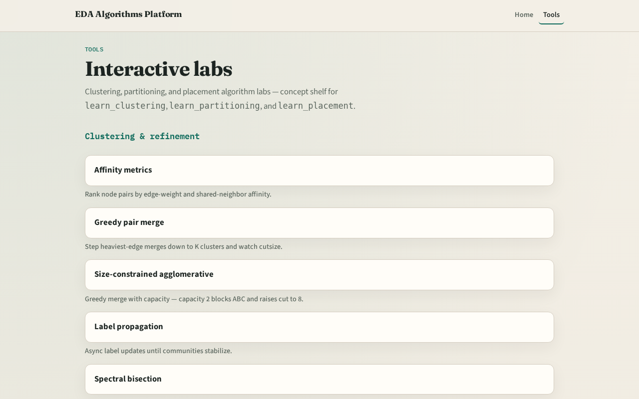
Two tracks
Track B is the browser lab: drag cells, watch heat maps, clear challenges
Track A is implement: Python solvers on a tiny JSON instance
Use either or both
Browser first for intuition is fine
learn_congestion — 00 intro
Notes:
Track B is the browser lab: drag cells, watch heat maps, clear challenges. Track A is implement: Python solvers on a tiny JSON instance. Use either or both. Browser first for intuition is fine.

Slide 3
Course map
Foundations cover GCells and capacity
Estimation covers RUDY, probabilistic demand, heat maps, and overflow metrics
Feedback covers inflators, net weights, and one placement loop
Offline compare and wrap close the path
learn_congestion — 00 intro
Notes:
Foundations cover GCells and capacity. Estimation covers RUDY, probabilistic demand, heat maps, and overflow metrics. Feedback covers inflators, net weights, and one placement loop. Offline compare and wrap close the path.

Slide 4
Prerequisites
Finish learn_placement or learn_legalization first so float versus legal coordinates
Density bins from placement are cousins, not the same as routing GCells
learn_congestion — 00 intro
Notes:
Finish learn_placement or learn_legalization first so float versus legal coordinates already make sense. Density bins from placement are cousins—not the same as routing GCells.

Slide 5
How to move
Read each module README
Odd module slots leave room to insert algorithms later without renumbering
learn_congestion — 00 intro
Notes:
Read each module README, pick a track, check the checklist, then skim the clip when media is available. Odd module slots leave room to insert algorithms later without renumbering.

Slide 6
Next
Complete the quiz for this part
Open the GCell grid model and learn the four-by-two tiling by heart
learn_congestion — 00 intro
Notes:
Open the GCell grid model and learn the four-by-two tiling by heart.

