Slide 1
Why GCells
After legalization you have legal cell sites, but routers still think in coarser tiles called GCells
learn_congestion — 01 gcell grid
Notes:
After legalization you have legal cell sites, but routers still think in coarser tiles called GCells. Our toy chip is twelve by eight. We overlay a four by two grid: each GCell is three wide and four tall. Congestion literacy starts by naming which tile owns a point.

Slide 2
The idea
Index with lower-left origin
Column i is floor of x over cell width, clamped to zero through three
Row j is floor of y over cell height, clamped to zero or one
Cell A at one comma one lands in GCell zero comma zero
Cell D at eight comma five lands in two comma one
Memorize that mapping, every estimator reuses it
learn_congestion — 01 gcell grid
Notes:
Index with lower-left origin. Column i is floor of x over cell width, clamped to zero through three. Row j is floor of y over cell height, clamped to zero or one. Cell A at one comma one lands in GCell zero comma zero. Cell D at eight comma five lands in two comma one. Memorize that mapping—every estimator reuses it.

Slide 3
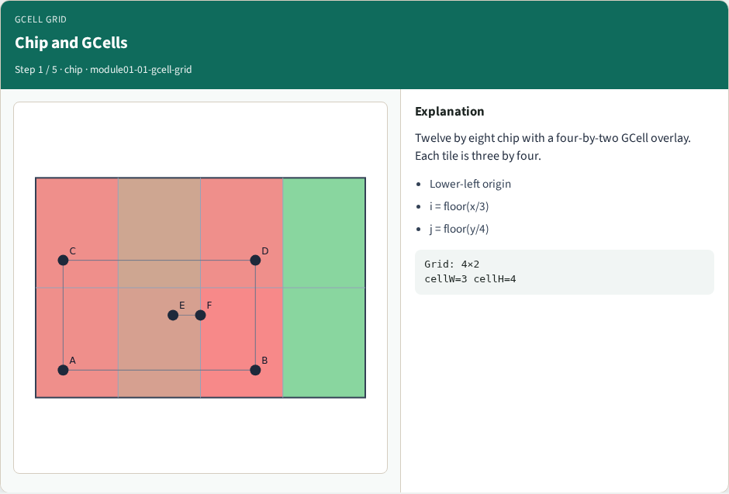
Chip and GCells
Chip and GCells
learn_congestion — 01 gcell grid
Notes:
Twelve by eight chip with a four-by-two GCell overlay. Each tile is three by four.

Slide 4
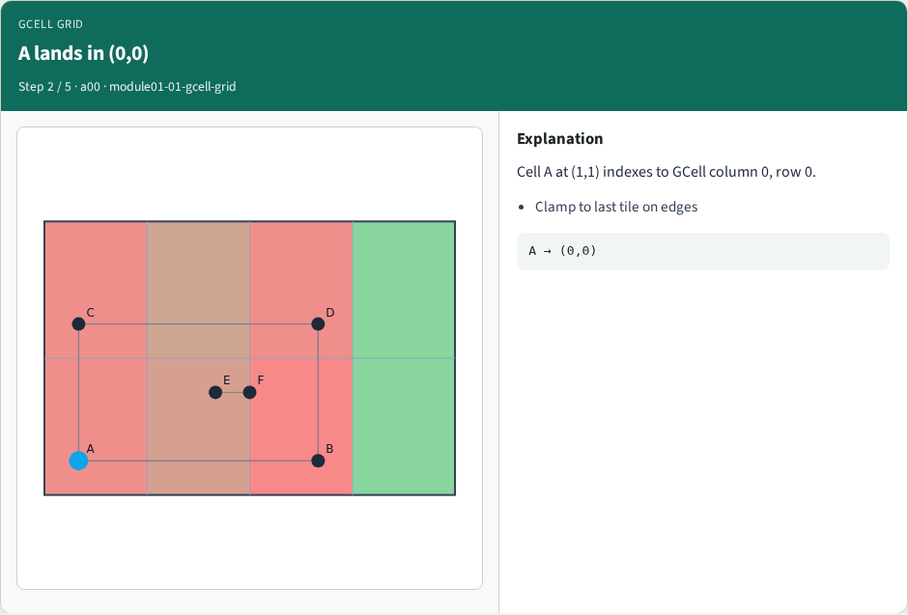
A lands in (0,0)
A lands in (0,0)
learn_congestion — 01 gcell grid
Notes:
Cell A at (1,1) indexes to GCell column 0, row 0.

Slide 5
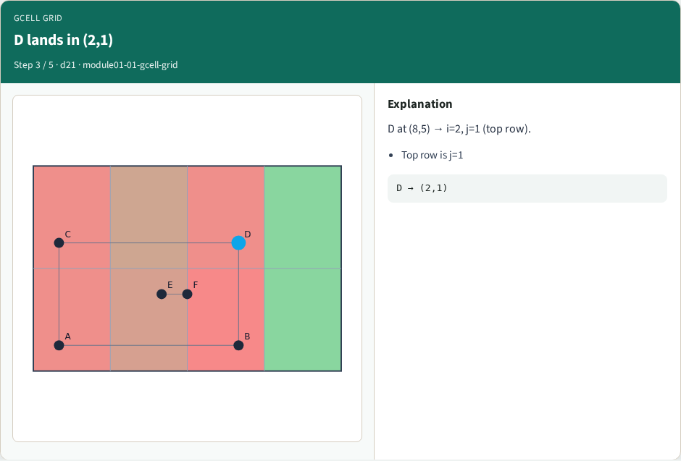
D lands in (2,1)
D lands in (2,1)
learn_congestion — 01 gcell grid
Notes:
D at (8,5) → i=2, j=1 (top row).

Slide 6

Paint all centers
Paint all centers
learn_congestion — 01 gcell grid
Notes:
Every cell maps to exactly one GCell; the grid is the router’s coarse map.

Slide 7
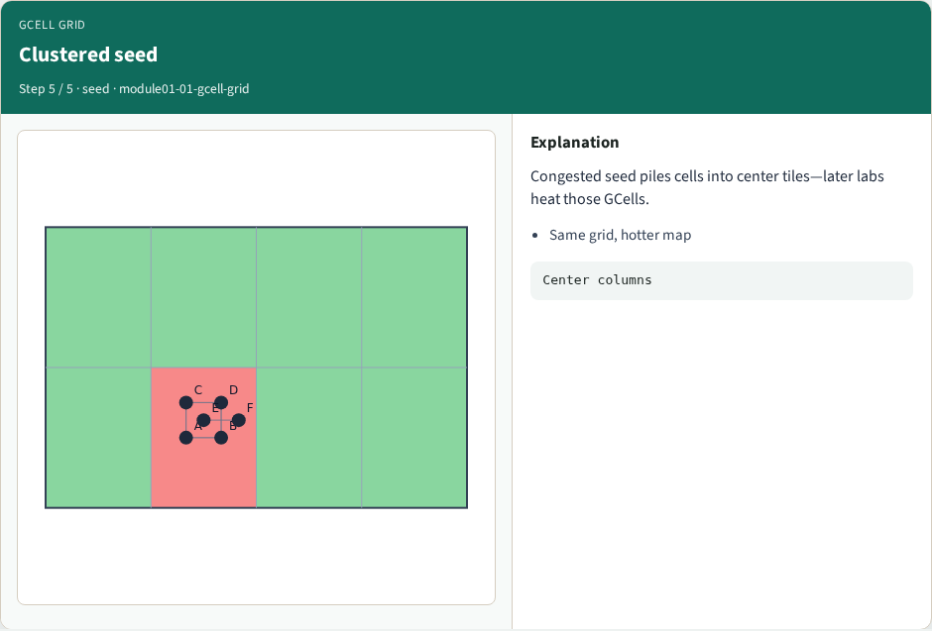
Clustered seed
Clustered seed
learn_congestion — 01 gcell grid
Notes:
Congested seed piles cells into center tiles—later labs heat those GCells.

Slide 8
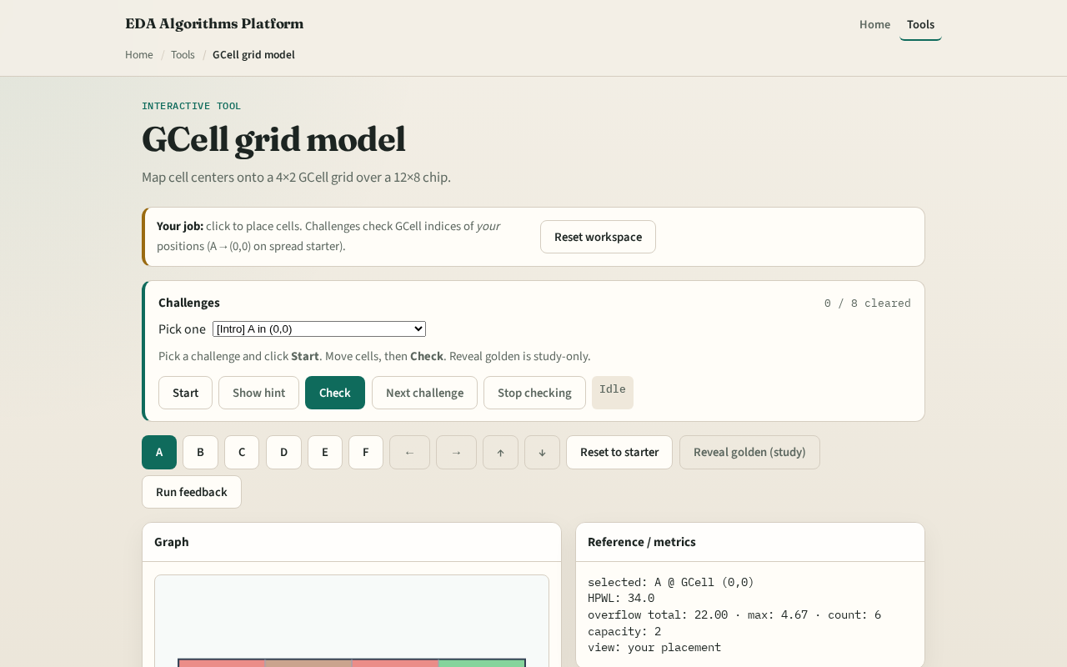
Browser lab track
Browser lab starter
learn_congestion — 01 gcell grid
Notes:
Open the **gcell-grid** lab. Move a cell and read the GCell index in the metrics panel. Paint the grid lines so the four-by-two tiling is obvious. Then encode the same clamp-and-floor rule in Track A.

Slide 9
Implement track
Parse `tiny_cong.json`
Print nx, ny, cellW, cellH
Write `cell_gcell(x, y)` returning (i, j)
Assert A→(0,0) and D→(2,1) on the spread placement
No demand yet, this module is pure geometry
learn_congestion — 01 gcell grid
Notes:
Parse `tiny_cong.json`. Print nx, ny, cellW, cellH. Write `cell_gcell(x, y)` returning (i, j). Assert A→(0,0) and D→(2,1) on the spread placement. No demand yet—this module is pure geometry.

Slide 10
Pitfalls
Using upper-left image coordinates instead of chip lower-left
Forgetting to clamp points on the right or top edge into the last tile
Mixing site columns from legalization with GCell columns, different grids
learn_congestion — 01 gcell grid
Notes:
Using upper-left image coordinates instead of chip lower-left. Forgetting to clamp points on the right or top edge into the last tile. Mixing site columns from legalization with GCell columns—different grids.

Slide 11
Your turn
Finish the checklist
Be able to sketch the eight GCells from memory
Next: capacity versus demand, the supply side of the map
learn_congestion — 01 gcell grid
Notes:
Finish the checklist. Be able to sketch the eight GCells from memory. Next: capacity versus demand—the supply side of the map.

