Slide 1
Supply and load
A GCell has a routing budget, capacity
learn_congestion — 03 capacity demand
Notes:
A GCell has a routing budget—capacity. Estimators deposit demand into the same tiles. When demand exceeds capacity the tile is oversubscribed. On our toy instance capacity is two point zero for every GCell unless you change it.

Slide 2
The idea
Surplus equals demand minus capacity
Positive surplus means overflow
List oversubscribed tiles before you trust a heat map
Capacity can later become anisotropic edge capacities
learn_congestion — 03 capacity demand
Notes:
Surplus equals demand minus capacity. Positive surplus means overflow. List oversubscribed tiles before you trust a heat map. Capacity can later become anisotropic edge capacities; here it is a scalar so goldens stay simple.

Slide 3
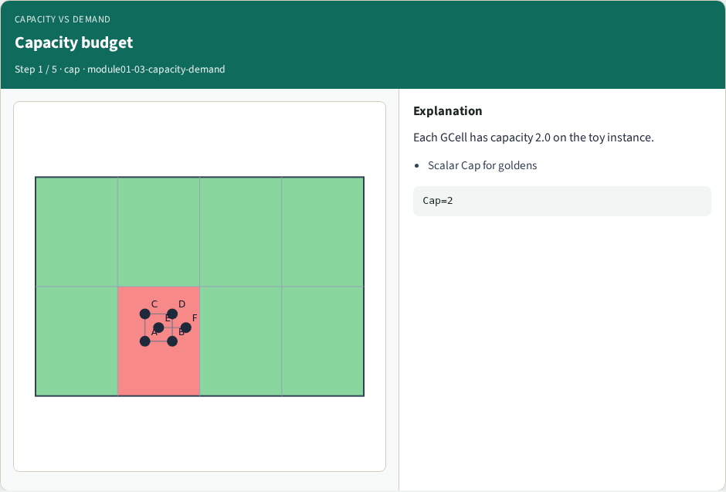
Capacity budget
Capacity budget
learn_congestion — 03 capacity demand
Notes:
Each GCell has capacity 2.0 on the toy instance.

Slide 4
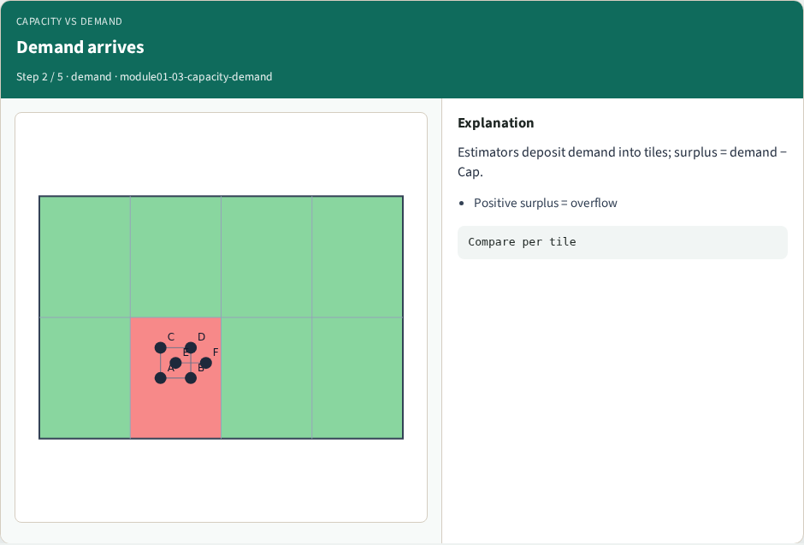
Demand arrives
Demand arrives
learn_congestion — 03 capacity demand
Notes:
Estimators deposit demand into tiles; surplus = demand − Cap.

Slide 5

Oversubscribed tiles
Oversubscribed tiles
learn_congestion — 03 capacity demand
Notes:
Flag every tile with demand > Cap before trusting a heat map.

Slide 6

Lower Cap
Lower Cap
learn_congestion — 03 capacity demand
Notes:
At Cap=1 more tiles fail—capacity is part of the contract.

Slide 7
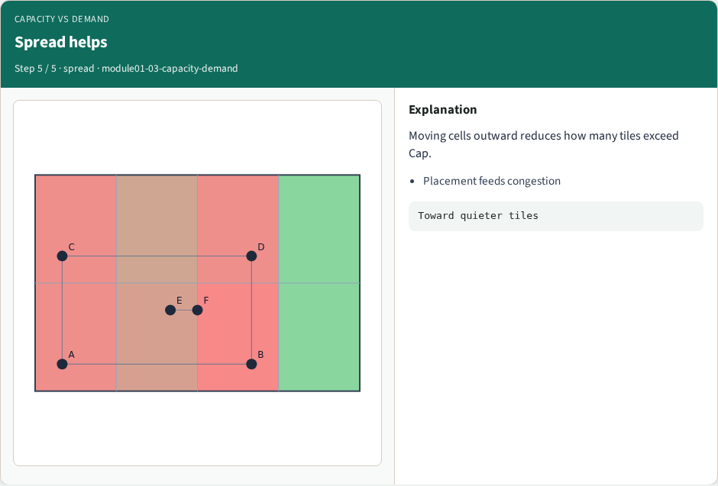
Spread helps
Spread helps
learn_congestion — 03 capacity demand
Notes:
Moving cells outward reduces how many tiles exceed Cap.

Slide 8
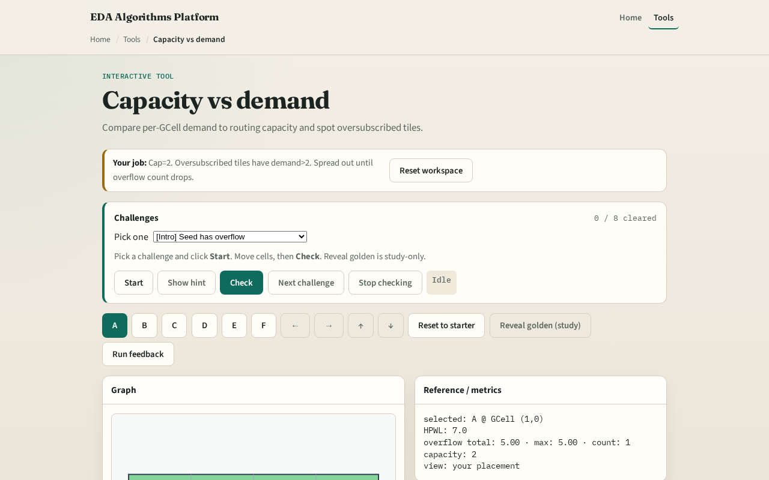
Browser lab track
Browser lab starter
learn_congestion — 03 capacity demand
Notes:
Open **capacity-demand**. Toggle capacity between one and two while holding a fixed demand seed. Watch which tiles flip. Check challenges that score your capacity choice against overflow counts—not a “show golden” click.

Slide 9
Implement track
Given a demand matrix from RUDY (or a hand-filled stub)
Print both for capacity equals two and capacity equals one
Keep the API ready for the overflow-metrics lab
learn_congestion — 03 capacity demand
Notes:
Given a demand matrix from RUDY (or a hand-filled stub), compute surplus and the oversubscribed set. Print both for capacity equals two and capacity equals one. Keep the API ready for the overflow-metrics lab.

Slide 10
Pitfalls
Comparing demand to capacity without documenting units
Treating zero demand as “healthy” while ignoring that neighboring tiles may be hot
Changing capacity mid-challenge without resetting the starter placement
learn_congestion — 03 capacity demand
Notes:
Comparing demand to capacity without documenting units. Treating zero demand as “healthy” while ignoring that neighboring tiles may be hot. Changing capacity mid-challenge without resetting the starter placement.

Slide 11
Your turn
Complete Track A or B
Next: RUDY, the classic demand estimator that fills those tiles from net bounding boxes
learn_congestion — 03 capacity demand
Notes:
Complete Track A or B. Next: RUDY—the classic demand estimator that fills those tiles from net bounding boxes.

