Slide 1
Uniform wire density
RUDY, Rectangular Uniform wire DensitY, spreads each net’s wirelength evenly across GCells under its bounding box
learn_congestion — 01 rudy estimate
Notes:
RUDY—Rectangular Uniform wire DensitY—spreads each net’s wirelength evenly across GCells under its bounding box. It is fast, deterministic, and good enough to teach overflow before you build a full global router.

Slide 2
The idea
For each net, take the axis-aligned bbox of pin positions
Half-perimeter wirelength is width plus height
Collect overlapping GCells, at least one
Density equals HPWL divided by the tile count
Add that density into every overlapping tile
Sum across nets for the demand map
learn_congestion — 01 rudy estimate
Notes:
For each net, take the axis-aligned bbox of pin positions. Half-perimeter wirelength is width plus height. Collect overlapping GCells—at least one. Density equals HPWL divided by the tile count. Add that density into every overlapping tile. Sum across nets for the demand map.

Slide 3
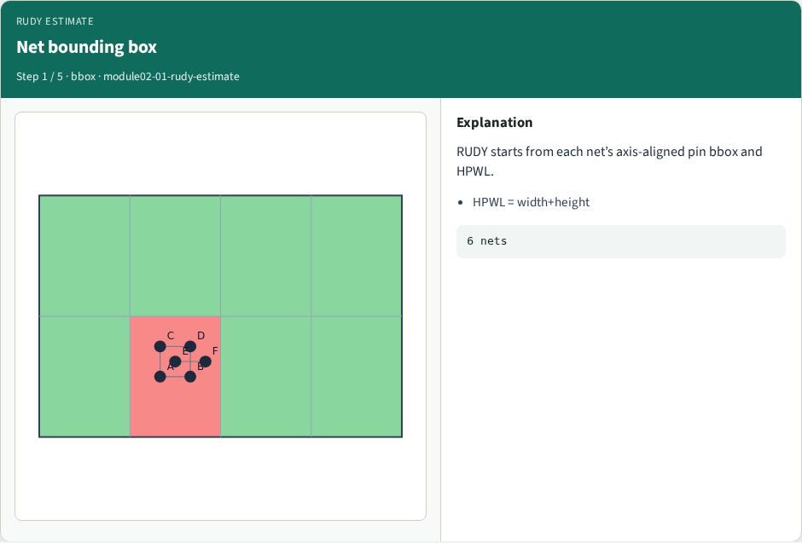
Net bounding box
Net bounding box
learn_congestion — 01 rudy estimate
Notes:
RUDY starts from each net’s axis-aligned pin bbox and HPWL.

Slide 4
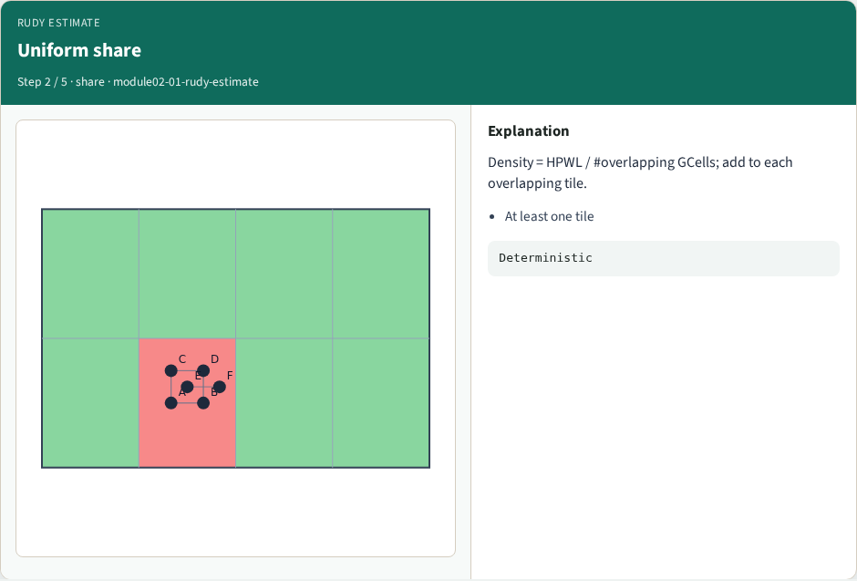
Uniform share
Uniform share
learn_congestion — 01 rudy estimate
Notes:
Density = HPWL / #overlapping GCells; add to each overlapping tile.

Slide 5
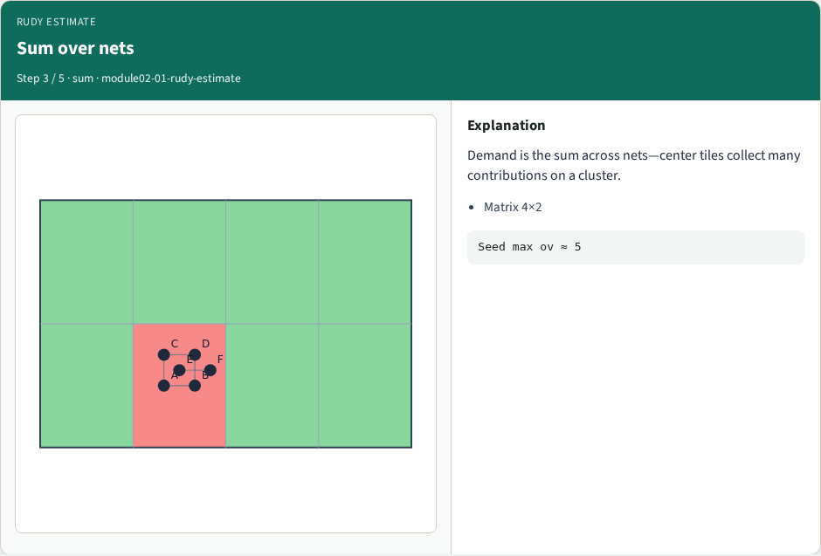
Sum over nets
Sum over nets
learn_congestion — 01 rudy estimate
Notes:
Demand is the sum across nets—center tiles collect many contributions on a cluster.

Slide 6

Overflow appears
Overflow appears
learn_congestion — 01 rudy estimate
Notes:
ov = max(0, demand−Cap). Seed shows a clear hotspot.

Slide 7
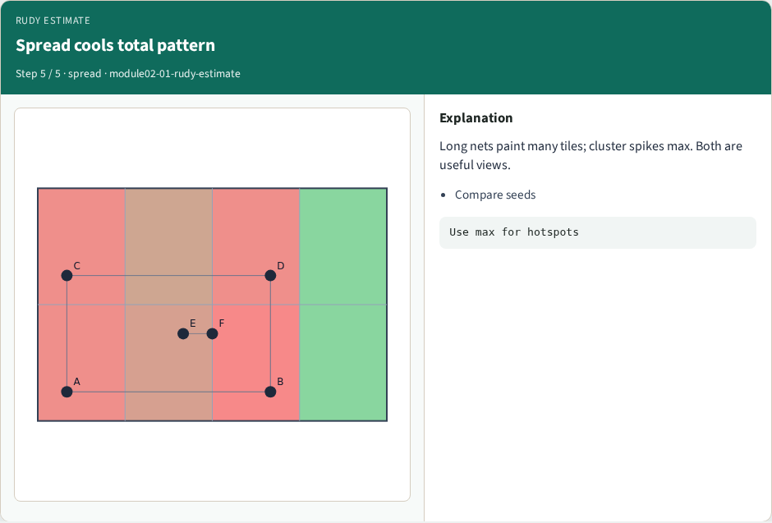
Spread cools total pattern
Spread cools total pattern
learn_congestion — 01 rudy estimate
Notes:
Long nets paint many tiles; cluster spikes max. Both are useful views.

Slide 8
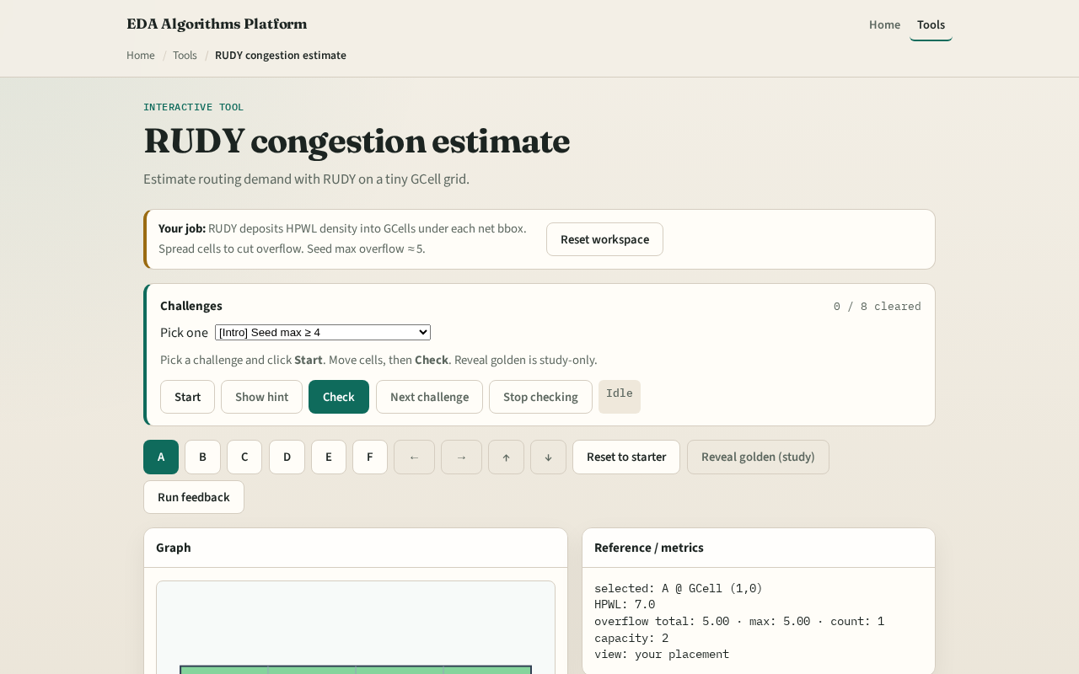
Browser lab track
Browser lab starter
learn_congestion — 01 rudy estimate
Notes:
Open **rudy-estimate**. Start from the spread placement, then load the congested seed and watch center tiles heat up. Check challenges against your demand totals. Reveal golden is study-only.

Slide 9
Implement track
Implement `rudy_demand(positions)` in `common/solvers.py`
On `congested_seed`
Match the browser golden within a small rounding tolerance
learn_congestion — 01 rudy estimate
Notes:
Implement `rudy_demand(positions)` in `common/solvers.py`. On `congested_seed`, print the four-by-two demand matrix and total overflow at capacity two. Match the browser golden within a small rounding tolerance.

Slide 10
Pitfalls
Dividing by bbox area in continuous units while depositing into discrete tiles
Skipping nets with coincident pins, still touch one GCell
Mutating the demand matrix in place across calls without zeroing
learn_congestion — 01 rudy estimate
Notes:
Dividing by bbox area in continuous units while depositing into discrete tiles inconsistently. Skipping nets with coincident pins—still touch one GCell. Mutating the demand matrix in place across calls without zeroing.

Slide 11
Your turn
Ship Track A RUDY and clear the browser challenges
Next: probabilistic L-shapes for a different demand signature
learn_congestion — 01 rudy estimate
Notes:
Ship Track A RUDY and clear the browser challenges. Next: probabilistic L-shapes for a different demand signature.

