Slide 1
L-shape routes
RUDY paints the whole bbox
learn_congestion — 03 probabilistic demand
Notes:
RUDY paints the whole bbox. Probabilistic demand instead assumes two-pin nets route on L-shapes: half the probability goes horizontal-then-vertical, half the other bend. That concentrates demand on corridors instead of the filled rectangle.

Slide 2
The idea
For a two-pin net
Multi-pin nets: star from the bbox center to each pin and deposit like two-pin edges
Compare the resulting matrix to RUDY on the same placement
learn_congestion — 03 probabilistic demand
Notes:
For a two-pin net, walk GCells along each L and add one half unit of demand per walk (toy scaling). Multi-pin nets: star from the bbox center to each pin and deposit like two-pin edges. Compare the resulting matrix to RUDY on the same placement.

Slide 3
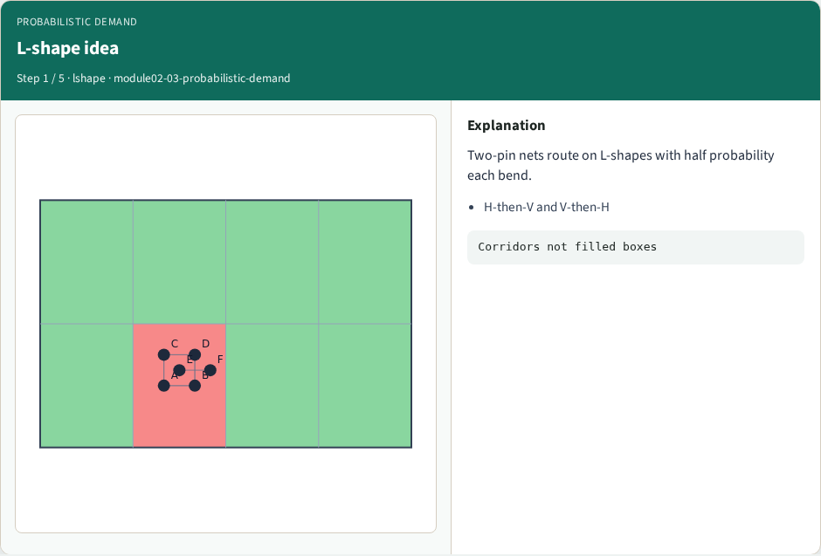
L-shape idea
L-shape idea
learn_congestion — 03 probabilistic demand
Notes:
Two-pin nets route on L-shapes with half probability each bend.

Slide 4
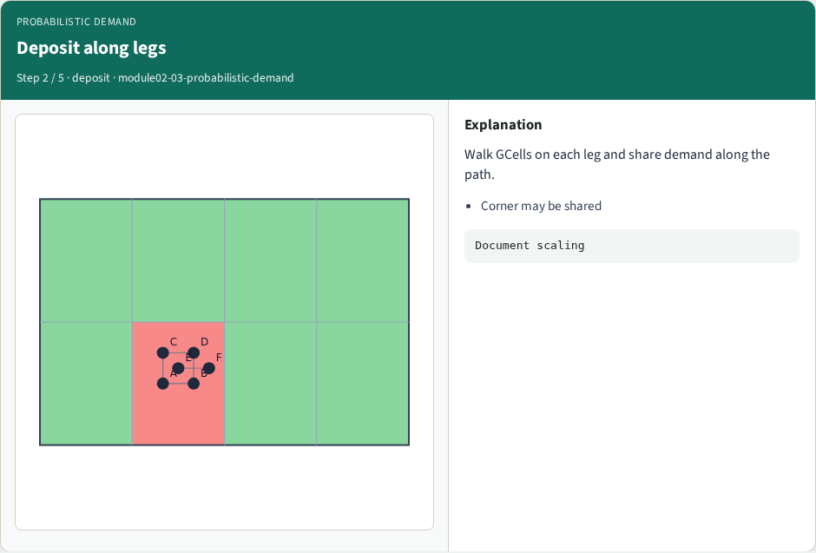
Deposit along legs
Deposit along legs
learn_congestion — 03 probabilistic demand
Notes:
Walk GCells on each leg and share demand along the path.

Slide 5
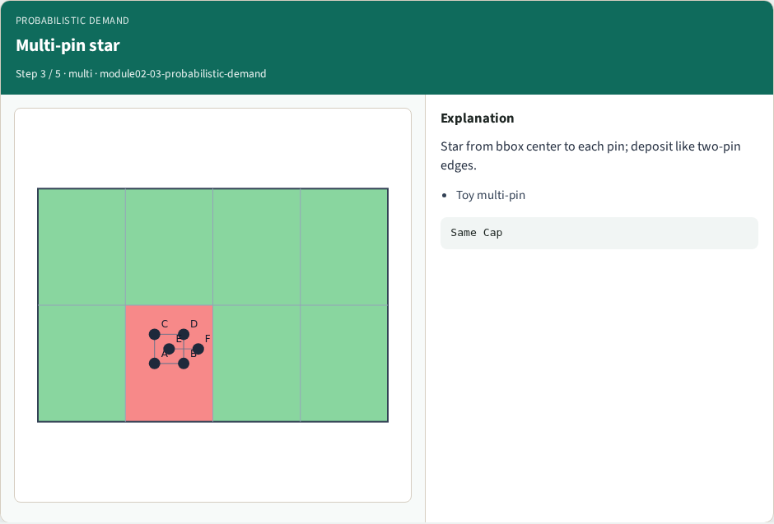
Multi-pin star
Multi-pin star
learn_congestion — 03 probabilistic demand
Notes:
Star from bbox center to each pin; deposit like two-pin edges.

Slide 6
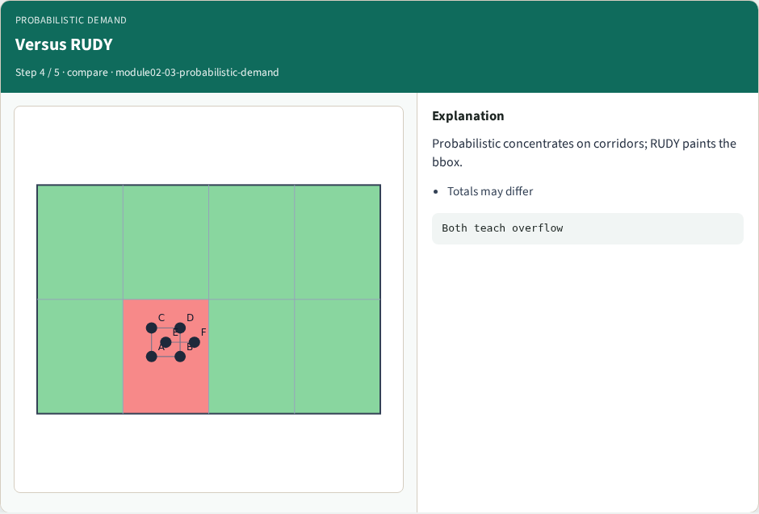
Versus RUDY
Versus RUDY
learn_congestion — 03 probabilistic demand
Notes:
Probabilistic concentrates on corridors; RUDY paints the bbox.

Slide 7
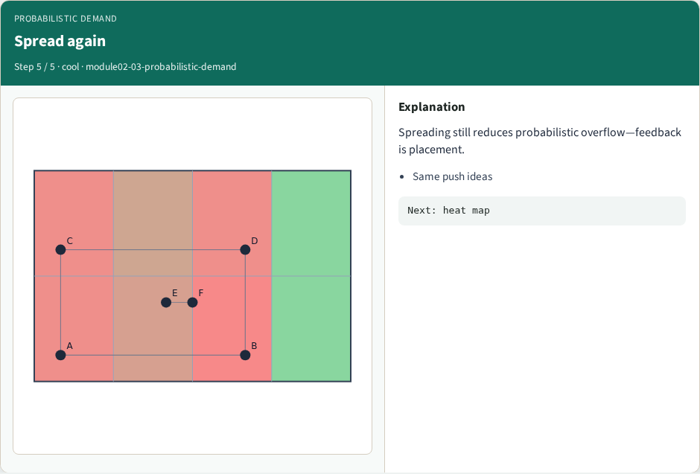
Spread again
Spread again
learn_congestion — 03 probabilistic demand
Notes:
Spreading still reduces probabilistic overflow—feedback is placement.

Slide 8
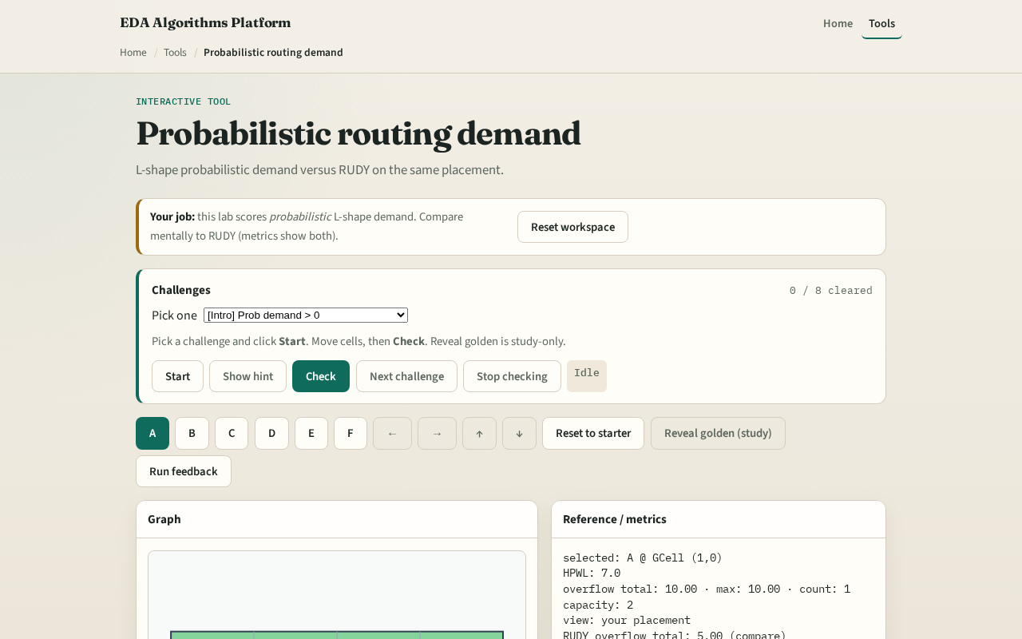
Browser lab track
Browser lab starter
learn_congestion — 03 probabilistic demand
Notes:
Open **probabilistic-demand**. Toggle RUDY versus probabilistic overlays. Note which center tiles differ. Challenges score your placement’s probabilistic overflow, not which button you clicked.

Slide 9
Implement track
Implement `probabilistic_demand`
On spread placement, print both RUDY and probabilistic totals
Explain one tile where they disagree and why
learn_congestion — 03 probabilistic demand
Notes:
Implement `probabilistic_demand`. On spread placement, print both RUDY and probabilistic totals. Explain one tile where they disagree and why.

Slide 10
Pitfalls
Double-counting the corner GCell on both L legs
Forgetting multi-pin nets
Document your unit choice
learn_congestion — 03 probabilistic demand
Notes:
Double-counting the corner GCell on both L legs. Forgetting multi-pin nets. Scaling probabilistic deposits so differently from RUDY that overflow comparisons become meaningless—document your unit choice.

Slide 11
Your turn
Clear the checklist
Next: turn demand into a congestion heat map
learn_congestion — 03 probabilistic demand
Notes:
Clear the checklist. Next: turn demand into a congestion heat map.

