Slide 1
Demand over capacity
Congestion is a ratio: demand divided by capacity
learn_congestion — 05 congestion map
Notes:
Congestion is a ratio: demand divided by capacity. A heat map paints that ratio per GCell so you can point at the hottest tile without reading a matrix of floats aloud.

Slide 2
The idea
Cong[i][j] equals demand[i][j] over Cap
Values above one are oversubscribed
The hottest GCell is the argmax
On the congested seed, expect the center columns to light up first
learn_congestion — 05 congestion map
Notes:
cong[i][j] equals demand[i][j] over Cap. Values above one are oversubscribed. The hottest GCell is the argmax. On the congested seed, expect the center columns to light up first.

Slide 3
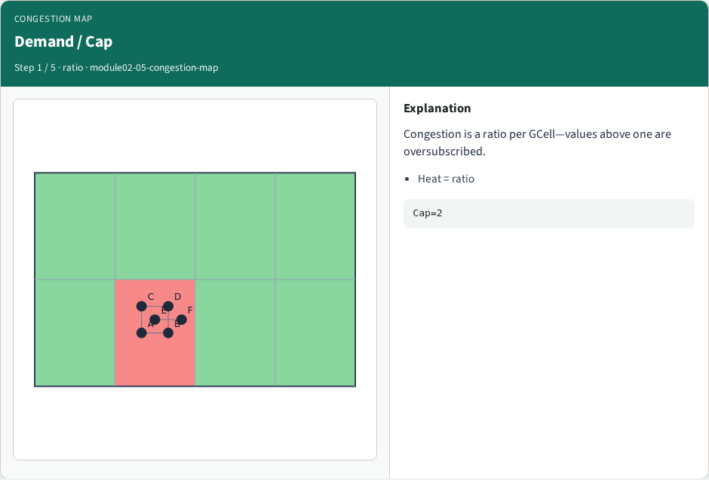
Demand / Cap
Demand / Cap
learn_congestion — 05 congestion map
Notes:
Congestion is a ratio per GCell—values above one are oversubscribed.

Slide 4
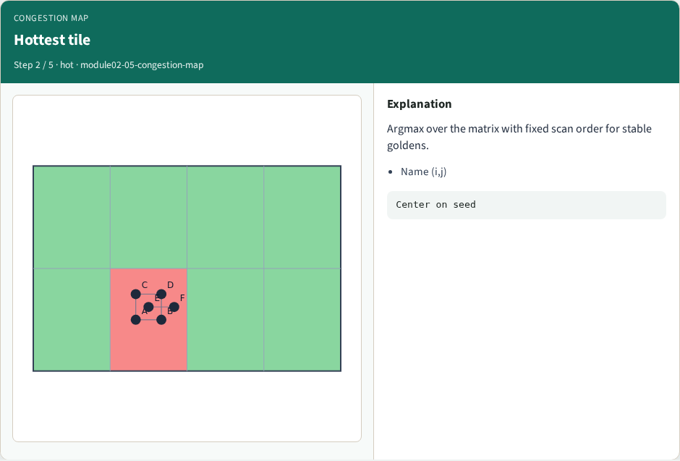
Hottest tile
Hottest tile
learn_congestion — 05 congestion map
Notes:
Argmax over the matrix with fixed scan order for stable goldens.

Slide 5
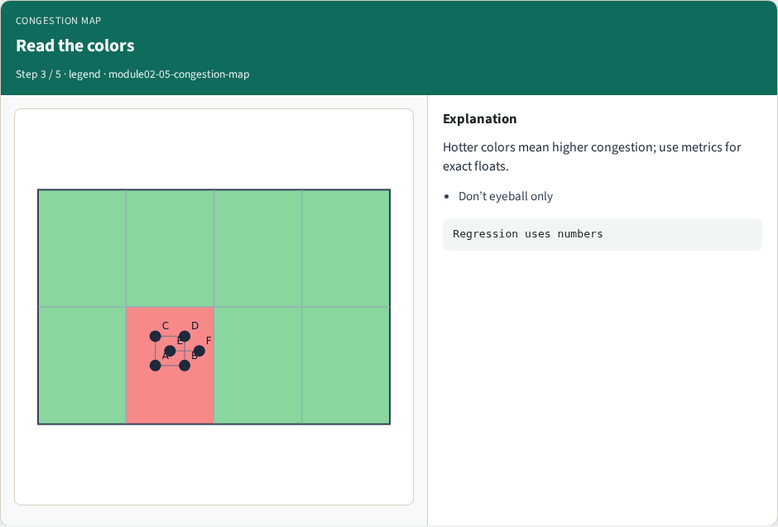
Read the colors
Read the colors
learn_congestion — 05 congestion map
Notes:
Hotter colors mean higher congestion; use metrics for exact floats.

Slide 6

Move the hotspot
Move the hotspot
learn_congestion — 05 congestion map
Notes:
Dragging cells can move which tile is hottest.

Slide 7
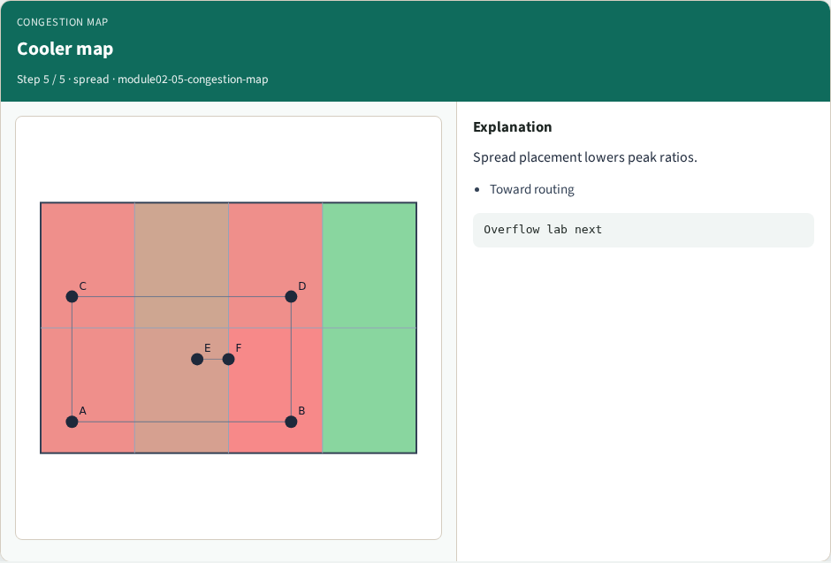
Cooler map
Cooler map
learn_congestion — 05 congestion map
Notes:
Spread placement lowers peak ratios.

Slide 8
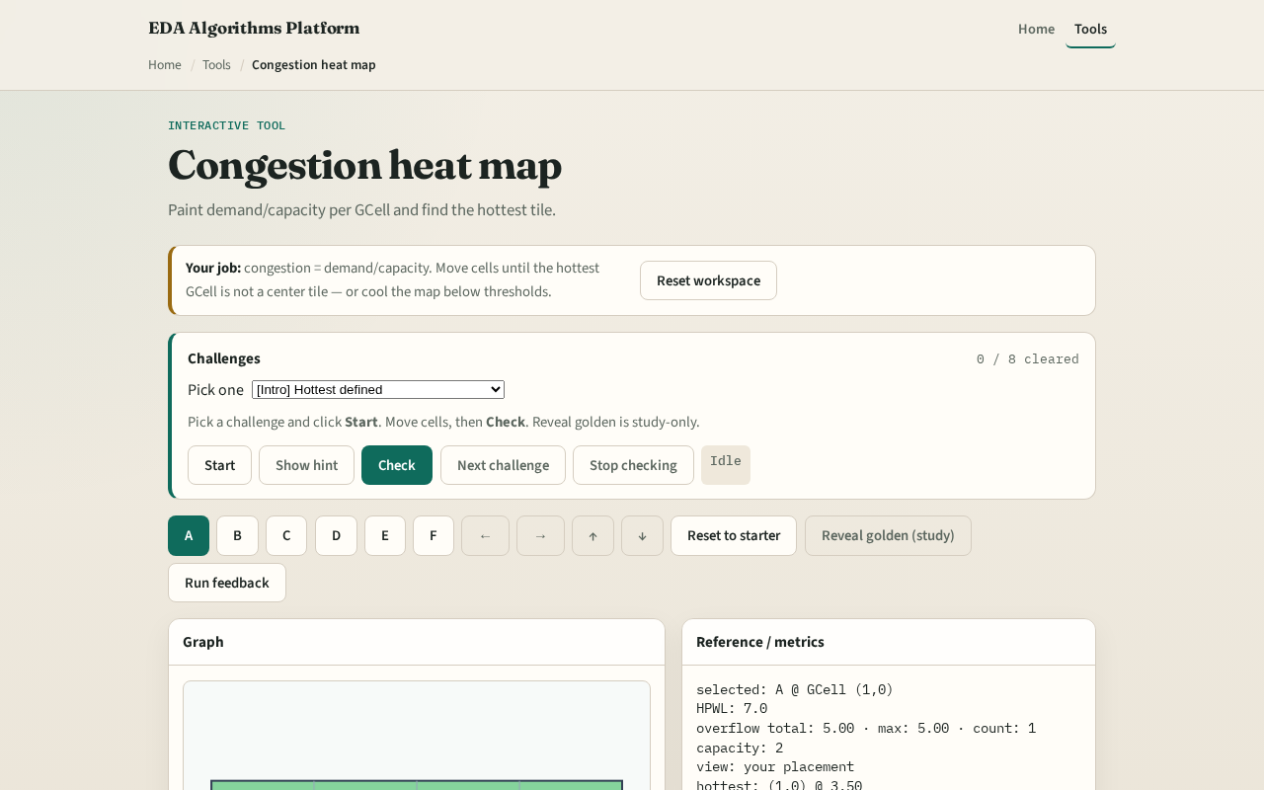
Browser lab track
Browser lab starter
learn_congestion — 05 congestion map
Notes:
Open **congestion-map**. Read the heat legend. Move cells until a different GCell becomes hottest, then Check. Study reveal shows a reference map—do not rely on it to pass.

Slide 9
Implement track
Build `congestion_map(demand, capacity)` returning the ratio matrix and hottest index
Print hottest for both placement seeds
learn_congestion — 05 congestion map
Notes:
Build `congestion_map(demand, capacity)` returning the ratio matrix and hottest index. Print hottest for both placement seeds.

Slide 10
Pitfalls
Dividing by zero capacity
Pick a fixed scan order
learn_congestion — 05 congestion map
Notes:
Dividing by zero capacity. Coloring by raw demand while labeling the plot “congestion.” Breaking ties in argmax nondeterministically—pick a fixed scan order.

Slide 11
Your turn
Finish the lab
Next: overflow metrics compress the map into totals you can regress
learn_congestion — 05 congestion map
Notes:
Finish the lab. Next: overflow metrics compress the map into totals you can regress.

