Slide 1
Numbers that regress
Overflow is demand above capacity
learn_congestion — 07 overflow metrics
Notes:
Overflow is demand above capacity. Sum it, take the max, and count how many GCells overflow. Those three numbers become your regression bar for estimators and feedback loops.

Slide 2
The idea
Ov equals max of zero and demand minus Cap, per tile
Total is the sum
Max is the worst tile
Count is how many tiles have positive overflow
Report all three every time you change placement
learn_congestion — 07 overflow metrics
Notes:
ov equals max of zero and demand minus Cap, per tile. Total is the sum. Max is the worst tile. Count is how many tiles have positive overflow. Report all three every time you change placement.

Slide 3
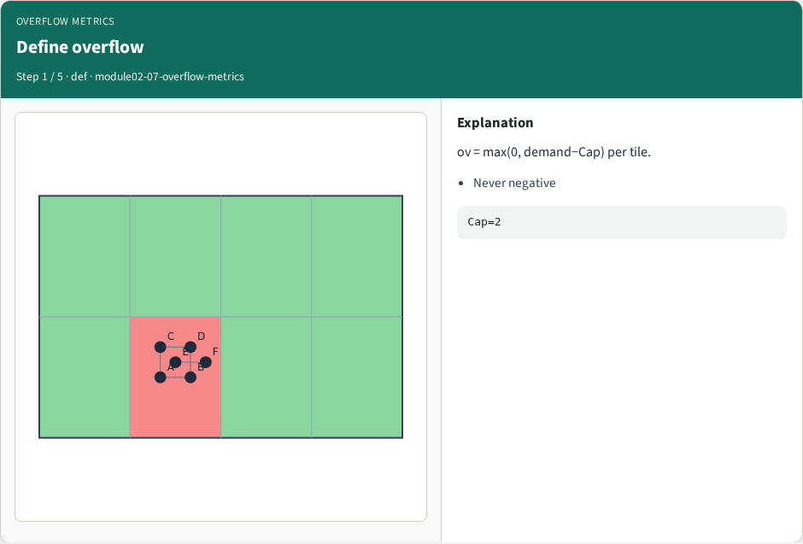
Define overflow
Define overflow
learn_congestion — 07 overflow metrics
Notes:
ov = max(0, demand−Cap) per tile.

Slide 4
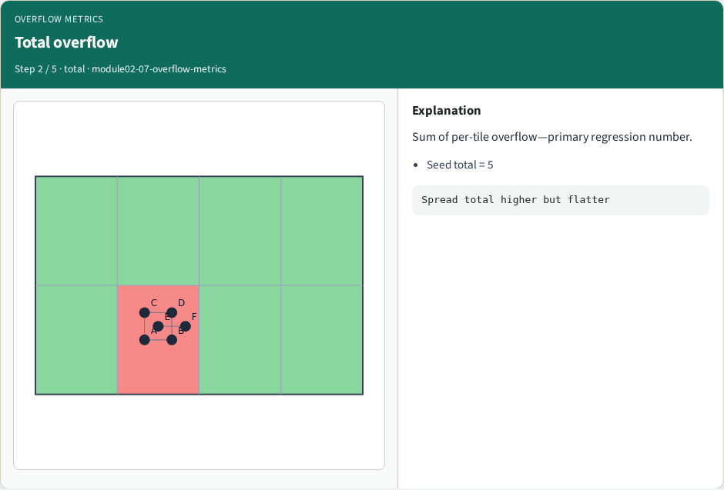
Total overflow
Total overflow
learn_congestion — 07 overflow metrics
Notes:
Sum of per-tile overflow—primary regression number.

Slide 5
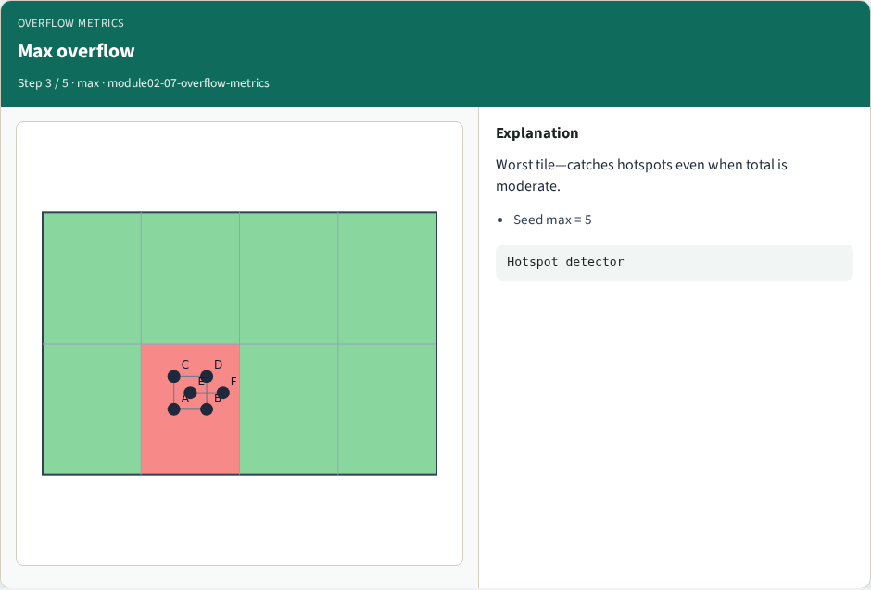
Max overflow
Max overflow
learn_congestion — 07 overflow metrics
Notes:
Worst tile—catches hotspots even when total is moderate.

Slide 6

Congested count
Congested count
learn_congestion — 07 overflow metrics
Notes:
How many tiles overflow—useful for “how widespread”.

Slide 7
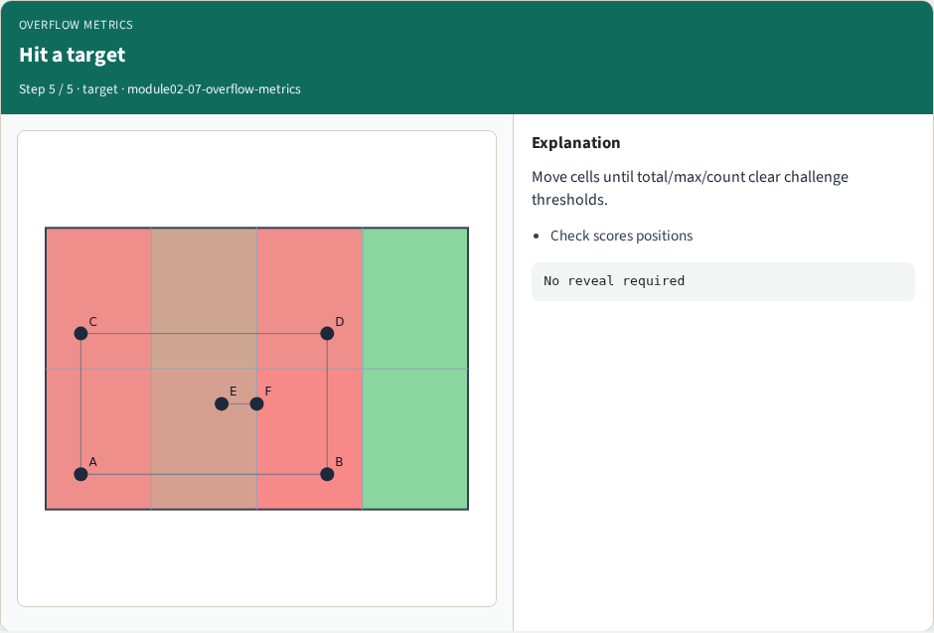
Hit a target
Hit a target
learn_congestion — 07 overflow metrics
Notes:
Move cells until total/max/count clear challenge thresholds.

Slide 8
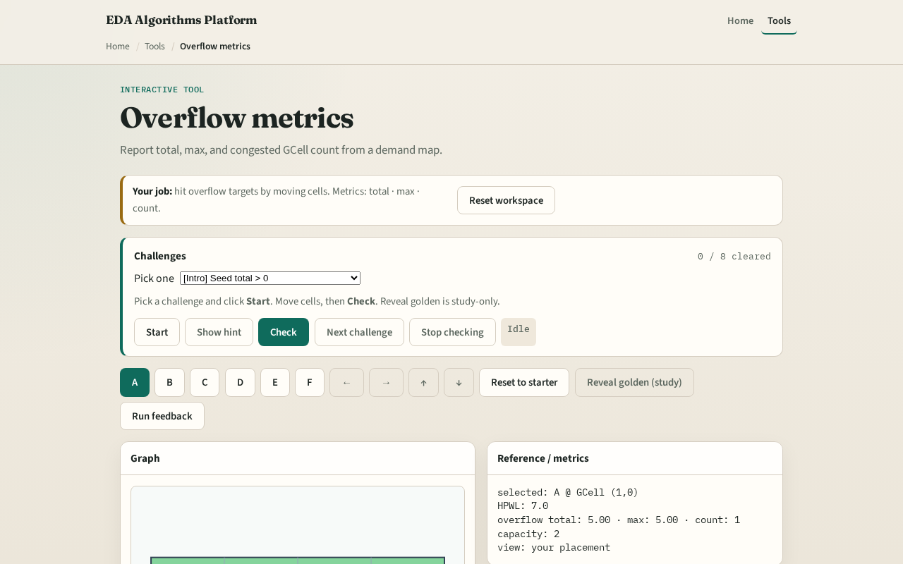
Browser lab track
Browser lab starter
learn_congestion — 07 overflow metrics
Notes:
Open **overflow-metrics**. Start from congested_seed. Move cells outward until total overflow drops below a challenge threshold. Check reads your positions through RUDY—not a mode flag.

Slide 9
Implement track
Implement `overflow_metrics`
Assert congested_seed has higher total overflow than spread placement at Cap equals two
Print the triple (total, max, count)
learn_congestion — 07 overflow metrics
Notes:
Implement `overflow_metrics`. Assert congested_seed has higher total overflow than spread placement at Cap equals two. Print the triple (total, max, count).

Slide 10
Pitfalls
Reporting negative “overflow.” Counting tiles with congestion greater than one while
Comparing totals across estimators with incompatible demand units
learn_congestion — 07 overflow metrics
Notes:
Reporting negative “overflow.” Counting tiles with congestion greater than one while computing overflow from a different Cap. Comparing totals across estimators with incompatible demand units.

Slide 11
Your turn
Hit the overflow targets
Next: cell inflation, the first feedback knob
learn_congestion — 07 overflow metrics
Notes:
Hit the overflow targets. Next: cell inflation—the first feedback knob.

