Slide 1
Make hot cells larger
Inflators tell the placer that cells in congested GCells should act bigger, encouraging spreading on the next pass
learn_congestion — 01 cell inflator
Notes:
Inflators tell the placer that cells in congested GCells should act bigger, encouraging spreading on the next pass. On the toy grid we scale width: width prime equals width times one plus alpha times congestion minus one, when congestion is above one.

Slide 2
The idea
Map each cell center to a GCell
If that tile’s congestion exceeds one, inflate; otherwise leave width alone
Alpha around zero point five keeps the demo visible without exploding geometry
Coordinates stay put, this lab changes widths, not x y
learn_congestion — 01 cell inflator
Notes:
Map each cell center to a GCell. If that tile’s congestion exceeds one, inflate; otherwise leave width alone. Alpha around zero point five keeps the demo visible without exploding geometry. Coordinates stay put—this lab changes widths, not x y.

Slide 3
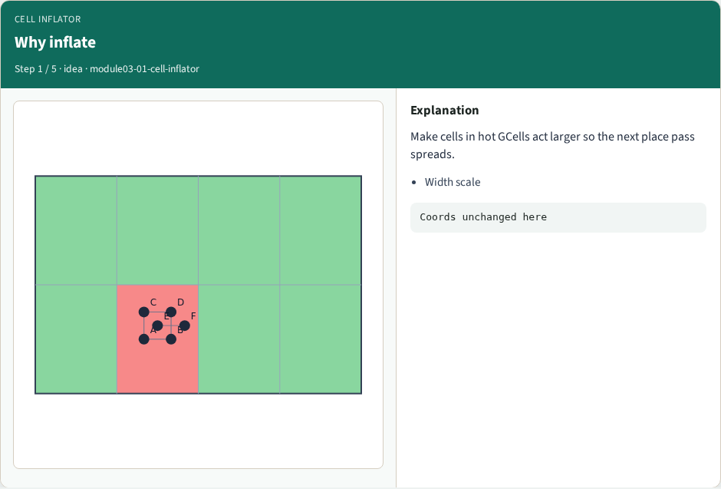
Why inflate
Why inflate
learn_congestion — 01 cell inflator
Notes:
Make cells in hot GCells act larger so the next place pass spreads.

Slide 4
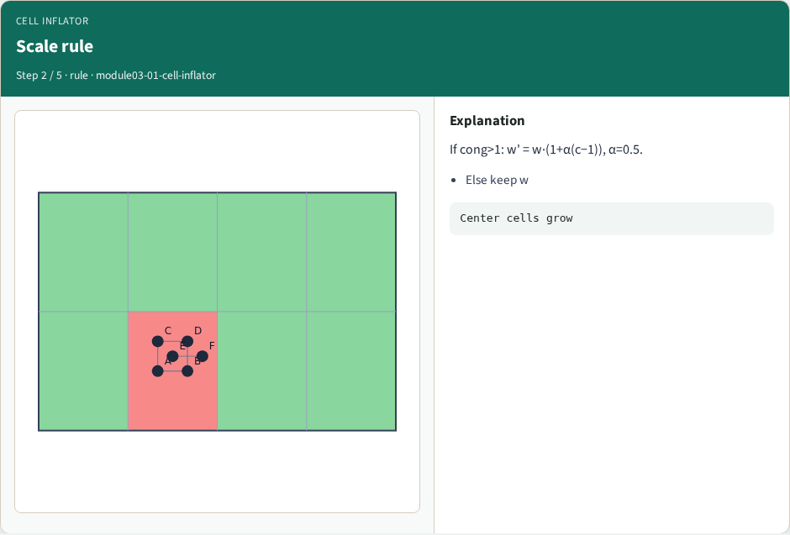
Scale rule
Scale rule
learn_congestion — 01 cell inflator
Notes:
If cong>1: w' = w·(1+α(c−1)), α=0.5.

Slide 5

Apply once
Apply once
learn_congestion — 01 cell inflator
Notes:
Compute congestion from RUDY, then inflate widths once.

Slide 6

Quiet tiles
Quiet tiles
learn_congestion — 01 cell inflator
Notes:
Cells in tiles with cong≤1 stay at base width.

Slide 7
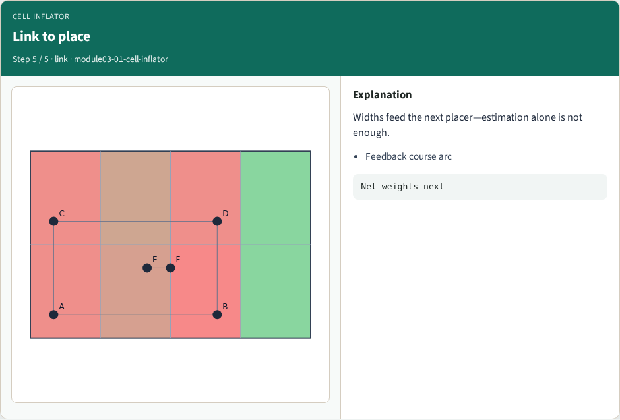
Link to place
Link to place
learn_congestion — 01 cell inflator
Notes:
Widths feed the next placer—estimation alone is not enough.

Slide 8
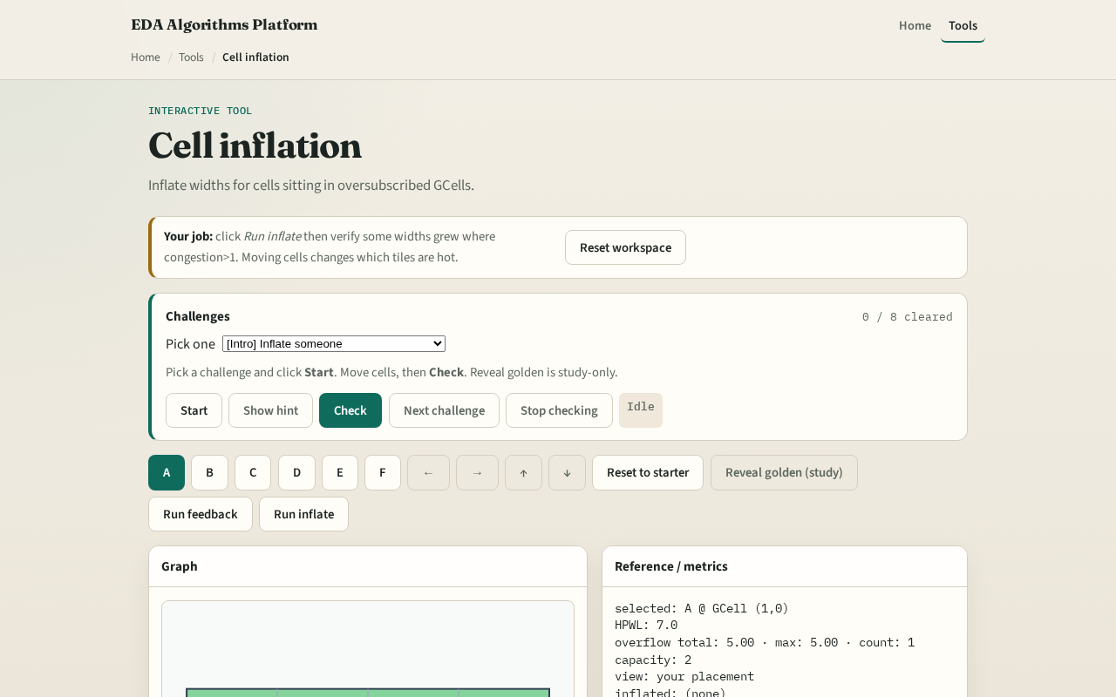
Browser lab track
Browser lab starter
learn_congestion — 01 cell inflator
Notes:
Open **cell-inflator**. Run inflate on congested_seed and read which cells grew. Challenges verify inflated widths from your congestion state.

Slide 9
Implement track
Implement `inflate_cells` with alpha equals zero point five
Print before/after widths for cells sitting in oversubscribed tiles
learn_congestion — 01 cell inflator
Notes:
Implement `inflate_cells` with alpha equals zero point five. Print before/after widths for cells sitting in oversubscribed tiles.

Slide 10
Pitfalls
Inflating every cell when only some GCells are hot
Inflating height when the placer model only tracks width
Applying inflation twice without resetting to base widths
learn_congestion — 01 cell inflator
Notes:
Inflating every cell when only some GCells are hot. Inflating height when the placer model only tracks width. Applying inflation twice without resetting to base widths.

Slide 11
Your turn
Clear the inflator challenges
Next: net weighting, the wirelength-side knob
learn_congestion — 01 cell inflator
Notes:
Clear the inflator challenges. Next: net weighting—the wirelength-side knob.

