Slide 1
Pull soft from hotspots
Net weighting raises the cost of nets that cross congested GCells so a weighted placer pulls those pins apart
learn_congestion — 03 net weighting
Notes:
Net weighting raises the cost of nets that cross congested GCells so a weighted placer pulls those pins apart. Weight equals one plus beta times mean congestion under the net bbox.

Slide 2
The idea
For each net, average congestion over GCells under its bbox
Scale with beta, one point zero is a clear demo
The four-pin net on a clustered seed should outrank the short E–F net
learn_congestion — 03 net weighting
Notes:
For each net, average congestion over GCells under its bbox. Scale with beta—one point zero is a clear demo. The four-pin net on a clustered seed should outrank the short E–F net.

Slide 3
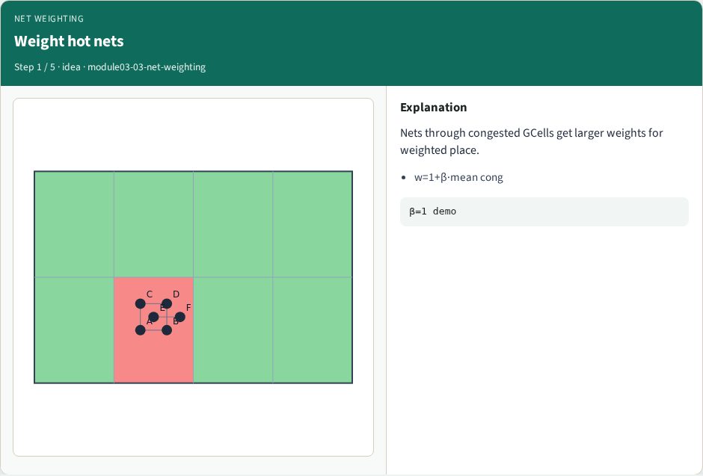
Weight hot nets
Weight hot nets
learn_congestion — 03 net weighting
Notes:
Nets through congested GCells get larger weights for weighted place.

Slide 4
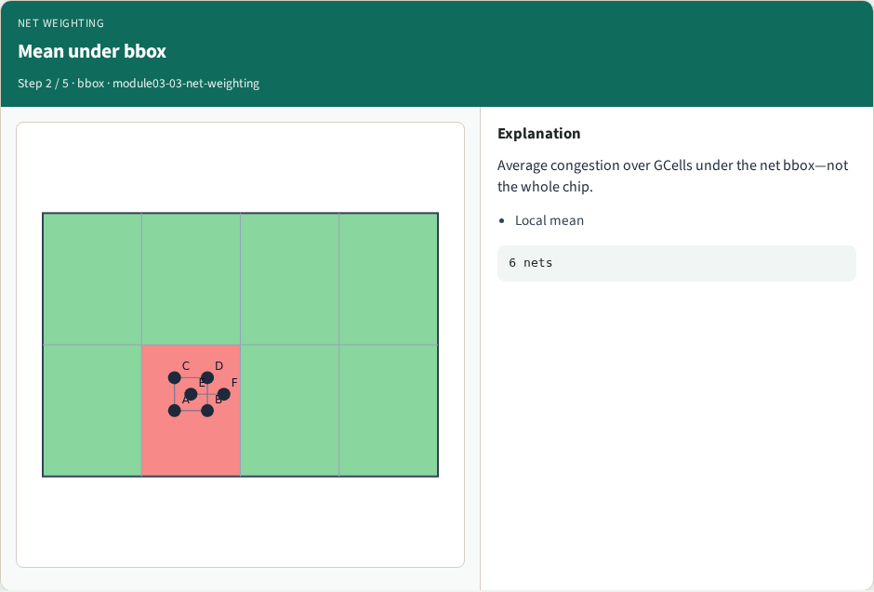
Mean under bbox
Mean under bbox
learn_congestion — 03 net weighting
Notes:
Average congestion over GCells under the net bbox—not the whole chip.

Slide 5
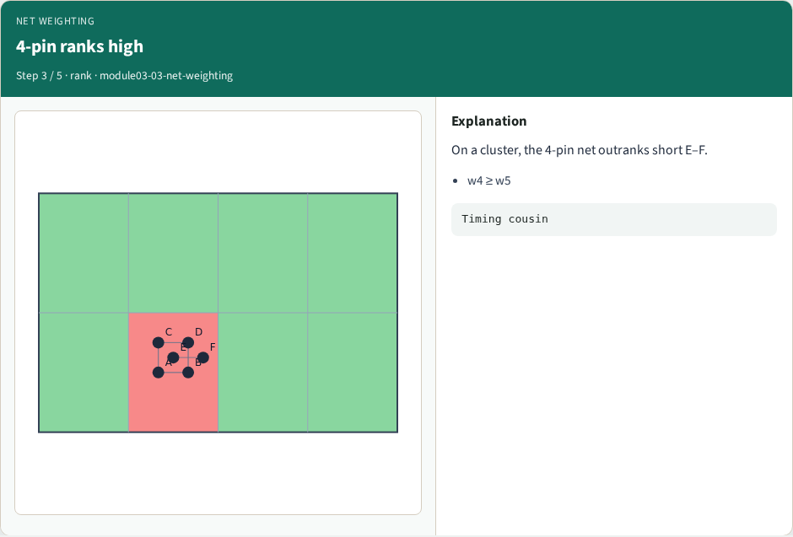
4-pin ranks high
4-pin ranks high
learn_congestion — 03 net weighting
Notes:
On a cluster, the 4-pin net outranks short E–F.

Slide 6
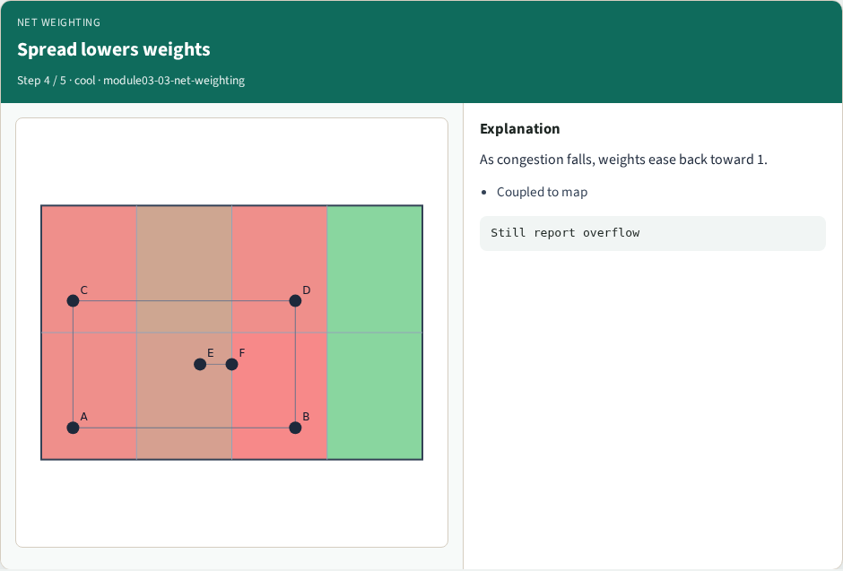
Spread lowers weights
Spread lowers weights
learn_congestion — 03 net weighting
Notes:
As congestion falls, weights ease back toward 1.

Slide 7

Use in placer
Use in placer
learn_congestion — 03 net weighting
Notes:
Weighted HPWL pulls soft from hotspots—pair with inflators.

Slide 8
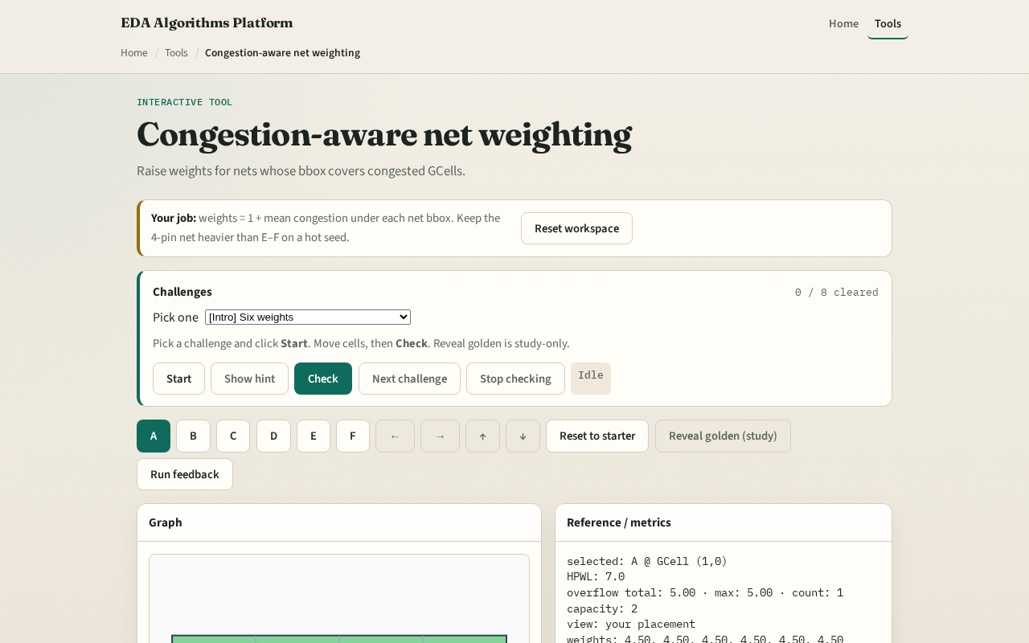
Browser lab track
Browser lab starter
learn_congestion — 03 net weighting
Notes:
Open **net-weighting**. Compare weights on spread versus congested seeds. Challenges check that a hot net’s weight exceeds a cool net’s weight on your map.

Slide 9
Implement track
Implement `net_weights_from_congestion`
Print the six weights for congested_seed
Confirm net index four is among the highest
learn_congestion — 03 net weighting
Notes:
Implement `net_weights_from_congestion`. Print the six weights for congested_seed. Confirm net index four is among the highest.

Slide 10
Pitfalls
Averaging over the whole chip instead of the net bbox
Using demand instead of congestion ratios
Updating weights but forgetting the placer still optimizes unweighted HPWL in the toy lab
learn_congestion — 03 net weighting
Notes:
Averaging over the whole chip instead of the net bbox. Using demand instead of congestion ratios. Updating weights but forgetting the placer still optimizes unweighted HPWL in the toy lab.

Slide 11
Your turn
Finish weighting
Next: one full placement feedback pass
learn_congestion — 03 net weighting
Notes:
Finish weighting. Next: one full placement feedback pass.

