Slide 1
Close the loop
Congestion estimation matters when it changes placement
learn_congestion — 01 placement feedback
Notes:
Congestion estimation matters when it changes placement. One toy pass: RUDY → congestion → inflate → push cells from overflowing GCells toward quieter neighbors → remeasure overflow.

Slide 2
The idea
After inflation
Clamp to the chip
Recompute RUDY
On congested_seed you should see total overflow drop after one pass
learn_congestion — 01 placement feedback
Notes:
After inflation, each movable cell in an overflowing tile takes a step toward the neighbor GCell with least overflow. Clamp to the chip. Recompute RUDY. On congested_seed you should see total overflow drop after one pass—not to zero, but clearly down.

Slide 3
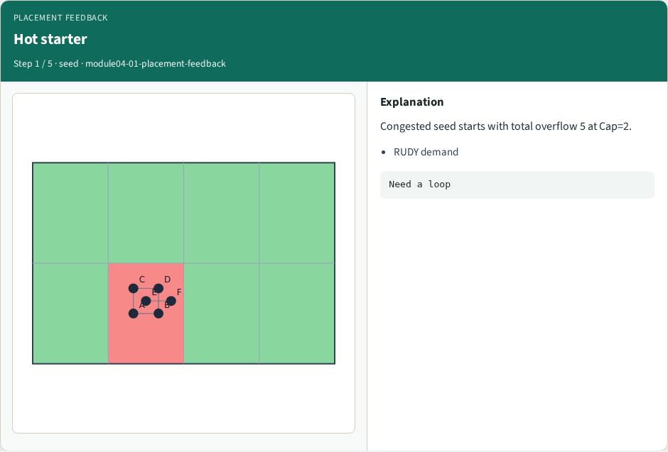
Hot starter
Hot starter
learn_congestion — 01 placement feedback
Notes:
Congested seed starts with total overflow 5 at Cap=2.

Slide 4

Estimate
Estimate
learn_congestion — 01 placement feedback
Notes:
Run RUDY → congestion → overflow per tile.

Slide 5

Push outward
Push outward
learn_congestion — 01 placement feedback
Notes:
Cells in overflowing tiles step toward the quietest neighbor GCell.

Slide 6
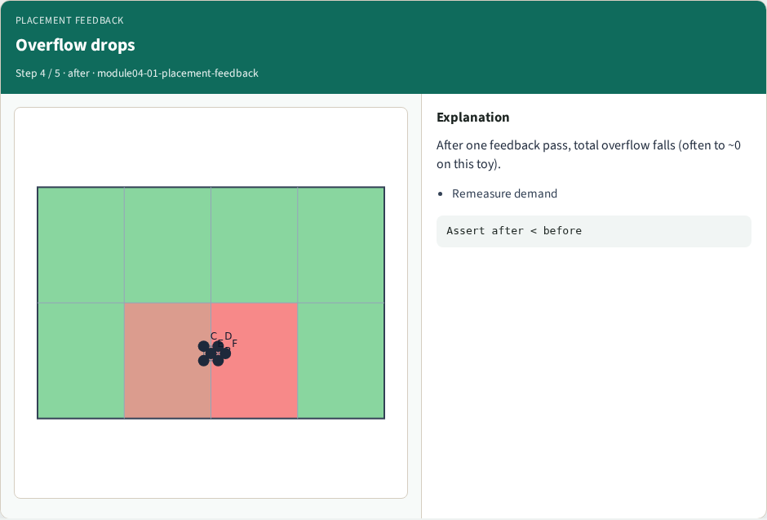
Overflow drops
Overflow drops
learn_congestion — 01 placement feedback
Notes:
After one feedback pass, total overflow falls (often to ~0 on this toy).

Slide 7
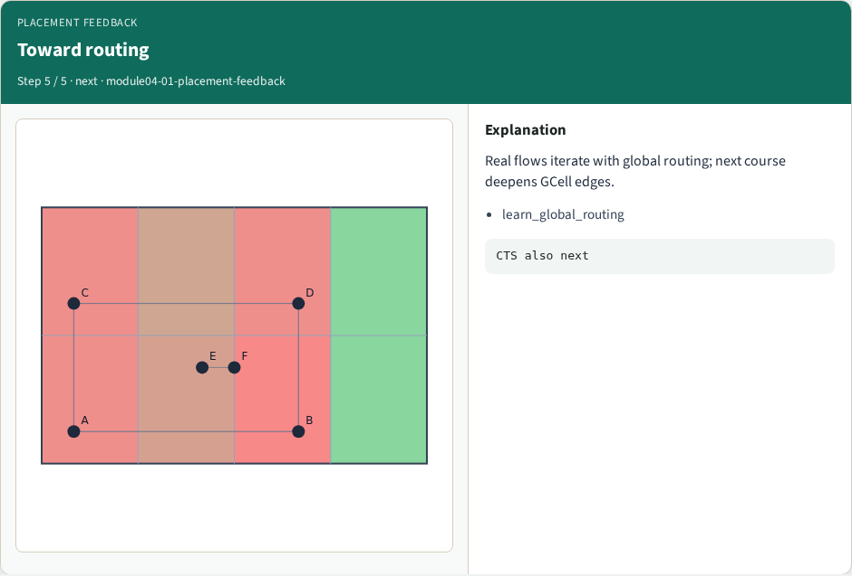
Toward routing
Toward routing
learn_congestion — 01 placement feedback
Notes:
Real flows iterate with global routing; next course deepens GCell edges.

Slide 8
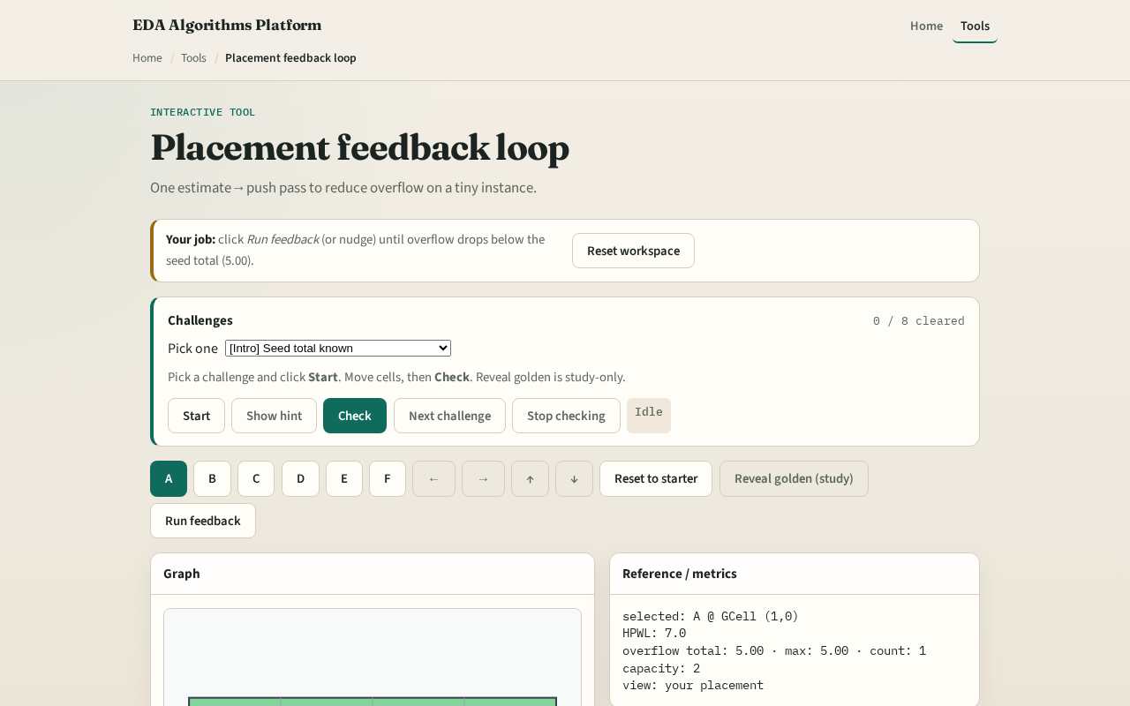
Browser lab track
Browser lab starter
learn_congestion — 01 placement feedback
Notes:
Open **placement-feedback**. Run the feedback helper, then nudge further if needed to clear challenges. Check scores post-feedback overflow from your positions.

Slide 9
Implement track
Implement `placement_feedback_lite`
Print overflow before and after on congested_seed
Assert after is strictly less than before at Cap equals two
learn_congestion — 01 placement feedback
Notes:
Implement `placement_feedback_lite`. Print overflow before and after on congested_seed. Assert after is strictly less than before at Cap equals two.

Slide 10
Pitfalls
Pushing macros that should stay fixed
Infinite oscillation from oversized steps, use a fraction of GCell size
Declaring victory without recomputing demand after the move
learn_congestion — 01 placement feedback
Notes:
Pushing macros that should stay fixed. Infinite oscillation from oversized steps—use a fraction of GCell size. Declaring victory without recomputing demand after the move.

Slide 11
Your turn
Complete the feedback lab and offline compare next
Then the wrap points you to global routing
learn_congestion — 01 placement feedback
Notes:
Complete the feedback lab and offline compare next. Then the wrap points you to global routing.

