Slide 1
Net models for wirelength
Multi-pin nets need a model before you optimize
learn_placement — 03 net models
Notes:
Multi-pin nets need a model before you optimize. Bounding-box HPWL is the usual report. Clique sums every pairwise HPWL; star sums spokes from a hub. On the golden four-pin net ABCD, bbox HPWL is four, clique is sixteen, and star-from-A is eight—same pins, different numbers.

Slide 2
The idea
Bbox is cheap and standard
Clique overestimates affinity on multi-pin nets
Star depends on the hub choice
Use one model for the reported objective and say which
learn_placement — 03 net models
Notes:
Bbox is cheap and standard. Clique overestimates affinity on multi-pin nets. Star depends on the hub choice. Use one model for the reported objective and say which—mixing them in one table is how goldens quietly disagree.

Slide 3
Pseudocode
Net models change which edges enter the sum
Pseudocode names bbox, clique, and star so reports stay comparable
Open this module's examples file and find the Pseudocode section
That written sketch is what you implement on the implement track and what the browser
learn_placement — 03 net models
Notes:
Net models change which edges enter the sum. Pseudocode names bbox, clique, and star so reports stay comparable.
Open this module's examples file and find the Pseudocode section. That written sketch is what you implement on the implement track and what the browser challenges measure.

Slide 4
Algorithm sketch
On golden ABCD, clique HPWL is sixteen and star from A is eight
Mixing models in one table is a metric bug
learn_placement — 03 net models
Notes:
On golden ABCD, clique HPWL is sixteen and star from A is eight. Mixing models in one table is a metric bug.

Slide 5
Algorithm sketch — try these
INPUT: net pins, positions, model
bbox: one HPWL on all pins
clique: Σ pairwise HPWL over pin pairs
star: Σ HPWL(hub, other pins)
GOLDEN 4-pin ABCD on golden place:
clique=16; star from A=8
learn_placement — 03 net models

Slide 6
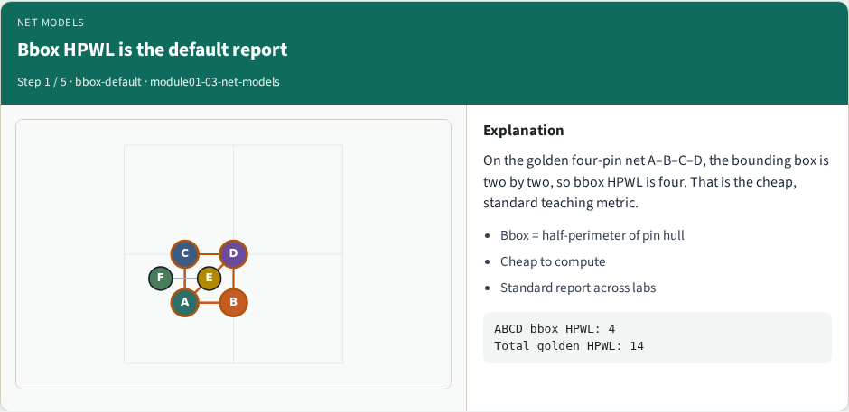
Bbox HPWL is the default report
Bbox HPWL is the default report
learn_placement — 03 net models
Notes:
On the golden four-pin net A–B–C–D, the bounding box is two by two, so bbox HPWL is four. That is the cheap, standard teaching metric.

Slide 7
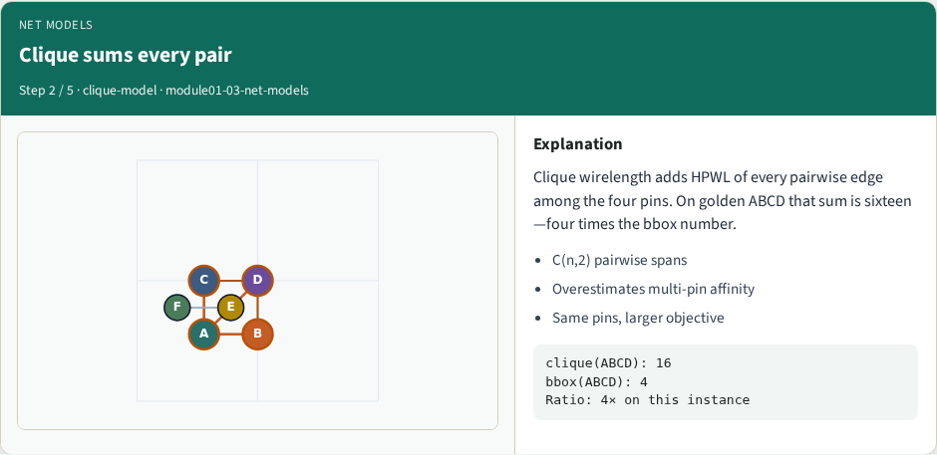
Clique sums every pair
Clique sums every pair
learn_placement — 03 net models
Notes:
Clique wirelength adds HPWL of every pairwise edge among the four pins. On golden ABCD that sum is sixteen—four times the bbox number.

Slide 8
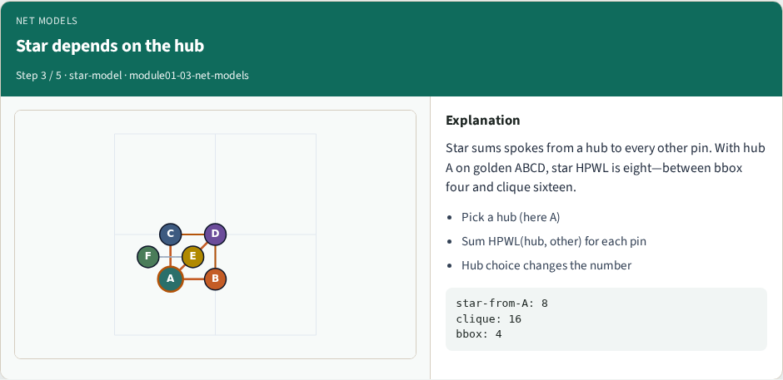
Star depends on the hub
Star depends on the hub
learn_placement — 03 net models
Notes:
Star sums spokes from a hub to every other pin. With hub A on golden ABCD, star HPWL is eight—between bbox four and clique sixteen.

Slide 9
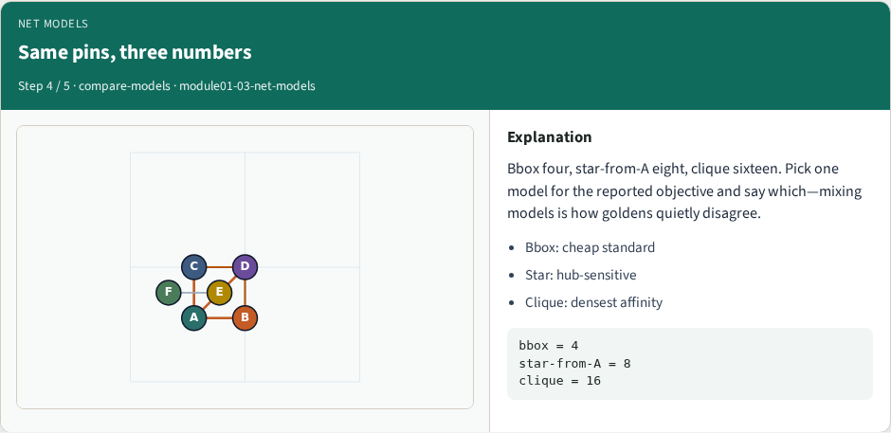
Same pins, three numbers
Same pins, three numbers
learn_placement — 03 net models
Notes:
Bbox four, star-from-A eight, clique sixteen. Pick one model for the reported objective and say which—mixing models is how goldens quietly disagree.

Slide 10
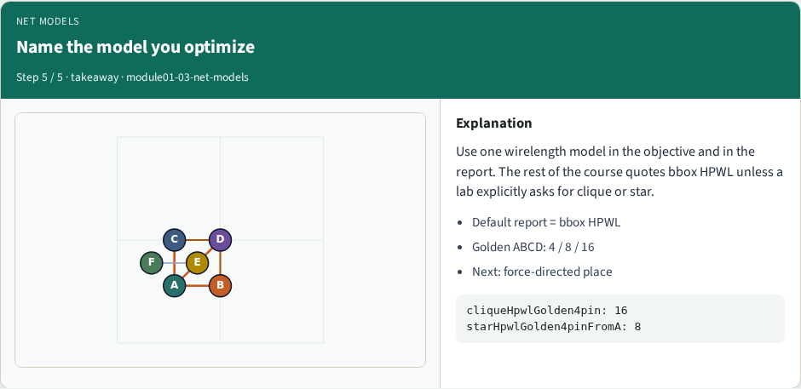
Name the model you optimize
Name the model you optimize
learn_placement — 03 net models
Notes:
Use one wirelength model in the objective and in the report. The rest of the course quotes bbox HPWL unless a lab explicitly asks for clique or star.

Slide 11
Browser lab track
In the browser lab track, open the net-models lab from the tools shelf
Load the starter placement, run the algorithm once
Work the challenges that lock the goldens
learn_placement — 03 net models
Notes:
In the browser lab track, open the **net-models** lab from the tools shelf. Load the starter placement, run the algorithm once, and read HPWL—and density when the panel shows it. Work the challenges that lock the goldens, then come back to implement the same loop yourself.

Slide 12
Implement track
In the implement track
Parse `tiny_place.json`, run the algorithm with a deterministic seed
Match the browser goldens before you claim the checklist
learn_placement — 03 net models
Notes:
In the implement track, open this module's EXAMPLES.md Pseudocode section and the course common solvers. Parse `tiny_place.json`, run the algorithm with a deterministic seed, and print coordinates plus HPWL. Match the browser goldens before you claim the checklist.

Slide 13
Pitfalls
Common traps
learn_placement — 03 net models
Notes:
Common traps: celebrating HPWL while cells pile into one bin; ignoring fixed pads A and D; mixing bbox and clique models in one report; keeping only the final SA iterate instead of the best; and forgetting that timing weights change the objective, not just the label.

Slide 14
Your turn
Complete the checklist for at least one track, preferably both
Implement until your metrics match the starter goldens
When you’re ready, take the short quiz, then continue to the next module
learn_placement — 03 net models
Notes:
Complete the checklist for at least one track—preferably both. Implement until your metrics match the starter goldens. When you’re ready, take the short quiz, then continue to the next module.

