Slide 1
Force-directed placement
Force-directed place pulls each free cell toward the average of its net neighbors, plus a weak center pull
learn_placement — 01 force directed place
Notes:
Force-directed place pulls each free cell toward the average of its net neighbors, plus a weak center pull. From the starter HPWL of fifty-two, a few lite iterations land near eighteen point seven—better wirelength, still above the golden fourteen.

Slide 2
The idea
Each iteration
Fixed pads stay put
Too much alpha collapses the design; too little barely moves
Report HPWL before and after with the same net model
learn_placement — 01 force directed place
Notes:
Each iteration: for free cells, blend current position toward the neighbor average with a small alpha. Fixed pads stay put. Too much alpha collapses the design; too little barely moves. Report HPWL before and after with the same net model.

Slide 3
Pseudocode
Force-directed place blends each free cell toward its neighbor average with step alpha
Fixed pads do not move
Open this module's examples file and find the Pseudocode section
That written sketch is what you implement on the implement track and what the browser
learn_placement — 01 force directed place
Notes:
Force-directed place blends each free cell toward its neighbor average with step alpha. Fixed pads do not move.
Open this module's examples file and find the Pseudocode section. That written sketch is what you implement on the implement track and what the browser challenges measure.

Slide 4
Algorithm sketch
From starter fifty-two
learn_placement — 01 force directed place
Notes:
From starter fifty-two, default lite iterations land near eighteen point seven—better wirelength, still above compact fourteen.

Slide 5
Algorithm sketch — try these
INPUT: positions, nets, α, iters, fixed pads
OUTPUT: updated positions + HPWL
each iter, for free cell c:
tgt ← avg neighbor coords (+ weak center)
pos[c] ← (1−α)·pos[c] + α·tgt
pads stay fixed
GOLDEN starter 52 → ≈18.7 after defaults
learn_placement — 01 force directed place

Slide 6
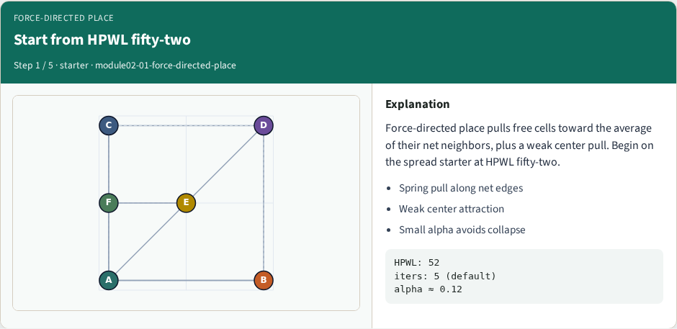
Start from HPWL fifty-two
Start from HPWL fifty-two
learn_placement — 01 force directed place
Notes:
Force-directed place pulls free cells toward the average of their net neighbors, plus a weak center pull. Begin on the spread starter at HPWL fifty-two.

Slide 7
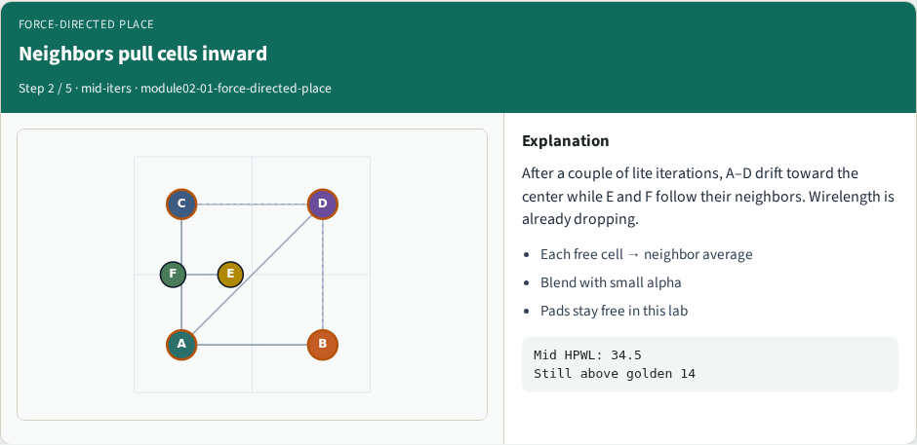
Neighbors pull cells inward
Neighbors pull cells inward
learn_placement — 01 force directed place
Notes:
After a couple of lite iterations, A–D drift toward the center while E and F follow their neighbors. Wirelength is already dropping.

Slide 8
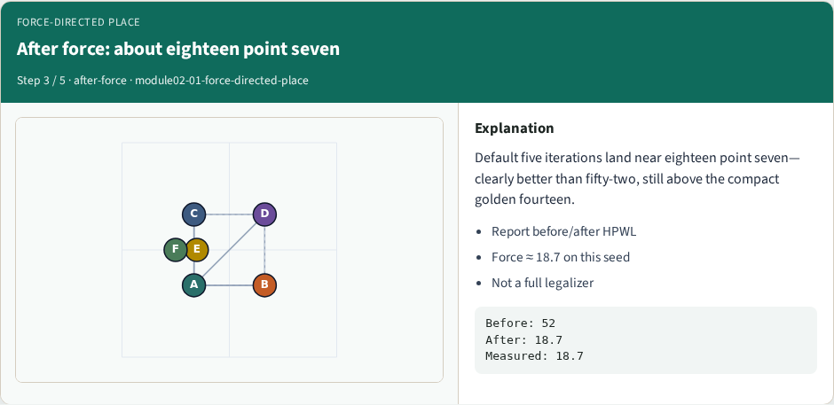
After force: about eighteen point seven
After force: about eighteen point seven
learn_placement — 01 force directed place
Notes:
Default five iterations land near eighteen point seven—clearly better than fifty-two, still above the compact golden fourteen.

Slide 9
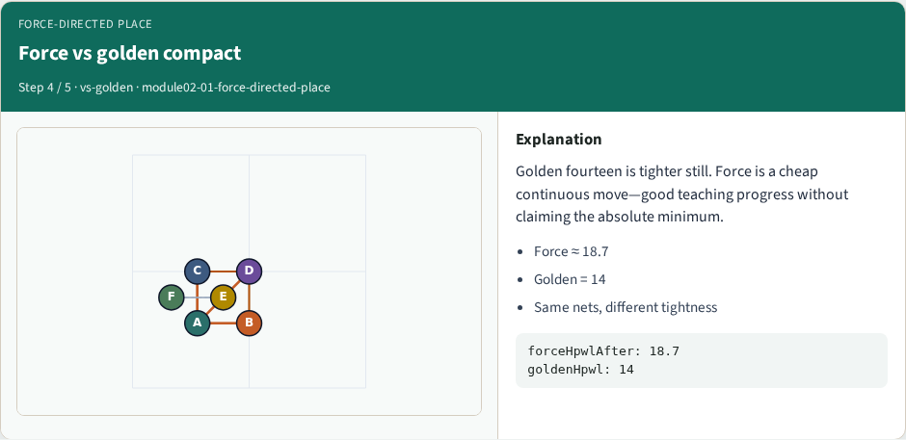
Force vs golden compact
Force vs golden compact
learn_placement — 01 force directed place
Notes:
Golden fourteen is tighter still. Force is a cheap continuous move—good teaching progress without claiming the absolute minimum.

Slide 10
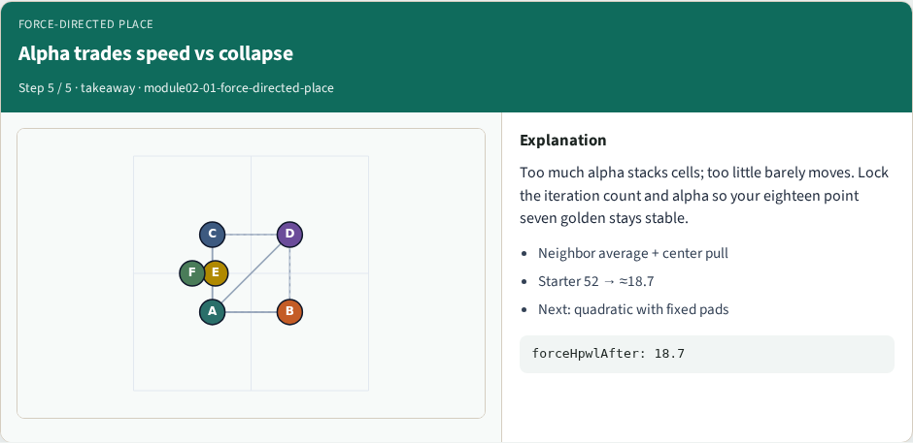
Alpha trades speed vs collapse
Alpha trades speed vs collapse
learn_placement — 01 force directed place
Notes:
Too much alpha stacks cells; too little barely moves. Lock the iteration count and alpha so your eighteen point seven golden stays stable.

Slide 11
Browser lab track
In the browser lab track, open the force-directed-place lab from the tools shelf
Load the starter placement, run the algorithm once
Work the challenges that lock the goldens
learn_placement — 01 force directed place
Notes:
In the browser lab track, open the **force-directed-place** lab from the tools shelf. Load the starter placement, run the algorithm once, and read HPWL—and density when the panel shows it. Work the challenges that lock the goldens, then come back to implement the same loop yourself.

Slide 12
Implement track
In the implement track
Parse `tiny_place.json`, run the algorithm with a deterministic seed
Match the browser goldens before you claim the checklist
learn_placement — 01 force directed place
Notes:
In the implement track, open this module's EXAMPLES.md Pseudocode section and the course common solvers. Parse `tiny_place.json`, run the algorithm with a deterministic seed, and print coordinates plus HPWL. Match the browser goldens before you claim the checklist.

Slide 13
Pitfalls
Common traps
learn_placement — 01 force directed place
Notes:
Common traps: celebrating HPWL while cells pile into one bin; ignoring fixed pads A and D; mixing bbox and clique models in one report; keeping only the final SA iterate instead of the best; and forgetting that timing weights change the objective, not just the label.

Slide 14
Your turn
Complete the checklist for at least one track, preferably both
Implement until your metrics match the starter goldens
When you’re ready, take the short quiz, then continue to the next module
learn_placement — 01 force directed place
Notes:
Complete the checklist for at least one track—preferably both. Implement until your metrics match the starter goldens. When you’re ready, take the short quiz, then continue to the next module.

