Slide 1
Quadratic placement
Quadratic-lite placement averages neighbors under fixed pads, here A and D stay pinned
learn_placement — 03 quadratic place
Notes:
Quadratic-lite placement averages neighbors under fixed pads—here A and D stay pinned. From starter HPWL fifty-two the solve reaches forty-eight. Pads constrain the free cells, so you will not match free force’s eighteen point seven on this instance.

Slide 2
The idea
Gauss–Seidel style
Fixed pads anchor the system
Teaching point: pad constraints raise HPWL versus unconstrained force on the same seed
learn_placement — 03 quadratic place
Notes:
Gauss–Seidel style: replace each free cell with a blend of neighbor average and prior coordinate so the solve does not collapse. Fixed pads anchor the system. Teaching point: pad constraints raise HPWL versus unconstrained force on the same seed.

Slide 3
Pseudocode
Quadratic-lite solves free cells toward neighbor averages under pinned pads
Damping keeps the system from collapsing
Open this module's examples file and find the Pseudocode section
That written sketch is what you implement on the implement track and what the browser
learn_placement — 03 quadratic place
Notes:
Quadratic-lite solves free cells toward neighbor averages under pinned pads. Damping keeps the system from collapsing.
Open this module's examples file and find the Pseudocode section. That written sketch is what you implement on the implement track and what the browser challenges measure.

Slide 4
Algorithm sketch
With A and D fixed
learn_placement — 03 quadratic place
Notes:
With A and D fixed, the teaching solve reaches HPWL forty-eight from fifty-two—modest win, honest about pad constraints.

Slide 5
Algorithm sketch — try these
INPUT: positions, nets, fixed pads {A,D}
OUTPUT: free-cell coords + HPWL
repeat: for free c:
blend toward neighbor average (damped)
pads A,D remain pinned
GOLDEN starter 52 → HPWL 48
learn_placement — 03 quadratic place

Slide 6
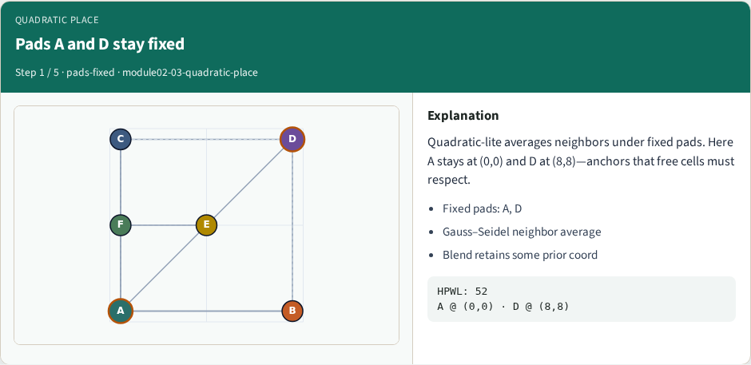
Pads A and D stay fixed
Pads A and D stay fixed
learn_placement — 03 quadratic place
Notes:
Quadratic-lite averages neighbors under fixed pads. Here A stays at (0,0) and D at (8,8)—anchors that free cells must respect.

Slide 7
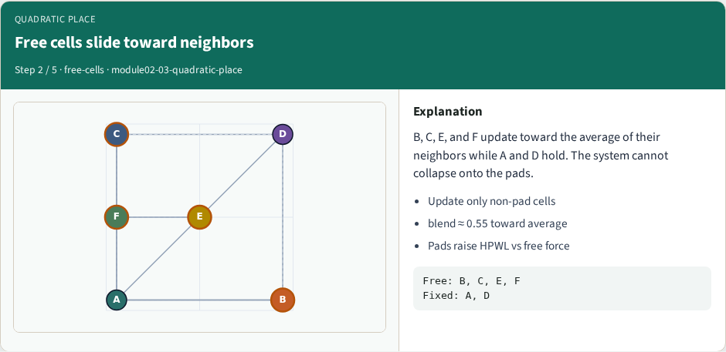
Free cells slide toward neighbors
Free cells slide toward neighbors
learn_placement — 03 quadratic place
Notes:
B, C, E, and F update toward the average of their neighbors while A and D hold. The system cannot collapse onto the pads.

Slide 8
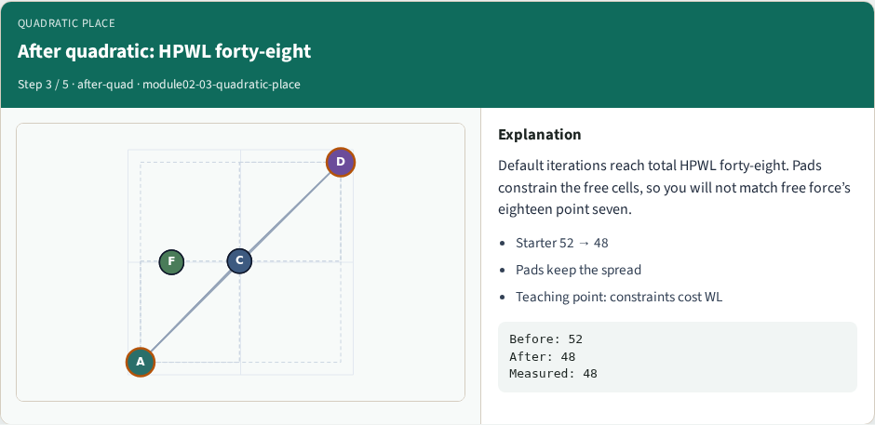
After quadratic: HPWL forty-eight
After quadratic: HPWL forty-eight
learn_placement — 03 quadratic place
Notes:
Default iterations reach total HPWL forty-eight. Pads constrain the free cells, so you will not match free force’s eighteen point seven.

Slide 9
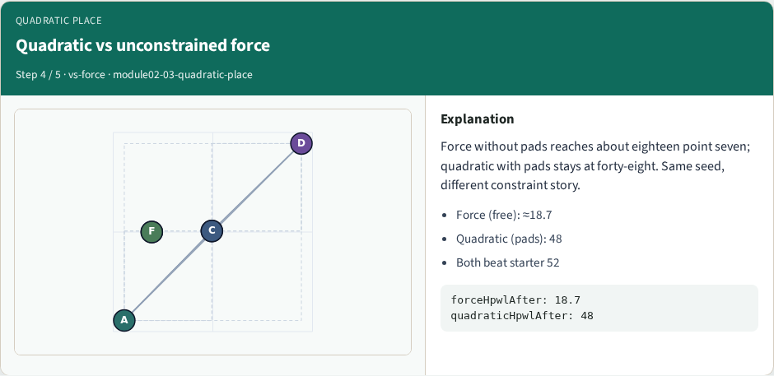
Quadratic vs unconstrained force
Quadratic vs unconstrained force
learn_placement — 03 quadratic place
Notes:
Force without pads reaches about eighteen point seven; quadratic with pads stays at forty-eight. Same seed, different constraint story.

Slide 10
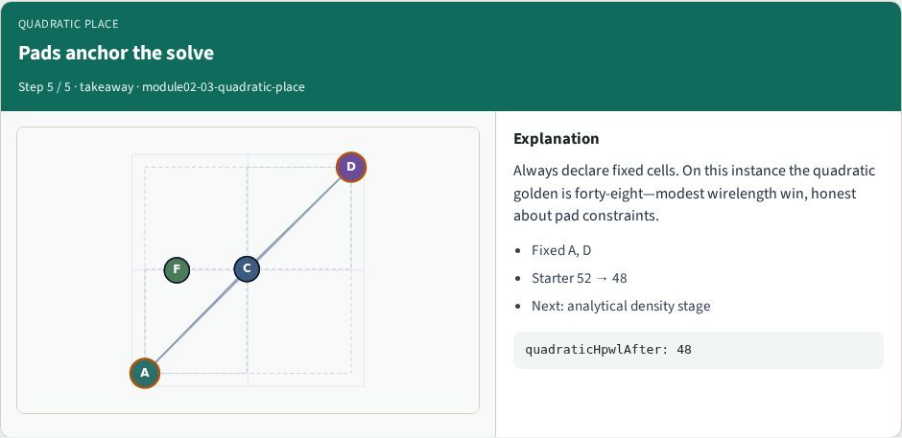
Pads anchor the solve
Pads anchor the solve
learn_placement — 03 quadratic place
Notes:
Always declare fixed cells. On this instance the quadratic golden is forty-eight—modest wirelength win, honest about pad constraints.

Slide 11
Browser lab track
In the browser lab track, open the quadratic-place lab from the tools shelf
Load the starter placement, run the algorithm once
Work the challenges that lock the goldens
learn_placement — 03 quadratic place
Notes:
In the browser lab track, open the **quadratic-place** lab from the tools shelf. Load the starter placement, run the algorithm once, and read HPWL—and density when the panel shows it. Work the challenges that lock the goldens, then come back to implement the same loop yourself.

Slide 12
Implement track
In the implement track
Parse `tiny_place.json`, run the algorithm with a deterministic seed
Match the browser goldens before you claim the checklist
learn_placement — 03 quadratic place
Notes:
In the implement track, open this module's EXAMPLES.md Pseudocode section and the course common solvers. Parse `tiny_place.json`, run the algorithm with a deterministic seed, and print coordinates plus HPWL. Match the browser goldens before you claim the checklist.

Slide 13
Pitfalls
Common traps
learn_placement — 03 quadratic place
Notes:
Common traps: celebrating HPWL while cells pile into one bin; ignoring fixed pads A and D; mixing bbox and clique models in one report; keeping only the final SA iterate instead of the best; and forgetting that timing weights change the objective, not just the label.

Slide 14
Your turn
Complete the checklist for at least one track, preferably both
Implement until your metrics match the starter goldens
When you’re ready, take the short quiz, then continue to the next module
learn_placement — 03 quadratic place
Notes:
Complete the checklist for at least one track—preferably both. Implement until your metrics match the starter goldens. When you’re ready, take the short quiz, then continue to the next module.

