Slide 1
Analytical / density-aware place
Analytical lite first pulls for wirelength, then spreads for density with pads A and D fixed
learn_placement — 05 analytical place
Notes:
Analytical lite first pulls for wirelength, then spreads for density with pads A and D fixed. From starter fifty-two you should land near forty-eight point one—close to quadratic, deliberately above free force, because spreading fights pure collapse.

Slide 2
The idea
Wirelength stage clusters
Watch both HPWL and overflow
learn_placement — 05 analytical place
Notes:
Wirelength stage clusters; density stage pushes cells out of overloaded bins; a light reconnect keeps HPWL from exploding. Watch both HPWL and overflow—winning wirelength while overflowing every bin is not analytical success.

Slide 3
Pseudocode
Analytical lite is three stages in pseudocode
Open this module's examples file and find the Pseudocode section
That written sketch is what you implement on the implement track and what the browser
learn_placement — 05 analytical place
Notes:
Analytical lite is three stages in pseudocode: wirelength clustering, density repulsion from overloaded bins, then a light reconnect so HPWL does not explode.
Open this module's examples file and find the Pseudocode section. That written sketch is what you implement on the implement track and what the browser challenges measure.

Slide 4
Algorithm sketch
Default teaching run lands near forty-eight point one HPWL
Winning wirelength while overflowing every bin is not success, report both metrics
learn_placement — 05 analytical place
Notes:
Default teaching run lands near forty-eight point one HPWL. Winning wirelength while overflowing every bin is not success—report both metrics.

Slide 5
Algorithm sketch — try these
INPUT: positions, bins, pads
OUTPUT: positions, HPWL, overflow
stage1: wirelength pull (force/quad style)
stage2: push out of overloaded bins
stage3: light reconnect for HPWL
report HPWL and overflow together
GOLDEN lite ≈48.1 HPWL after defaults
learn_placement — 05 analytical place

Slide 6
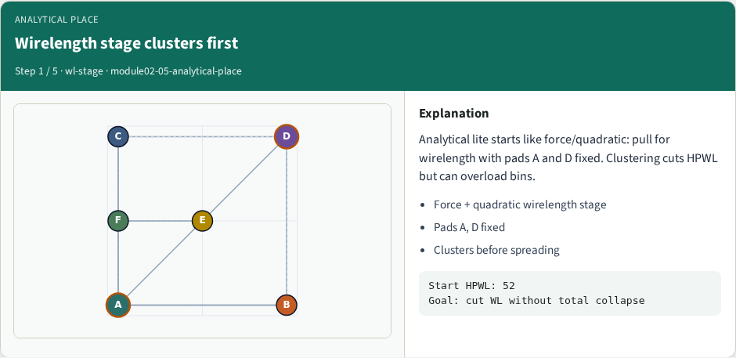
Wirelength stage clusters first
Wirelength stage clusters first
learn_placement — 05 analytical place
Notes:
Analytical lite starts like force/quadratic: pull for wirelength with pads A and D fixed. Clustering cuts HPWL but can overload bins.

Slide 7
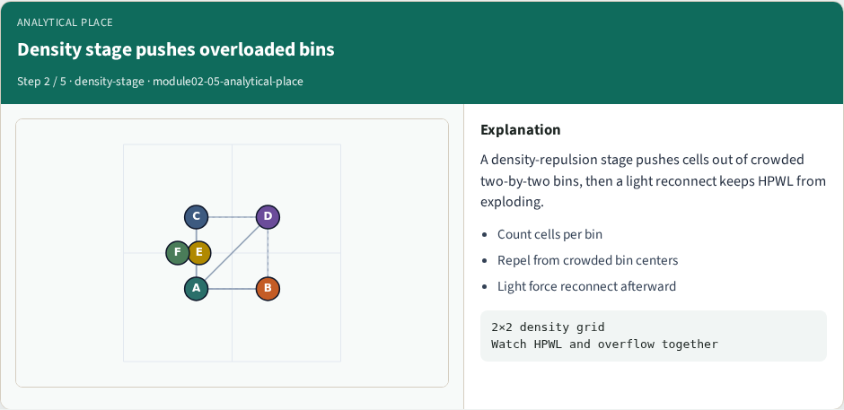
Density stage pushes overloaded bins
Density stage pushes overloaded bins
learn_placement — 05 analytical place
Notes:
A density-repulsion stage pushes cells out of crowded two-by-two bins, then a light reconnect keeps HPWL from exploding.

Slide 8
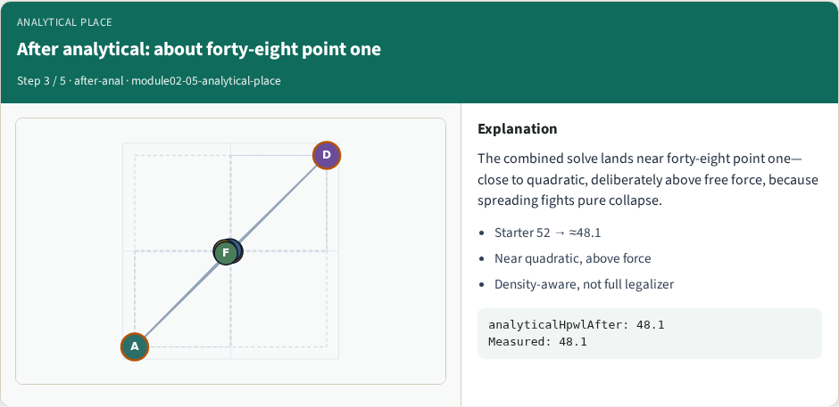
After analytical: about forty-eight point one
After analytical: about forty-eight point one
learn_placement — 05 analytical place
Notes:
The combined solve lands near forty-eight point one—close to quadratic, deliberately above free force, because spreading fights pure collapse.

Slide 9
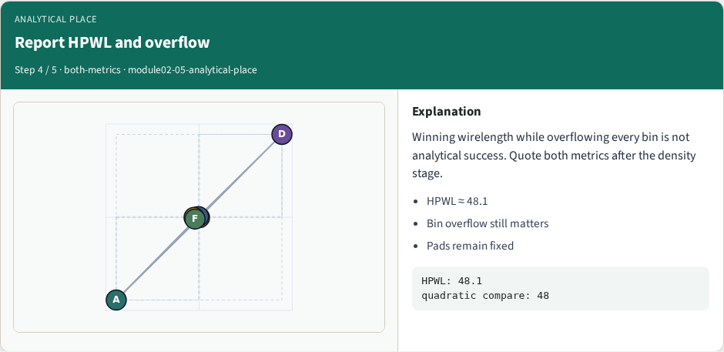
Report HPWL and overflow
Report HPWL and overflow
learn_placement — 05 analytical place
Notes:
Winning wirelength while overflowing every bin is not analytical success. Quote both metrics after the density stage.

Slide 10
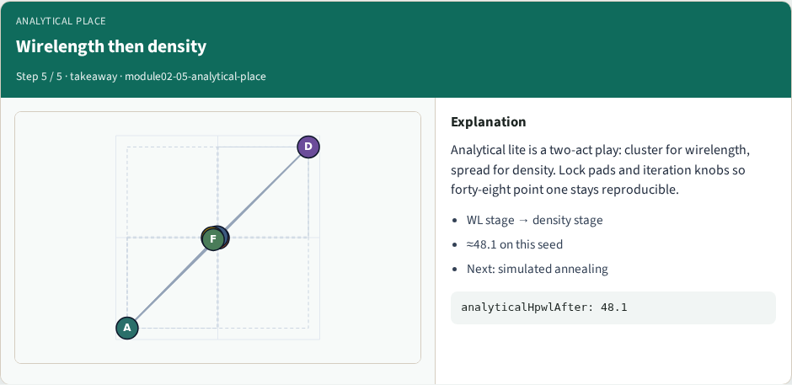
Wirelength then density
Wirelength then density
learn_placement — 05 analytical place
Notes:
Analytical lite is a two-act play: cluster for wirelength, spread for density. Lock pads and iteration knobs so forty-eight point one stays reproducible.

Slide 11
Browser lab track
In the browser lab track, open the analytical-place lab from the tools shelf
Load the starter placement, run the algorithm once
Work the challenges that lock the goldens
learn_placement — 05 analytical place
Notes:
In the browser lab track, open the **analytical-place** lab from the tools shelf. Load the starter placement, run the algorithm once, and read HPWL—and density when the panel shows it. Work the challenges that lock the goldens, then come back to implement the same loop yourself.

Slide 12
Implement track
In the implement track
Parse `tiny_place.json`, run the algorithm with a deterministic seed
Match the browser goldens before you claim the checklist
learn_placement — 05 analytical place
Notes:
In the implement track, open this module's EXAMPLES.md Pseudocode section and the course common solvers. Parse `tiny_place.json`, run the algorithm with a deterministic seed, and print coordinates plus HPWL. Match the browser goldens before you claim the checklist.

Slide 13
Pitfalls
Common traps
learn_placement — 05 analytical place
Notes:
Common traps: celebrating HPWL while cells pile into one bin; ignoring fixed pads A and D; mixing bbox and clique models in one report; keeping only the final SA iterate instead of the best; and forgetting that timing weights change the objective, not just the label.

Slide 14
Your turn
Complete the checklist for at least one track, preferably both
Implement until your metrics match the starter goldens
When you’re ready, take the short quiz, then continue to the next module
learn_placement — 05 analytical place
Notes:
Complete the checklist for at least one track—preferably both. Implement until your metrics match the starter goldens. When you’re ready, take the short quiz, then continue to the next module.

