Slide 1
Simulated annealing placement
Simulated annealing jogs one cell at a time under an HPWL cost
learn_placement — 07 sa placement
Notes:
Simulated annealing jogs one cell at a time under an HPWL cost. With seed forty-two and sixty moves on the starter, best HPWL lands near forty-nine point six—modest improvement over fifty-two, not a force-style collapse.

Slide 2
The idea
Propose a small axis move, accept improvements always
Keep the best iterate, not only the final temperature
Fix the seed so your golden stays stable across runs
learn_placement — 07 sa placement
Notes:
Propose a small axis move, accept improvements always, and accept worsenings with temperature probability. Keep the best iterate, not only the final temperature. Fix the seed so your golden stays stable across runs.

Slide 3
Pseudocode
Placement annealing jogs one cell per move under HPWL cost, accepts by Metropolis
Open this module's examples file and find the Pseudocode section
That written sketch is what you implement on the implement track and what the browser
learn_placement — 07 sa placement
Notes:
Placement annealing jogs one cell per move under HPWL cost, accepts by Metropolis, and keeps the best iterate—not only the final temperature.
Open this module's examples file and find the Pseudocode section. That written sketch is what you implement on the implement track and what the browser challenges measure.

Slide 4
Algorithm sketch
Seed forty-two with sixty moves yields best HPWL near forty-nine point six from fifty-two
Lock the seed so goldens stay stable
learn_placement — 07 sa placement
Notes:
Seed forty-two with sixty moves yields best HPWL near forty-nine point six from fifty-two. Lock the seed so goldens stay stable.

Slide 5
Algorithm sketch — try these
INPUT: positions, seed, moves, T0
OUTPUT: best positions + best HPWL
for i in 1..moves:
jog one cell on one axis
accept if ΔHPWL<0 or rand<e^(−Δ/T)
keep best; cool T
GOLDEN seed=42, 60 moves → best≈49.6
accepted≈44 rejected≈16
learn_placement — 07 sa placement

Slide 6
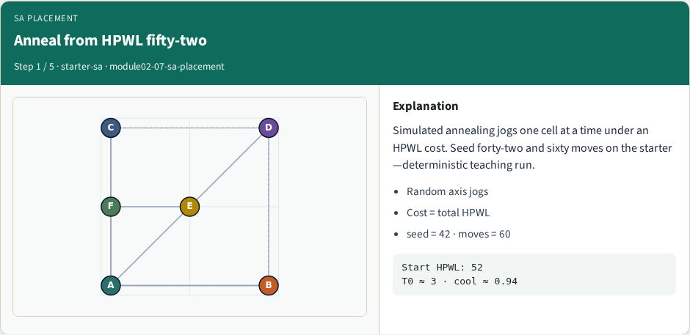
Anneal from HPWL fifty-two
Anneal from HPWL fifty-two
learn_placement — 07 sa placement
Notes:
Simulated annealing jogs one cell at a time under an HPWL cost. Seed forty-two and sixty moves on the starter—deterministic teaching run.

Slide 7
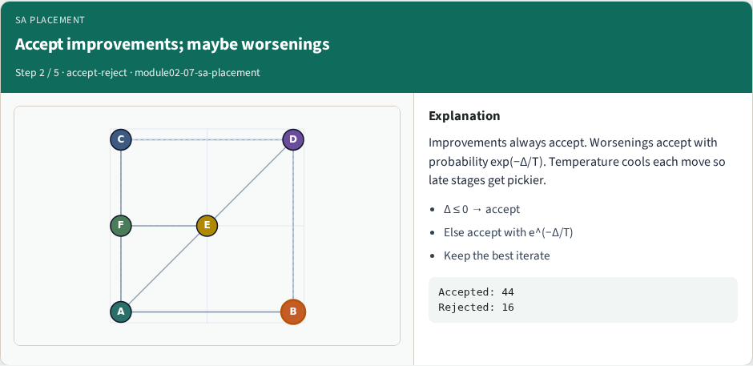
Accept improvements; maybe worsenings
Accept improvements; maybe worsenings
learn_placement — 07 sa placement
Notes:
Improvements always accept. Worsenings accept with probability exp(−Δ/T). Temperature cools each move so late stages get pickier.

Slide 8
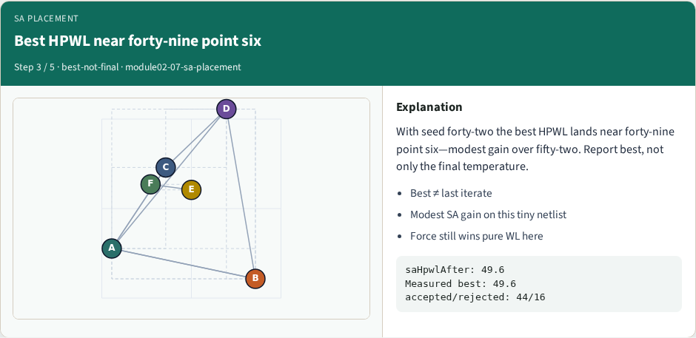
Best HPWL near forty-nine point six
Best HPWL near forty-nine point six
learn_placement — 07 sa placement
Notes:
With seed forty-two the best HPWL lands near forty-nine point six—modest gain over fifty-two. Report best, not only the final temperature.

Slide 9
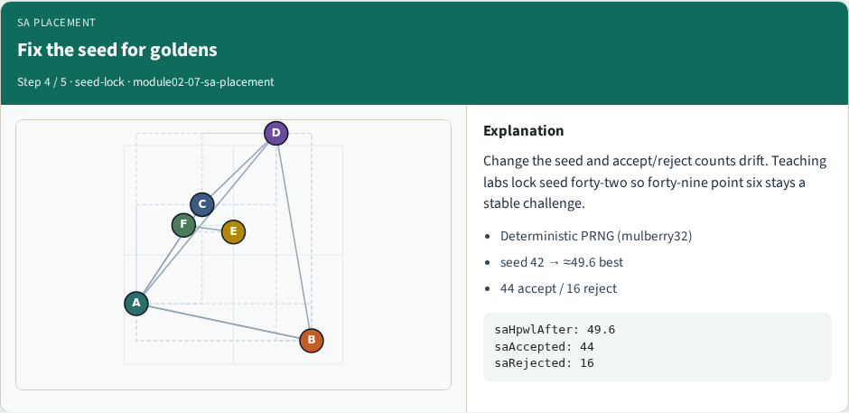
Fix the seed for goldens
Fix the seed for goldens
learn_placement — 07 sa placement
Notes:
Change the seed and accept/reject counts drift. Teaching labs lock seed forty-two so forty-nine point six stays a stable challenge.

Slide 10
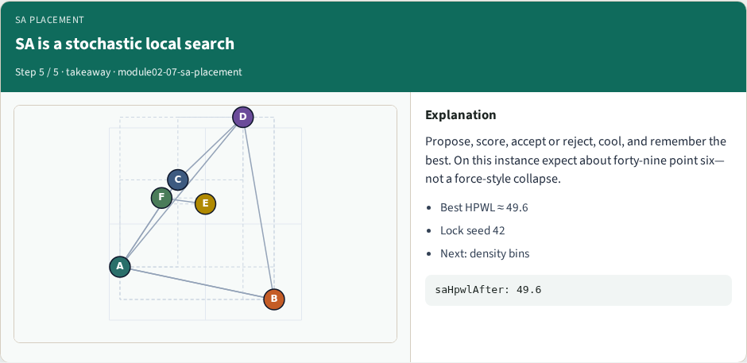
SA is a stochastic local search
SA is a stochastic local search
learn_placement — 07 sa placement
Notes:
Propose, score, accept or reject, cool, and remember the best. On this instance expect about forty-nine point six—not a force-style collapse.

Slide 11
Browser lab track
In the browser lab track, open the sa-placement lab from the tools shelf
Load the starter placement, run the algorithm once
Work the challenges that lock the goldens
learn_placement — 07 sa placement
Notes:
In the browser lab track, open the **sa-placement** lab from the tools shelf. Load the starter placement, run the algorithm once, and read HPWL—and density when the panel shows it. Work the challenges that lock the goldens, then come back to implement the same loop yourself.

Slide 12
Implement track
In the implement track
Parse `tiny_place.json`, run the algorithm with a deterministic seed
Match the browser goldens before you claim the checklist
learn_placement — 07 sa placement
Notes:
In the implement track, open this module's EXAMPLES.md Pseudocode section and the course common solvers. Parse `tiny_place.json`, run the algorithm with a deterministic seed, and print coordinates plus HPWL. Match the browser goldens before you claim the checklist.

Slide 13
Pitfalls
Common traps
learn_placement — 07 sa placement
Notes:
Common traps: celebrating HPWL while cells pile into one bin; ignoring fixed pads A and D; mixing bbox and clique models in one report; keeping only the final SA iterate instead of the best; and forgetting that timing weights change the objective, not just the label.

Slide 14
Your turn
Complete the checklist for at least one track, preferably both
Implement until your metrics match the starter goldens
When you’re ready, take the short quiz, then continue to the next module
learn_placement — 07 sa placement
Notes:
Complete the checklist for at least one track—preferably both. Implement until your metrics match the starter goldens. When you’re ready, take the short quiz, then continue to the next module.

