Slide 1
Density bins and overflow
Density bins count cells on a grid and sum overflow above capacity
learn_placement — 01 density bins
Notes:
Density bins count cells on a grid and sum overflow above capacity. On a two-by-two grid with capacity one, both starter and golden still overflow by two—compact HPWL does not automatically mean legal density. Raise capacity to two on golden and overflow drops to one.

Slide 2
The idea
Assign each cell to a bin by coordinates
Report HPWL and overflow together
A pretty wirelength with piled bins fails the density half of placement
learn_placement — 01 density bins
Notes:
Assign each cell to a bin by coordinates, count occupants, then overflow equals sum of max(zero, count minus capacity). Report HPWL and overflow together. A pretty wirelength with piled bins fails the density half of placement.

Slide 3
Pseudocode
Density bins count occupants per grid cell and sum overflow above capacity
Pseudocode always pairs that number with HPWL
Open this module's examples file and find the Pseudocode section
That written sketch is what you implement on the implement track and what the browser
learn_placement — 01 density bins
Notes:
Density bins count occupants per grid cell and sum overflow above capacity. Pseudocode always pairs that number with HPWL.
Open this module's examples file and find the Pseudocode section. That written sketch is what you implement on the implement track and what the browser challenges measure.

Slide 4
Algorithm sketch
On a two-by-two grid with capacity one, both starter and golden still overflow by two
Raise capacity to two on golden and overflow drops to one
learn_placement — 01 density bins
Notes:
On a two-by-two grid with capacity one, both starter and golden still overflow by two. Raise capacity to two on golden and overflow drops to one.

Slide 5
Algorithm sketch — try these
INPUT: positions, grid Gx×Gy, capacity C
OUTPUT: overflow, per-bin counts
assign each cell to a bin by (x,y)
overflow ← Σ max(0, count[b]−C)
report HPWL with overflow
GOLDEN 2×2 C=1: starter&golden overflow=2
C=2 on golden → overflow=1
learn_placement — 01 density bins

Slide 6
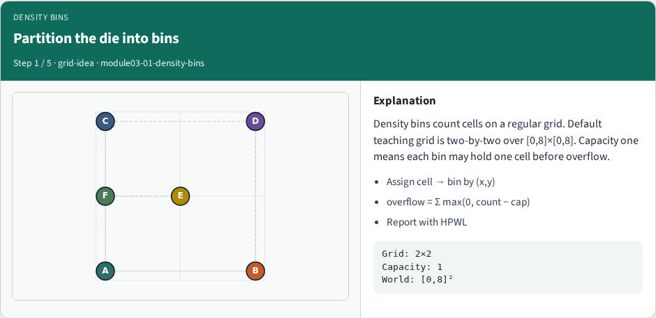
Partition the die into bins
Partition the die into bins
learn_placement — 01 density bins
Notes:
Density bins count cells on a regular grid. Default teaching grid is two-by-two over [0,8]×[0,8]. Capacity one means each bin may hold one cell before overflow.

Slide 7
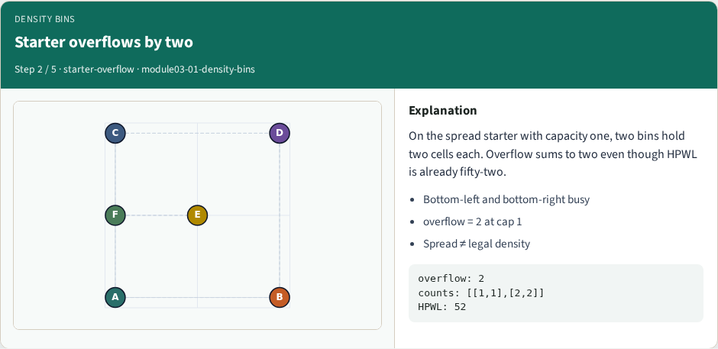
Starter overflows by two
Starter overflows by two
learn_placement — 01 density bins
Notes:
On the spread starter with capacity one, two bins hold two cells each. Overflow sums to two even though HPWL is already fifty-two.

Slide 8
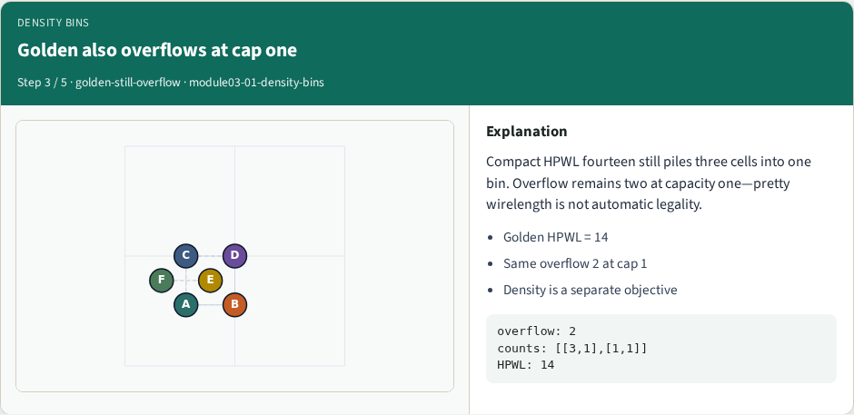
Golden also overflows at cap one
Golden also overflows at cap one
learn_placement — 01 density bins
Notes:
Compact HPWL fourteen still piles three cells into one bin. Overflow remains two at capacity one—pretty wirelength is not automatic legality.

Slide 9

Raise capacity to ease overflow
Raise capacity to ease overflow
learn_placement — 01 density bins
Notes:
With capacity two on the golden placement, overflow drops to one. Capacity is part of the spec—quote it with the overflow number.

Slide 10
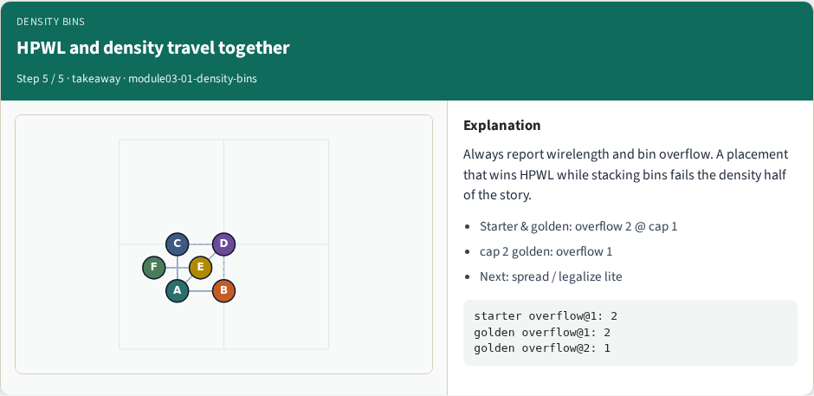
HPWL and density travel together
HPWL and density travel together
learn_placement — 01 density bins
Notes:
Always report wirelength and bin overflow. A placement that wins HPWL while stacking bins fails the density half of the story.

Slide 11
Browser lab track
In the browser lab track, open the density-bins lab from the tools shelf
Load the starter placement, run the algorithm once
Work the challenges that lock the goldens
learn_placement — 01 density bins
Notes:
In the browser lab track, open the **density-bins** lab from the tools shelf. Load the starter placement, run the algorithm once, and read HPWL—and density when the panel shows it. Work the challenges that lock the goldens, then come back to implement the same loop yourself.

Slide 12
Implement track
In the implement track
Parse `tiny_place.json`, run the algorithm with a deterministic seed
Match the browser goldens before you claim the checklist
learn_placement — 01 density bins
Notes:
In the implement track, open this module's EXAMPLES.md Pseudocode section and the course common solvers. Parse `tiny_place.json`, run the algorithm with a deterministic seed, and print coordinates plus HPWL. Match the browser goldens before you claim the checklist.

Slide 13
Pitfalls
Common traps
learn_placement — 01 density bins
Notes:
Common traps: celebrating HPWL while cells pile into one bin; ignoring fixed pads A and D; mixing bbox and clique models in one report; keeping only the final SA iterate instead of the best; and forgetting that timing weights change the objective, not just the label.

Slide 14
Your turn
Complete the checklist for at least one track, preferably both
Implement until your metrics match the starter goldens
When you’re ready, take the short quiz, then continue to the next module
learn_placement — 01 density bins
Notes:
Complete the checklist for at least one track—preferably both. Implement until your metrics match the starter goldens. When you’re ready, take the short quiz, then continue to the next module.

