Slide 1
Timing-driven placement
Timing-driven place weights critical nets in the wirelength objective
learn_placement — 01 timing driven place
Notes:
Timing-driven place weights critical nets in the wirelength objective. On the starter, plain HPWL is fifty-two but timing-weighted HPWL is one hundred sixteen because the four-pin net carries weight five. The compact golden drops timing-weighted cost to thirty.

Slide 2
The idea
Multiply each net’s HPWL by its criticality weight and sum
Heavy weights pull critical nets shorter even when plain HPWL looks fine
Always report both plain and weighted totals so you can see what the objective actually
learn_placement — 01 timing driven place
Notes:
Multiply each net’s HPWL by its criticality weight and sum. Heavy weights pull critical nets shorter even when plain HPWL looks fine. Always report both plain and weighted totals so you can see what the objective actually optimized.

Slide 3
Pseudocode
Timing-driven place multiplies each net’s HPWL by criticality and sums
Pseudocode always reports plain and weighted totals together
Open this module's examples file and find the Pseudocode section
That written sketch is what you implement on the implement track and what the browser
learn_placement — 01 timing driven place
Notes:
Timing-driven place multiplies each net’s HPWL by criticality and sums. Pseudocode always reports plain and weighted totals together.
Open this module's examples file and find the Pseudocode section. That written sketch is what you implement on the implement track and what the browser challenges measure.

Slide 4
Algorithm sketch
Starter plain fifty-two becomes timing one hundred sixteen because the four-pin net has
Compact golden drops timing cost to thirty
learn_placement — 01 timing driven place
Notes:
Starter plain fifty-two becomes timing one hundred sixteen because the four-pin net has weight five. Compact golden drops timing cost to thirty.

Slide 5
Algorithm sketch — try these
INPUT: positions, nets, weights w[net]
OUTPUT: plain HPWL, timing HPWL
plain ← Σ HPWL(net)
timing ← Σ w[net]·HPWL(net)
optimize timing (or report both)
GOLDEN starter: plain=52 timing=116
compact: plain=14 timing=30
learn_placement — 01 timing driven place

Slide 6
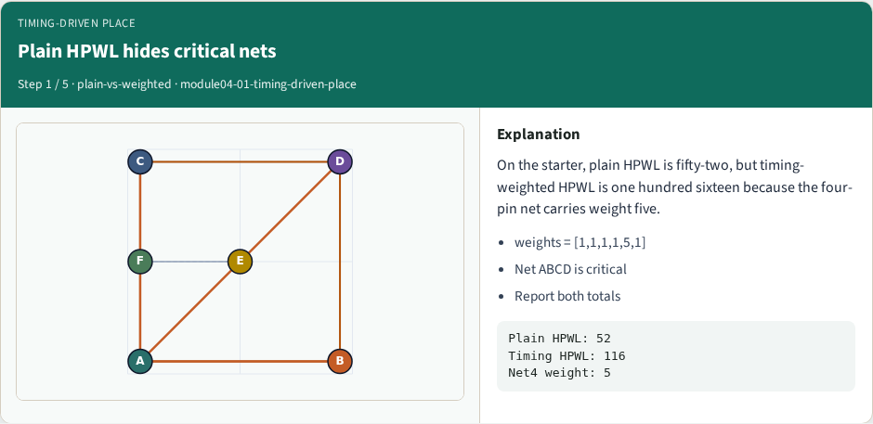
Plain HPWL hides critical nets
Plain HPWL hides critical nets
learn_placement — 01 timing driven place
Notes:
On the starter, plain HPWL is fifty-two, but timing-weighted HPWL is one hundred sixteen because the four-pin net carries weight five.

Slide 7
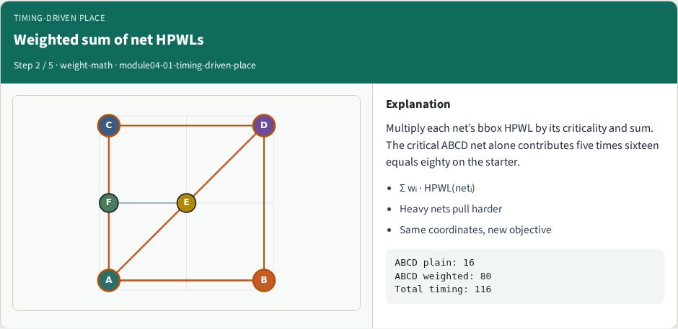
Weighted sum of net HPWLs
Weighted sum of net HPWLs
learn_placement — 01 timing driven place
Notes:
Multiply each net’s bbox HPWL by its criticality and sum. The critical ABCD net alone contributes five times sixteen equals eighty on the starter.

Slide 8
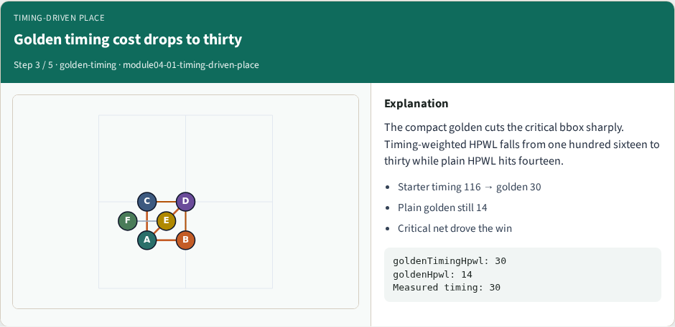
Golden timing cost drops to thirty
Golden timing cost drops to thirty
learn_placement — 01 timing driven place
Notes:
The compact golden cuts the critical bbox sharply. Timing-weighted HPWL falls from one hundred sixteen to thirty while plain HPWL hits fourteen.

Slide 9

Always quote plain and weighted
Always quote plain and weighted
learn_placement — 01 timing driven place
Notes:
A placement can look fine on plain HPWL while the critical net stays long. Timing labs demand both numbers so the objective is visible.

Slide 10

Weights change what you optimize
Weights change what you optimize
learn_placement — 01 timing driven place
Notes:
Timing-driven place is still wirelength—just weighted. Remember one hundred sixteen to thirty on this instance, and never drop the plain HPWL report.

Slide 11
Browser lab track
In the browser lab track, open the timing-driven-place lab from the tools shelf
Load the starter placement, run the algorithm once
Work the challenges that lock the goldens
learn_placement — 01 timing driven place
Notes:
In the browser lab track, open the **timing-driven-place** lab from the tools shelf. Load the starter placement, run the algorithm once, and read HPWL—and density when the panel shows it. Work the challenges that lock the goldens, then come back to implement the same loop yourself.

Slide 12
Implement track
In the implement track
Parse `tiny_place.json`, run the algorithm with a deterministic seed
Match the browser goldens before you claim the checklist
learn_placement — 01 timing driven place
Notes:
In the implement track, open this module's EXAMPLES.md Pseudocode section and the course common solvers. Parse `tiny_place.json`, run the algorithm with a deterministic seed, and print coordinates plus HPWL. Match the browser goldens before you claim the checklist.

Slide 13
Pitfalls
Common traps
learn_placement — 01 timing driven place
Notes:
Common traps: celebrating HPWL while cells pile into one bin; ignoring fixed pads A and D; mixing bbox and clique models in one report; keeping only the final SA iterate instead of the best; and forgetting that timing weights change the objective, not just the label.

Slide 14
Your turn
Complete the checklist for at least one track, preferably both
Implement until your metrics match the starter goldens
When you’re ready, take the short quiz, then continue to the next module
learn_placement — 01 timing driven place
Notes:
Complete the checklist for at least one track—preferably both. Implement until your metrics match the starter goldens. When you’re ready, take the short quiz, then continue to the next module.

