Slide 1
Detailed routing in the stack
You committed coarse paths in global routing
learn_routing — 00 intro
Notes:
You committed coarse paths in global routing. Detailed routing assigns tracks on M1 and M2, places vias, and chases DRC-clean geometry before compaction or signoff. This course teaches that grid, maze, A*, track usage, vias, spacing, and rip-up on a tiny chip.

Slide 2
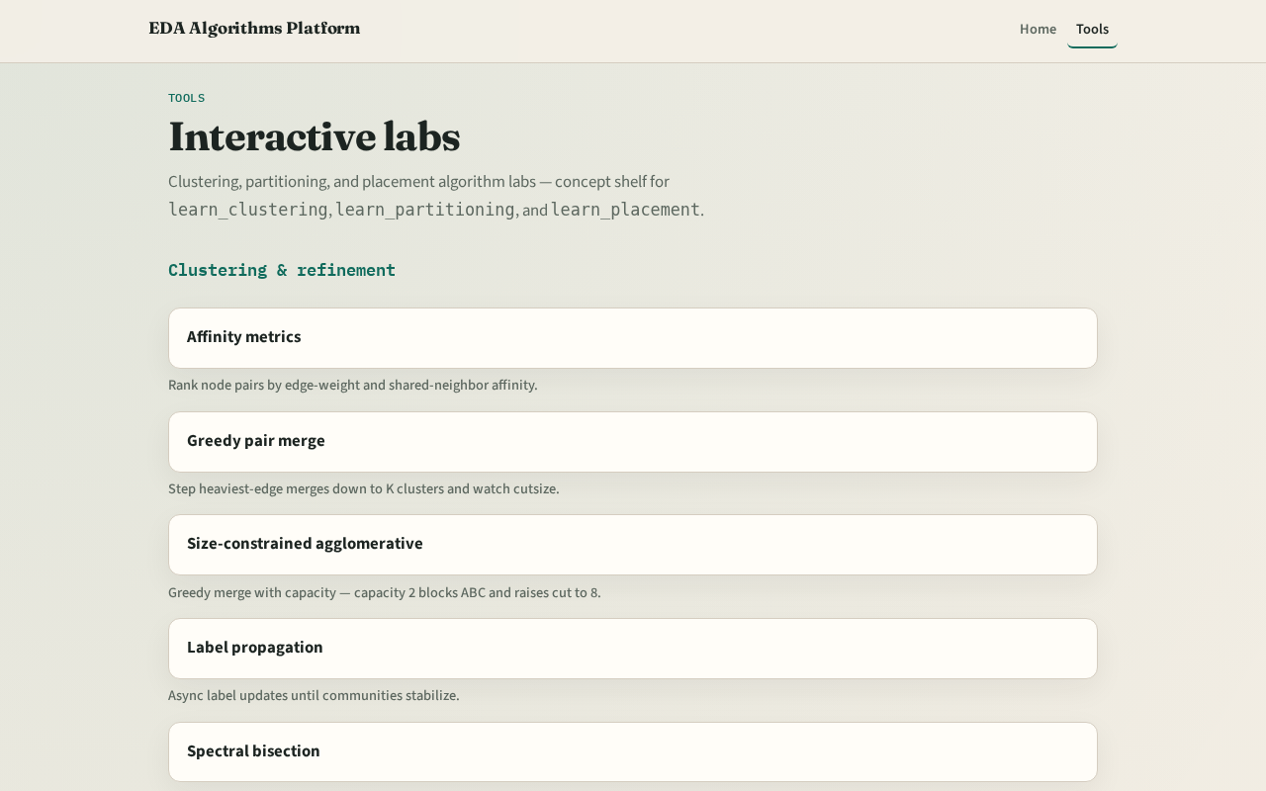
Two tracks
Track B is the browser lab: route nets, watch track heat, inspect vias, clear challenges
Track A is implement: Python solvers on tiny_dr.json
Use either or both
Browser first for intuition is fine
learn_routing — 00 intro
Notes:
Track B is the browser lab: route nets, watch track heat, inspect vias, clear challenges. Track A is implement: Python solvers on tiny_dr.json. Use either or both. Browser first for intuition is fine.

Slide 3
Course map
Foundations cover the routing grid and pin access
Algorithms cover Lee maze, A*, track usage, and via assignment
DRC and rip-up cover spacing lite and detailed rip-up
Sequential detailed ties the flow together
Offline compare and wrap close the path
learn_routing — 00 intro
Notes:
Foundations cover the routing grid and pin access. Algorithms cover Lee maze, A*, track usage, and via assignment. DRC and rip-up cover spacing lite and detailed rip-up. Sequential detailed ties the flow together. Offline compare and wrap close the path.

Slide 4
Prerequisites
Finish learn_global_routing so GCell graphs and edge usage deposits already make sense
Directed track usage is finer-grained, not the same keys as GCell edges
learn_routing — 00 intro
Notes:
Finish learn_global_routing so GCell graphs and edge usage deposits already make sense. Directed track usage is finer-grained—not the same keys as GCell edges.

Slide 5
How to move
Read each module README
Odd module slots leave room to insert algorithms later without renumbering
learn_routing — 00 intro
Notes:
Read each module README, pick a track, check the checklist, then skim the clip when media is available. Odd module slots leave room to insert algorithms later without renumbering.

Slide 6
Next
Complete the quiz for this part
Open the routing grid graph and enumerate M1 and M2 tracks on the twelve-by-eight grid
learn_routing — 00 intro
Notes:
Open the routing grid graph and enumerate M1 and M2 tracks on the twelve-by-eight grid.

