Slide 1
Why a track graph
Detailed routers do not hop GCell to GCell
learn_routing — 01 routing grid
Notes:
Detailed routers do not hop GCell to GCell. They walk a fine grid whose edges are directed tracks: M1 horizontal and M2 vertical. Before any maze or A* route, you must enumerate those tracks on our twelve-by-eight toy grid.

Slide 2
The idea
A directed M2 edge upward when y plus one is less than ny
Canonical keys sort endpoints so left-to-right and bottom-to-top always win
On twelve by eight you get eighty-eight M1 edges and eighty-four M2 edges
learn_routing — 01 routing grid
Notes:
For each grid point at column x and row y, add a directed M1 edge to the right neighbor when x plus one is less than nx, and a directed M2 edge upward when y plus one is less than ny. Canonical keys sort endpoints so left-to-right and bottom-to-top always win. On twelve by eight you get eighty-eight M1 edges and eighty-four M2 edges.

Slide 3
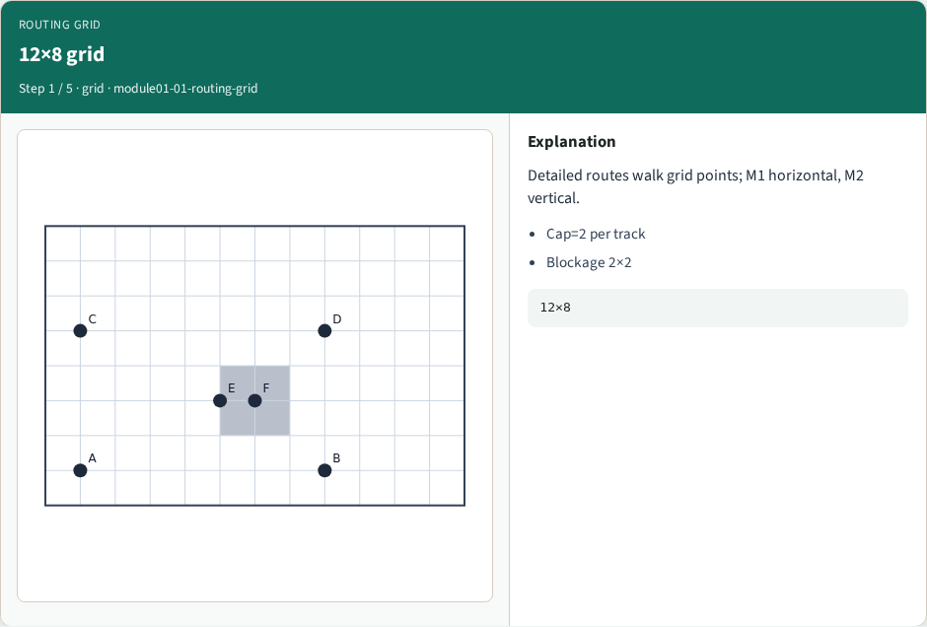
12×8 grid
12×8 grid
learn_routing — 01 routing grid
Notes:
Detailed routes walk grid points; M1 horizontal, M2 vertical.

Slide 4
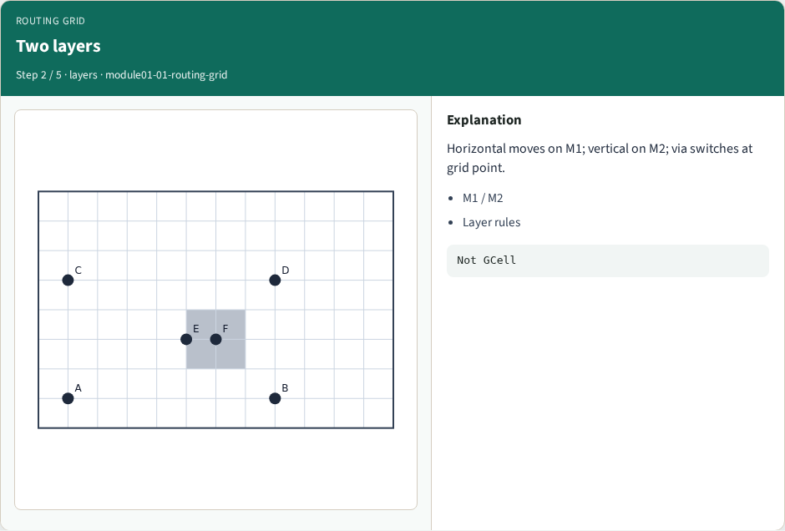
Two layers
Two layers
learn_routing — 01 routing grid
Notes:
Horizontal moves on M1; vertical on M2; via switches at grid point.

Slide 5
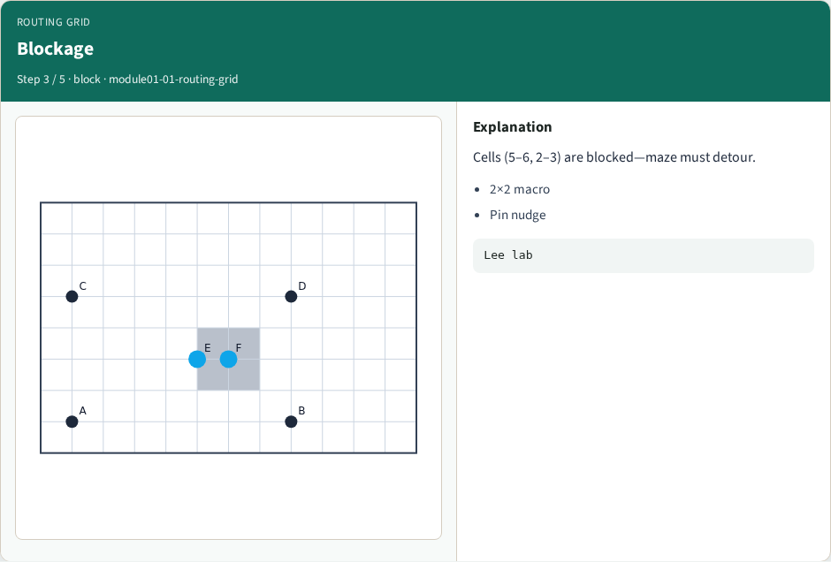
Blockage
Blockage
learn_routing — 01 routing grid
Notes:
Cells (5–6, 2–3) are blocked—maze must detour.

Slide 6
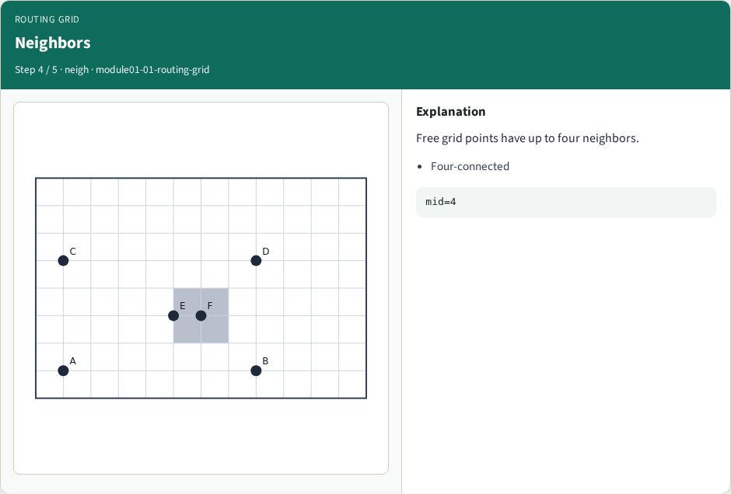
Neighbors
Neighbors
learn_routing — 01 routing grid
Notes:
Free grid points have up to four neighbors.

Slide 7
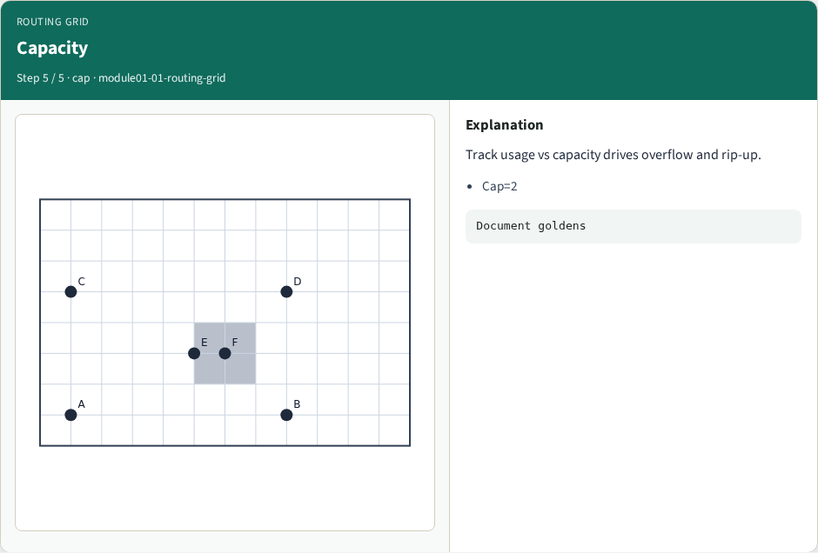
Capacity
Capacity
learn_routing — 01 routing grid
Notes:
Track usage vs capacity drives overflow and rip-up.

Slide 8
Browser lab track
Open the routing-grid lab
Toggle layer M1 and M2 overlays
Highlight one horizontal track between columns one and two on row one
Read the track list in the metrics panel and match the counts
learn_routing — 01 routing grid
Notes:
Open the **routing-grid** lab. Toggle layer M1 and M2 overlays. Highlight one horizontal track between columns one and two on row one. Read the track list in the metrics panel and match the counts.

Slide 9
Implement track
Inspect `h_edge`, `v_edge`, and `track_key` in `common/drutil.py`
Print sample M1 and M2 keys for tiny_dr
Verify diagonals are absent and layers match movement axis
learn_routing — 01 routing grid
Notes:
Inspect `h_edge`, `v_edge`, and `track_key` in `common/drutil.py`. Print sample M1 and M2 keys for tiny_dr. Verify diagonals are absent and layers match movement axis.

Slide 10
Pitfalls
Counting grid points instead of directed tracks
Treating M1 and M2 as interchangeable
Forgetting blockages still occupy cells even if tracks exist between free neighbors
learn_routing — 01 routing grid
Notes:
Counting grid points instead of directed tracks. Treating M1 and M2 as interchangeable. Forgetting blockages still occupy cells even if tracks exist between free neighbors.

Slide 11
Your turn
Finish the checklist
Sketch M1 on one row from memory
Next: map pin placements to access points on the grid
learn_routing — 01 routing grid
Notes:
Finish the checklist. Sketch M1 on one row from memory. Next: map pin placements to access points on the grid.

